Slide 1
Manifest Destiny: ingredients
American exceptionalism
Puritanism: “the elect”
Millennialism
“noble savage” > “savage”
Racism
Capitalism (“grow or die”)
Slavery: expand, or abolish?
“Lebensraum”

Slide 2
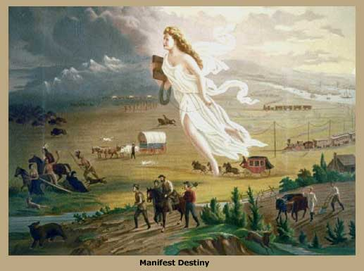

Slide 3
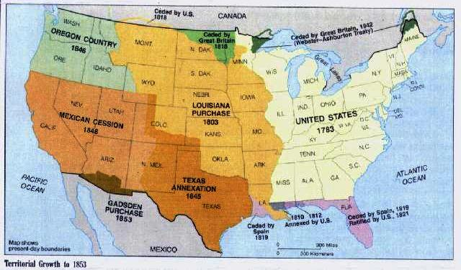
Territorial expansion

Slide 4
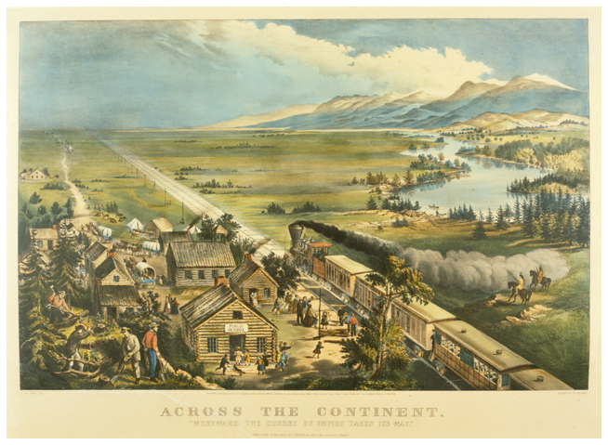
Currier & Ives print (by Frances Bond Palmer and James Ives, 1868)

Slide 5
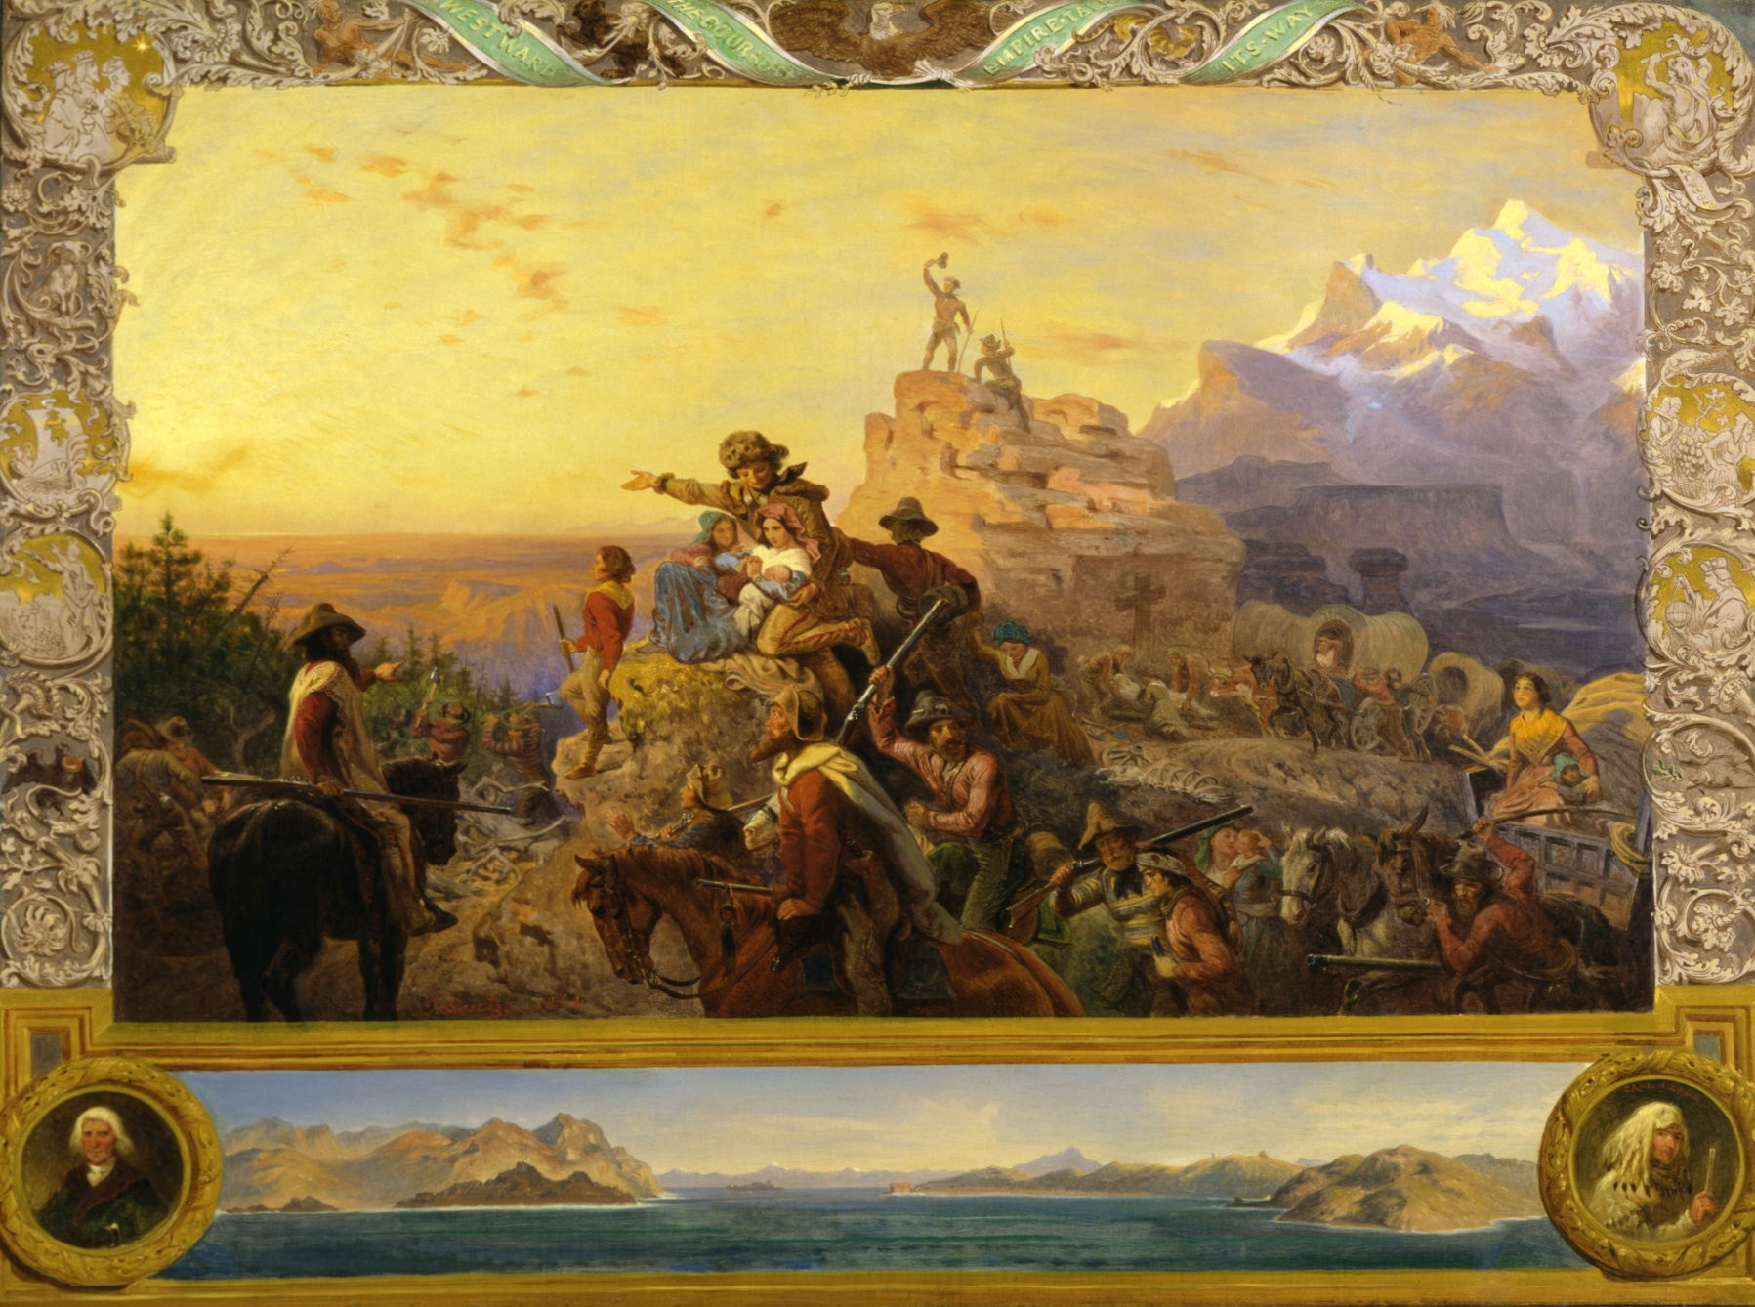
Westward the Course of Empire Takes Its Way (6.1 m × 9.1 m) - Emmanuel Leutze, 1861 – US Capitol

Slide 6
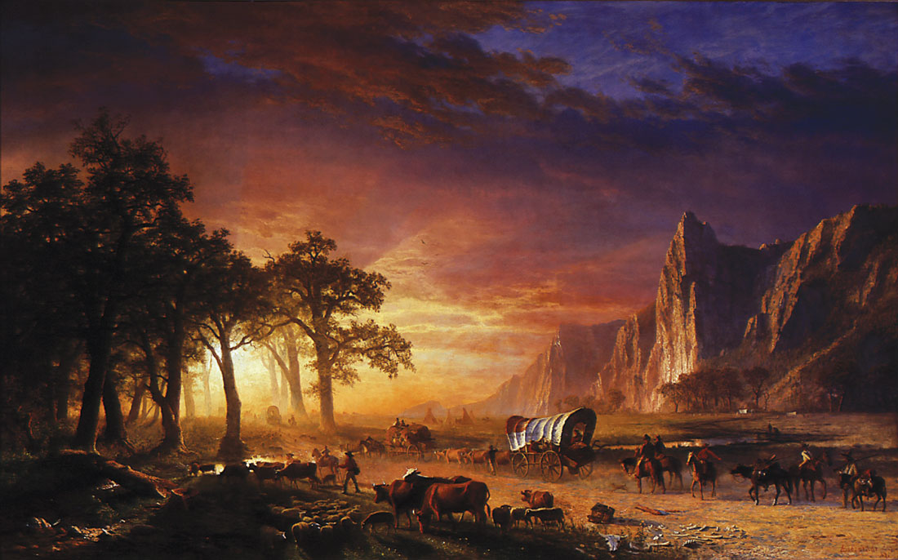
Albert Bierstadt, Emigrants Crossing the Plains (1867)

Slide 7
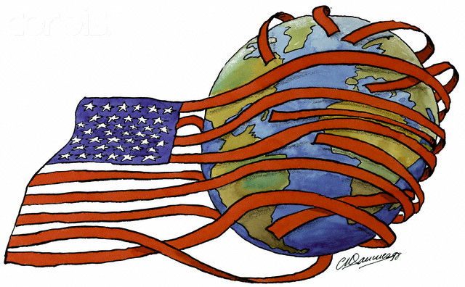

Slide 8
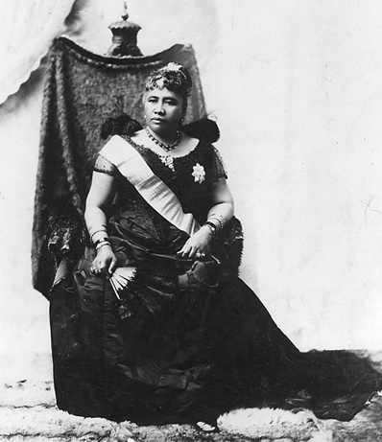
Lydia Kamakaeha Liliuokalani

Slide 9
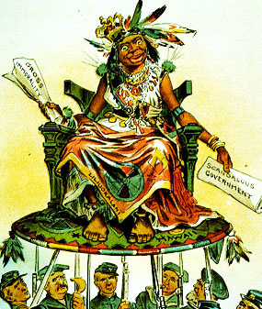
The real Liliuokalani

Slide 10
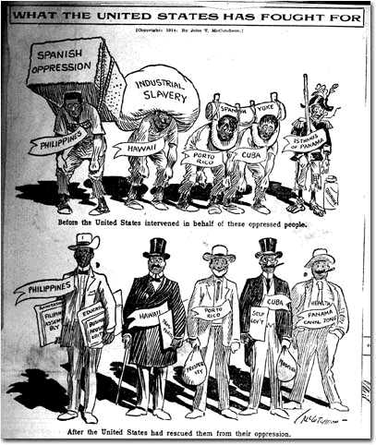

Slide 11
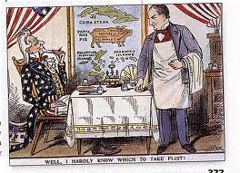

Slide 12
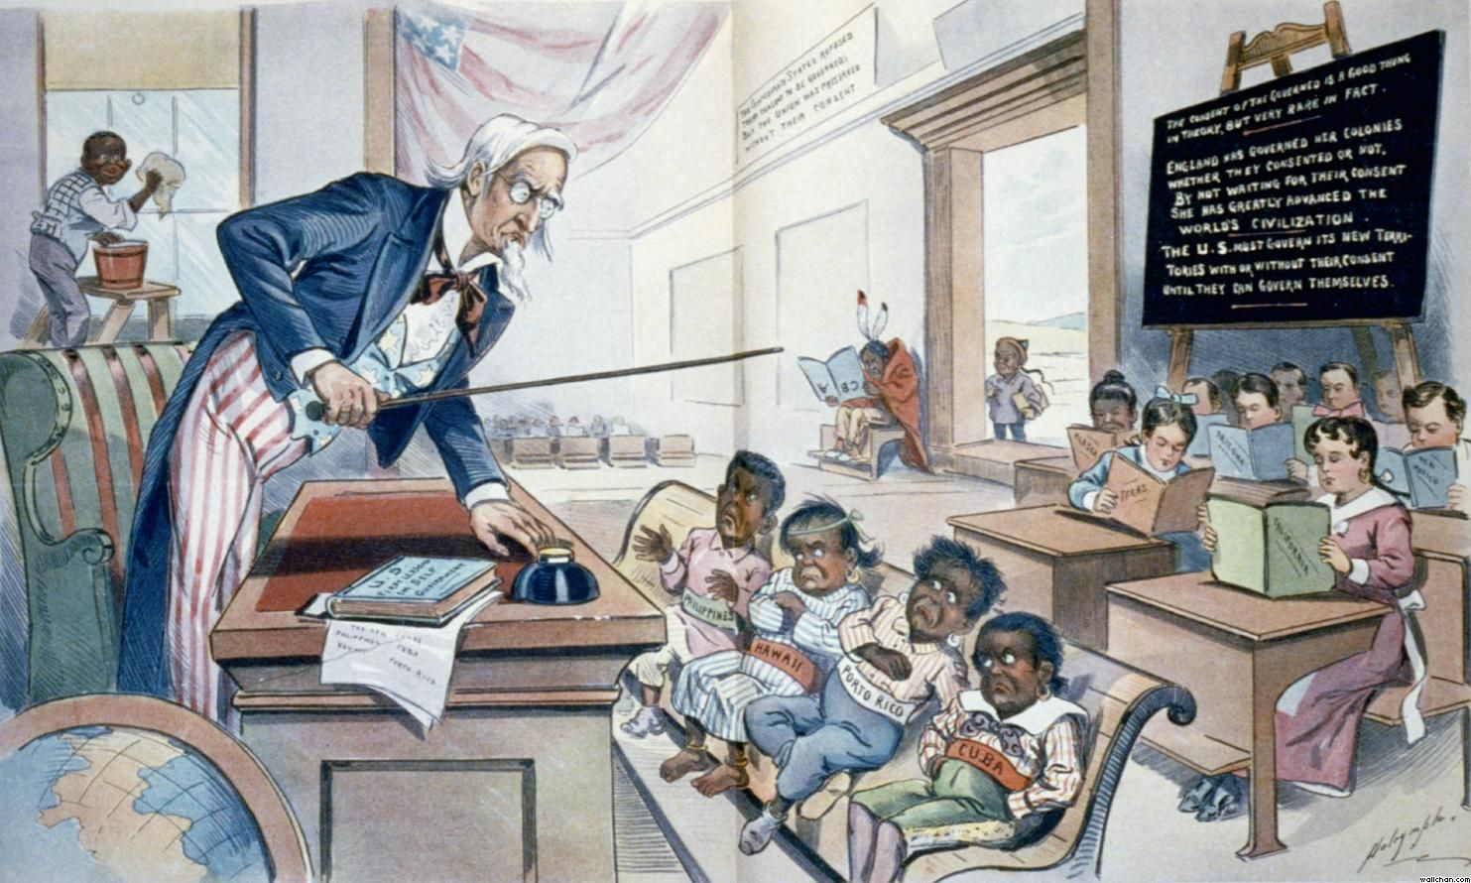

Slide 13
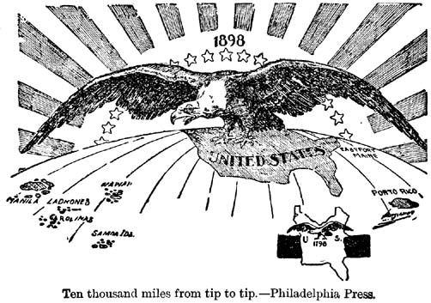
Manifest Destiny, 1898 version

Slide 14
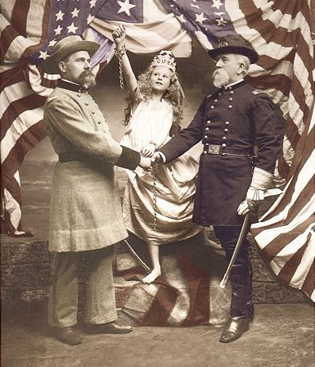
A Spanish-American war propaganda photo

Slide 15
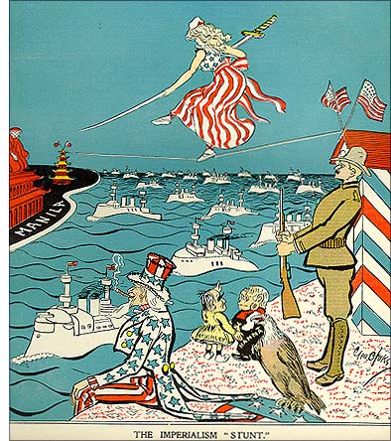
Philippines, 1898…

Slide 16
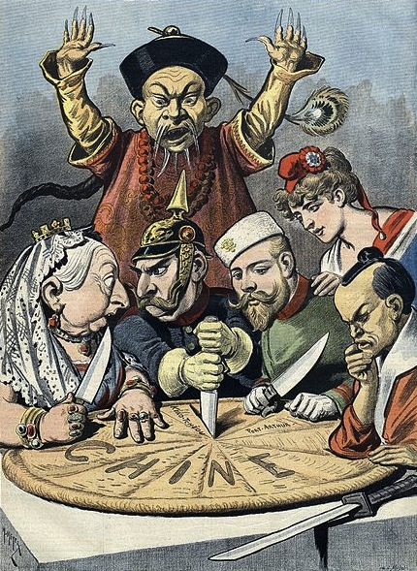
China, Boxer Rebellion, 1900
Imperialist pizza party: Queen Victoria, Kaiser Wilhelm, Tsar Nicholas, “Marianne,” and (probably) the Meiji Emperor

Slide 17
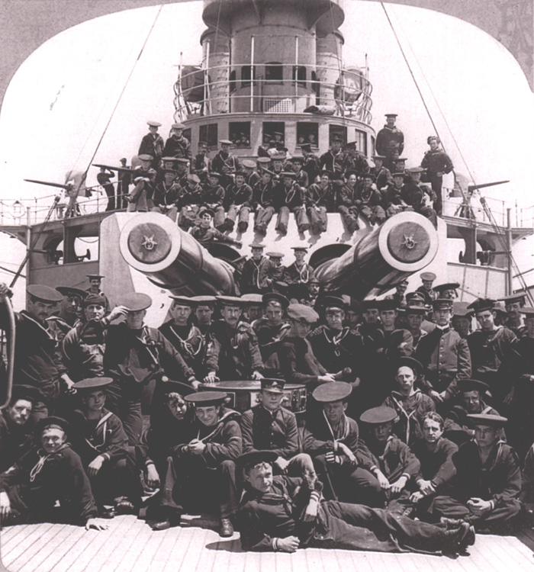
USS Missouri, 1900

Slide 18
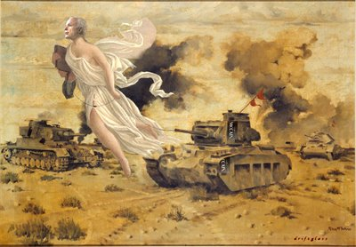
Manifest destiny, World War I version

Slide 19
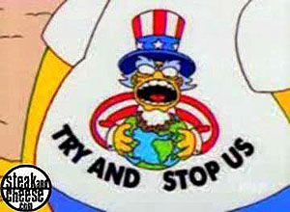

Slide 20
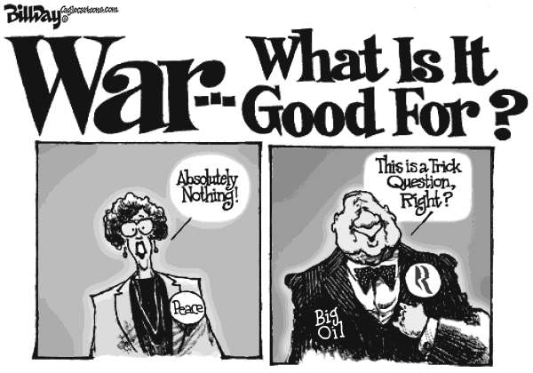

Slide 21
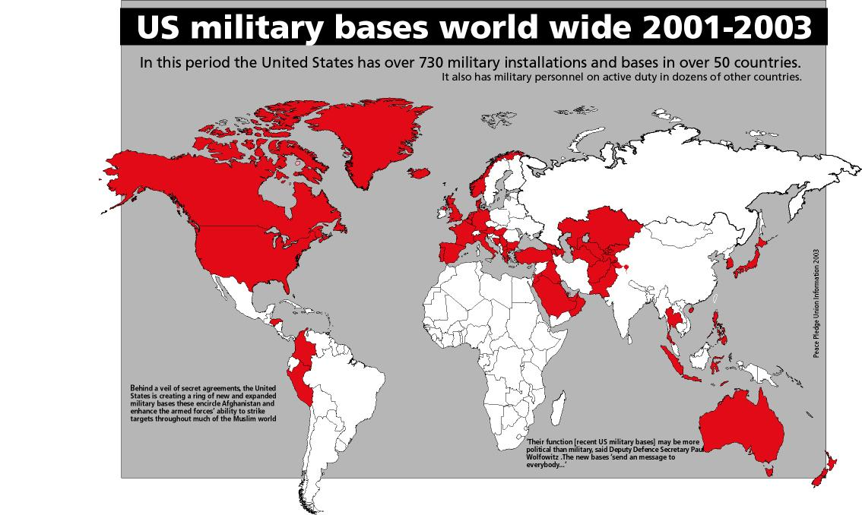

Slide 22
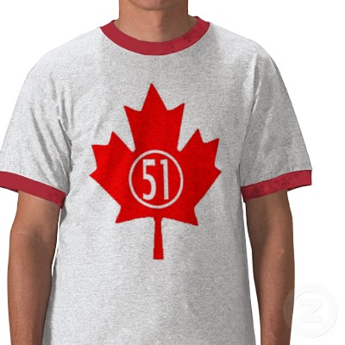
http://www.expansionistparty.org/Canada.html

Slide 23
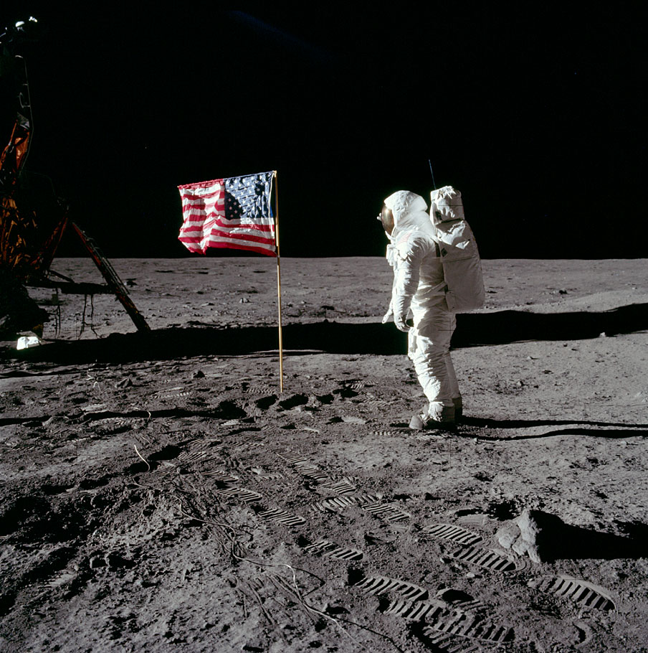
“When we have 13,000 Americans living on the moon, they can petition to become a state". – Newt Gingrich, 2011

Slide 24
