Slide 1
Weddings around the world
Alexandra Jelínková, Zuzana Čechová, Lucie Kantor

Slide 2
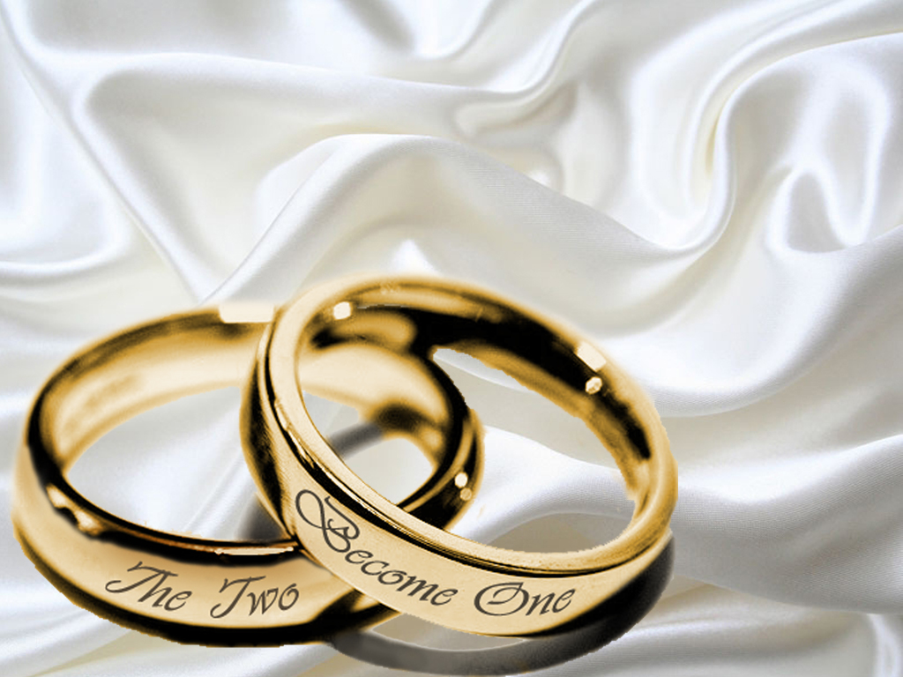
What is a wedding?

Slide 3
„A wedding is a ceremony where two people are united in marriage.“
„Marriage, also called matrimony or wedlock, is a socially or ritually recognized union or legal contract between spouses that establishes rights and obligations between them, between them and their children, and between them and their in-laws. “

Slide 4
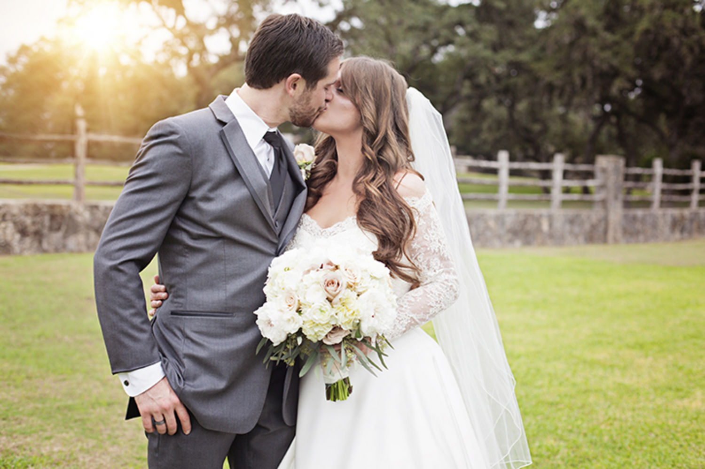
Heterosexual marriage

Slide 5
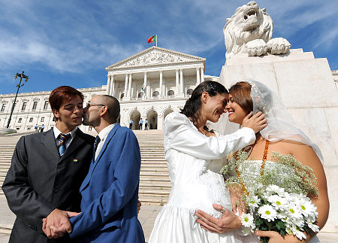
Same-sex marriage

Slide 6
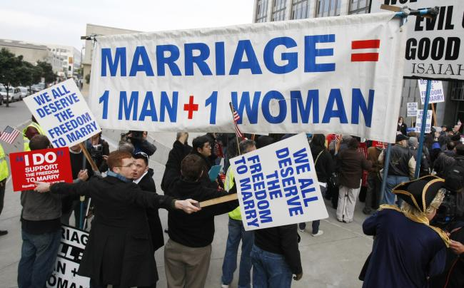

Slide 7
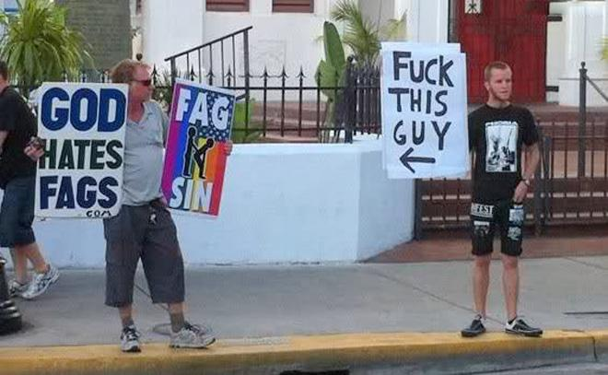

Slide 8
Marriages: Argentina, Portugal, Spain, UK (Scotland, Wales, England), South Africa, Iceland, Brazil, Canada, France, Finland, Sweden, Uruguay, Mexico, Luxembourg,…
Civil unions: Austria, Australia, Czech Republic, Malta, Liechtenstein, Italy, Slovenia, Venezuela,…
Illegal, punishable by death: Libya, Sudan, Uganda, Saudi Arabia, Afghanistan, Yemen, Qatar (muslims only), Malaysia, Singapore and Sierra Leone (males only),…

Slide 9
Polyamorous weddings

Slide 10
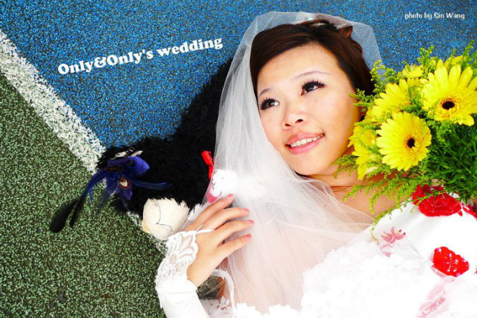
Self-marriage

Slide 11
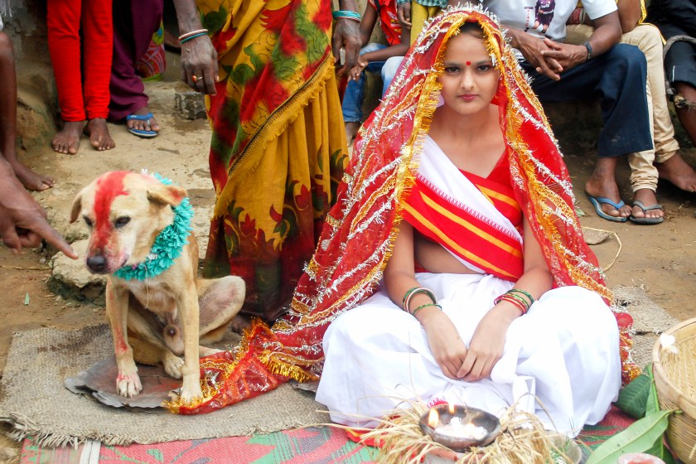
Wedding with a… dog?

Slide 12
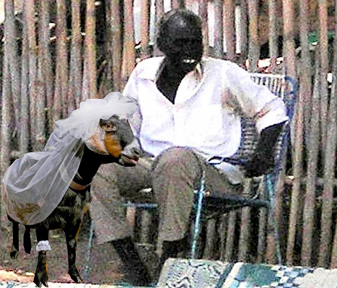
… a goat?

Slide 13
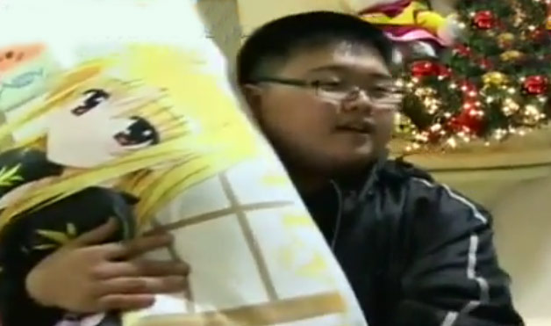
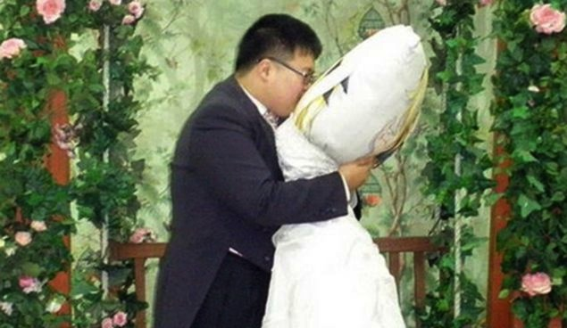
… don‘t even get me started on Japan.

Slide 14
Wait, what?
Better get back to normal weddings.

Slide 15
Why do people get married?

Slide 16
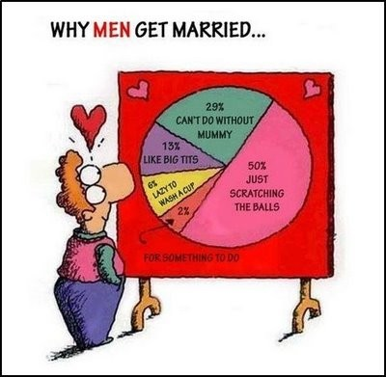

Slide 17
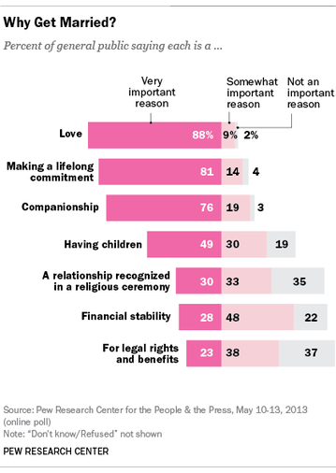

Slide 18
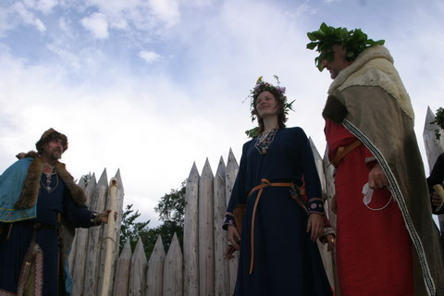
Czech wedding traditions
Bretislaus I., Duke of Bohemia – 12th century
Men married at 16-18, women at 14-16
Margaret of Bohemia married at 7 in 1328

Slide 19
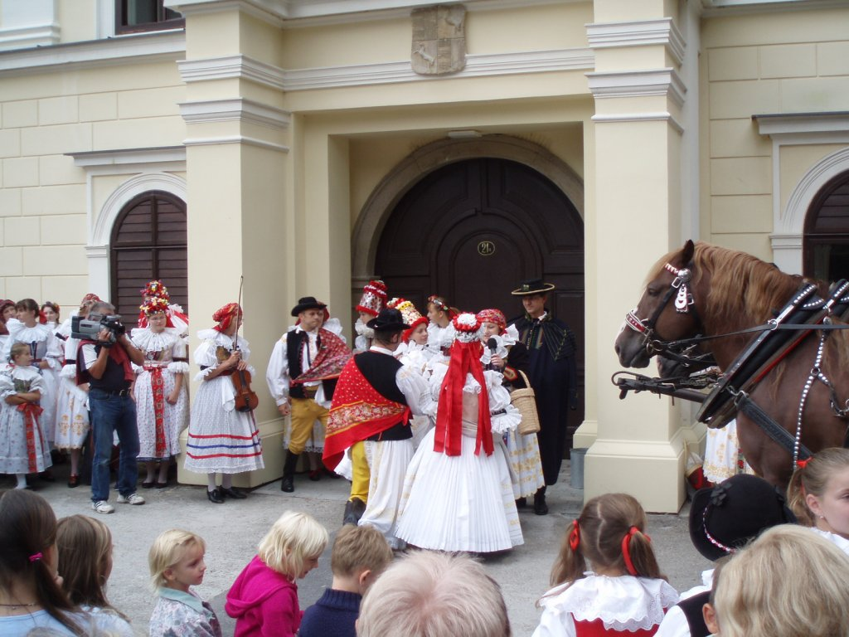

Slide 20
We all know some typical Czech wedding traditions. But do you know why…
… the bride wears a veil?
…. there are bridesmaids?
….do we throw rice?
….sprinkle the newlyweds with flower petals?
….do the newlyweds eat the soup jointly?
….do the circular dance?

Slide 21
And now let’s go around the world a little bit

Slide 31
Wierd (?) wedding traditions

Slide 32
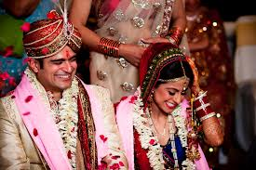
Indian Wedding Traditions

Slide 33
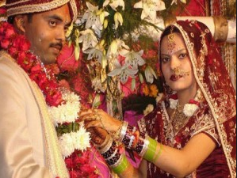
India = huge diversity in from of food & clothing & customs & traditions
Marriage – a union of two individuals and their families
Arranged marriages are still norm
First ceremonies start months before the wedding
There is numerous amount of pre-wedding, wedding and post-wedding ceremonies

Slide 34
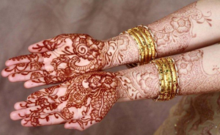
One of pre-wedding ceremonies is Mehendi ceremony, the bride’s hands and feet are decorated with intricate patterns by the application of Henna.
The deeper the colour of the mehendi (henna) stronger is the groom’s love for the bride
Aafter the wedding, the bride is not expected to perform any housework until her mehendi has faded away.

Slide 35
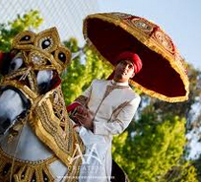
Indian weddings are very colourful – red, yellow, green and white are crucial colours
The actual wedding ceremony is 3 hours long
Bride is decorated with flowers and jewellery, ornaments and stones, she wears a sari
Traditionally groom comes to bride‘s home on decorated elephant or horse

Slide 36
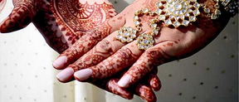
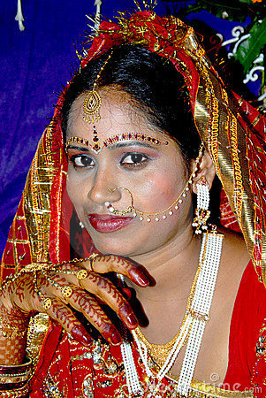
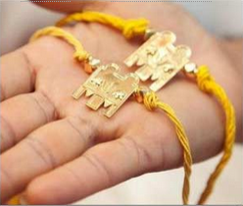
The bride and groom are considered wed when the groom ties a which is a sacred thread that symbolizes his promise to take care of the bride as long as he lives.
The thread is later replaced with a gold chain.

Slide 37
Nearly 60% of women in India had no say in the men they married.
Only 18% of Indian women knew their husbands before the wedding.
About a decade ago, the number of girls who married before puberty stood at 16%. Today that figure is 10%.
More than 15% of married couples don’t immediately move in together.
The average age of couples moving in together is 18.
Video
https://www.youtube.com/watch?v=aeEA8t1x2SI

Slide 38
Thank you
Sources:
https://oiss.rice.edu , Sravani Gullapalli and Aparna Raju Sagi
http://www.vocativ.com/world/india/5-surprising-facts-marriage-india/
http://svatebni-tradice-a-zvyky.svatba.cz/
http://www.svatebniinfo.cz/svatebni-zvyky-v-cechach.html
http://en.wikipedia.org/wiki/Same-sex_marriage
http://thefw.com/weirdest-marriages-of-the-world-photos-videos/
http://www.wedme.cz/magazin/historie/historie-svatby/201
http://www.bohemiaweddings.com/czech-weddings-traditions-s-15.html
http://www.pragueweddingagency.com/czech-wedding-traditions/
http://svatebni-tradice-a-zvyky.svatba.cz/
http://ibnlive.in.com/photogallery/2178-1.html
http://www.yourtango.com/2013193457/12-strangest-wedding-traditions-around-world

