Slide 1
Lecture 5:
Overview of Deaf Education in Nigeria

Slide 2
Lecture Objectives:
By the end of the lecture, students will be able to:
Explain how deaf education started in Nigeria
Mention individuals who played a role in the development of deaf education in Nigeria
Elucidate the contribution of each of the individuals to the development of deaf education in Nigeria
Mention some facts and figures with respect to deaf people in Nigeria
Exhibit correct signs for question words and some verbs.

Slide 3
Timeline in the development of deaf education in Nigeria
1957: a group of missionaries from the Lutheran Church decided to have social interaction with Deaf people in Lagos under the aegis of “friends of the deaf”
1958: Dr. Andrew Forster, an African-American graduate of Gallaudet University visited Ibadan in Nigeria, and some West African countries on familiarization visits preparatory to his plans to establish deaf Churches in those places
1960: Dr. Forster started a Church school in Ibadan called the Christian Mission for the Deaf
During his visits to nurture the deaf Church, Dr. Forster also persuaded many deaf Nigerians to attend Gallaudet College

Slide 4
Timeline contd:
1970: a sizeable number of deaf Nigerians were given Government scholarships to study in Gallaudet College
1974: Kwara State Schools for the Handicapped was established by a Gallaudet returnee, Mr. Gabriel Adepoju
1974: another Gallaudet returnee, Dr. Pius Mba, helped establish the first special education Department in a Nigerian University – University of Ibadan. He became the first deaf Head of Department in a Nigerian University
1977: Plateau School for the Deaf was established by yet another Gallaudet returnee, Mr. Ezekiel Sambo
There are over 50 schools for the deaf in Nigeria at present

Slide 5
Profile of Deaf people in Nigeria
There is an estimated 4 million deaf people in Nigeria at present (a newspaper report called them “a growing army”. Punch newspaper, Feb 5 & 12)
40% of deaf Nigerians have no education. 30% have low education. 30% have some form of education
Deaf Nigerians can be found in works of life, example, Executive arms of government, Judiciary, Education sector, business and NGOS

Slide 6
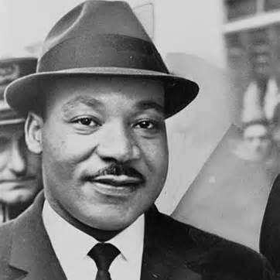
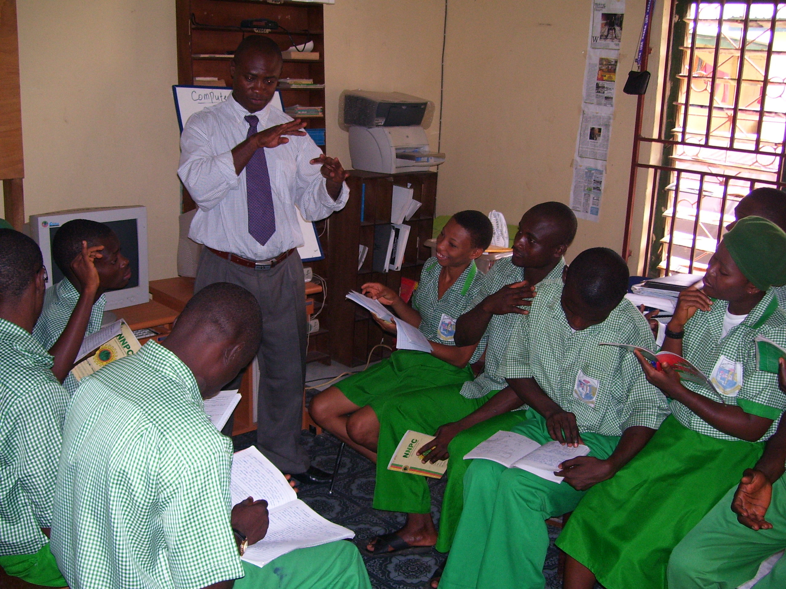
Dr. Andrew Forster: He is the pioneer deaf educator in Ngieria

Slide 7
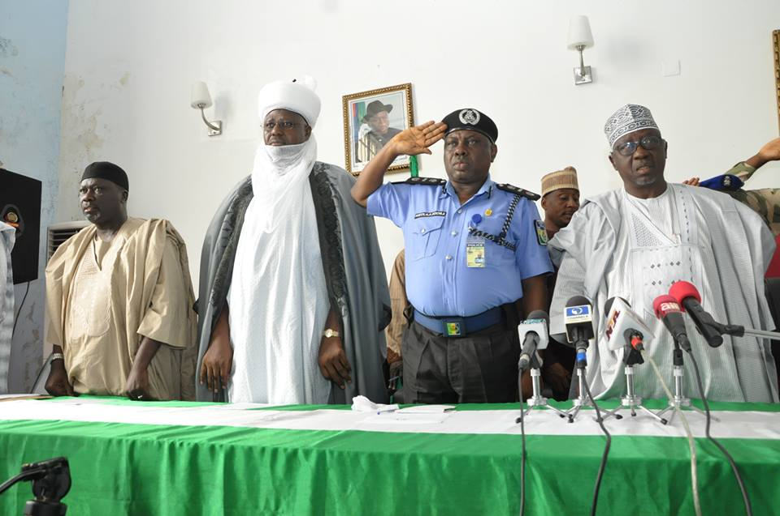
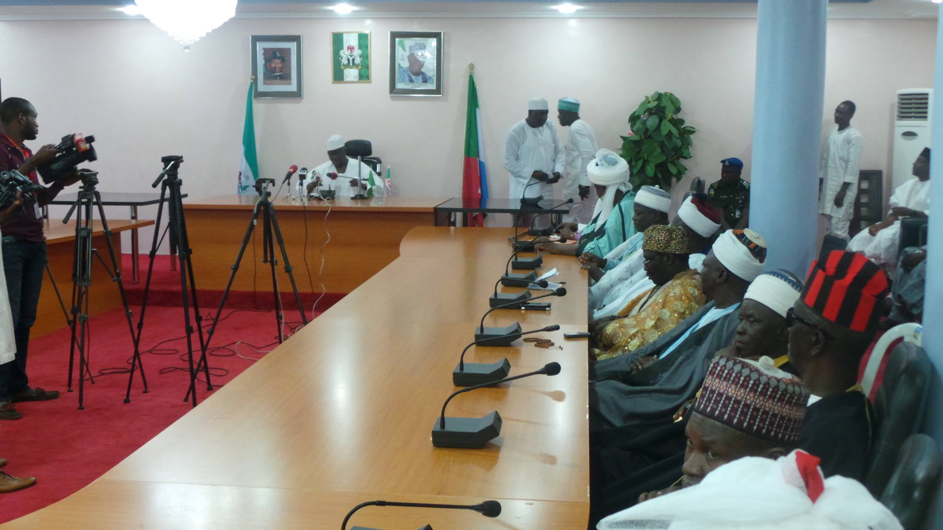
Tanko Almakura is the Governor of Nassarawa State in North Central Nigeria. He is a cochlear implant user. He has a deaf son.

Slide 8
7 minutes break

Slide 9
ASL practices: ‘wh’ questions and verbs
What when where who
Whose what’s up?
Come go buy sell
Walk run sit stand
work play give take
Laugh cry dance rest
Eat sleep teach learn
Clean up mess up cook serve
Draw paint read write

