Slide 1
Lecture 10:
Deaf associations and clubs in Nigeria

Slide 2
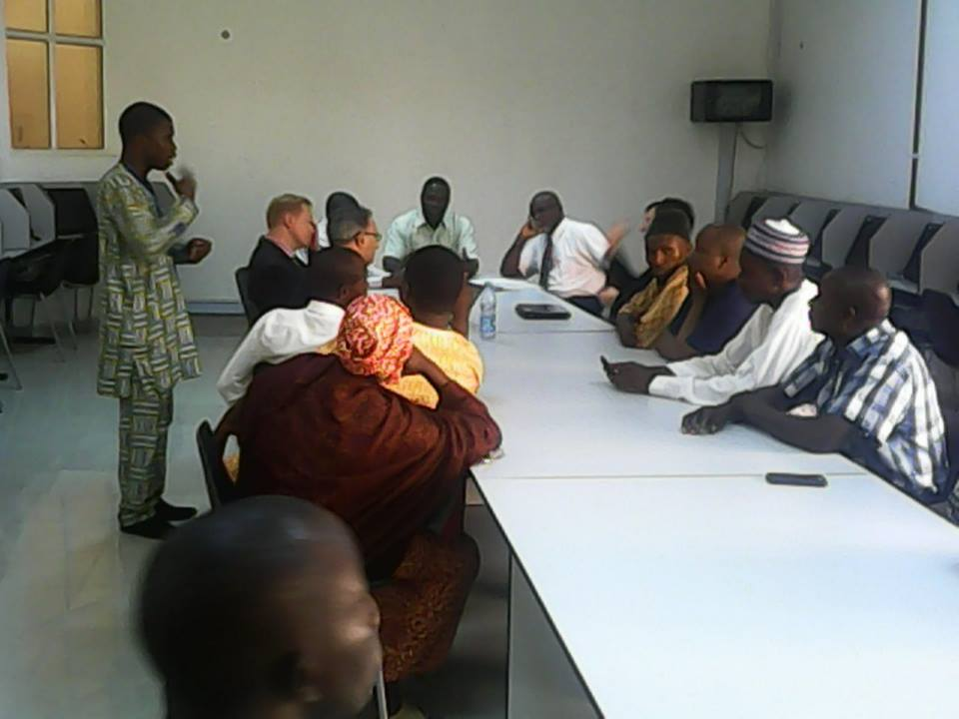
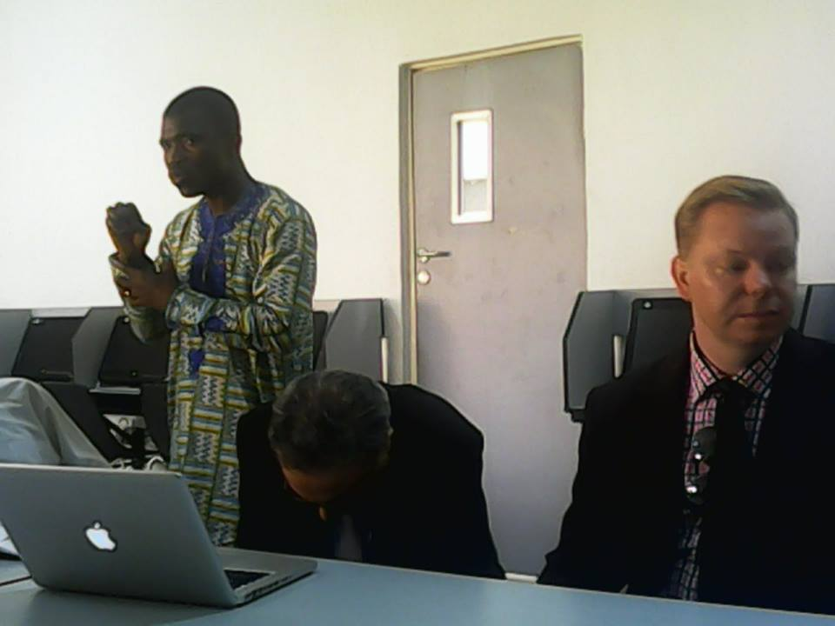
Nigeria National Association of the Deaf (NNAD)
NNAD is the umbrella association of the deaf. It caters to the welfare of deaf people in Nigeria. It is affiliated to the WFD.

Slide 3
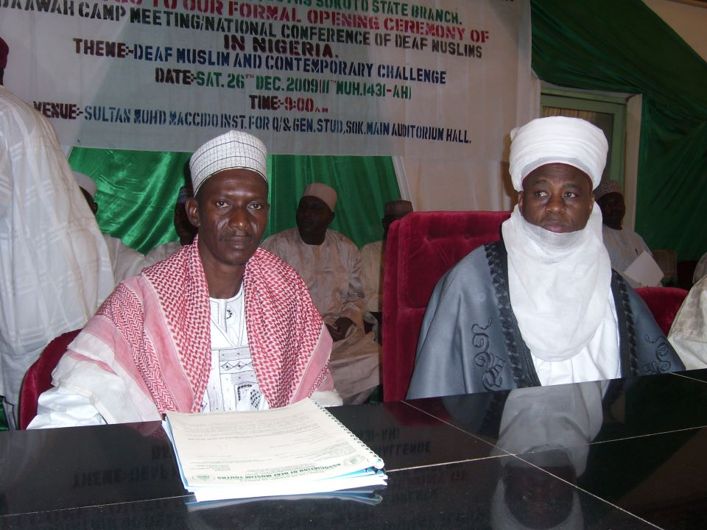
NNAD regularly organize events aimed at advancing and protecting the rights of deaf Nigerians.
NNAD has a president and he is responsible for the day to day running of the association.
The association does not have a registered office at the moment. It functions under the Ministry of Social Welfare

Slide 4
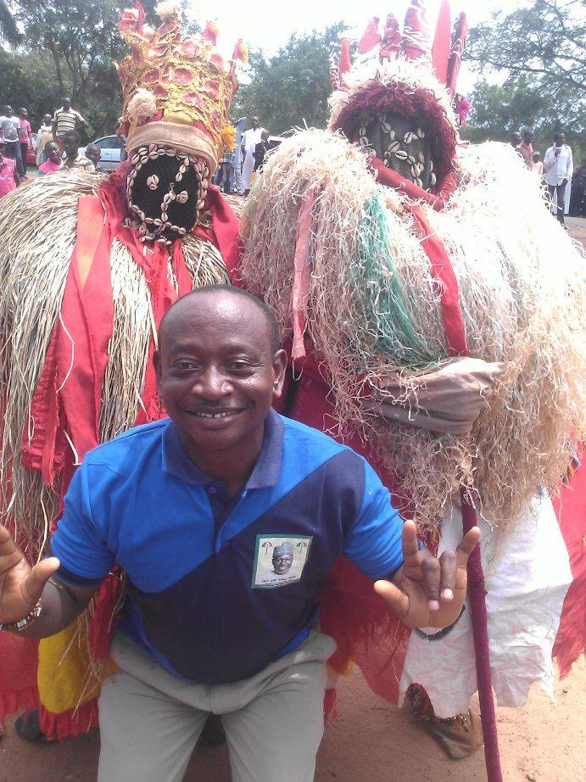
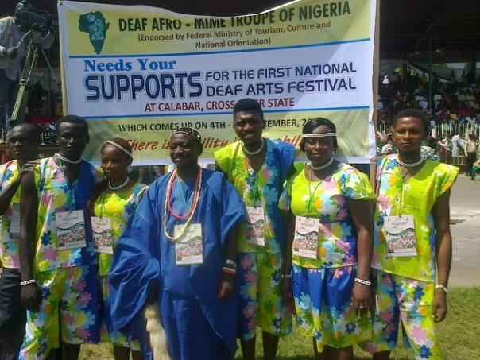
The Deaf Afro mime group is a dance troupe which entertains guest during festivals or political rallies in Nigeria
The group is an independent association

Slide 5
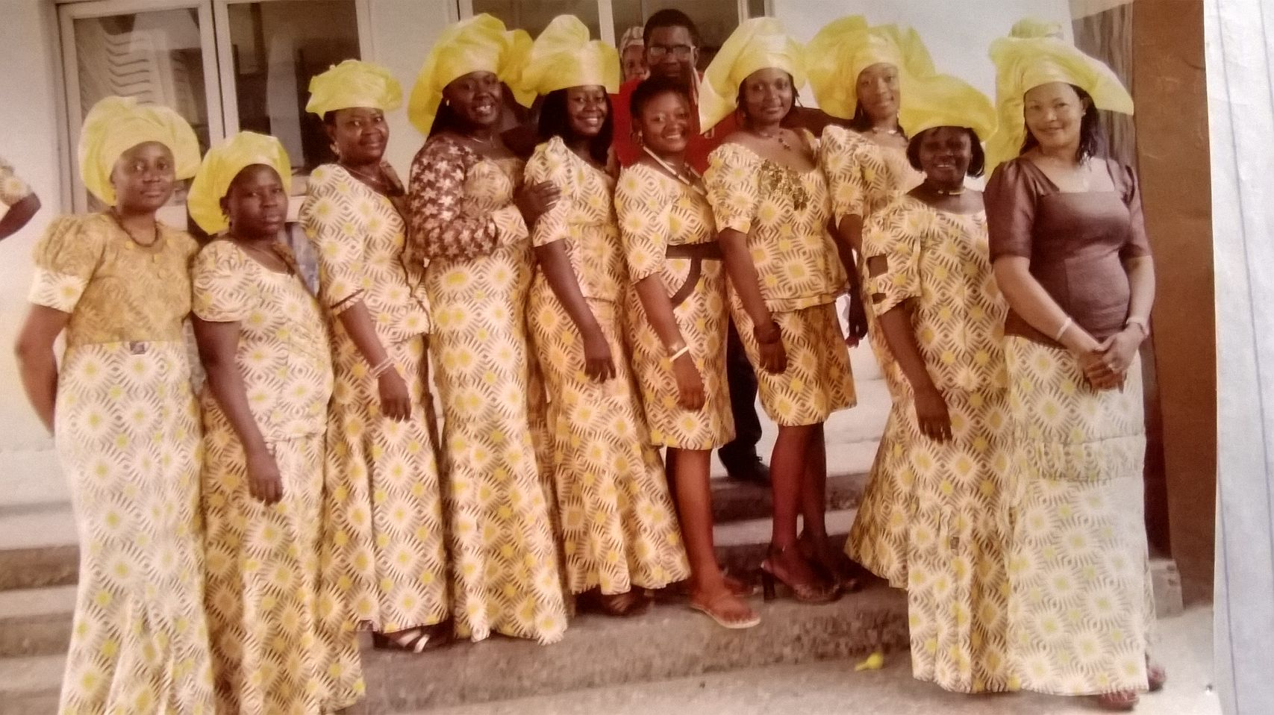
There is also Deaf Women Association. It work in collaboration with the NNAD. The aims of the DWA are to:
foster unity among deaf women in Nigeria.
Promote deaf culture including sign language.
organize programs of diverse kind to sensitize society on disability.
Exerting influence on the different tiers of govt with d aim of bringing about favorable disability policies and laws.

Slide 6
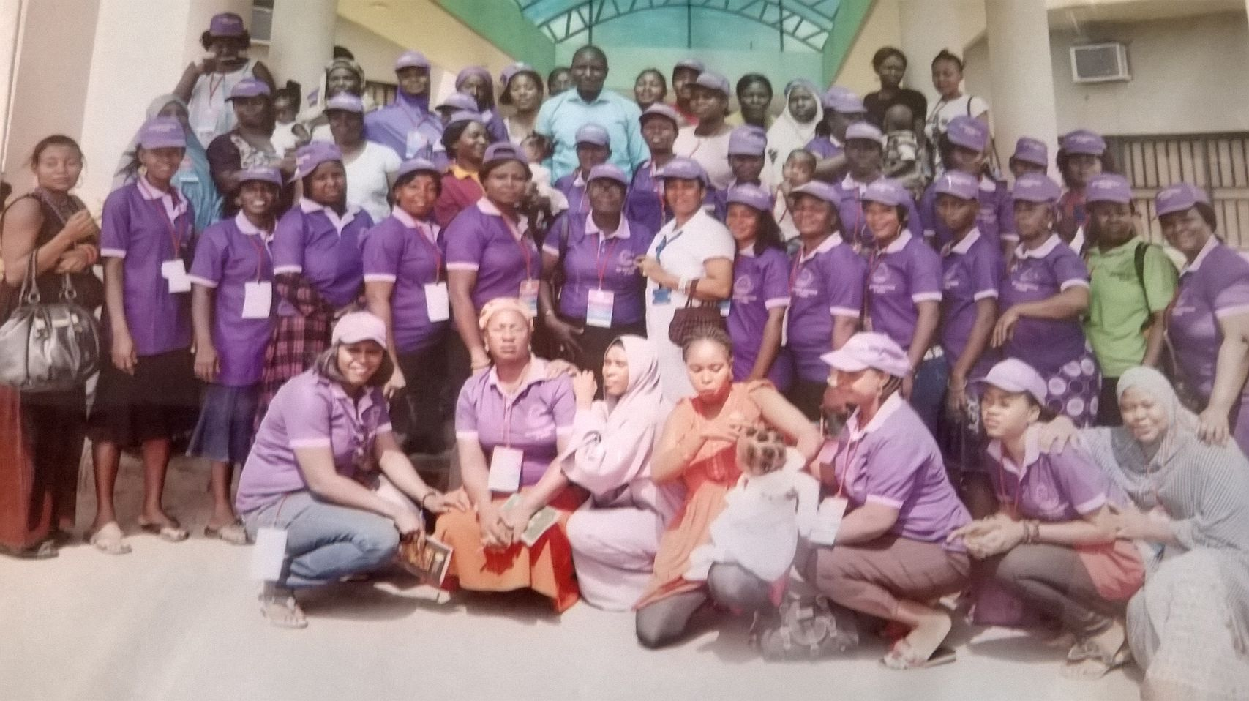
The deaf women association organizes periodic training of women in:
making izal, Dettol, menthelatum, harpic soap Vaseline, beads work etc

Slide 7
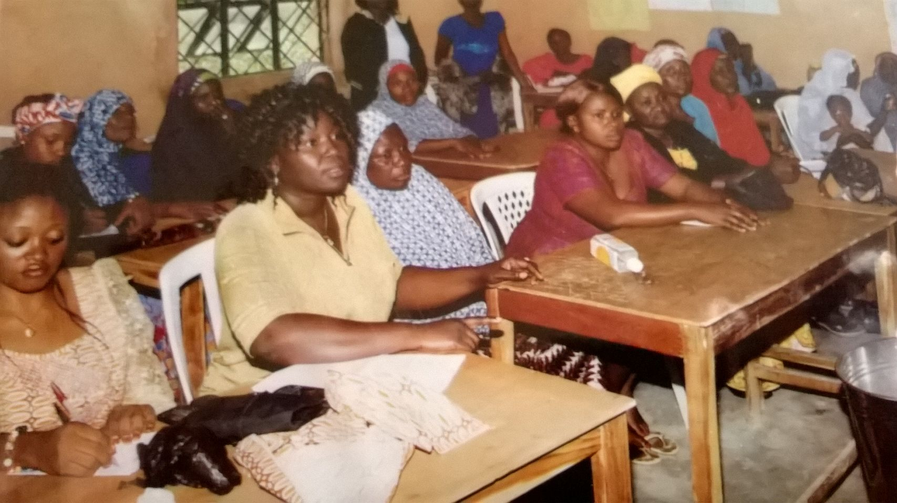
The DWA also hold period meetings in their respective regions to deliberate on issues affecting deaf women in their areas.

Slide 8
Nigeria Deaf Sports Federation (NDSF)
There is also the NDSF which oversees deaf sport events in Nigeria
It is assisted by the Federal Ministry of Sports
It is a member of the Deaflympics federation
It organizes sports events for the deaf in Nigeria and select representatives to Deaflympics events

Slide 9
Break Time:
7 minutes break

Slide 10
ASL Practices: Negations in ASL
Phrases | Negation
Yes, I do I like I care I understand I want What’s up? Do you have……. Do you mind…….. | No, I don’t I don’t like I don’t care I don’t understand I don’t want Nothing spoil I don’t have I don’t mind

Slide 11
Group Practices
In a group of twos, students communicate using phrases and negations

