Slide 1
Lecture 7
Deaf Education in Ghana, Cote d’Ivoire, and Uganda

Slide 2
Lesson Objectives:
At the end of the lesson, students will be able to:
Compare information about deaf education in the 3 African countries under study,
Identify services available to deaf people in those countries
Practice signs and sentences with time information in ASL

Slide 3
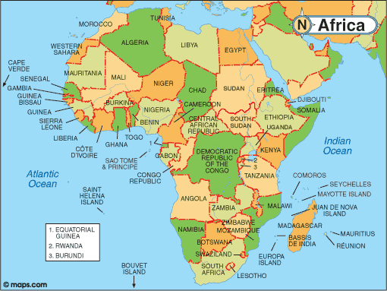
Map of Africa

Slide 4
Deaf education in Ghana
There are 110, 211 deaf people in Ghana
There are 12 basic schools for the Deaf in Ghana
1 senior secondary school
1 inclusive senior secondary school
Education of deaf people in Ghana is generally poor
Disability ACT 715, of 2006 guarantees the rights of disabled people in Ghana
The Ghana National Association of the Deaf is the umbrella organization of deaf people
2 Universities offer courses in Special Education in Ghana

Slide 5
Deaf education in CIV
Number of deaf people in CIV = 50,689 (1998 Census Report)
1 primary school for the deaf in CIV (established by Dr. Andrew Foster in 1974)
6 privately runned schools for disabled persons
Zero secondary school for the deaf
No legislation on disability matters in CIV
5 deaf associations, 2 organizations run by the deaf
More than 100 people with disabilities work in the public service in CIV
1 association of sign language interpreters

Slide 6
Deaf education in Uganda
Number of deaf people in Uganda = 260,000 (WHO 2005 estimate)
There are 20 schools, units and inclusive education schools serving deaf children in Uganda (Gallaudet University information unit: (http://www.gallaudet.edu/rsia/world_deaf_information_resource/deaf_orgs/local_orgs/uganda.html)
Uganda is the only country in the world where the deaf are voted into regional parliaments in elections

Slide 7
Issues for class discussion
In the United States for instance, there is a program called the Peace Corp. It is a program for volunteers who wish to serve humanity outside their home country. Is there any equivalence of the Peace Corp program in Europe? Have you ever thought of volunteering in a programme in some third countries?

Slide 8
Break Time
7 minutes break

Slide 9
ASL Practices: Telling time related events in contextual situations
We have class every Wednesday from 3:45 pm – 5:30 pm
The administrator will have appointment with some students at 9:00 am
Solomon Grundy was born on Sunday, Christened on Monday, Married on Tuesday, took ill on Wednesday, worsened on Thursday, died on Friday, buried on Saturday
Today is April 1st
We will have test next week
Last week was busy for her and her kids
This year is 2015
Next year will be 2016
He came to the Czech Republic last year

