Slide 1


Engaged Learning in Czech Republic
Modern Eastern Europe Alternative
Radek Pospíšil

Slide 2
„ENGAGED“
word origin french - meaning: personal, active participation, active interest in sth.
At school:
Pupil feels the need to get to know sth. (out of his own will)
To learn (educate himself) voluntarily, without anything being imposed on him or without any other way of negative motivation

Slide 3
Why the method is called “engaged” learning?
Name of Engaged Learning arose in connection with the search for the name of the method of teaching in which the main decesive word has the pupil himself
Pupil who is active with concern about the problem, working independently and with willingness, is drawn into the work and loves to learn.

Slide 4
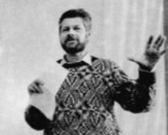
Founding of Engaged Learning
The Enagaged Learning is czech alternative conception
It was found by Stanislav Červenka in 1991
He is a teacher at Second grade of elementary School*(6th – 9th year of school attendance, pupils from 11-15 years old) at Železná Ruda (city near German borders)
He is a chairman of PAU (FEL) - Civic Association of the Friends of Engaged Learning .

Slide 5
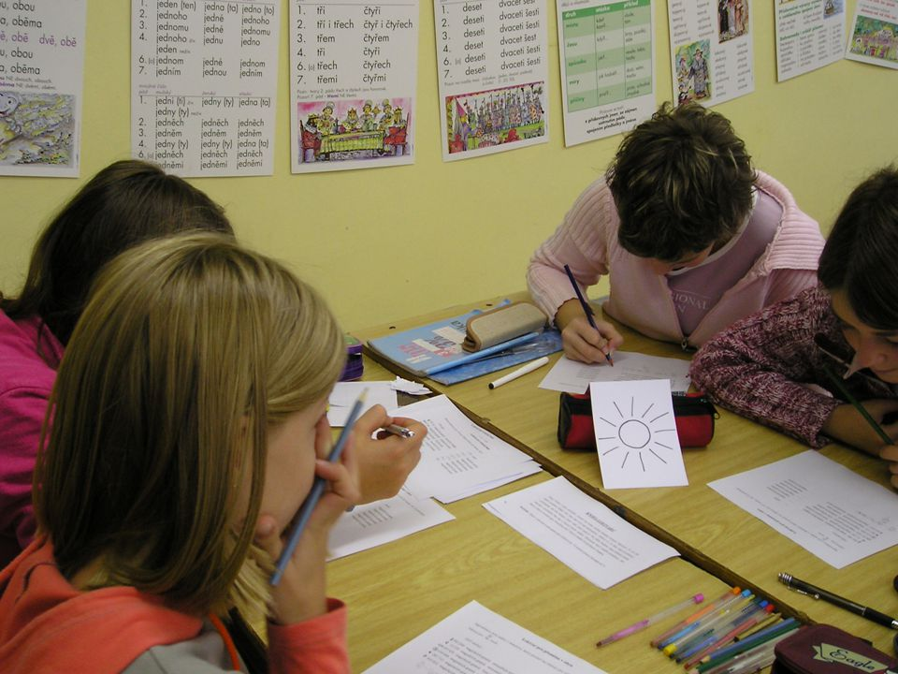
Stanislav Červenka explains
The Engaged Learning is evolving type of teaching with a strong emphasis on the positive internal motivation which leads the pupil so that he wants to engage himself, really wants to do something to fulfill certain goals.
Thus, the pupil is not only able, but willing to work, mainly on educational tasks (projects, active teaching).

Slide 6
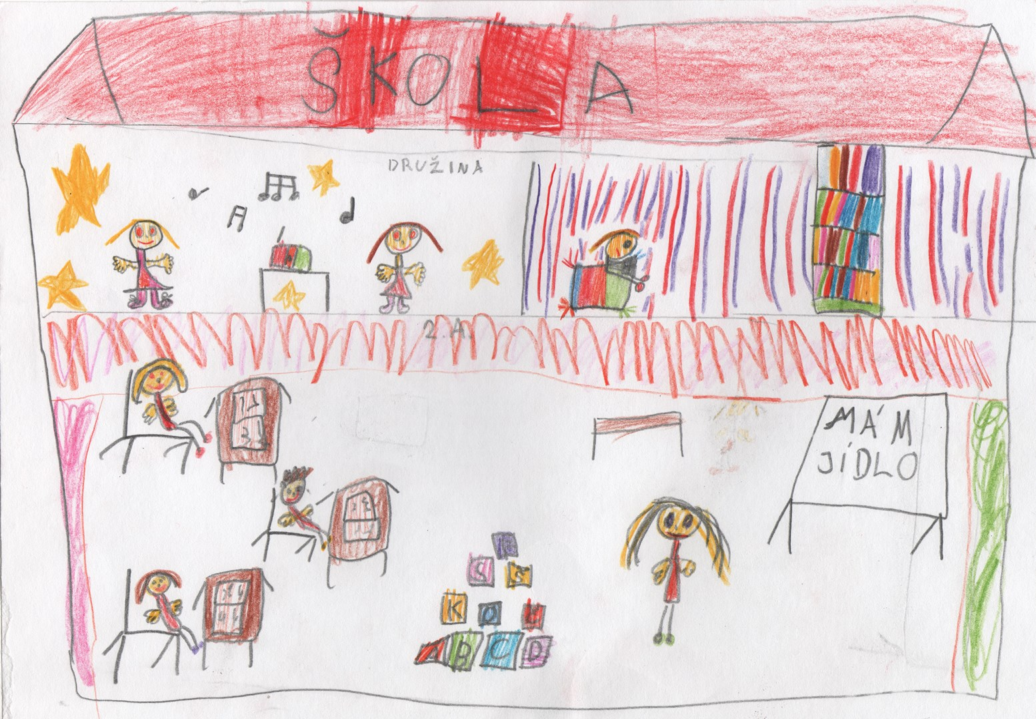
How did it start I.?
At the very beginning was the story that Červenka found in dedicated journal called Teaching newspapers.
Its content was the story of a boy who dreamt about a perfect school which he would enjoy. He would like comfort, welcoming atmosphere, cooperation and understanding, without any marks or written works or HW.
In the story, the boy wakes up, goes to his real school, where everything is vice versa than his dream was and is disappointed because his ideal school was just a dream.

Slide 7

How did it start II.?
Červenka read this story and as he already those days used a different method, which was close to this boy’s ideal school, in his school with his pupils he decided to share his experience and wrote another article into this Teaching newspaper. He also offered to share his expertise if anybody interested.
Article dropped rapidly spreading avalanche of letters with requests for advice, visit and exchange of experience.
Because it was not possible to handle all the answers in writing, he used Miluše Havlínová offer from NEMES (Prague Independent interdisciplinary group for the transformation of education) on the formation of the Professional Association of Teachers with similar interests to implement such changes in our schools.

Slide 8

Engaged Learning Critize Traditional Education in these points
A. Not respecting personality
B. Focus on current performance
C. Concentrating on an error
D. Inappropriate ways of transmitting information
E. Preference for Encyclopaedic Memory
F. Overwhelming imperative atmosphere
G. The center of the school is the teacher, not a pupil
H. Exclusion of mutual cooperation
CH. Non-satisfaction of pupil's needs

Slide 9
Ten Principles of Engaged Learning
1. Principle of independent thinking and collective cooperation
2. Principle of involvement and responsibility for assigned tasks
3. Principle of application of positive motivation
4. Principle of voluntary and conscious creative activity
5. Principle of understanding the curriculum for all pupils
6. Principle of problem solving challenging tasks
7. Principle of respect for the personality
8. Principle predominance of positive evaluation
9. Principle of usage of unusual teaching situations
10. Principle of an open system of education (Cervenka, 1992)

Slide 10
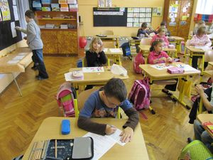
Principle of independent thinking and collective cooperation (group teaching, classroom adujstment…)
Principle of involvement and responsibility for assigned tasks (role of teacher and pupil, preparing the conditions for teaching, choice of tasks, work with goals, reflection and selfreflection)

Slide 11
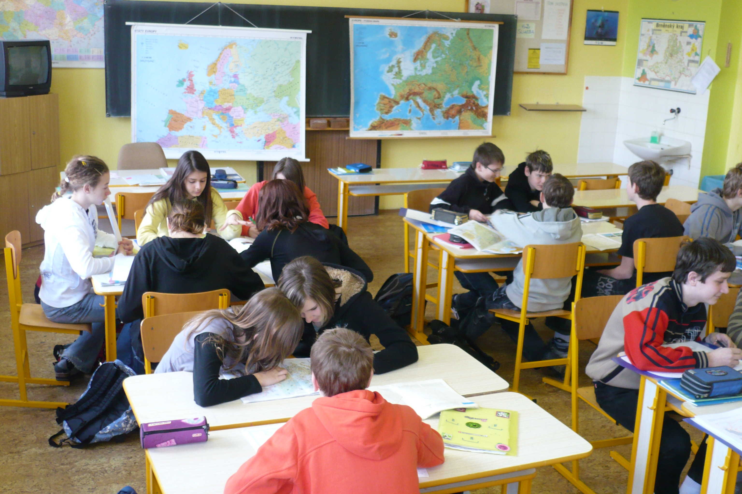
Principle of application of positive motivation (appreciation, expectation of positive performance of the child, group pressure)
Principle of voluntary and conscious creative activity (extended basic curriculum, respect basic physiological needs, sense of homework)
Principle of understanding the curriculum for all pupils (everybody should have the possibility to understand)

Slide 12
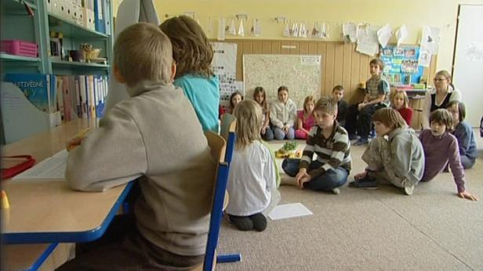
Principle of problem solving challenging tasks (Think, compile, compile algorithms for solution, problem learning, "what?" And "how much?" Should be replaced by „HOW?" And "WHY?„)
Principle of predominance of positive evaluation (You know – You don´t know –mark is five, objectivity, comfort, nervousness, irritability, reluctance, threats, punishments, stress)
Principle of respect for the personality (respect and be respected)

Slide 13
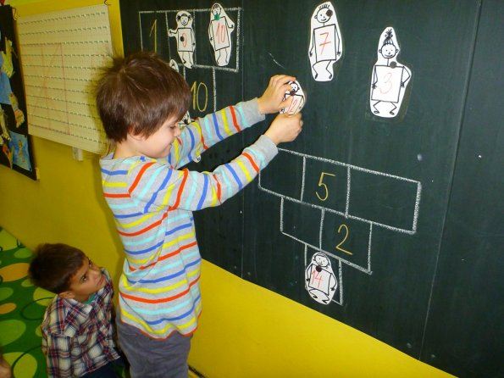
Principle of usage of unusual teaching situations (learning when sleeping, brainstorming, teacher's helpers, working with mistake, music, humor and laughter etc.)
Principle of an open system of education (education of educatable people, lifelong learning idea)

Slide 14
How does Engaged Learning work I.
It is not necessary to do testing, written works and tests of knowledge.
Does not use the marks.
Homework is a voluntary activity.
It is prohibited to pupils to learn anything at home, the principle is that everything can be handled in school lessons.
After a prolonged illness or other absence of a pupil, the pupil attends morning consultations to catch up with the rest of class.
In this method the teacher evaluates the pupils verbally and several times a day so that they can experience the great feeling of a positive assessment of their work and the benefit their work brings to others.

Slide 15
How does Engaged Learning work II.
Does not punish, because there are virtually no disciplinary problems.
Working together in groups.
Pupils have the opportunity to leave the classroom during the lesson (mostly drawn into action so that this option is rarely exercised).
In the group working on a task it is natural that they can talk together, consult and negotiate.
At the end of the classification period, students receive a written assessment instead of a certificate.

Slide 16
Preparing teachers I.
Preparing teachers for Engaged Teaching corresponds to the concept of school work with children as one of the most responsible human activities.
Assumes perfect preparation of every lesson so that nothing was left to chance.
What is important is a thorough diagnosis of each one group of pupils, which is the starting point for the analysis of curriculum focusing on proper selection of subject matter.

Slide 17
Preparing teachers II.
To the understanding of the real actual status serves for example.
Meetings and interviews with speakers of different groups in the class, which reveals when it is necessary to slow the pace or go back and re-explain the topic
Monitors mastering of core curriculum, which is necessary for every pupil.

Slide 18
Preparing teachers III.
To the understanding of the real actual status serves for example.
From my own experience recommends Červenka analysis of the lessons from the perspective of the pupils' own work, which is needed to reveal the successes and failures and to assess the fulfillment of the objectives
A similar analysis should be the rule after a prolonged period closed (thematic unit, semester, school year)

Slide 19
What is PAU (FEL) I.?
PAU (english FEL) a civic association was founded in 1992 and in 1992-1994 acted as an instigator expert group within the association NEMES (Independent interdisciplinary group for transforming education).
A number of creative teachers participated in the transformation of the document NEMES Czech education reform.
Since 1994 PAU operates as an independent organization bringing together teachers, parents, students, school staff, officials and politicians.

Slide 20
What is PAU (FEL) II.?
In 1999 it became one of the founding organizations of the Standing Conference associations in education and its framework contributes significantly to the creation of a new strategy of state education policy, which has managed to push through most common ideas and goals. PAU, among other things also cooperated on the development of so-called Green and White Papers
Today focuses on issues of practical implications of curriculum reform.

Slide 21
Červenka´s Papers (in CZ)
Červenka, S. Angažované učení (Engaged learning). Praha: T. Houška, 1992.
Červenka, S. Učit se. Učit se? Učit se! (Learn. Learn? Learn!) Praha: Strom, 1993.
PAU website http://www.pau.cz/

Slide 22
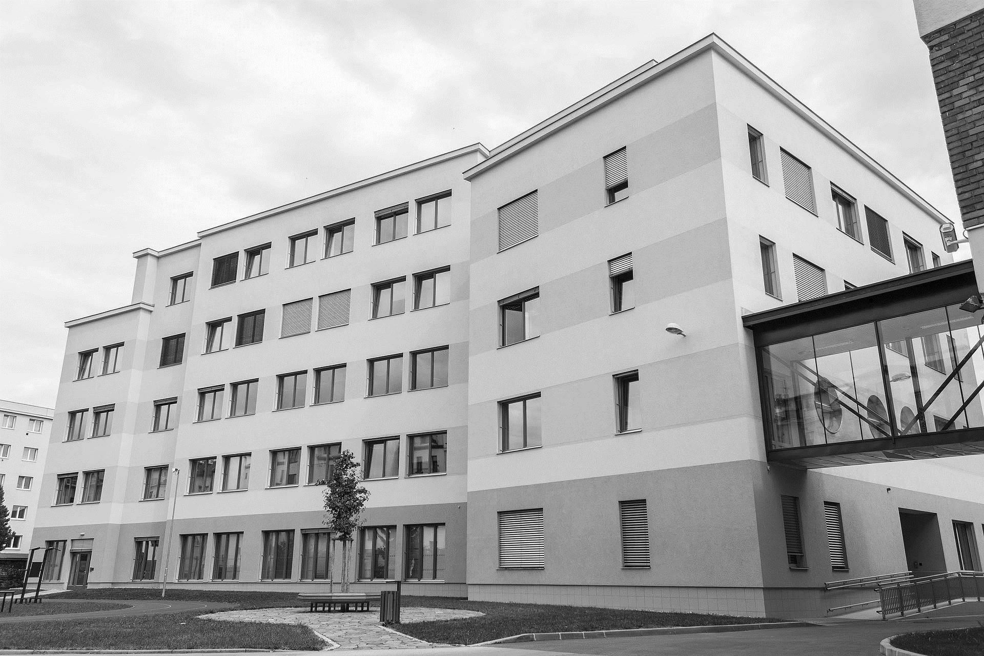
THANK YOU.
Obrigado.
Děkuji.

Slide 23
Back – up slides. MU

Slide 24
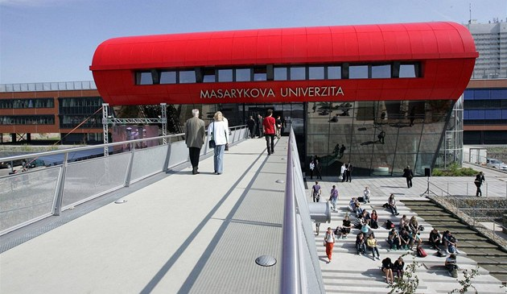

Back – Up: Where to find more info about our University:
Masaryk University: https://www.muni.cz/
Faculty of Education: http://www.ped.muni.cz/en/introduction
Facebook:
Faculty of Education https://www.facebook.com/pdfmu
Department of Education https://www.facebook.com/pedagogikaMU
Youtube:
Welcome to MU https://www.youtube.com/watch?v=_FQBx_lGoLY
Faculty of Education https://youtu.be/OY8XgY5KD2I
Find out more at: https://www.youtube.com/user/MasarykuniBrno

Slide 25

