Slide 1
individual´s needs
12th March 2018

Slide 2
describe a diagram...

Slide 3
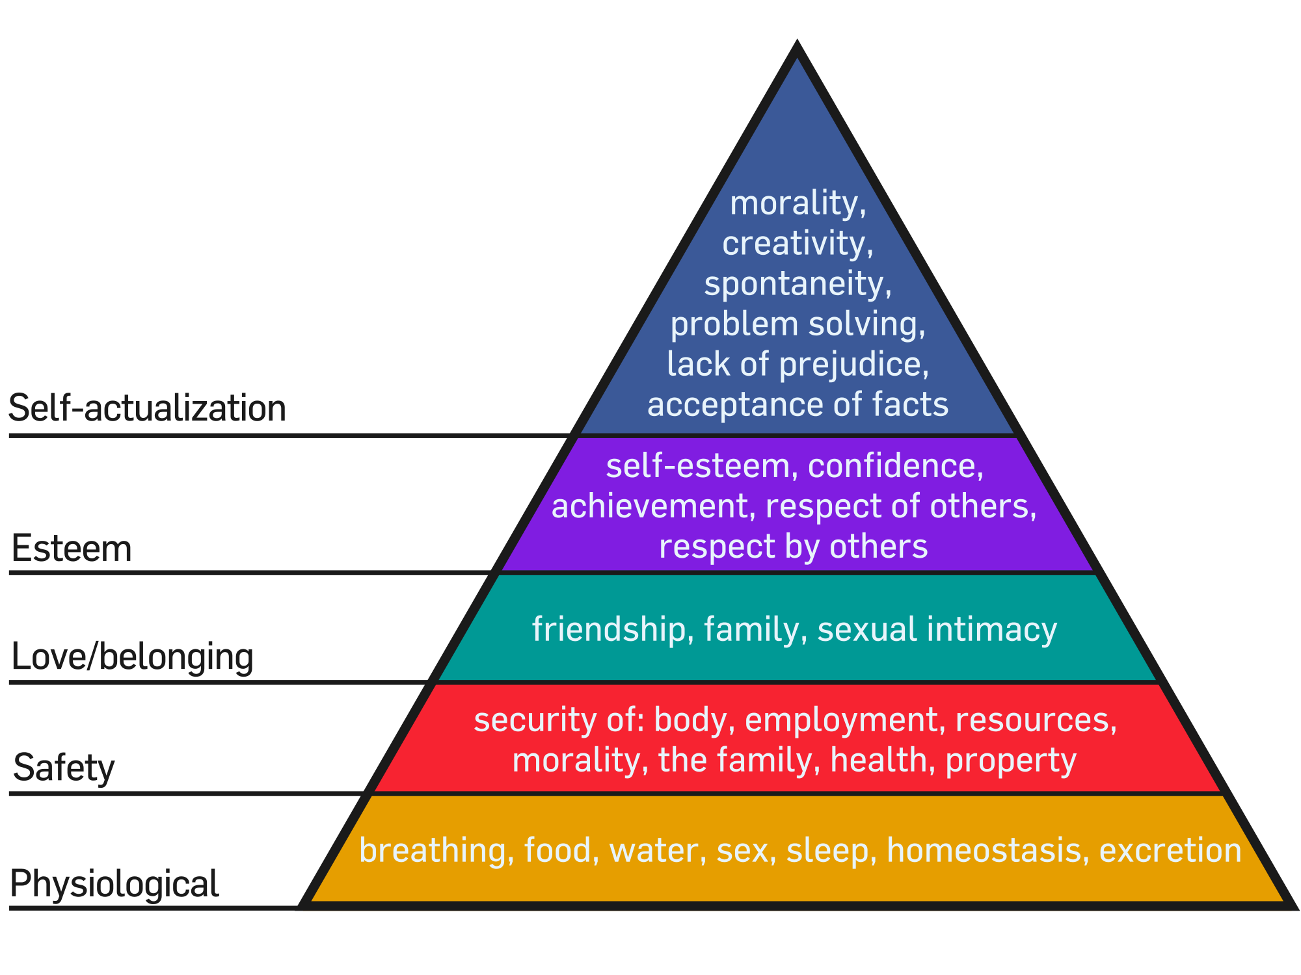
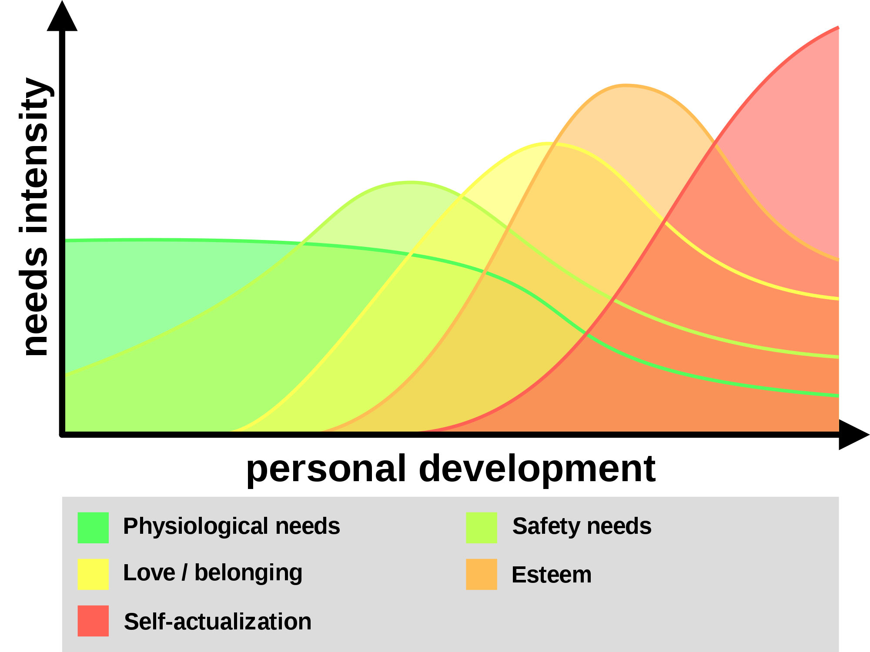
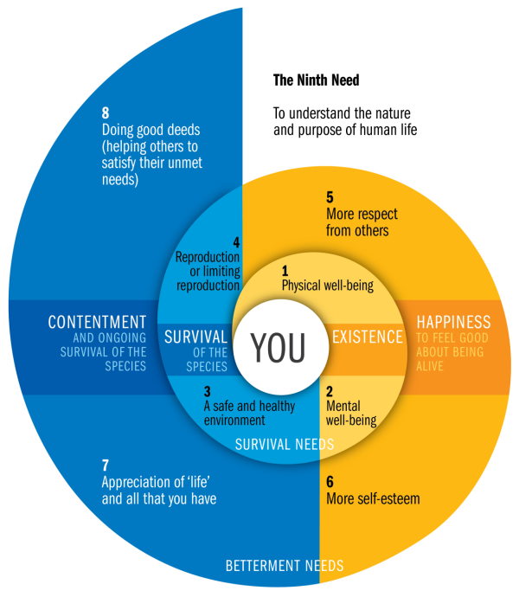
http://simonhertnon.com/human-needs-theory-nautilus-diagram/
https://en.wikipedia.org/wiki/Maslow%27s_hierarchy_of_needs
https://cz.pinterest.com/pin/565483296942457383/

Slide 4
your needs

Slide 5
your needs
word formation
tenses
passive X active voice
prepositions
articles

