Slide 1
people and society - education
26th March2018

Slide 2
self-reflection in metaphors
learning is like …
a learner is like a …
a teacher is like a …

Slide 3
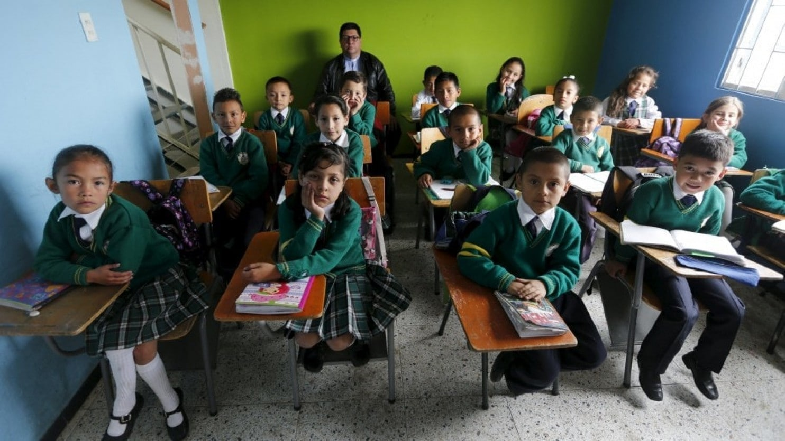

Slide 9
Colombia

Slide 10
Tunisia

Slide 11
the USA

Slide 12
Russia

Slide 13
Pakistan

Slide 14
United Kingdom

