Slide 1
Developmental Psychology

Slide 2
Photos Task
Brinng, please, five photos from your childhood and adolescence to our next meeting

Slide 3
Moral Development and Social Development
Kohlberg’s Theory of Moral Reasoning
Attachment and Parenting Styles
Erikson’s Psychosocial Stage Theory of Development

Slide 4
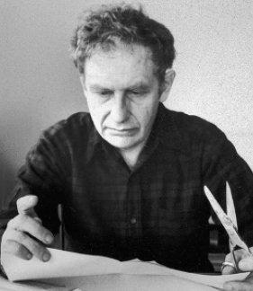
Kohlberg’s Theory of Moral Reasoning
Built on an earlier theory of moral reasoning proposed by Piaget, using a series of stories that involved moral dilemmas to assess a person’s level of moral reasoning
Discerned three levels of moral reasoning based on responses to the stories and the reasoning behind the responses given

Slide 5
Kohlberg’s Levels of Moral Reasoning
1. At the preconventional level of moral reasoning, the emphasis is on avoiding punishment and looking out for your own welfare and needs
Moral reasoning is self-oriented
2. At the conventional level of moral reasoning, moral reasoning is based on social rules and laws
Social approval and being a dutiful citizen are important
3. At the highest level, the postconventional level of moral reasoning, moral reasoning is based on self-chosen ethical principles
Human rights taking precedent over laws; the avoidance of self-condemnation for violating such principles

Slide 6
Kohlberg’s Levels of Moral Reasoning
Level 1 | Preconventional Morality
Stage 1 | Punishment orientation | Compliance with rules to avoid punishment
Stage 2 | Reward orientation | Compliance with rules to obtain rewards and satisfy own needs

Slide 7
Kohlberg’s Levels of Moral Reasoning
Level 2 | Conventional Morality
Stage 3 | Good-girl/ good-boy orientation | Engages in behavior to get approval of others
Stage 4 | Law and order orientation | Behavior is guided by duty to uphold laws and rules for their own sake

Slide 8
Kohlberg’s Levels of Moral Reasoning
Level 3 | Postconventional Morality
Stage 5 | Social contract orientation | Obeys rules because they are necessary for social order but understands rules are relative
Stage 6 | Universal ethical principles orientation | Concerned about self-condemnation for violating universal ethical principles based on human rights

Slide 9
Kohlberg’s Theory of Moral Reasoning
Kohlberg proposed that we all start at the preconventional level as children and as we develop, especially cognitively, we move up the ladder of moral reasoning
The sequence is uniform; however, not everyone reaches the postconventional level

Slide 10
Kohlberg’s Theory of Moral Reasoning
Shortcomings of Kohlberg’s theory
Studied moral reasoning and not moral behavior
May not have adequately represented the morality of women
The higher stages may be biased toward Western cultures

Slide 11
Attachment and Parenting Styles
Attachment is the lifelong emotional bond that exists between the infants and their mothers or other caregivers, formed during the first six months of life

Slide 12
Attachment and Harlow’s Monkeys
Harry Harlow separated infant monkeys from their mothers at birth and put them in cages containing two inanimate surrogate mothers, one made of wire and one made of terry cloth

Slide 13
Attachment and Harlow’s Monkeys
Half of the monkeys received their nourishment from a milk dispenser in the wire and half from a dispenser in the terry cloth mother
All of the monkeys preferred the cloth monkey regardless of which monkey provided their nourishment
The monkeys being fed by the wire mother would only go to the wire mother to eat and then return to the cloth mother
Thus, “contact comfort,” not reinforcement from nourishment, was the crucial element for attachment formation

Slide 14
Attachment and Harlow’s Monkeys

Slide 15
Attachment and Harlow’s Monkeys
When confronted with a strange situation (e.g., an unfamiliar room with toys) without the surrogate mother, the infant monkey would be fearful
When the surrogate mother was brought into the strange situation, the infant monkey would initially cling to the terry cloth mother to reduce its fear, but then begin to explore the new environment and eventually play with toys

Slide 16
Types of Attachment
https://www.youtube.com/watch?v=PnFKaaOSPmk
Discerned via the strange situation devised by Ainsworth, in which an infant’s behavior is observed in an unfamiliar room with toys, while the infant’s mother or caregiver and a stranger move in and out of the room in a structured series of simulations
Secure
Insecure- avoidant
Insecure- ambivalent
Insecure- disorganized

Slide 17
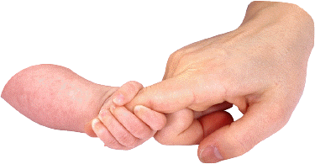
Types of Attachment
Secure attachment is indicated when an infant explores the situation freely in the presence of the mother, but displays distress when the mother leaves, and responds enthusiastically when the mother returns
Caregivers who are sensitive and responsive to an infant’s needs are more likely to develop a secure attachment with the infant
Insecure-avoidant attachment is indicated by exploration, but minimal interest in the mother, the infant showing little distress when the mother leaves, and avoiding her when she returns

Slide 18
Types of Attachment
Insecure-ambivalent attachment is indicated by the infant seeking closeness to the mother and not exploring the situation, high level of distress when the mother leaves, and ambivalent behavior when she returns by alternately clinging to and pushing away from her
Insecure-disorganized (disoriented) attachment is marked by the infant’s confusion when the mother leaves and when she returns
The infant acts disoriented, seems overwhelmed by the situation, and does not demonstrate a consistent way of coping with it

Slide 19
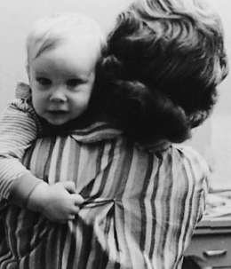
Types of Attachment
Infant temperament, a set of innate tendencies or dispositions that lead us to behave certain ways, is also a factor in determining type of attachment
Specifically, how an infant’s temperament matches the child- rearing expectations and personality of its caregiver is important in forming the attachment relationship
Secure attachments have been linked to higher levels of cognitive functioning and social competence in adulthood
Daycare does not appear to be detrimental to the formation of secure attachments

Slide 20
Parenting Styles
Authoritarian | Parents are demanding, expect unquestioned obedience, are not responsive to their children’s desires, and communicate poorly with their children
Authoritative | Parents are demanding but set rational limits for their children and communicate well with their children
Permissive | Parents make few demands and are overly responsive to their child’s desires, letting their children do pretty much as they please
Uninvolved | Parents minimize both the time they spend with the children and their emotional involvement with them, doing little more than providing for basic needs

Slide 21
Parenting Styles
An authoritative parenting style seems to have the most positive effect on cognitive and social development
Children are the most independent, happy, self-reliant, and academically successful of the four parenting styles

Slide 22
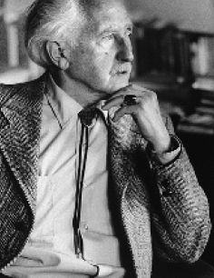
Erikson’s Psychosocial Stage Theory of Development
Emphasized the impact of society and culture upon development
Lead to an increase in research on life-span development
Criticized for the lack of solid experimental data to support it
Eight stages of development, each with a major issue or crisis that has to be resolved
Each stage is named after the two sides of the issue relevant in that stage

Slide 23
Erikson’s Psychosocial Stages
1 | Trust vs. Mistrust (birth to 1 year) | Infants learn that they can or cannot trust others to take care of their basic needs
2 | Autonomy vs. Shame and Doubt (1 to 2 years) | Children learn to be self-sufficient in many activities such as toilet training, walking, and exploring; if restrained too much they learn to doubt their abilities and feel shame

Slide 24
Erikson’s Psychosocial Stages
3 | Initiative vs. Guilt (3 to 5 years) | Children learn to assume more responsibility by taking the initiative but will feel guilty if they overstep limits set by parents
4 | Industry vs. Inferiority (5 years to puberty) | Children learn to be competent by mastering new intellectual, social, and physical skills or feel inferior if they fail to develop these skills

Slide 25
Erikson’s Psychosocial Stages
5 | Identity vs. Role Confusion (adolescence) | Adolescents develop a sense of identity by experimenting with different roles; no role experimentation may result in role confusion
6 | Intimacy vs. Isolation (young adulthood) | Young adults form intimate relationships with others or become isolated because of failure to do so

Slide 26
Erikson’s Psychosocial Stages
7 | Generativity vs. Stagnation (middle adulthood) | Middle-aged adults feel they are helping the next generation though their work and child rearing, or they stagnate because they feel that they are not helping
8 | Integrity vs. Despair (late adulthood) | Older adults assess their lives and develop sense of integrity if they find lives have been meaningful; develop sense of despair if not meaningful

Slide 27
Erikson’s Psychosocial Theory of Development
Probably the greatest impact of Erikson’s theory is that it expanded the study of developmental psychology past adolescence into the stages of adulthood (young, middle, and late)
The sequence in the theory (intimacy issues followed by identity issues) turns out to be the most applicable to men and career-oriented women
Many women may solve these issues in reverse order or simultaneously
For example, a woman may marry and have children and then confront the identity issues when the children become adults

Slide 28
Prenatal Development and Infancy
Prenatal Development
How We Develop During Infancy

Slide 29
Prenatal Development
Human conception begins when a sperm penetrates the membrane of an ovum
When the two combine, a complete set of genetic instructions is formed, half from the father and half from the mother
The fertilized egg that is formed from the union of the sperm and egg is called a zygote

Slide 30
The Gene
The basic unit of genetic instructions
Genes are short segments of chromosomes, molecules of DNA that hold the genetic instructions for every cell in our body
Every cell of a normal human has 23 pairs of chromosomes, one of each pair coming from the mother and one from the father

Slide 31
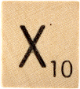
Sex Determination
It is the 23rd pair of chromosomes that determines a person’s sex
In a female, there are two X-shaped chromosomes (XX)
In a male, there is one X-shaped chromosome and one smaller Y-shaped chromosome (XY)
It is the Y chromosome that leads to the development of a male, so the sex of the zygote is determined by which sperm X or Y, fertilizes the egg

Slide 32
Twins
Sometimes the growing cluster of duplicated cells breaks apart early in development resulting in two clusters with identical genes
These clusters become identical (monozygotic) twins because they come from the same zygote

Slide 33
Twins
Fraternal (dizygotic) twins originate from the fertilization of two eggs at about the same time
Chance determines which of the 23 pairs of chromosomes goes to a reproductive cell, so there are about 8 million chromosome possibilities for each reproductive cell in each parent
Consequently, fraternal twins, as well as any two children of the same parents, may vary greatly in appearance

Slide 34
Stages of Prenatal Development
Germinal | Begins with the formation of the zygote and ends after about 2 weeks, when the outer portion of the zygote’s developing cluster of cells has attached itself to the uterine wall
Embryonic | From 2 weeks to about 2 months, the major structures and organs of the body begin to develop, and the embryo starts to resemble a human being
Fetal | From about 2 months to birth, the developing organism is called a fetus, and through very rapid growth, the body structures and organs complete their growth

Slide 35
Influences
Prenatal development is mainly a function of the zygote’s genetic code (nature), but the environment (nurture) also plays a role
Teratogens are environmental agents (such as drugs or viruses), diseases (such as German measles), and physical conditions (such as malnutrition) that impair prenatal development and lead to birth defects or even death

Slide 36
How We Develop During Infancy
Motor Development
Sensory- Perceptual Development

Slide 37
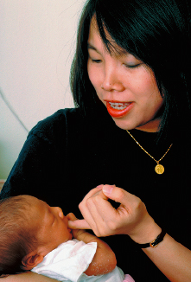
Motor Development
A reflex is an unlearned response to a specific stimulus
The Babinski reflex occurs when an infant fans her toes upward when her feet are touched
The grasping reflex occurs when an infant grasps any object that touches their palms
The sucking reflex leads an infant to suck anything that touches its lips
The rooting reflex leads an infant to turn its mouth toward anything that touches its cheeks and search for something to suck

Slide 38
Sensory-Perceptual Development
Preferential-looking technique is used to study vision
Two visual stimuli are displayed side by side, and the researcher records how long the infant looks at each stimulus
If the infant looks at one stimulus longer, it is inferred he can tell the difference between the two stimuli and has a preference

Slide 39
Sensory-Perceptual Development
Habituation is a decrease in the physiological responding to a stimulus once it becomes familiar
Infants, for example, tend to look longer at novel stimuli
If infants look longer at a new stimulus than an old one, then it is inferred he must be able to perceive the difference between the two stimuli
Infants also intensity their sucking of a pacifier in their mouths when confronted with a novel stimulus

Slide 40
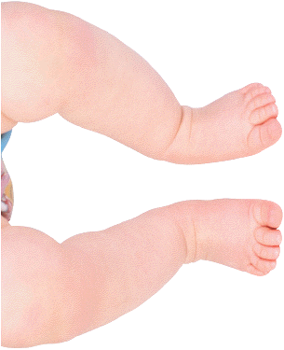
Sensory-Perceptual Development
Vision is the least-developed sense at birth
Newborns’ visual acuity is estimated to be about 20/400 to 20/800
Visual acuity reaches 20/20 within the first year of life
Color vision develops by 2 to 3 months
Infants’ preference for visual complexity may be due to the fact that such stimulation is necessary for proper development of the visual pathways and cortex during infancy

Slide 41
Sensory-Perceptual Development
Hearing in the newborn is more fully developed than vision
Can distinguish their mother’s voice from those of others
This ability appears to develop in the womb before birth
By 6 months, an infant’s hearing is comparable to that of an adult

Slide 42
Sensory-Perceptual Development
The senses of smell, taste, and touch are also fairly well-developed at birth
Infants can differentiate the smell of their mother from those of other people
Very young infants may have an innate conceptual understanding of object movement (e.g., that objects cannot go through solid surfaces)

Slide 43
Sensory-Perceptual Development
The brain contains about 100 billion neurons at birth, but the infant’s brain is immature, and connections between neurons (neural networks) need to be formed
Without visual experiences, the visual pathways do not develop, and vision will be permanently lost
During infancy, the networks of neurons that are used become stronger and those that are not used disappear

