Slide 1
Developmental Psychology
Developing Through the Life Span

Slide 2
Developing Through the Life Span
Prenatal Development and the Newborn
  Conception
  Prenatal Development
  The Competent Newborn

Slide 3
  Infancy and Childhood
  Physical Development
  Cognitive Development
  Social Development
Adolescence
  Physical Development
  Cognitive Development
  Social Development
  Emerging Adulthood

Slide 4
  Adulthood
  Physical Development
  Cognitive Development
  Social Development
  Reflections on Two Major Developmental Issues
  Continuity and Stages
  Stability and Change

Slide 5
Developmental Psychology
Issue | Details
Nature/Nurture | How do genetic inheritance (our nature) and experience (the nurture we receive) influence our behavior?
Continuity/Stages | Is development a gradual, continuous process or a sequence of separate stages?
Stability/Change | Do our early personality traits persist through life, or do we become different persons as we age.

Slide 6
Prenatal Development and the Newborn
How, over time, did we come to be who we are? From zygote to birth, development progresses in an orderly, though fragile, sequence.
Notes:
Preview Question 1: How does life develop before birth?

Slide 7
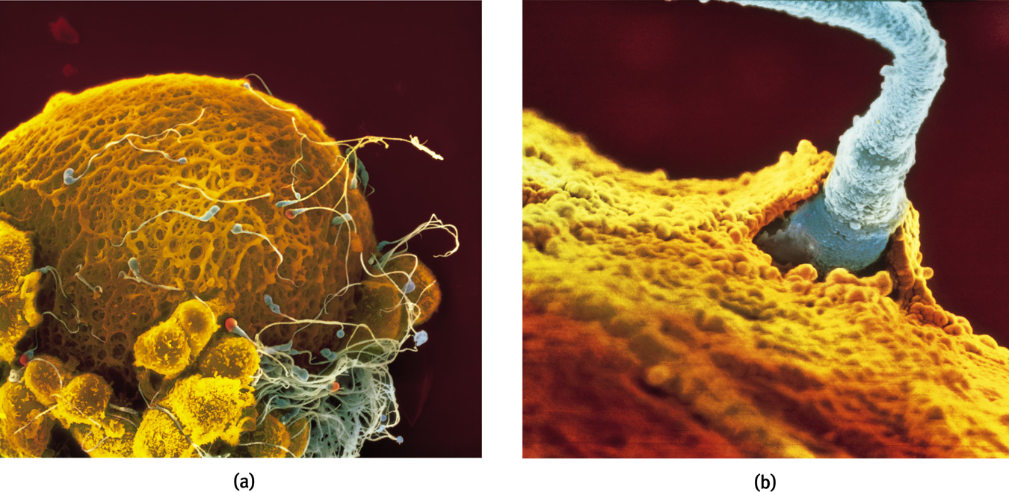
Conception
A single sperm cell (male) penetrates the outer coating of the egg (female) and fuses to form one fertilized cell.
Lennart Nilsson/ Albert Bonniers Publishing Company
Lennart Nilsson/ Albert Bonniers Publishing Company

Slide 8
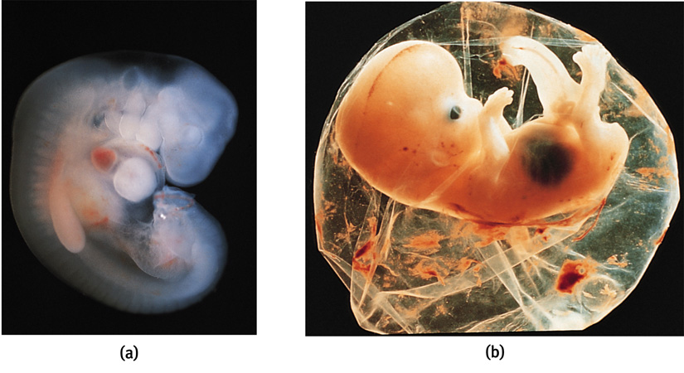
Prenatal Development
A zygote is a fertilized egg with 100 cells that become increasingly diverse. At about 14 days the zygote turns into an embryo (a and b).
Lennart Nilsson/ Albert Bonniers Publishing Company
Biophoto Associates/ Photo Researchers, Inc.

Slide 9
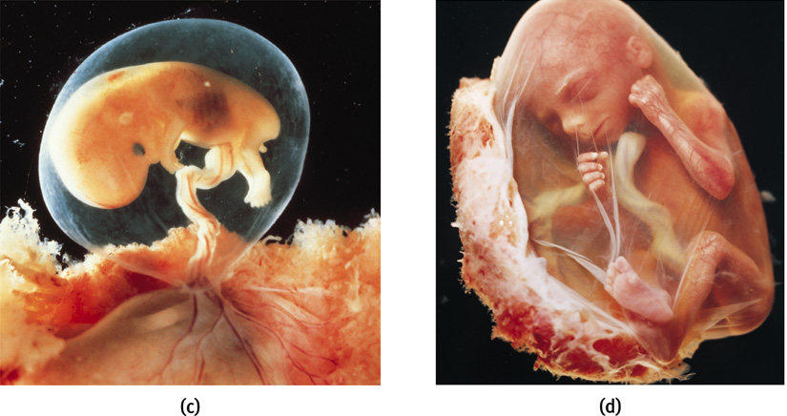
Prenatal Development
At 9 weeks, an embryo turns into a fetus (c and d). Teratogens are chemicals or viruses that can enter the placenta and harm the developing fetus.
Lennart Nilsson/ Albert Bonniers Publishing Company
Lennart Nilsson/ Albert Bonniers Publishing Company

Slide 10

The Competent Newborn
Infants are born with reflexes that aid in survival, including rooting reflex which helps them locate food.
Notes:
Preview Question 2: What are some of the newborn’s abilities, and how do researchers explore infants’ mental abilities?

Slide 11
Infancy and Childhood
Infancy and childhood span from birth to the teenage years. During these years, the individual grows physically, cognitively, and socially.
Stage | Span
Infancy | Newborn to toddler
Childhood | Toddler to teenager

Slide 12
Physical Development
Infants’ psychological development depends on their biological development. To understand the emergence of motor skills and memory, we must understand the developing brain.
Notes:
Preview Question 3: During infancy and childhood, how do the brain and motor skills develop?

Slide 13
Developing Brain
At birth, most brain cells are present. After birth, the neural networks multiply resulting in increased physical and mental abilities.

Slide 14
Maturation
The development of the brain unfolds based on genetic instructions, causing various bodily and mental functions to occur in sequence— standing before walking, babbling before talking—this is called maturation.
Maturation sets the basic course of development, while experience adjusts it.

Slide 15
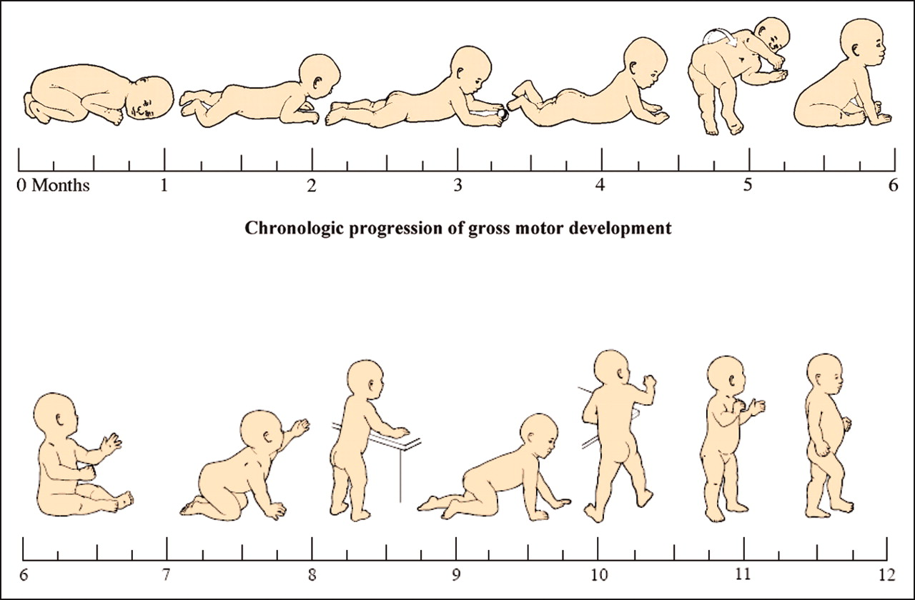
Motor Development
First, infants begin to roll over. Next, they sit unsupported, crawl, and finally walk. Experience has little effect on this sequence.

Slide 16

Maturation and Infant Memory
The earliest age of conscious memory is around 3½ years (Bauer, 2002). A 5-year-old has a sense of self and an increased long-term memory, thus organization of memory is different from 3-4 years.

Slide 17

Cognitive Development
Piaget believed that the driving force behind intellectual development is our biological development amidst experiences with the environment. Our cognitive development is shaped by the errors we make.
Notes:
Preview Question 4: From the perspective of Piaget and of today’s researchers, how does a child’s mind develop?

Slide 18
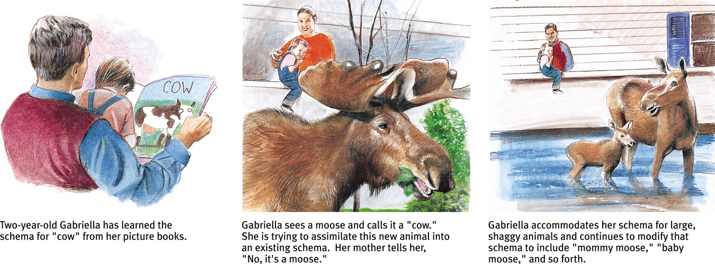
Schemas
Schemas are mental molds into which we pour our experiences.

Slide 19
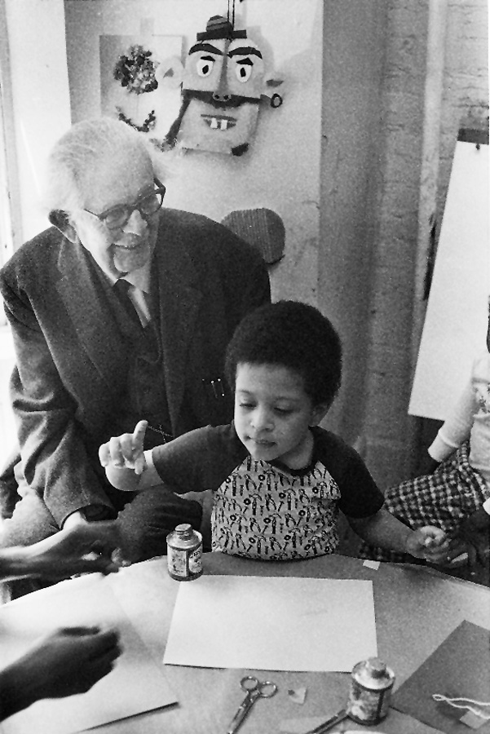
Assimilation and Accommodation
The process of assimilation involves incorporating new experiences into our current understanding (schema). The process of adjusting a schema and modifying it is called accommodation.
Bill Anderson/ Photo Researchers, Inc.
Jean Piaget with a subject

Slide 20
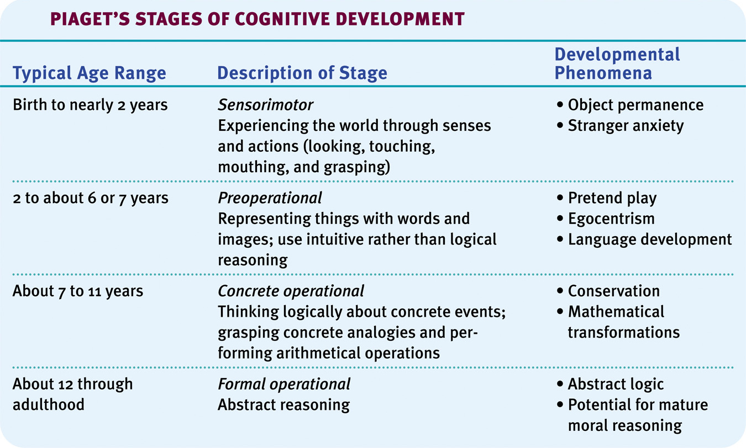
Piaget’s Theory and Current Thinking

Slide 21
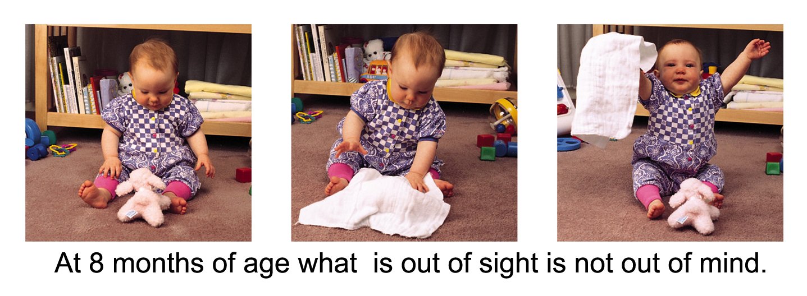
Sensorimotor Stage
In the sensorimotor stage, babies take in the world by looking, hearing, touching, mouthing, and grasping. Children younger than 6 months of age do not grasp object permanence, i.e., objects that are out of sight are also out of mind.
Doug Goodman

Slide 22
Sensorimotor Stage: Criticisms
Piaget believed children in the sensorimotor stage could not think —they do not have any abstract concepts or ideas.
However, recent research shows that children in the sensorimotor stage can think and count.
Children understand the basic laws of physics. They are amazed at how a ball can stop in midair or disappear.

Slide 23
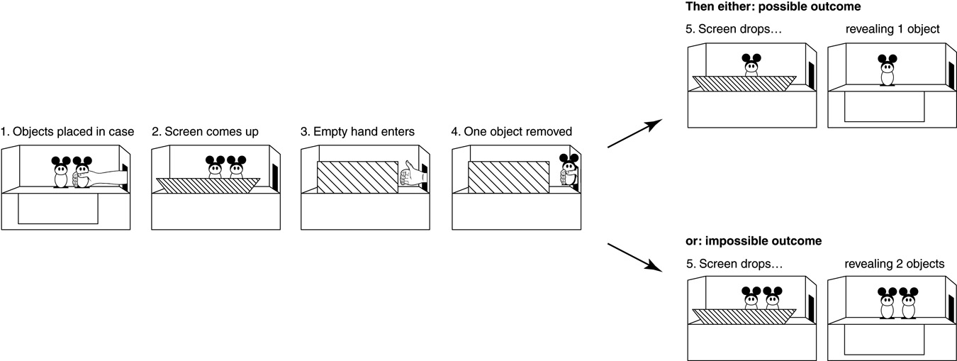
Sensorimotor Stage: Criticisms
2. Children can also count. Wynn (1992, 2000) showed that children stared longer at the wrong number of objects than the right ones.

Slide 24
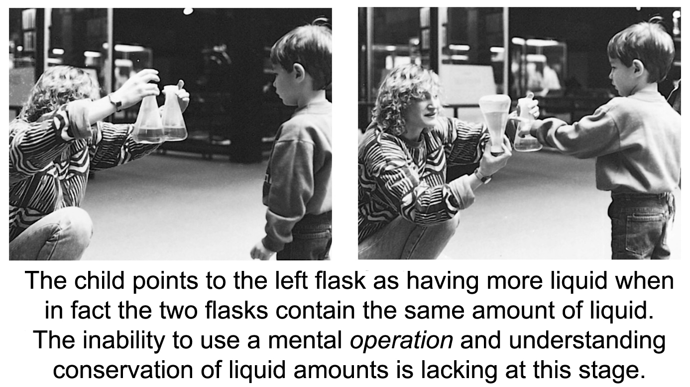
Preoperational Stage
Piaget suggested that from 2 years old to about 6-7 years old, children are in the preoperational stage—too young to perform mental operations.
Ontario Science Center

Slide 25
Preoperational Stage: Criticism
DeLoache (1987) showed that children as young as 3 years of age are able to use metal operations. When shown a model of a dog’s hiding place behind the couch, a 2½-year-old could not locate the stuffed dog in an actual room, but the 3-year-old did.

Slide 26
Egocentrism
Piaget concluded that preschool children are egocentric. They cannot perceive things from another’s point of view.
When asked to show her picture to mommy, 2-year-old Gabriella holds the picture facing her own eyes, believing that her mother can see it through her eyes.

Slide 27
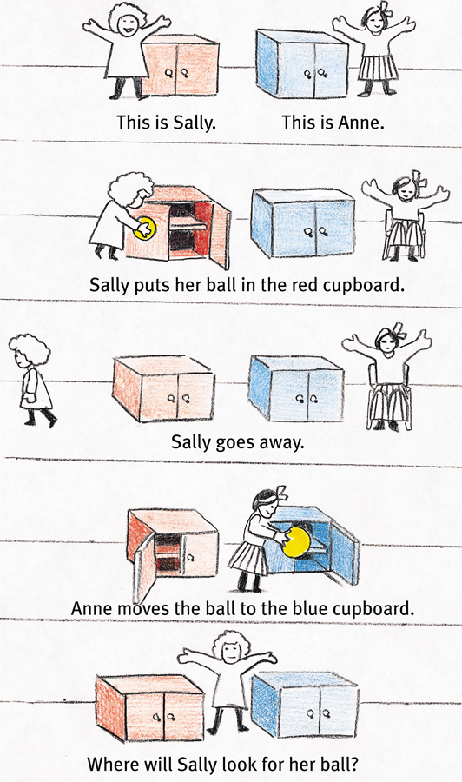
Theory of Mind
Preschoolers, although still egocentric, develop the ability to understand another’s mental state when they begin forming a theory of mind.
The problem on the right probes such ability in children.

Slide 28
Concrete Operational Stage
In concrete operational stage, given concrete materials, 6- to 7-year-olds grasp conservation problems and mentally pour liquids back and forth into glasses of different shapes conserving their quantities.
Children in this stage are also able to transform mathematical functions. So, if 4 + 8 = 12, then a transformation, 12 – 4 = 8, is also easily doable.

Slide 29
Formal Operational Stage
Around age 12, our reasoning ability expands from concrete thinking to abstract thinking. We can now use symbols and imagined realities to systematically reason. Piaget called this formal operational thinking.

Slide 30
Formal Operational Stage
Rudiments of such thinking begin earlier (age 7) than what Piaget suggested, since 7-year-olds can solve the problem below (Suppes, 1982).
If John is in school, Mary is in school. John is in school. What can you say about Mary?

Slide 31
Reflecting on Piaget’s Theory
Piaget’s stage theory has been influential globally, validating a number of ideas regarding growth and development in many cultures and societies. However, today’s researchers believe the following:
Development is a continuous process.
Children express their mental abilities and operations at an earlier age.
Formal logic is a smaller part of cognition.

Slide 32
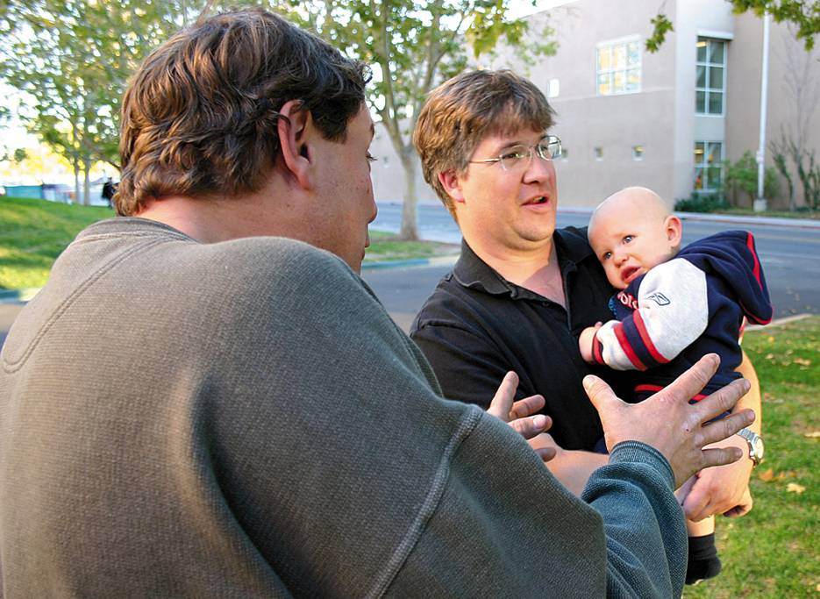
Social Development
Stranger anxiety is the fear of strangers that develops at around 8 months. This is the age at which infants form schemas for familiar faces and cannot assimilate a new face.
© Christina Kennedy/ PhotoEdit
Notes:
Preview Question 5: How do the parent-infant attachment bonds form?

Slide 33
Problems of Childhood
Normal Problems
  Overprotection
  Sibling Rivalry
  Childhood Rebellion
  Divorce
Serious Problems
  Autism
  Toilet Training disturbances
  Feeding Disturbances
    Overeating
    Anorexia Nervousa
    Pica
  Speech Disturbances
    Delayed speech
    Telegraphic speech
    Stuttering
  Learning Disorders
    Dyslexia
    ADHD
  Conduct Disorders

Slide 34

Adolescence
Many psychologists once believed that our traits were set during childhood. Today psychologists believe that development is a lifelong process. Adolescence is defined as a life between childhood and adulthood.
AP Photo/ Jeff Chiu

Slide 35
Puberty-Biological Event
Girls- 9-12 years old, begin
Boys- 11-14 years
Hormonal changes
  Cause rapid physical and sexual maturity
Immature- social experience, intellectual and knowledge
Identity Formation- puberty- “Time to begin a new self image”

Slide 36
Adolescence transition
Adulthood transition
  Responsibility for oneself
  Independent decisions
  Financial independence

Slide 37
Early and Late Maturation
Bodily awareness concerns
Timing of puberty→ may cause dissatisfaction over body
Early maturation for boys is seen positive in society (seen as athletic, self assured…)
Girls seen as less prestige
  Poor self image.. (not in middle school)

Slide 38
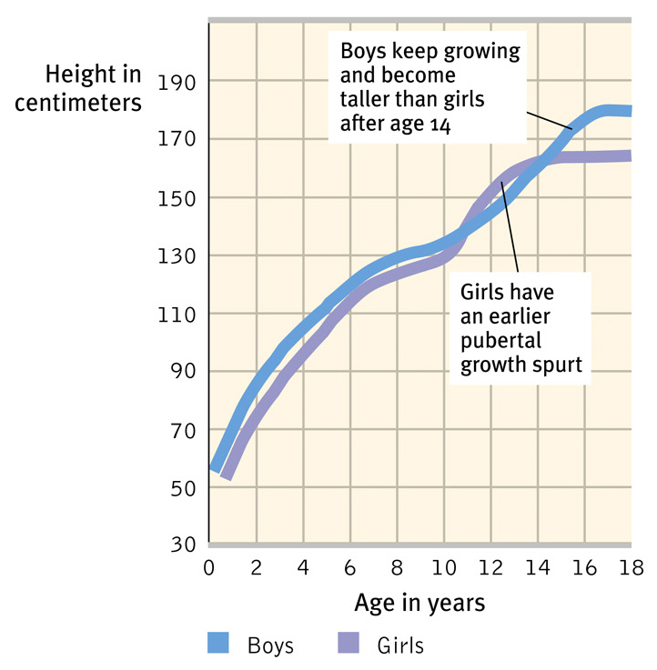
Physical Development
Adolescence begins with puberty (sexual maturation). Puberty occurs earlier in females (11 years) than males (13 years). Thus height in females increases before males.
Notes:
Preview Question 9: What physical changes mark adolescence?

Slide 39

Primary Sexual Characteristics
During puberty primary sexual characteristics — the reproductive organs and external genitalia — develop rapidly.
Ellen Senisi/ The Image Works

Slide 40
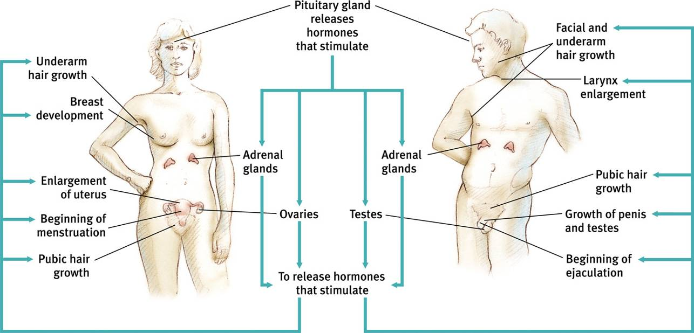
Secondary Sexual Characteristics
Also secondary sexual characteristics—the nonreproductive traits such as breasts and hips in girls and facial hair and deepening of voice in boys develop. Pubic hair and armpit hair grow in both sexes.

Slide 41
Brain Development
Until puberty, neurons increase their connections. However, at adolescence, selective pruning of the neurons begins. Unused neuronal connections are lost to make other pathways more efficient.

Slide 42
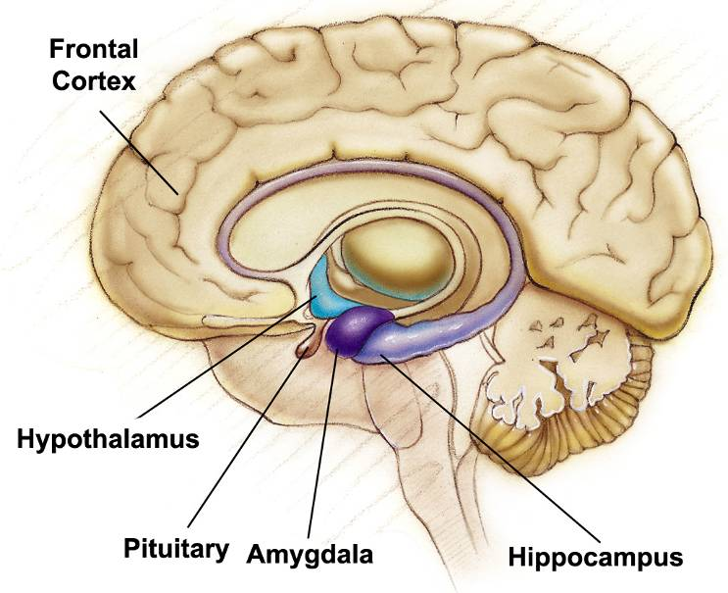
Frontal Cortex
During adolescence, neurons in the frontal cortex grow myelin, which speeds up nerve conduction. The frontal cortex lags behind the limbic system’s development. Hormonal surges and the limbic system may explain occasional teen impulsiveness.

Slide 43
Cognitive Development
Adolescents’ ability to reason gives them a new level of social awareness. In particular, they may think about the following:
Their own thinking.
What others are thinking.
What others are thinking about them.
How ideals can be reached. They criticize society, parents, and even themselves.
Notes:
Preview Question 10: How did Piaget, Kohlberg, and later researchers describe adolescent cognitive and moral development?

Slide 44

Developing Reasoning Power
According to Piaget, adolescents can handle abstract problems, i.e., they can perform formal operations. Adolescents can judge good from evil, truth and justice, and think about God in deeper terms.
William Thomas Cain/ Getty Images
AP/Wide World Photos

Slide 45
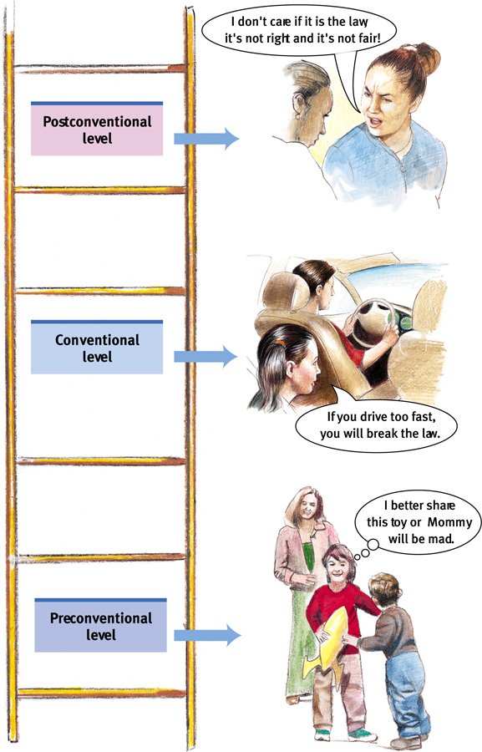
3 Basic Levels of Moral Thinking
Preconventional Morality: Before age 9, children show morality to avoid punishment or gain reward.
Conventional Morality: By early adolescence, social rules and laws are upheld for their own sake.
Postconventional Morality: Affirms people’s agreed-upon rights or follows personally perceived ethical principles.

Slide 46
Morality
As our thinking matures, so does our behavior in that we become less selfish and more caring. People who engage in doing the right thing develop empathy for others and the self-discipline to resist their own impulses.

Slide 47
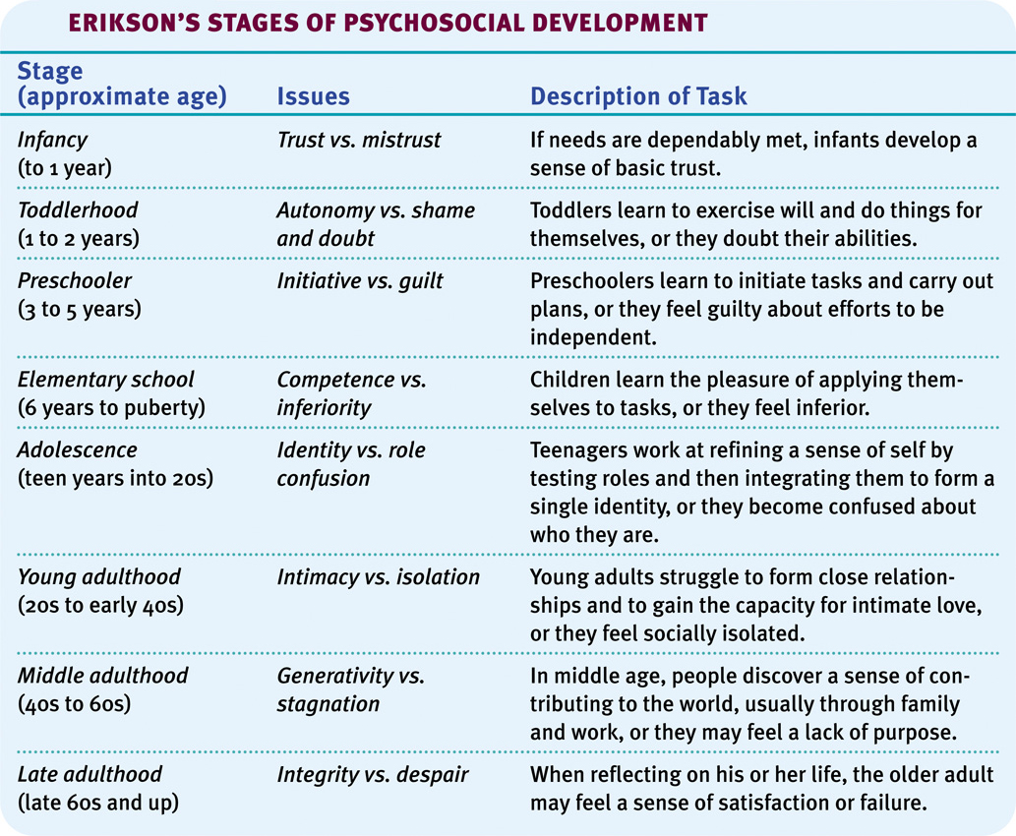
Social Development
Notes:
Preview Question 11: What are the social tasks and challenges of adolescence?

Slide 48

Forming an Identity
In Western cultures, many adolescents try out different selves before settling into a consistent and comfortable identity. Having such an identity leads to forming close relationships.
Leland Bobble/ Getty Images
Matthias Clamer/ Getty Images

Slide 49
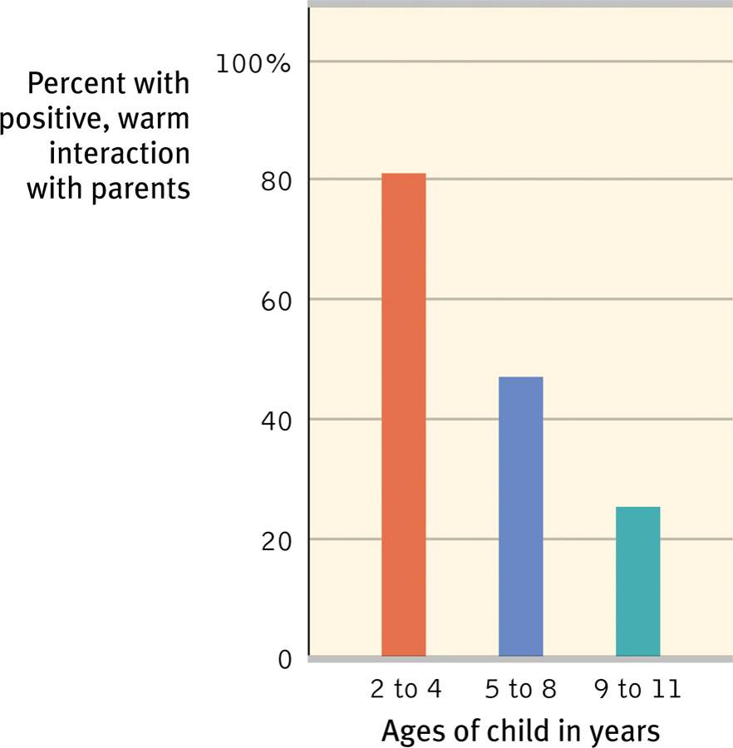
Parent and Peer Influence
Although teens become independent of their parents as they grow older, they nevertheless relate to their parents on a number of things, including religiosity and career choices. Peer approval and relationships are also very important.

Slide 50
Parents and Teens
David Elkind (researcher)
Hurried Adulthood- parents push kids too much
  Causes too much stress
Parents affect Identity Formation: sometimes creates- conflict
  Dating, sex, substance abuse, freedom
Parents should be authoritative- don’t give in or give up

Slide 51
Adolescent Perceptions
Elkind
Imaginary Audiences: teens are preoccupied by imagining audiences-
  Concerned that they are being watched
  Affects behavior
  Kids try to control outside impressions

Slide 52
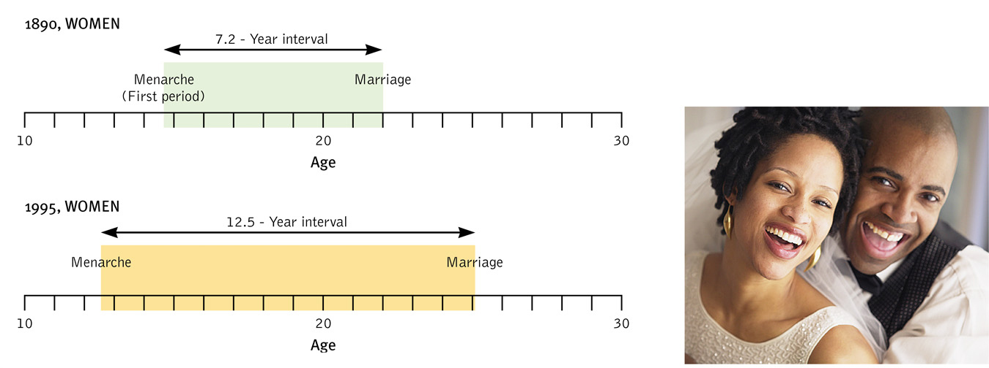
Emerging Adulthood
Emerging adulthood spans ages 18-25. During this time, young adults may live with their parents and attend college or work. On average, emerging adults marry in their mid-twenties.
Ariel Skelley/ Corbis
Notes:
Preview Question 12: What is emerging adulthood?

Slide 53

Adulthood
Although adulthood begins sometime after a person’s mid-twenties, defining adulthood into stages is more difficult than defining the stages of childhood or adolescence.
Rick Doyle/ Corbis

Slide 54
Physical Development
The peak of physical performance occurs around 20 years of age, after which it declines imperceptibly for most of us.
Notes:
Preview Question 13: What physical changes occur during middle and late adulthood?

Slide 55
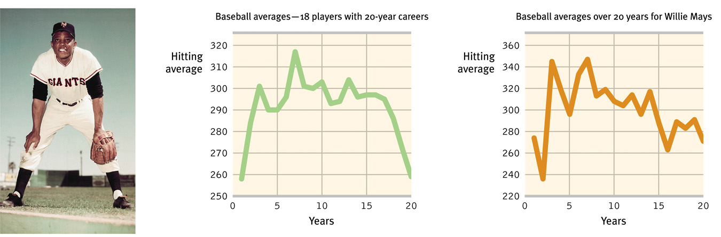
Middle Adulthood
Muscular strength, reaction time, sensory abilities and cardiac output begin to decline after the mid-twenties. Around age 50, women go through menopause, and men experience decreased levels of hormones and fertility.
Bettman/ Corbis
Batting performance of Willie Mays.

Slide 56
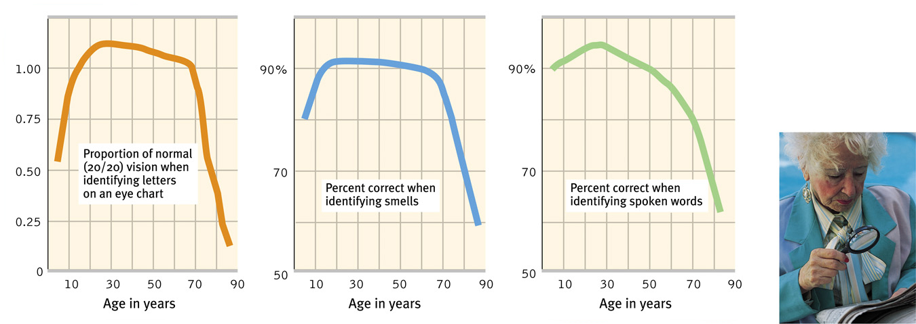
Old Age: Sensory Abilities
After age 70, hearing, distance perception, and the sense of smell diminish, as do muscle strength, reaction time, and stamina. After 80, neural processes slow down, especially for complex tasks.
Michael Newman/ PhotoEdit

Slide 57
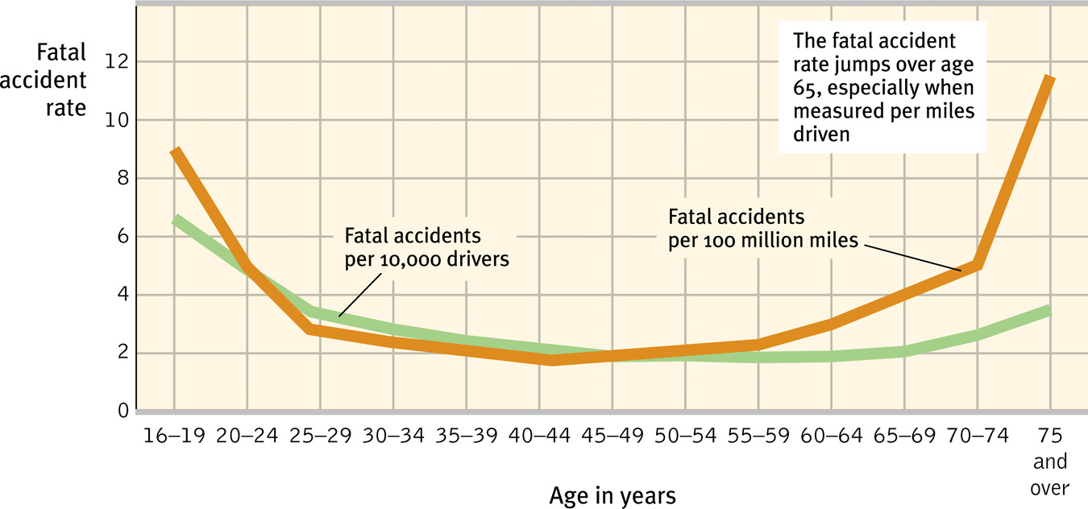
Old Age: Motor Abilities
At age 70, our motor abilities also decline. A 70-year-old is no match for a 20-year-old individual. Fatal accidents also increase around this age.

Slide 58
Cognitive Development
Do cognitive abilities like memory, creativity, and intelligence decline with age the same way physical abilities do?
Notes:
Preview Question 14: How do memory and intelligence change with age?

Slide 59
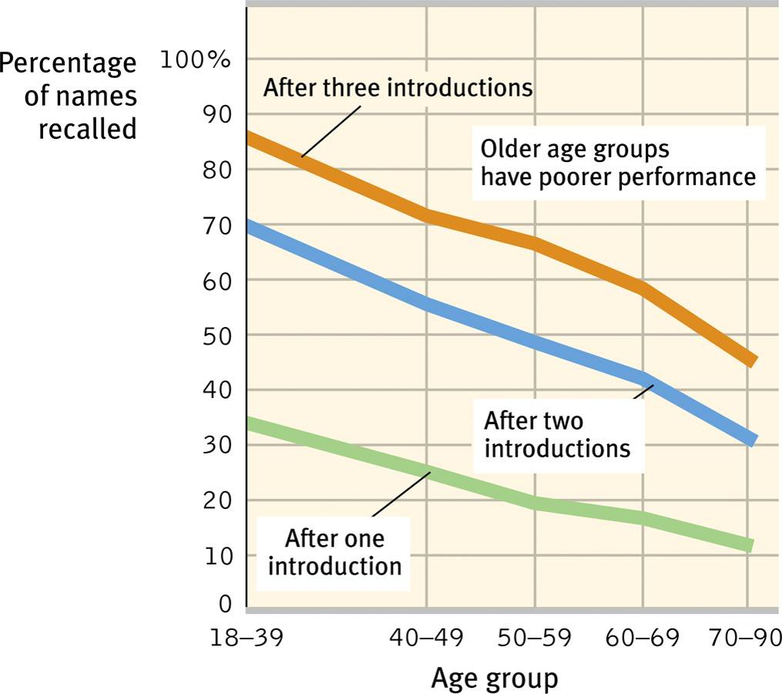
Aging and Memory
As we age, we remember some things well. These include recent past events and events that happened a decade or two back. However, recalling names becomes increasingly difficult.

Slide 60
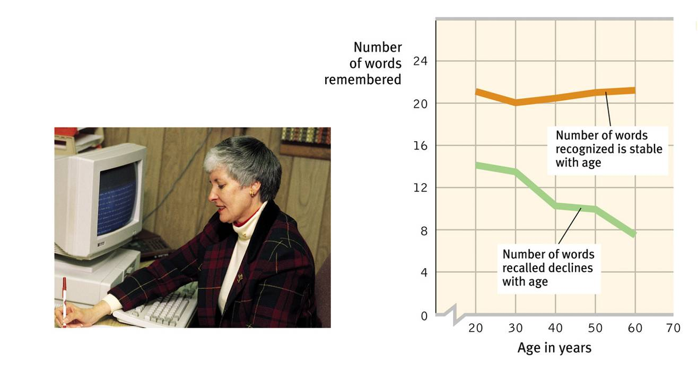
Aging and Memory
Recognition memory does not decline with age, and material that is meaningful is recalled better than meaningless material.
David Myers

Slide 61
Aging and Intelligence
It is believed today that fluid intelligence (ability to reason speedily) declines with age, but crystalline intelligence (accumulated knowledge and skills) does not. We gain vocabulary and knowledge but lose recall memory and process more slowly.

Slide 62
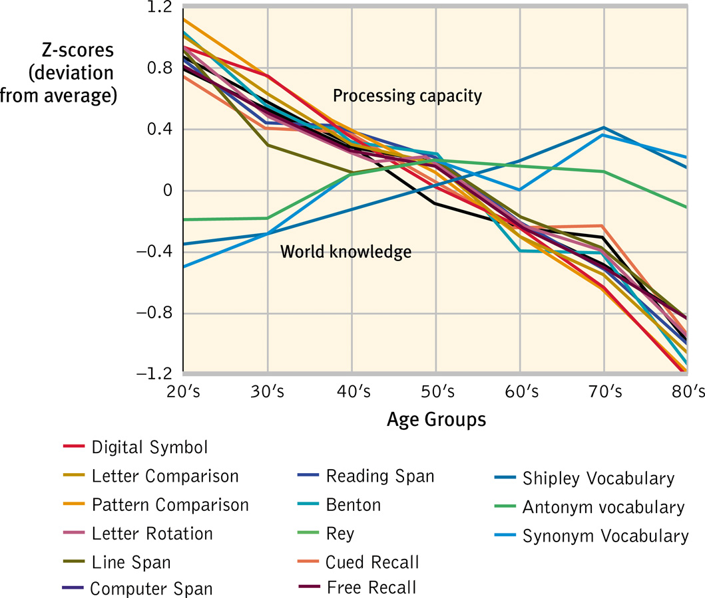
Aging and Intelligence
A number of cognitive abilities decline with age. However, vocabulary and general knowledge increase with age.

Slide 63
Social Development
Many differences between the young and old are not simply based on physical and cognitive abilities, but may instead be based on life events associated with family, relationships, and work.

Slide 64
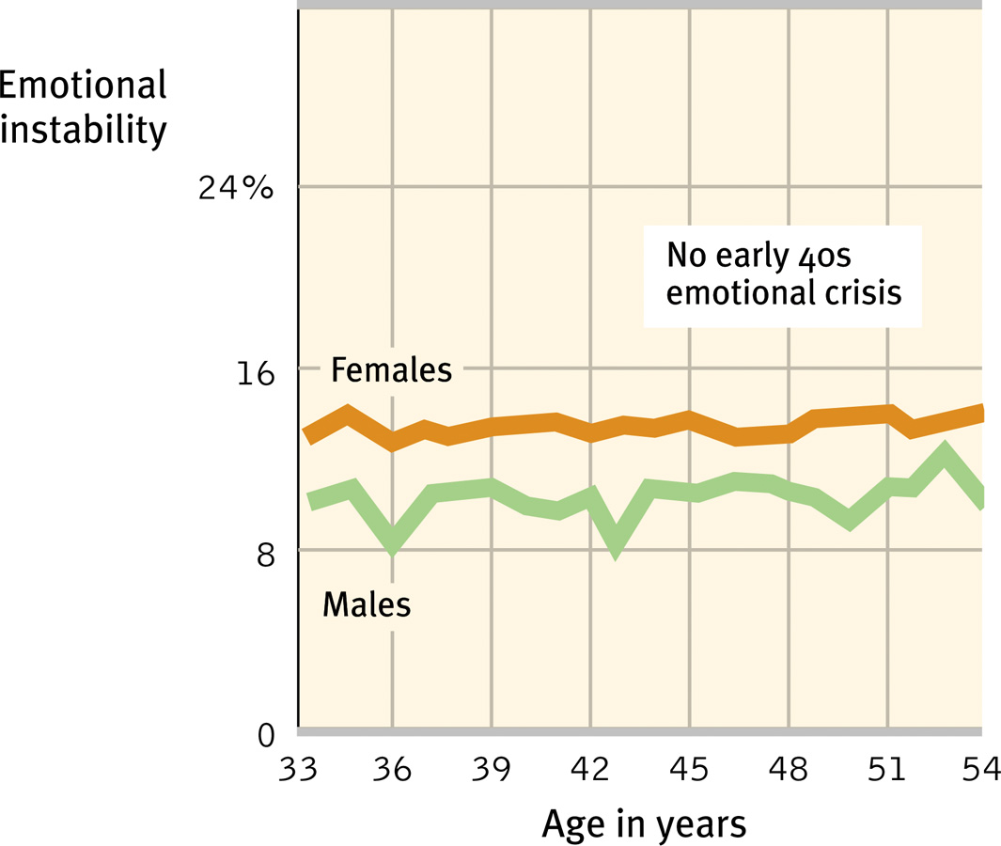
Adulthood’s Ages and Stages
Psychologists doubt that adults pass through an orderly sequence of age-bound stages. Mid-life crises at 40 are less likely to occur than crises triggered by major events (divorce, new marriage).
Neuroticism scores, 10,000 subjects
(McCrae & Costa, 1996).
Notes:
Preview Question 15: What themes and influences mark our social journey from early adulthood to death?

Slide 65
Adulthood’s Commitments
Love and work are defining themes in adult life. Evolutionary psychologists believe that commitment has survival value. Parents that stay together are likely to leave a viable future generation.

Slide 66
Adulthood’s Commitments
Happiness stems from working in a job that fits your interests and provides you with a sense of competence and accomplishment.

Slide 67
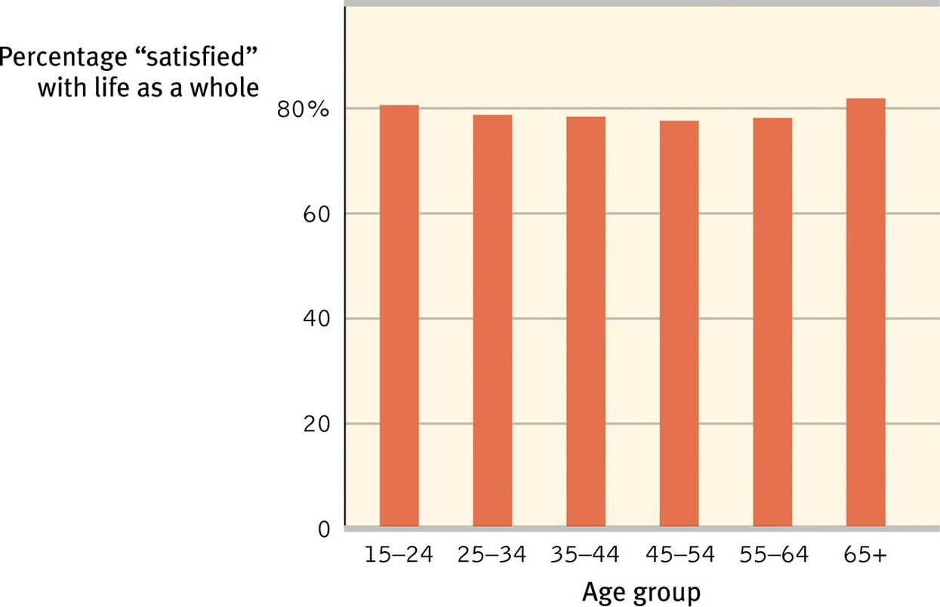
Well-Being Across the Life Span
Well-being and people’s feelings of satisfaction are stable across the life span.

Slide 68
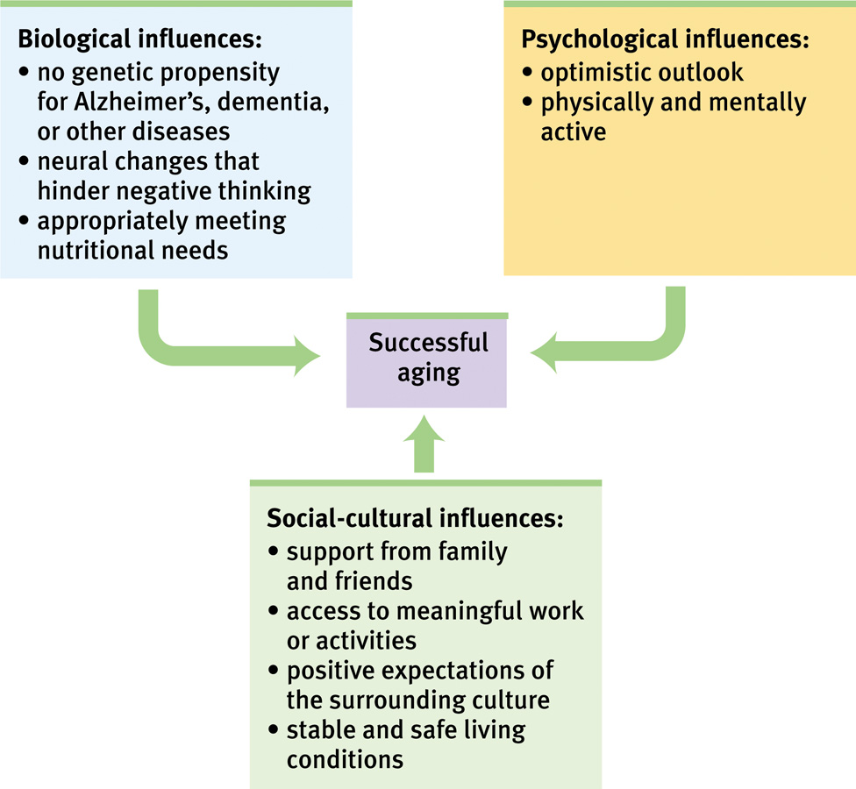
Successful Aging

Slide 69
Death and Dying
The “normal” range of reactions or grief stages after the death of a loved one varies widely. Grief is more severe if death occurs unexpectedly. People who view their lives with a sense of integrity (in Erikson’s terms) see life as meaningful and worthwhile.

Slide 70
Reflections on Two Major Developmental Issues
Continuity and Stages
Researchers who view development as a slow, continuous process are generally those who emphasize experience and learning. Those with a biological perspective, on the other hand, view maturation and development as a series of genetically predisposed steps or stages. These include psychologists like Piaget, Kohlberg and Erikson.

Slide 71
Developmental Issues
Stability and Change
Lifelong development requires both stability and change. Personality gradually stabilizes as people age. However, this does not mean that our traits do not change over a lifetime. Some temperaments are more stable than others.

