Slide 1
Introduction to
(Multi)cultural Education and
Axiological Dimension in
Diverse World
.

Slide 2
What is axiological dimension?
Axiology – philosophical study of values, Greek words „logos“ = word + „axias“ = worth, equivalent x equal ("Equal" and "equivalent" are equivalent, but they're not equal)
at the turn of the 19th and 20th centuries as a study
x
everlasting desire of human beings for values : what is good, what is right?

Slide 3
What is culture?
From latin noun „cultura“ or verb „colere“ = cultivate („cultura animi“ Plato)
CULTivate in religious way
What does it mean CULTIVATE?

Slide 4
Cultivate
Cultivate = take care of something
Agriculture:
„ager“ + „cultura“
= take care of the soil/land/field
to be responsible for, to respond to, to attend to it caringly
To reclaim, be active →
In Czech language zemědělství

Slide 5
Culture
system of things acquired by a member of particular society: language, knowledge, religion, art, law, morals, tradition…
not natural, must be learnt to become a member of a society;
not created by one;
it is collective and anonymous, been created in long-term;
kept by caring;
it units the society and makes it different from another

Slide 6
Culture
Human doings since the 16th century
High culture
Low culture (popular culture) since 18th
nowadays mix of these

Slide 7
Culture
Culture is linked with us = our culture
There are vertical levels:
Family (home, relatives)
  Neighbourhood
    Village / town
      Province / state / county
        Country
Notes:
Coinciding with Bronfenbrenner's bioecological model

Slide 8
Culture
There are horizontal levels of ours:
Nation / ethnicity (now and then)
  Race
    Political views
      Religion
        Socio-economic class (competitive)
          Gender
            Language

Slide 9
5 „Miracles“ of Western Culture
Ancient Greece
Ancient Rome
Jewish-Christian Europe
Gregorian reform
Liberal democracy

Slide 10
Miracle 1
Ancient Greece gifted Western civilization with:
The invention of Polis
Res publica x omnipotent ruler
  Public space – agora
      Rise of word and reason (collective laws)
      Equality before the law (known by all)
      Rule of Law modified by man not by gods
Science-s (experiments, not divination; individual)
→ Schools (read, write, count) but no will to change the world…
Care about soul (cultura animi)

Slide 11
Miracle 2
Ancient Rome gifted Western civilization with:
Rights (no magics, myths, but objective human nature)
Civil Law (root of modern western law)
Personal Ownership (mine → yours) →
The discovery of man
  → individual human persona – human nature and personal nature
  Public (gr) vs. Individual (rom)

Slide 12
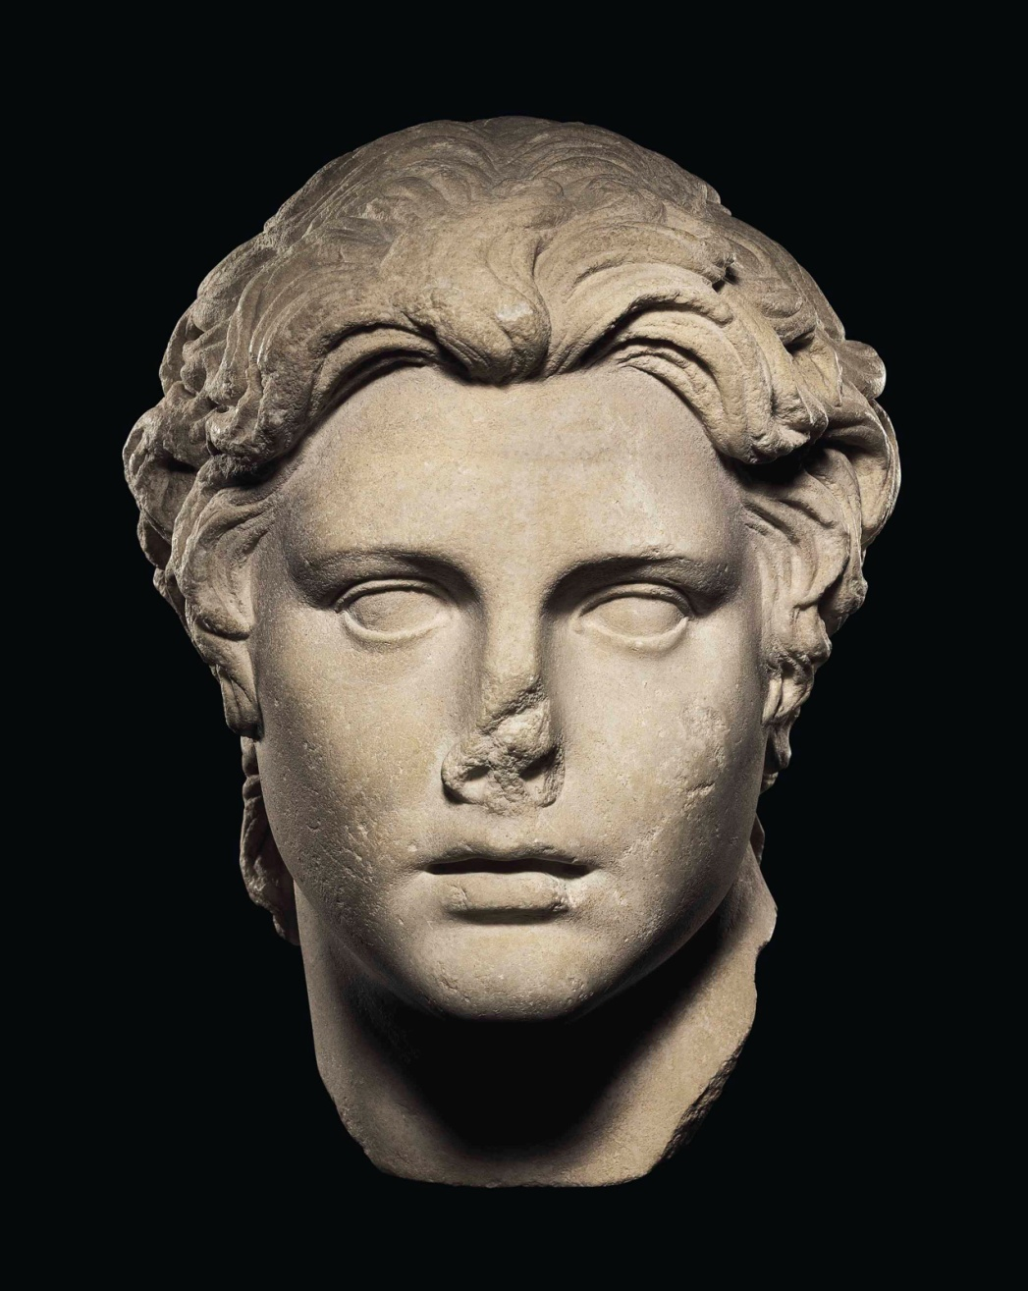
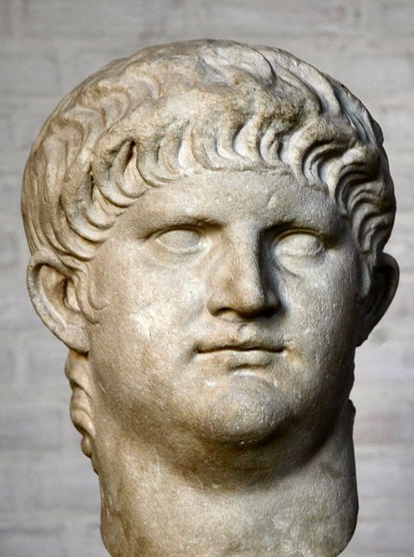
.
.
Notes:
Alexander – no portrait, idealized.

Slide 13
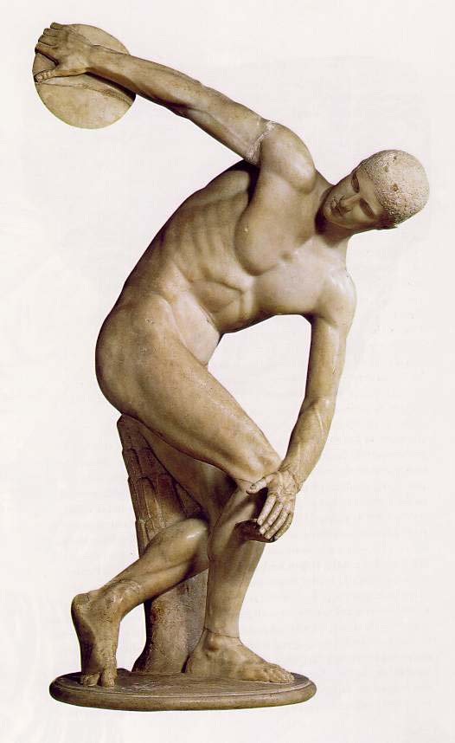
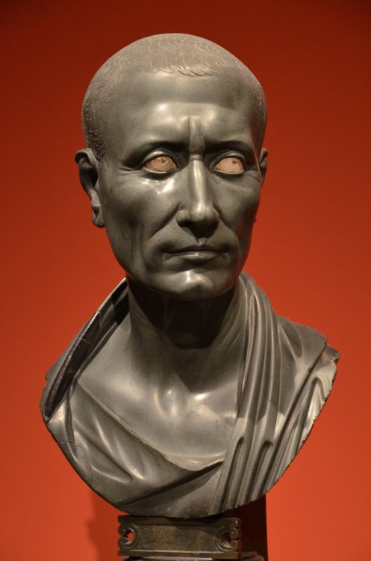
.
Notes:
Julius Caesar – portrait, no hair, scars, wrinkles.

Slide 14
Miracle 3
Jewish-Christian gifted Western civilization with:
Refused to consider evil as a normal part of life
Basis for ethics → justice (done from above) vs. compassion (coming from humans)
Me ↔ You, responsibility for others
Put mercy above justice = injustice
Seneca and Nero (forgiveness vs pardon)
Eschatology:
Cyclic (Myth of the Eternal Return) vs linear time
History , presence , future (not to “nothing new under the sun“)

Slide 15
Miracle 4 – 11th -13th C.
Gregorian reform: reorganization of knowledge, values, laws and institutions → progress (x Islam, China, India, Eastern Europe)
Resurrection of Roman Law - the Roman law became more humane which resurrected and reconciled with biblical ethics, so ethics became less utopian but more oriented on real life
consciously established the use of reason in form of Greek science and Roman law
University – education
One is part of society, every deeds is counted (x monks=deserters from the world → Buddhism x Jesus “Do to others what you want them to do to you.“
Work – curse x changing world in the name of good (roots of economy)
Western x Eastern(orthodox) Europe: horizontal – vertical way
Human responsibility, deeds, reason, work → organization of world → Economical and technological progress
X Eastern – God in the centre, and so Islam did-does since Averroes

Slide 16
Miracle 5
The birth of liberal democracy
de-sacralization of power (exp. 20th C.)
rise of pluralism and modernity
(representative) democracy
Right to vote
Independent justice
Human rights
Religious freedom
Freedom of speech
Diplomacy
Freedom to think and criticize
Market
Industrial revolution

