Slide 1

Theory and Methodology of Education

Slide 2
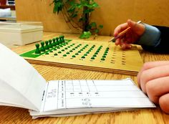
Today´s topics
Alternative Education
School and Family
Multiethnic Classes

Slide 3

School and Family
Mgr. Kateřina Lojdová, Ph.D.
(lojdova@ped.muni.cz)

Slide 4

When you had bad grades in school, how did your parents react?

Slide 5
Case 1
At the same time, I was aware that if I did something wrong at school, I’d also be correspondingly punished for it at home. That’s because my parents think that a teacher is an authority and I have to act accordingly. For this reason, it never even occurred to me to disobey a teacher. (Aleš)

Slide 6
Case 2
Our unexcused disappearance from school led to a reprimand from our school teacher. But it wasn’t really a big deal. After the initial bad feeling, we didn’t really take it too much to heart, and we were lucky that our parents only laughed at the paper with the reprimand which didn’t even affect our final report at all. (Karla)

Slide 7
Theoretical background
Socialization: The comprehensive and consistent induction of an individual into the objective world of a society or a sector of it
Primary socialization is the first socialization an individual undergoes in childhood, through which he becomes a member of society.
Secondary socialization is any subsequent process that inducts an already socialized individual into sectors of the objective world of his society” (Berger, Luckmann, 1999)
The constructed reality: It is learned as objective truth in the course of socialization and thus interalized as subjective reality.

Slide 8
School-family relationship
child belongs to an entire complex of normative worlds, with school being only one of the sub-worlds
secondary socialization is traditionally defined as internalization of institutional or institution-based sub-worlds (Berger & Luckmann, 1967). During this process, however, the child is not a passive object. Children negotiate, share, and create culture with others and one another

Slide 9
School-family relationship
Across human communities, the child is considered to be a member of a small social group – the family. This group provides structural arrangements such as race, cultural and social capital, family traditions, and social status (social and cultural capital).
The structural arrangements of these categories affect the nature of childhood (Corsaro, 2015). During adolescence, children can emancipate themselves from some of their families’ characteristics but not all (Allport, 1958).
Children behave in accordance with their families’ culture and norms (Newly, 2011).

Slide 10
School-family relationship
Woods’ (2012) research shows that middle-class families are more likely to explain school norms to children and more characteristically have a pro-school culture (emphasizing school success, attitude, dress, and middle-class values more broadly).
The family therefore mediates school norms, attributes importance to them and defines sanctions connected with violations of norms at school.

Slide 11
School-family relationship
The importance of the peer group and most importantly the family environment for conforming behavior at school was demonstrated.
In particular, the family environment predisposes students towards having a pro- or anti-school culture. This study found that family culture mediates school norms and strengthens or weakens school sanctions

Slide 12
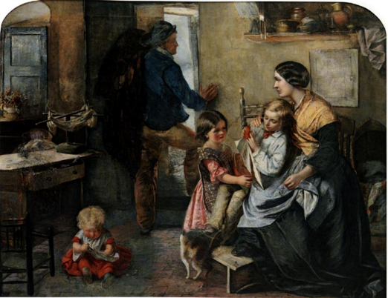
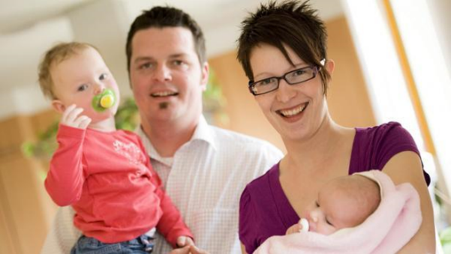
Family nowdays

Slide 13
Family nowdays
Size of a family
Roles (no more patriarchal or father centred or dominated)
Cohabitation and sexual freedom (less moral stigma)
Monogamy?
Ambiguous roles and changeable purpose
Registered partnership
Rising Individualism: Legitimacy of “self-interest” as criteria for decision-making
Secularization of culture and family life
Women’s economic independence

Slide 14
Demography :
Below replacement fertility
Delay marriage and fertility to establish careers
Increases in marital disruption, cohabitation, age at marriage, and nonmarital childbearing are widely shared across industrialized societies.
Highest share of single (non cohabiting) mothers with children
  50% of all births are non marital in Sweden, Denmark, and Iceland, but most are in cohabiting unions. U.S. has higher percent of births outside unions.
  US’s higher divorce rate, and lower rates of cohabitation

Slide 15
Family - definition
a group of people affiliated either by consanguinity (by recognized birth), affinity (by marriage or other relationship), or co-residence orientační (výchozí, původní)
Two types, one tabuu:
incest
"family of orientation": the family serves to locate children socially and plays a major role in their enculturation and socialization
"family of procreation", the goal of which is to produce and enculturate and socialize children

Slide 16
Functions
Reproduction
Provision of Food, Housing and Clothing
Security
Love and Affection
Economic and Social Functions
Socialization

Slide 17
Education in family
Autocratic
In the autocratic style, the leader takes decisions without consulting with others. The decision is made without any form of consultation. In Lewin's experiments, he found that this caused the most level of discontent.
An autocratic style works when there is no need for input on the decision, where the decision would not change as a result of input, and where the motivation of people to carry out subsequent actions would not be affected whether they were or were not involved in the decision-making.
Democratic
In the democratic style, the leader involves the people in the decision-making, although the process for the final decision may vary from the leader having the final say to them facilitating consensus in the group.
Democratic decision-making is usually appreciated by the people, especially if they have been used to autocratic decisions with which they disagreed. It can be problematic when there are a wide range of opinions and there is no clear way of reaching an equitable final decision.
Laissez-Faire
The laissez-faire style is to minimize the leader's involvement in decision-making, and hence allowing people to make their own decisions, although they may still be responsible for the outcome.
Laissez-faire works best when people are capable and motivated in making their own decisions, and where there is no requirement for a central coordination, for example in sharing resources across a range of different people and groups.

Slide 18

Read:
STUDENT NONCONFORMITY AT SCHOOL
http://www.phil.muni.cz/journals/index.php/studia-paedagogica/article/view/1570/1832

Slide 19

Multiethnic Classes

Slide 20
Ethnical diversity
ethnically diverse students: students whose background, ethnicity and experiences differ from the dominant Western culture (Gay 2002)
Czech educational system:
more and more pupils from ethnic or cultural minorities, with various social backgrounds, and also children with all kinds of special needs, especially in connection with the newly introduced inclusive education.
Internal x external diferentation of educational system

Slide 21
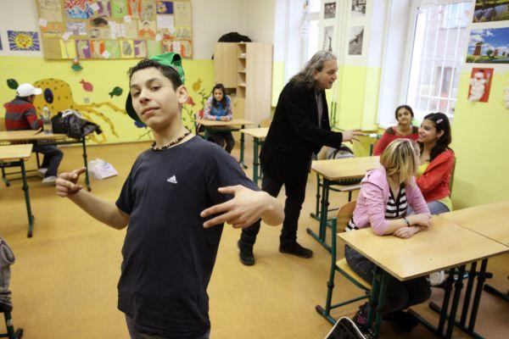
Case 1. Ethnical diversity: Roma children

Slide 22
Research on desegregated classroom
(Obrovská, 2016):
ethnicity primarily becomes visible during ritualised symbolic performances in which the significance of different identities is accentuated
Subculture indentiy of„Roma free style raper“
Baseball caps, sweatpans: pupil´s who do not indentify with school
masculine subculture of friendship practice: low status that Roma students are given in their role as students and the high status in their role as friends
Roma hip hop

Slide 23
Roma hip hop – resources
https://www.youtube.com/watch?v=SRcnnId15BA
https://www.youtube.com/watch?v=qJvZM1A_YpE

Slide 24


Case 2. Ethnical diversity: Migrants - Vietnamiese
5th grade: Tuan

Slide 25
Pupils approaches to ethnical diversity
Making ethnic identities invisible – Vietnamiese
Making ethnic identities visible – Roma childres
What about the teachers, shlould they make ethnic identities visible?
  “It’s necessary to talk about ethnicity because most of the time race takes the backseat to everything,” said Jotham White, another Chapel Hill junior and student facilitator.
  “Once they know that we need to talk about ethnic, we can help students build a positive ethnic identity

Slide 26
STUDENT SIX TIPS
(https://www.kqed.org/mindshift/34806)
Make sure every student feels welcome and part of the class. Small signs that teachers know and are interested in students go a long way to forming trust.
Create a safe space. The way a room is arranged and a teacher’s physical proximity to students can make a difference.
Connect to students' lives. Give students a reason to care about what they're learning by connecting it to situations and concepts that are relevant to their lives.
Connect to students' culture.
Address race and racial dynamics in the classroom.
Connect to students' future selves.

Slide 27
Challenges
conflicts are likely to occur when academics and students originate from different ethnic backgrounds (Weinstein, Tomlinson-Clarke, and Curran 2004)
many academics fail to fully adjust their teaching practices to support and engage students whose background and previous learning experiences may differ
ethnic minority students from across the world arrive in Western HEIs with a rich educational tradition emanating from different philosophies (Kingston and Forland) for example students from South-East Asia place great emphasis and value on the memorisation of the content as a means to deep understanding, reflection which ensures deep intellectual engagement with learning and active silent participation, strong, harmonious group collaboration, incontestable respect for the teacher, problem-solving strategies based on an attentive analysis of past experiences, mediation of a consensus in an argument and high respect for written text rather than spoken words
Solution: intercultural competence of teachers, ability to look beyond major differences between cultural systems, recognise cultural commonalities which could serve as the foundation of the mutual understanding

Slide 28
Literature
Culturally and Linguistically Diverse Classrooms: New Dilemmas for Teachers. 2009. ISBN 9781847692177.
White Teachers, Diverse Classrooms: Creating Inclusive Schools, Building on Students' Diversity, and Providing True Educational Equity. 2010. ISBN 9781579225957.
Managing Diverse Classrooms: How to Build on Students' Cultural Strengths. 2008. ISBN 9781416606246.
White Teachers, Diverse Classrooms: A Guide to Building Inclusive Schools, Promoting High Expectations, and Eliminating Racism. 2006. ISBN 9781579221461.

