Slide 1
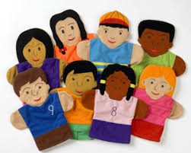
Integrating Drama into the Curriculum
Drama is a rehearsal for life

Slide 2
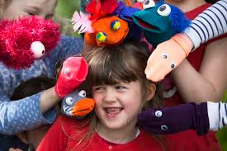
There are multiple benefits to adding Drama to the curriculum:
Communication through verbal and non verbal channels is practiced
New vocabulary, new ideas, new experiences are explored
Students develop confidence, imagination, and creativity
Drama is transformative, it can change our lives, help students to become the persons they dream of being.

Slide 3
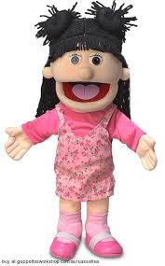
Teachers use Drama in multiple ways
Children can “try on” the characters in a story
Children can pretend to be the planets circling the sun
Children can pretend to be ingredients in making a recipe
Children can dramatize an historical event
Children can pretend to be letters of the alphabet
Children can be the numbers in a Math problem
Can you think of ways to use Drama in teaching?

Slide 4
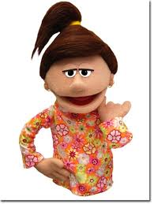
Power of Puppets
Puppets can explain important social and emotional lessons because they make everything a little less personal
Puppets are excellent tools for compassionate teaching
Puppets can teach social skills because they grab a child’s attention instantly
Children do not have language skills to communicate abstract thought so they can “act out” a problem.
As children use puppets to communicate, they learn to see issues from another person’s point of view which teaches them empathy. The added benefit is fun and stress relief.

Slide 5
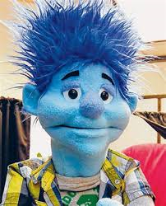
My Ideal Me Paper Bag Puppet
Have you ever dreamed of being taller, shorter, smarter,having green eyes or blonde hair ?
Have you ever wished for an exotic look, more muscles, or captivating smile?
Today we will make your wishes come true.
Project:
Review the Ideal You supplies. Create the ideal you by giving her /him everything to make your dreams come true. You will be asked to introduce your puppet to our class.

