Slide 1
Week 11

Slide 2
The (nearly) end of course mixed bag
TODAY
1. Fun with comparatives and superlatives!
2. Easter homework check
3. Social topic of the day
4. The formal email

Slide 3
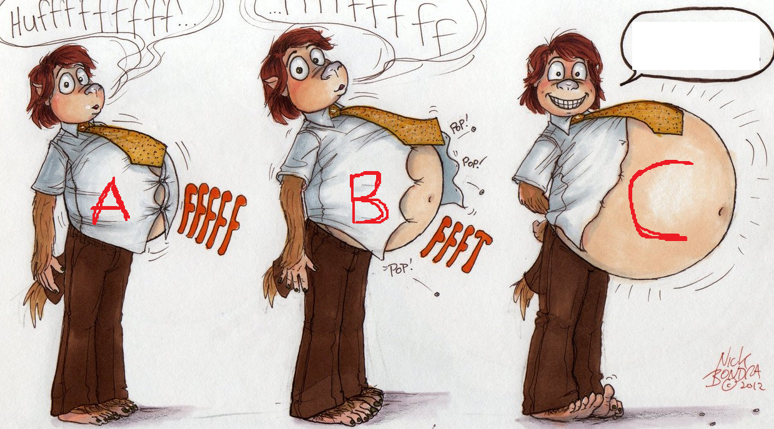
How many comparative or superlative sentences can you make about this picture?
You don’t have to write, but be ready to contribute an answer.

Slide 4
Adjectives
It was his the worst mistake

Slide 5
Look around the room for inspiration and write sentences for each structure:
1. as __ as
2. than
3. much + comparative
4. the + superlative
5. other determiner + superlative

Slide 6
The class is emptier than usual
Those chairs are more lime green than I like.
The wall is whiter than the door.
The chair next to me is as green as the other chairs.
Her hair is as wet as a sewer rat.
The tiles are a little bit darker than the walls.
The colour of the chair is the worst green I have ever seen.
The map of the of the US is smaller than the map of the UK.
My friend is as sociable as my cousin.

Slide 7
Homework check
1. What is the Foster Care Support Foundation? What do they do? How?
2. Remember the video? What happened in it? What did you think about it - as a video/advert for the FCSF?
3. What’s the difference between fostering and adopting?
4. Check 5E and 5F.
5. And 6 - Tracey and Dave’s views on Head Heart Hands.

Slide 8
Abortion
Define the following terms:
  Abortion Pro-life Pro-choice

Slide 9
Abortion is a medical operation in which a developing baby is removed from a woman's body so that it is not born alive.
From: http://www.macmillandictionary.com/dictionary/british/abortion
There are two key adjectives used in the debate about abortion. Pro-life refers to the belief that pregnant women should not be allowed to have an abortion. A person holding these views may also be referred to as a pro-lifer.
On the other hand, pro-choice is used to say that pregnant women should be able to decide whether to have an abortion or not.

Slide 10
Points of view
Task
Read the statements.
Discuss your reaction to them.
Sort the statements into pro-choice (PC) or pro-life (PL).

Slide 11
Formal writing
Sort the letter into the correct order.
What’s the purpose of each section?

Slide 12
Appropriate greeting
Reason for writing
Brief biographical background
Reason for choice of school
Personal qualities
Gratitude
Polite ending
Appropriate sign off

Slide 13
Homework
Choose one of the foreign universities that students from Masaryk University can go on Erasmus to.
Write a motivation letter, asking to be considered for a place at the unviersity, using between 200-300 words.
Follow the structure.
Be specific! - not, ‘your university is very good’
TYPE IT
PRINT IT
BRING IT TO THE NEXT LESSON

