Slide 1
Week 9

Slide 2
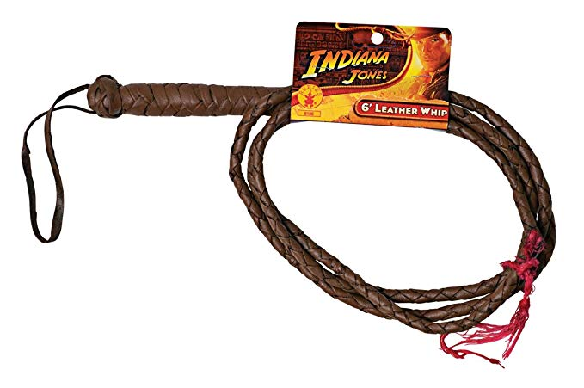
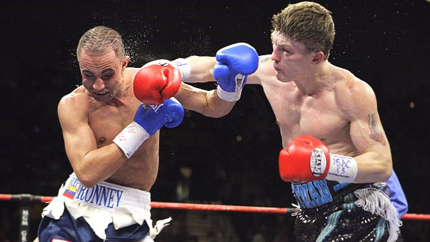
It’s a __________
The verb is to _________
You use it to ________
The man in red has __________ the man in blue.
The verb is to _________
You do this when ________

Slide 4
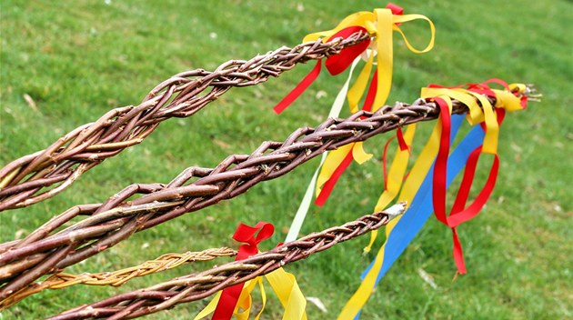
Discussion - explaining Czech Easter traditions to foreigners
1) What’s this?
2) What do you do with it?
3) Why do you do that?
4) Any Easter stories with the Hitting Stick?
5) Hitting stick is ridiculous – give it a new name

Slide 5
Read the article.
What’s your reaction to this?
Do you agree or disagree?
New words? Use the sentence context to guess the meaning, then check your dictionary.

Slide 6
Turn the page.
There are three comments from those that have read the article. Which of them do you agree/disagree with?
Choose one comment and write a short response. You can support a comment, or argue against it. Perhaps you can draw from personal experience?

Slide 7
Imagine you work in a primary school.
It’s nearly Easter, and your class of 10 year old pupils are discussing Czech traditions. What advice would you give 1) the boys, 2) the girls, 3) everyone to make sure that the Easter holiday is fun for everybody.
The pupils’ parents are interested in your lesson. In addition to the advice you gave the children, what advice could you give to the parents?
Write 10 pieces of advice. Use a variety of language structures.

Slide 8
RAPID FIRE QUESTION TIME
What’s a family?
What’s a close relative?
Who is your mum’s oldest sister’s son to you?
What’s the difference between being separated and being divorced?
Why do people get divorced? Give three reasons.
Why don’t people (in unhappy marriages) get divorced? Give three reasons.

Slide 9
Video time!
We’re going to watch a clip. Before each section, you will see an image from the clip and a question. Make notes for the answer.
The actors speak quite quickly. If you don’t hear what they say, use the context to guess the answer.
https://www.youtube.com/watch?v=CnO25IzzYgU

Slide 10
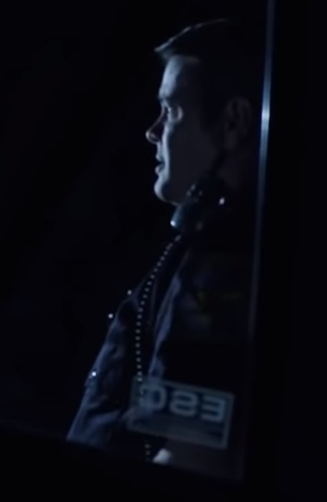
What happened?
Who is he talking to?

Slide 11
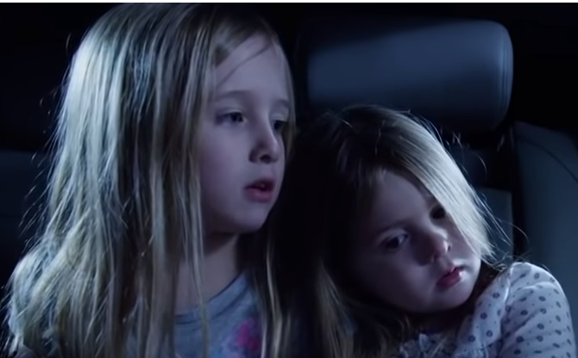
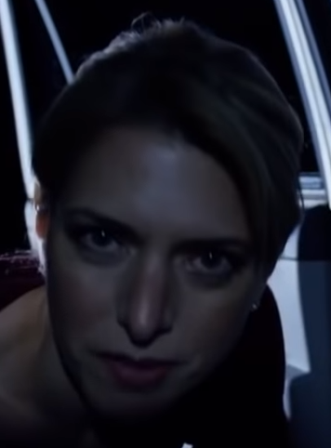
What are their names?
Apart from names, what else do we know about them?

Slide 12
Who are they?
Why are they in this clip?
What is the woman worrying about?

Slide 13
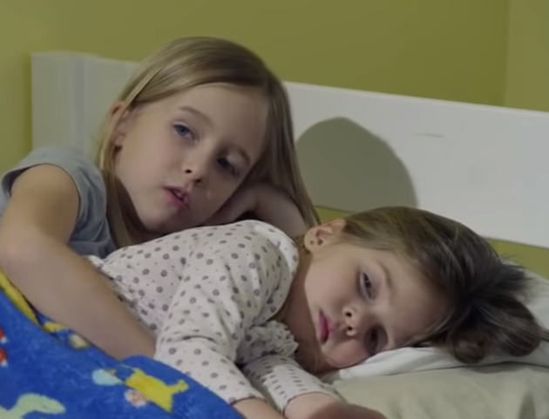
Before we watch – what problems are the girls likely to have on their first night?
After watching – what was the problem?

Slide 14
Does what?
How does it do that? What do you see?

Slide 15
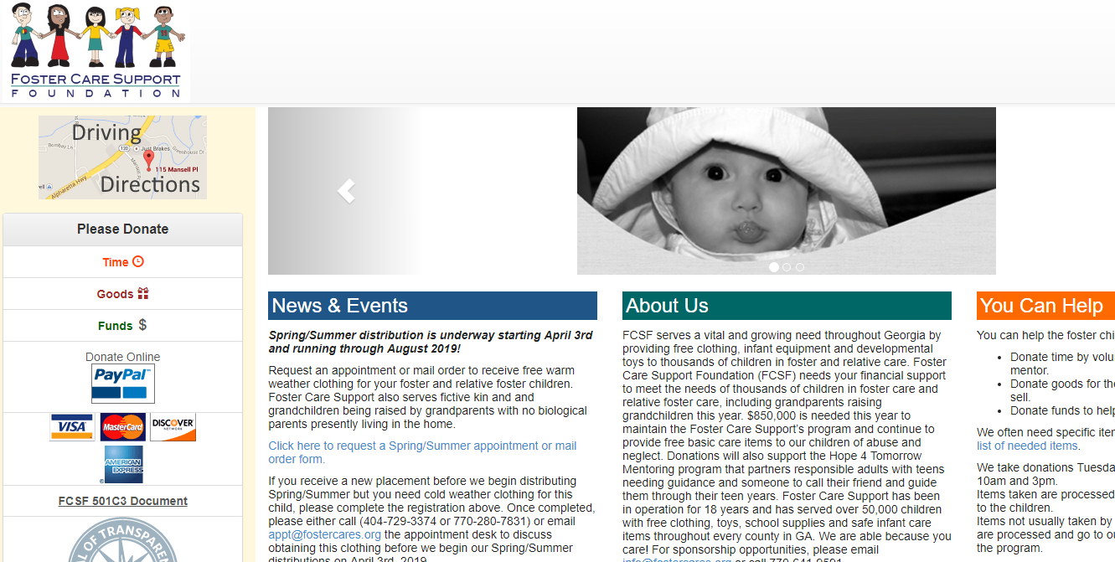

Slide 16
Convert your assigned word!
How many forms can you find?
Adopt | Arrange | Assess | Break | Legal | Meet | Permanent | Responsibility

Slide 17
Complete the sentences with the correct form of the verb
1. You ______________ the law if you don’t officially inform the local authority of any private fostering arrangements you are aware of.
2-3. A local authority needs to be able to ______________ both the child’s needs and the carer’s capacity to ______________ those needs.
Complete the sentences with the correct form of the word
1-4. ______________ (ADOPT) is when someone takes a child home with them ______________ (PERMANENT) and the child is ______________ (LEGAL) theirs. Fostering on the other hand is different in that the ______________ (ARRANGE) is only temporary, although official too. Foster parents simply do not become the child’s legal parents.
5. The child will stay with a ______________ adult. (RESPONSIBILITY)
6-7. It's a crime not to tell the local authority about a fostering ______________ you know about. (ARRANGE)

