Slide 1
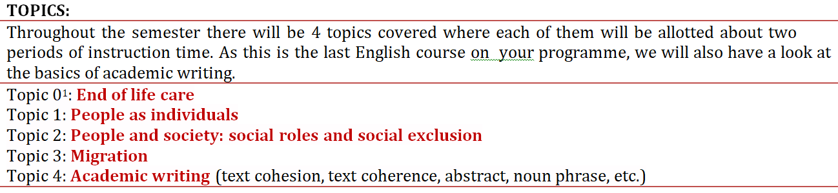

Slide 2
Assessment:
Two pieces of writing:
Academic abstract
Feedback on a classmates abstract

Slide 3
On a sheet of paper, write the numbers 1 - 10 down the side.
For each number, write a word that can be used to start a question.
Example:
1. Why
2.
3.
4.
5.
6.
7.
8.
9.
10.

Slide 4
What are the main stages of life? Complete the tale with the apropriate stages and ages.
STAGE | AGE RANGE
Newborn - infancy | 0-3

Slide 5
STAGE | AGE RANGE
Conception
Newborn - infancy | 0 - 3
Childhood | 4 - 11
Adolesence | 11 - 18
Adulthood | 18 - 64
Old age | 64+

Slide 6
Task
Imagine an average person from an average social background near the end of the adulthood stage. What might be the positive and negative aspects of their life?
Is/was the same true for your grandparents?

Slide 7
POSITIVES | NEGATIVES
May have more disposable income as mortgage may have been paid off. | Deteriorating health
May make more informal friends through active social life. | May feel isolated as may have lost social network of formal friends.
Time to take up new leisure activities | Unable to take part in former activities

Slide 8
The aging process is subtle and the changes can be slow.
How does the body change as it moves into old age? What begins to deteriorate?

Slide 9
1) The skin becomes thinner and less _______. _______ appear on the face.
2) _______ become more brittle an so more likely to _______.
3) Joints become ________ and more painful.
4) Height is reduced as the _______ may become more rounded.
5) Muscles become __________.
break | weaker | stiffer
spine | wrinkles | bones
 | elastic

Slide 10
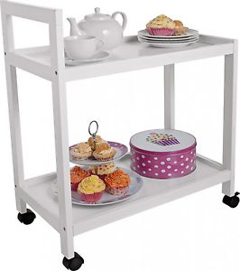

What situations are likely to occur in a senior care home?

Slide 11
You work at Oakbrook Home, a care home for the elderly. While at work one day, the following incidents all take place at the same time:
1. Mary (91) has wet herself.
2. Harry (76) is having an argument with Ann (79), who is very frail and deaf. Harry has a walking stick and is hitting the wall with it.
3 A member of staff puts the tea and biscuits out on a trolley then tells you that he is ‘going out for a few minutes’.
4. The telephone rings in the office.
5. The emergency buzzer from the bathroom is sounding (= going off)
6. Avis (88) keeps shouting ‘Out! Out!’ and is heading to the front door.
1. What priority would you give to these situations?
2. What further information would you like to know before taking action?
3. How did you decide what to do?

Slide 12
Completing the task:
Work alone – dictionary/translators can be used
Plan your response
Write-up your response (clearly!)
Think about the different language structures and vocabulary you can use
Have a computer? Type your response!

Slide 13
Homework - introduction letter
Mr and Mrs Sunderland are in their eighties and have daily help from a home warden. You
are the new worker. Their previous worker, Michelle Rutter, was unable to introduce you personally to the Sunderlands before she left, but promised them that you would write a letter of introduction.
The case notes are brief, but you read of complaints that Mr Sunderland has hit his wife on two occasions, but there is no note of this being discussed with Mr or Mrs Sunderland. Mr
Sunderland has complained about damp in the council flat and the previous worker has written a letter to the local Housing Department about this.
Task
Write your letter of introduction. Keep it short (no more than 80 words), and to the point.
Upload your letter to the IS homework vault.

