Slide 1
Week 10

Slide 2
1 minute speech – open topic
2 minutes of question and answer – back/and forth - joint interaction, as conversational as possible – not interviewer and interviewee!
What did you
What were you

Slide 3
What makes people happy? Complete the sentences with answers about yourself, your family, your friends, or people in general. Most will need a preposition.
1. Being admired for admired sport
2. Being part of society
3. Doing really well in/at social work
4. Falling in love
5. Having enough money for a holiday
6. Having lots of friends
7. Having time to spend with family/on + something
8. Living with my boyfriend
9. Not having to answer questions in front of the class
10. Winning at (game)

Slide 4
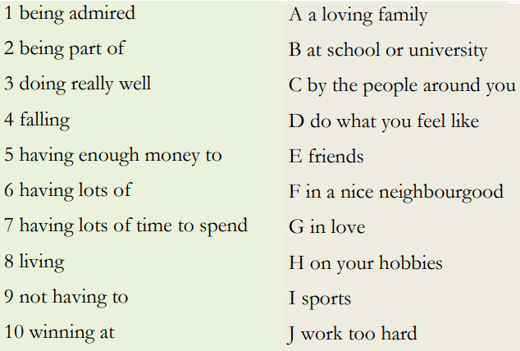

Slide 5
Personal Identity
Introduction
What makes you, you?
If we put all your knowledge, memories and beliefs into another's brain, is it still you?
If we are able to recreate every cell of your body and create your identical twin, is it you?
If someone with your memories and beliefs could undergo the same experiences, would it still be you?

Slide 6
Discussion
1. In your view, who are you?
2. What makes you, YOU?
3. What's your personal identity?
4. What roles do you have (mother, wife, son, uncle, worker, teacher, friend, boyfriend) and do you identify with them or not?
When you have exhausted your discussion, write a two-three sentence summary.

Slide 7
Questions - divide the questions with your partner
1. If you met a professional football player, what would you assume their values were - as in, what drives or motivates them?
2. What could happen if a person’s personal values don’t match with society’s values?
3. How do children form their identities?
4. What are teenagers dealing with (in connection to their identity?
a. They are trying to decide their future values, job and role in society
b. They are dealing with having many identities, one for each social group
c. Not much, they are just copying their parents identities
5. How does a person realise their best potential?
6. Knowing your identity makes you less depressed, more confident, happy, able to live in harmony with yourself

Slide 8
Language check
1. Which is correct:
a. a persons identity b. a person’s identity - apostrophe
2. Psychologists believe that finding one's identity is a matter of “finding oneself” by matching one’s skills and talents with available social roles. What does ‘is a matter of’ mean?
a. Finding your identity INVOLVES matching your skills and talents to social roles.
b. Finding your identity DOES NOT MEAN matching your skills and talents to social roles.
c. Finding your identity MUSN'T MEAN matching your skills and talents to social roles.
3. "Sadly, these values might not be the same" - What is the opposite of 'sadly'?
4a. What does "un" mean in unfulfilling, uncertainty, unfortunately?
4b. What other words take the un-?
Happy, likely, comfortable(ly), known, believable, able, natural, opened, available
5. If something doesn’t feel right, how does it feel? List as many as you can think of.
Uncomfortable, unwell/off, unnerved, unsure, unhappy, anxious (adj) anxiety (noun), wrong

Slide 9
Academic writing homework check

Slide 10
Homework
Academic Writing - Task 7 - read the instructions on page 13 before attempting the activity
Next week 30/4, we’ll be looking at...
Exam essay writing
Past questions, past answers, dos and don’ts
In two weeks 7/5, we’ll be watching ...
Abstract/dissertation presentations - supported by data/statistic/sources

