Slide 1
Week 7

Slide 2
Complete the sentences with a phrasal verb in the correct form
1. I’m having my birthday party tomorrow, but I _____________ - I don’t like being the centre of attention!
2. Now that she had a lot of spare time, Lucy decided to ____________ badminton.
3. When the power went out, they had to ___________ the information in an old, dusty encyclopedia.
4. Can you ___ me ____ at the station this evening?
5. He never really __________ his wife cheating on himwith the binman.

Slide 3
Complete the prepositional phrases
1) Do you have a friend that you can always rely ___ ?
2) When did you last complain _____ something? Who did you complain ____?
3) What do you think Krtek worries ______?
4) Think of an author/singer/director. What are they most known ______?
5) If you were famous, what would you like to be famous _____?

Slide 4
Homework
Academic writing Task 3.
Check your answers with your partner(s).

Slide 5
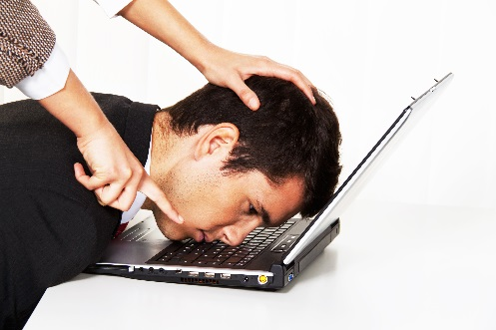
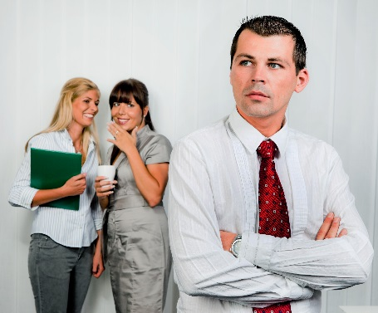
What is happening - be specific!
What are the impacts of this behavior in the workplace?

Slide 6
1. Define bullying. Bullying is ...
2. Do you think there are cultural differences in bullying - for example, would a German and a Swede give the same definition of bullying?
3. Are there differences in the way that men and women bully?

Slide 7
What are the differences between the word pairs?
1. humiliate v embarrass
2. feedback v advice
3. stalk v follow
4. discrimination v harrassment
5. intimidate v feel afraid
6. gossip v slander

Slide 8
Choose a word pair and write a sentence to demonstrate the difference between the words.
Example:
1a. I was humiliated when the head teacher called me an idiot in front of my students.
1b. I felt embarrassed when I realised that I should have blown my nose before opening the door.

Slide 9
Watch the video
What are examples of inappropriate workplace behaviour?
New words or phrases? Write them down! We’ll share and discuss them at the end of the clip.
https://www.youtube.com/watch?v=wz_hyeK5fBE&feature=related

Slide 10
Background (Describe the situation)
1. Identify the key players.
2. Identify the actions/ behaviours.
3. Identify the impact of the behavior.
Evaluation (Analyze the situation)
1. Determine if the details are fact or opinion.
2. Determine if the behavior is acceptable or bullying.
3. Determine if the impacts are mild or severe.
Recommendations (Suggest how to solve the problem)
1. Determine if any action is necessary.
2. If not, explain why the behavior is acceptable and of mild impact.
3. If so, suggest a specific course of action to address the situation.
4. Suggest strategies for preventing this situation from re-occurring.

Slide 11
Homework
Academic Writing - Task 5A - E

