Slide 1
Week 6

Slide 2
Last week’s phrasal verbs - what do you remember?
to look forward to
to take up
to run out of
to look up
to get over something
to pick up – to drop off
to pick on = tease/bully

Slide 3
Tell me two things that...
1... people look forward to
2... a person having a mid-life crisis might take up
3... that is very hard to get over
4... a teenager does to let their parents down
5... the supermarket might run out of at christmas
6... you would use to look something up

Slide 4
This week...
carry on cut down put off - delay
take in turn down - decline turn up
Choose your task
1) give a one word synonym for each phrasal verb
OR
2) explain its meaning using as many words as necessary

Slide 6
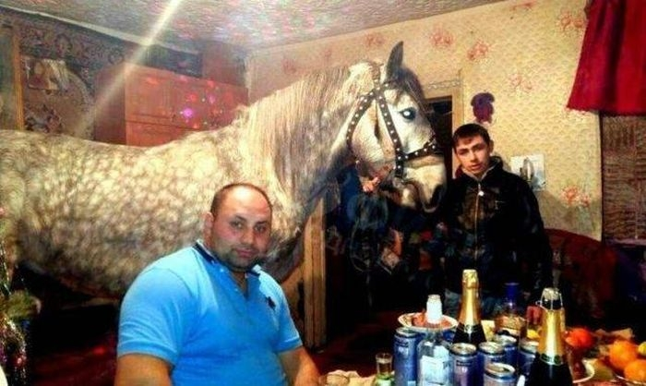

Slide 7
RP

Slide 8
More last week
Abstracts
Peer check
grammar
spelling
content

Slide 10
Also last week
We started to discuss social exclusion. What does social exclusion mean?
People can be excluded for any number of reasons. Each of you should give me one reason.unusual behaviour, appearance, skin colour, political affiliation, age, religion, homelessness, disabled
Why might governments be concerned about those that are excluded?

Slide 11
The teenage perspective
Watch the video and make notes on the following: (https://www.youtube.com/watch?v=OMbYEyBeSsU)
How is the word exclusive perceived?
Positively – exclusive offer/club/hotel
What was the positive thing about her experience?
Interacted with many people from different backgrounds
What advice does she give those that feel excluded?
Talk to / talk about (something) to (someone) / confide in – confidential
What’s your opinion of the video?
Not my cup of tea

Slide 12
How does the image on the next slide relate to social exclusion?

Slide 14
Watch and listen. Make notes on the following:
1. What are the features that make people different?
DNA, different experiences, fingerprints, iris
2. What could and should be flat and smooth?
The path to inclusion
3. The neural pathways that we use are the same for ourselves and for who? In the group
4. What is the presenter's image of a competent pilot?
(https://www.youtube.com/watch?v=zdV8OpXhl2g) to 4m23
(https://www.youtube.com/watch?v=YPkKEttKIQU) Monkey Dust

Slide 15
Can I play too?
https://www.youtube.com/watch?v=wKUTyGoAg8c

Slide 16
Homework
Academic Writing - Task 3 (A - E)
Next lesson we’ll begin with prepositional phrases. If you have time, look over the prepositional phrases work sheet.

