Slide 1
Classrooms of the world

Slide 2
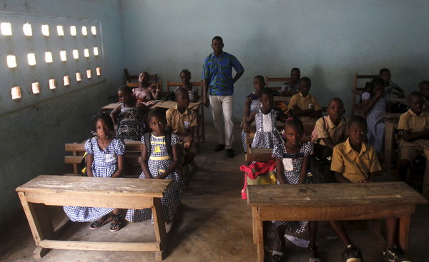

Slide 3
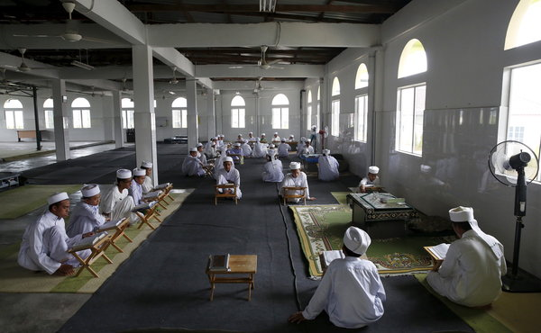

Slide 4
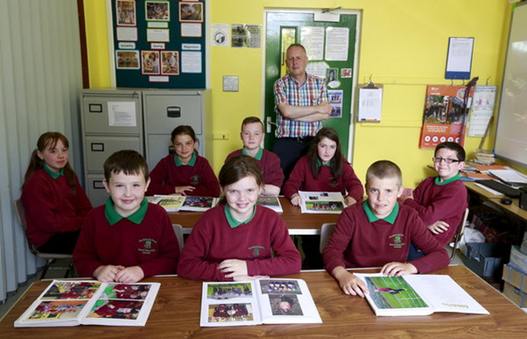

Slide 5
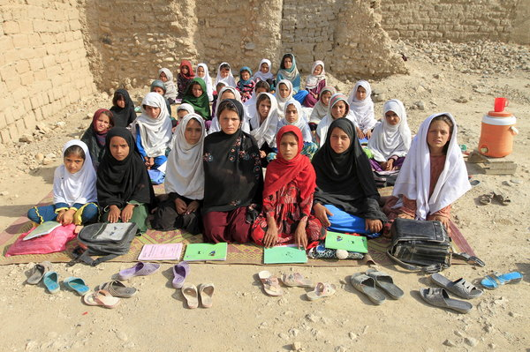

Slide 6
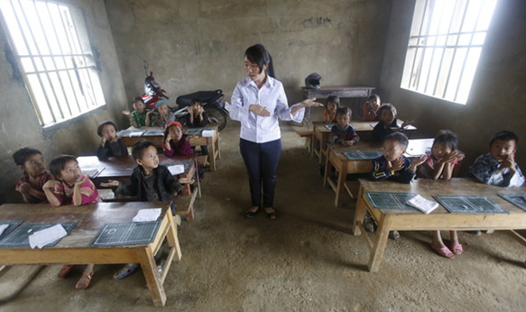

Slide 7
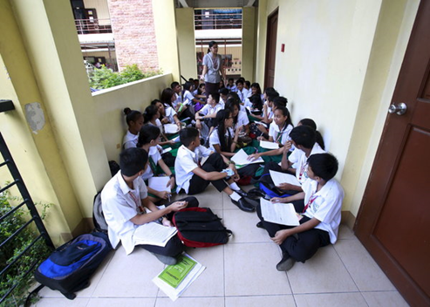

Slide 8
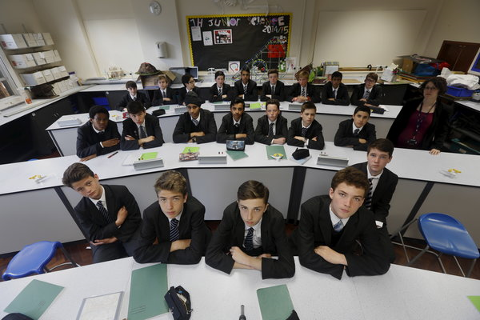

Slide 9
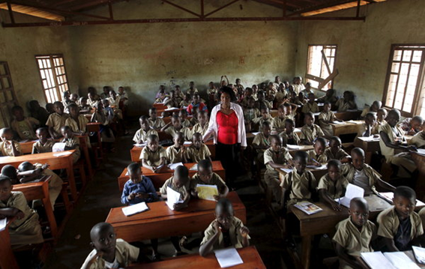

Slide 10
Abidjan, Cote d’Ivoire Abidjan, Cote d’Ivoire

Slide 11
Kuala Lumpur, Malaysia

Slide 12
Northern Ireland, U.K

Slide 13
Jalalabad, Afghanistan

Slide 14
Vietnam

Slide 15
Manila, Philippines

Slide 16
London, England

Slide 17
Bujumbura, Burundi

