Slide 1
self-development
26th Feb 2018

Slide 2
self-determination theory
Deci and Ryan
http://selfdeterminationtheory.org/
autonomy
relatedness
competence

Slide 3
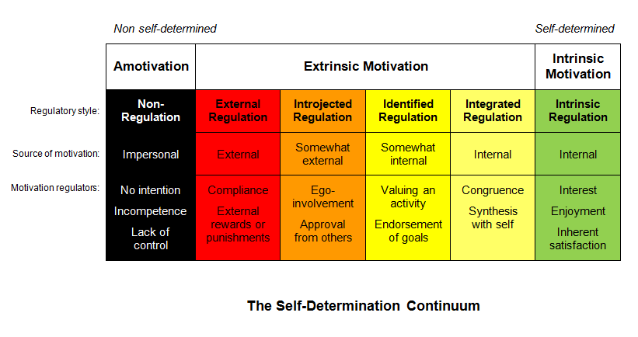
motivation

Slide 4
poster session

Slide 5
life-long, life-deep, life-wide LEARNING
http://agile.taylors.edu.my/thesa/about-thesa/

Slide 6
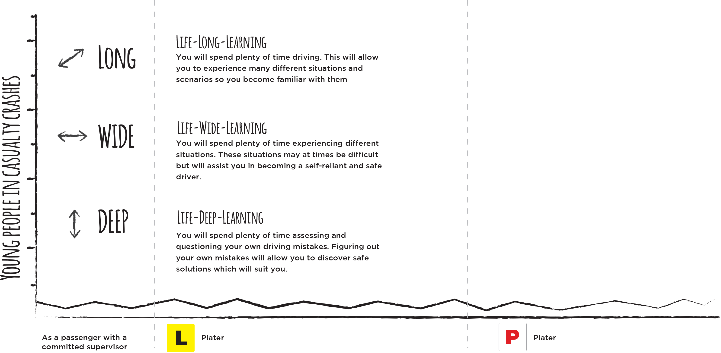
life-long, life-deep, life-wide LEARNING
http://www.leyladrivingschool.com.au/the-solution/

