Slide 1
Prevention of oncological diseases
Teaching lesson 2
Written by: Zdeňka Smejkalová, Jitka Slaná Reissmannová

Slide 2
Prevention of oncological diseases
Primary prevention:
  Focuses on the healthy population, the aim is to prevent the onset of cancer.
  Elimination of risk factors.
Secondary prevention:
  Focuses on the identification of neoplastic disease in the initial curable stage.
  Elimination of development of the disease.
Tertiary prevention:
  Applies to patients with cured oncological disease.
  The aim is especially to avoid the recurrence of the disease.

Slide 3
Primary prevention
Non-smoking
Lower consumption of alcohol
Balanced diet
Sufficient physical activity
Protected sexual intercourse
Lower promiscuity
Use of sunscreens with UV factor
Lower exposure to sunlight
Breastfeeding for at least 6 months
Rest

Slide 4
Preventive recommendations – nutrition
Suitable for prevention
Unsuitable for prevention
Fruit, vegetables
Wholemeal products, legumes
Fish meat
Cooked and stewed dishes
Diets containing all levels of the food pyramid
Regular, adequate and varied diet
Smoked and oversalted food
Red meat and offal (excessive consumption)
Baked, fried, smoked and grilled dishes

Slide 5
Food pyramid
(1)

Slide 6
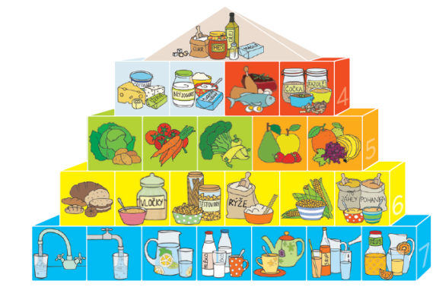
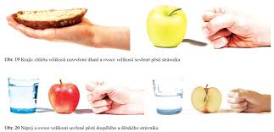
Food pyramid
Number of blocks = number of portions
1 portion = clenched fist, open palm
1 portion of drink = 250 ml
(2)

Slide 7
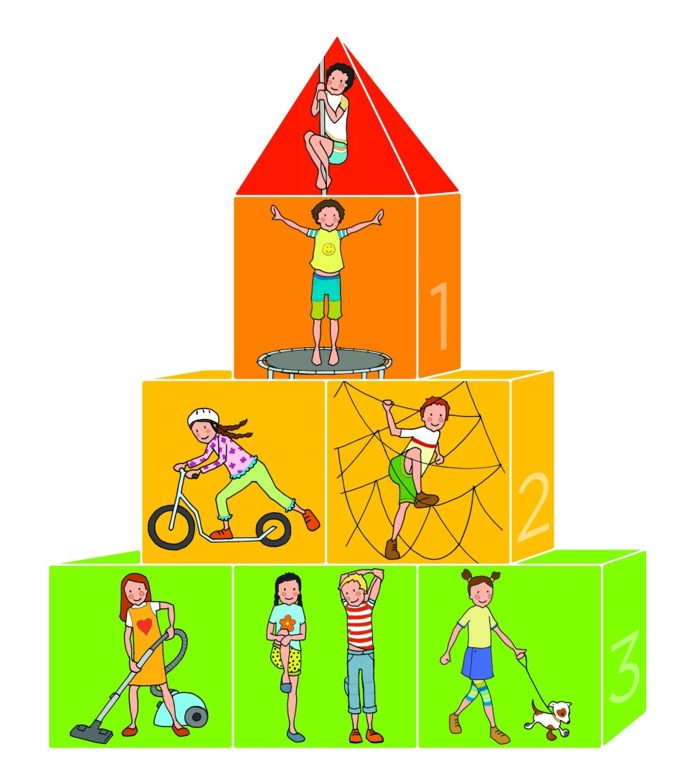
Preventive recommendations – physical activity Physical activity pyramid
Uphill running, running upstairs, pole climbing
Vigorous cycling, fast running (30 minutes)
Fast walking, running, physical games, cycling, skating (60 minutes)
Normal walking, slow walking, standing, housework (60–90 minutes)
(3)

Slide 8
Secondary prevention
Preventive examination by general practitioner
Self-examination of breasts and testicles
Screening programmes
  Screening: regular examination of the target population with no signs of the disease.
  Breast cancer examination = mammography
  Colorectal cancer examination = FOBT (faecal occult blood test), colonoscopy
  Cervical cancer examination

Slide 9
References
Pohyb a výživa: šest priorit v pohybovém a výživovém režimu žáků na 1. stupni ZŠ: pokusné ověřování účinnosti programu zaměřeného na změny v pohybovém a výživovém režimu žáků ZŠ. Praha: Národní ústav pro vzdělávání, 2014. ISBN 978-80-7481-069-5.
Prevention of tumour diseases. Masarykův onkologický ústav [online]. c2009-2018, 3.11.2017 [cit. 2018-09-10]. Retrieved from: https://www.mou.cz/prevence-nadorovych-onemocneni/t3017
TESAŘOVÁ, Petra. Terciární prevence vzniku zhoubných nádorů/rakoviny [online]. c2015–2017 [cit. 2018-05-02]. Retrieved from: http://www.pruvodce-onemocnenim.cz/dvd/zhoubny-nador#video-3-1
TOMÁŠEK, Jiří. Onkologie: minimum pro praxi. Praha: Axonite CZ, 2015. Asclepius. ISBN 978-80-88046-01-1.
VORLÍČEK, Jiří, Jan ŽALOUDÍK a Rostislav VYZULA. Onkoprevence pro českou republiku. Linkos: Lékař a multidisciplinární tým [online]. c2018, 30. 4. 2009 [cit. 2018-05-10]. Retrieved from: https://www.linkos.cz/lekar-a-multidisciplinarni-tym/prevence-a-skrining/onkoprevence-pro-ceskou-republiku-1/
Figures:
(1): Výživová doporučení pro obyvatelstvo ČR [online]. 2005 [cit. 2018-06-26]. Retrieved from: https://ris.uhk.cz/idv/zdravi/soubory/scan/13_rub.jpg
(2), (3): Pohyb a výživa: šest priorit v pohybovém a výživovém režimu žáků na 1. stupni ZŠ: pokusné ověřování účinnosti programu zaměřeného na změny v pohybovém a výživovém režimu žáků ZŠ. Praha: Národní ústav pro vzdělávání, 2014. ISBN 978-80-7481-069-5.

