Slide 1
Oncological disease of the testicles
Teaching lesson 6
Written by: Zdeňka Smejkalová, Jitka Slaná Reissmannová

Slide 2
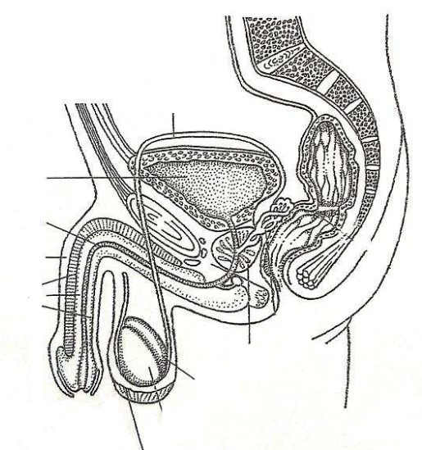
Testicular cancer
Petr Koukal’s dream journey – video
Testicles = testes
Part of internal male genitals
Egg-shaped pair organs
The testicles are located in the scrotum
Main functions
  Production of germ cells – sperm cells
  Production of sex hormone – testosterone
Sperm ducts
Urinary bladder
Urethra
Penis
Erectile bodies
Prostate
Epididymis
Testicle
Scrotum
(1)

Slide 3
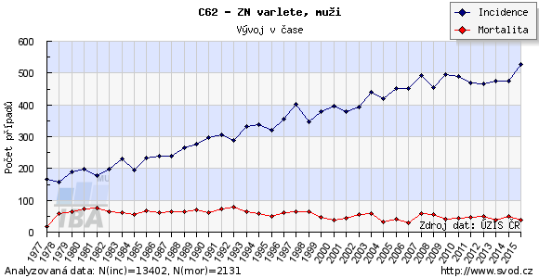
Occurrence of testicular cancer
(2)

Slide 4
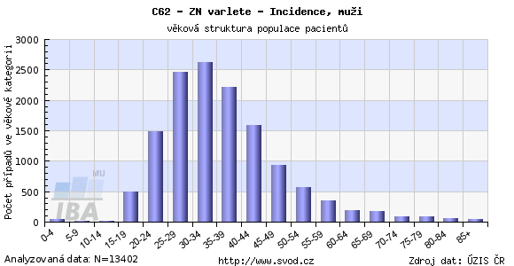
Testicular cancer is one of the most frequent neoplastic diseases in men aged 15-35 years!
(3)

Slide 5
Risk factors
Cryptorchidism = undescended testicle
  The testicle is withheld in the inguinal canal or the abdominal cavity.
  If not descended within 6 months after birth, surgical treatment must be undergone.
  Treatment must take place within 18 months.
Inheritance

Slide 6
Symptoms
Irregularity, palpable lump, bumps on the testicle
Changes in size
Stiff or hard testicle
Pain in the testicle, groin or lower abdomen
Enlargement and swelling of the mammary glands
Fatigue, lack of appetite, weight loss
In case of any deviations from normal state, the physician must be consulted immediately!
Later stage of disease

Slide 7
Prevention
Primary prevention
  Observing general principles of prevention of neoplastic diseases
Secondary prevention
  Self-examination of testicles

Slide 8
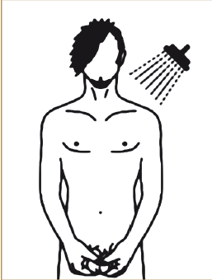
Self-examination of testicles
To be carried out regularly once a month.
Should be performed after a warm bath or shower, palpation is easier and pain-free.
(4)

Slide 9
First of all, visual examination is performed.
Any changes in the scrotum skin are identified in the mirror.
The skin should not be tight, reddish or darker compared with the previous examination.
Both size and volume must be checked.
Each testicle is palpated separately.
The testicle should be grasped by both hands – index fingers and middle fingers should be positioned under the testicle and the thumbs on the front side.
The testicle is then gently turned between the fingers.
(5)

Slide 10
It is important not to confuse a tumour and the epididymis.
The epididymis is adjacent to the rear edge of the testicle.
The same procedure is applied for the other testicle.
TASK: On the picture identify the epididymis and the shape that could be a tumour.
Tumour
Epididymis
(6)
Self-examination of testicles – video

Slide 11
References
Co jsou nádory varlat. Maskoule.cz [online]. c2010 [cit. 2018-05-06]. Retrieved from: http://www.maskoule.cz/co-jsou-nadory-varlat/
KLENER, Pavel. Klinická onkologie. Praha: Galen, 2002. ISBN 80-7262-151-3.
PYCHOVÁ, Marcela, Jan TRACHTA a Luboš ZEMAN. Nesestouplé varle. Česká urologická společnost [online]. 7. 4. 2015 [cit. 2018-05-06]. Retrieved from: http://www.cus.cz/pro-pacienty/detska-urologie-2/nesestouple-varle/
Figures:
(1): Rozmnožovací soustava [online]. 2018 [cit. 2018-06-10]. Retrieved from: http://docplayer.cz/6531963-Centralni-nervova-soustava-nervova-soustava-micha-mozek-centralni-nervovou-soustavu-tvori-a.html
(2), (3): Novotvary 2015 ČR [online]. Praha: Ústav zdravotnických informací a statistik ČR, 2015. [cit. 30/04/2018]. Retrieved from: http://www.uzis.cz/publikace/novotvary-2015
(4), (5), (6): SMEJKALOVÁ, Zdeňka a Jitka SLANÁ REISSMANNOVÁ. My se raka nebojíme aneb prevencí ke zdraví. Brno: Masarykova univerzita, 2018. ISBN 978-80-210-9060-6.

