Slide 1
Oncological disease of the skin
Teaching lesson 7
Written by: Zdeňka Smejkalová, Jitka Slaná Reissmannová

Slide 2
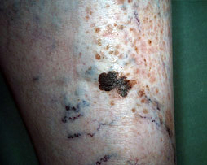
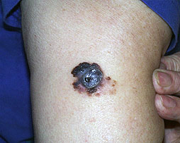
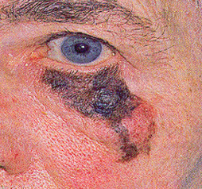
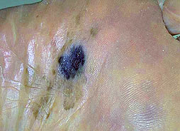
Skin cancer
Melanoma = very dangerous type of skin cancer
Inconspicuous spot
Extensive metastases at a later stage
(1)

Slide 3
Occurrence of skin cancer
Skin cancer is the most frequent neoplastic disease!
(2)

Slide 4
(3)

Slide 5
Risk factors
Ultraviolet radiation (UV radiation) – comes from sunshine
Excessive sunbathing
Repeated sunbathing
Excessive sunbathing in childhood
Absence of sun protection creams
Persons classified as phototype 1 and 2
Persons with a large number of birthmarks
Solaria
Inheritance

Slide 6
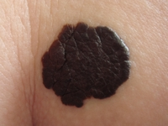
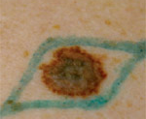
Symptoms
A warning sign should be any change on the skin, mostly this is a change in the birthmark!
(4)

Slide 7
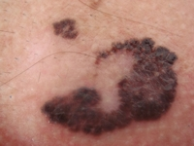
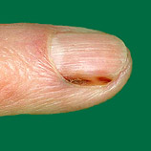
Symptoms
Change in birthmark colour (usually dark colour)
Spotty appearance
Change in size, surface spreading of the birthmark
Irregular edges
Bleeding or itching birthmark
The melanoma is a pigmented spot, which gradually changes
Spots under nails
A malignant tumour may resemble a wart, callus, or bruise
(5)

Slide 8
Prevention
Avoid direct exposure to sunshine (between 11 a.m. and 3 p.m.)
Use of sunscreens with protective factor
Stay in a shade
Avoid solariums
Self-examination of the skin – three times a year
Skin cancer – video

Slide 9
References
ARENBERGER, Petr. Maligní melanom a ostatní nádory kůže. Linkos [online]. c2018, 10.9.2014 [cit. 2018-05-07]. Retrieved from: https://www.linkos.cz/pacient-a-rodina/onkologicke-diagnozy/maligni-melanom-spinaliom-bazaliom-c43-44-d03/maligni-melanom-a-ostatni-nadory-kuze/
Kožní nádory. Vitalion [online]. c2018 [cit. 2018-05-07]. Retrieved from: https://nemoci.vitalion.cz/kozni-nadory/
Melanom.cz [online]. 2018 [cit. 2018-05-08]. Retrieved from: http://www.melanom.cz/
VOJAČKOVÁ, Naděžda a Michaela FRIDRICHOVÁ. Kůže a její ochrana: obecné informace pro pacienty. Praha: Liga proti rakovině, 2013. ISBN 978-80-260-5064-3.
Figures:
(1), (4), (5): Melanom.cz [online]. 2018 [cit. 2018-05-08]. Retrieved from: http://www.melanom.cz/
(2), (3): Novotvary 2015 ČR [online]. Praha: Ústav zdravotnických informací a statistik ČR, 2015. [cit. 30/04/2018]. Retrieved from: http://www.uzis.cz/publikace/novotvary-2015

