Slide 1
European Code Against Cancer
Teaching lesson 9
Written by: Zdeňka Smejkalová, Jitka Slaná Reissmannová

Slide 2
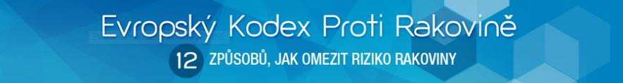
European Code Against Cancer
12 recommendations supporting the prevention of tumour diseases.
Respecting these principles leads to a decrease in the prevalence of the disease and mortality.
The European Code includes both primary and secondary prevention.
(1)

Slide 3
Do not smoke. Do not use any form of tobacco.
Make your home smoke free. Support smoke-free policies in your workplace.
Take action to be a healthy body weight.
Be physically active in everyday life. Limit the time you spend sitting.
Have a healthy diet:
  Eat plenty of whole grains, pulses, vegetables and fruits.
  Limit high-calorie foods (food high in sugar or fat) and avoid sugary drinks.
  Avoid processed meat, limit red meat and foods high in salt.
If you drink alcohol of any type, limit your intake. Not drinking alcohol is better for cancer prevention.
Avoid too much sun; especially for children. Use sun protection. Do not use sunbeds.
In the workplace, protect yourself against cancer-causing substances by following health and safety instructions.

Slide 4
Find out if you are exposed to radiation from naturally high radon levels in your home. Take action to reduce high radon levels.
For women:
  Breastfeeding reduces the mother’s cancer risk. If you can, breastfeed your baby.
  Hormone replacement therapy (HRT) increases the risk of certain cancers. Limit use of HRT.
Ensure your children take part in vaccination programmes for:
  Hepatitis B (for newborns).
  Human papillomavirus (for girls).
Take part in organized cancer screening programmes for:
  Bowel cancer (men and women).
  Breast cancer (women).
  Cervical cancer (women).

Slide 5
References
Evropský Kodex Proti Rakovině. International Agency for Research on Cancer. [online]. © 2016 [cit. 2016-12-31]. Retrieved from: http://cancer-code-europe.iarc.fr/index.php/cs/
Figures:
(1): Evropský Kodex Proti Rakovině. International Agency for Research on Cancer. [online]. © 2016 [cit. 2016-12-31]. Retrieved from: http://cancer-code-europe.iarc.fr/index.php/cs/

