Slide 1
Oncological diseases
Teaching lesson 1
Written by: Zdeňka Smejkalová, Jitka Slaná Reissmannová

Slide 2
Neoplastic diseases
neoplastic diseases = oncological diseases
A neoplastic disease is defined as a growth of tissue, which is out of control and grows independently of the organism.
Oncology
  Medical branch that deals with the issue of neoplastic diseases
  Derived from the Greek onkos = crab

Slide 3
Basic terms
Non-malignant = benign tumours
Malignant tumours
Uncontrolled cell division
Slow growth
Delimited structure
Do not spread through the surrounding tissues
Pressure on the surrounding tissues
Surgical removal
No secondary tumours
Uncontrolled cell division
Aggressive growth
Damage and pressure on the surrounding tissues
Surgical removal
Spread through the surrounding tissues
Development of metastases
Spread through blood and lymphatic channels
Death of the organism

Slide 4
Basic terms
Metastasis
Risk factor
= new secondary (subsidiary) source of malignant tumour.
= factor that increases the probability of the onset of neoplastic disease.
Internal and external risk factors

Slide 5
Risk factors
Risk factor | Increased risk of neoplastic disease
Smoking | Lung cancer, oral cavity cancer, pharynx cancer, larynx cancer, oesophagus cancer Pancreatic cancer, urinary system cancer
Alcohol | Oral cavity cancer, pharynx cancer, larynx cancer, oesophagus cancer Colon cancer, liver cancer, breast cancer
Poor diet | Colorectal cancer, stomach cancer, prostate cancer, lung cancer Breast cancer, uterine cancer
Overweight, obesity | Uterine cancer, breast cancer, colorectal cancer, gall bladder cancer
HPV infection | Cervical cancer
UV radiation | Skin cancer

Slide 6
Risk factors
Other risk factors include:
  Decreased physical activity
  Stress
  Frequent menstruation
  Late or no pregnancy
  Short-term or no breastfeeding
  Inheritance
  Age
  Gender
Internal risk factors

Slide 7
Neoplastic diseases in the Czech Republic
The second most frequent cause of death!
Most frequent neoplastic diseases
  Skin cancer
  Prostate cancer in men, breast cancer in women
  Colorectal cancer
  Lung cancer

Slide 8
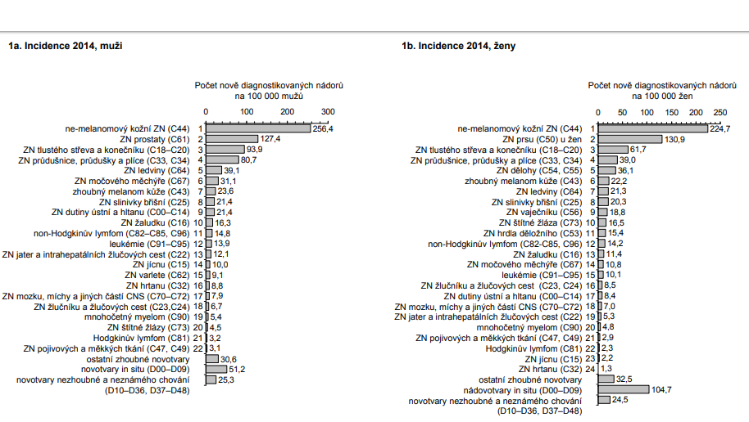
(1)

Slide 9
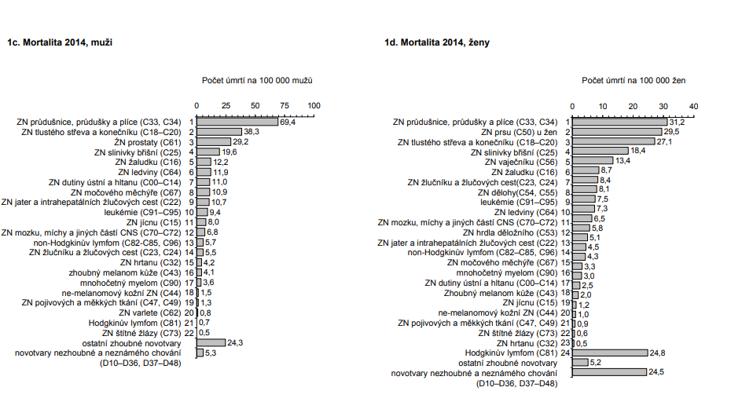
(2)

Slide 10
References
ADAM, Zdeněk, Marta KREJČÍ a Jiří VORLÍČEK. Obecná onkologie. Praha: Galen, 2011. ISBN 978-80-7262-715-8.
HOLEČKOVÁ, Petra. Rakovina žaludku: obecné informace pro pacienty. Praha: Liga proti rakovině Praha, 2011. ISBN 978-80-260-0672-5.
Novotvary 2015 ČR [online]. Praha: Ústav zdravotnických informací a statistik ČR, 2015. [cit. 2018-04-30]. Retrieved from: http://www.uzis.cz/publikace/novotvary-2015
TOMÁŠEK, Jiří. Co je nádorové onemocnění [online]. c2015–2017 [cit. 2018-04-30]. Retrieved from: http://www. pruvodce-onemocnenim.cz/dvd/zhoubny-nador#video-3-1
VOKURKA, Martin a Jan HUGO. Praktický slovník medicíny. 10th updated edition Praha: Maxdorf, 2011. ISBN 9788073452629.
Figures:
(1), (2): Novotvary 2015 ČR [online]. Praha: Ústav zdravotnických informací a statistik ČR, 2015. [cit. 2018-04-30]. Retrieved from: http://www.uzis.cz/publikace/novotvary-2015

