Slide 1
Oncological disease of the cervix
Teaching lesson 5
Written by: Zdeňka Smejkalová. Jitka Slaná Reissmannová

Slide 2
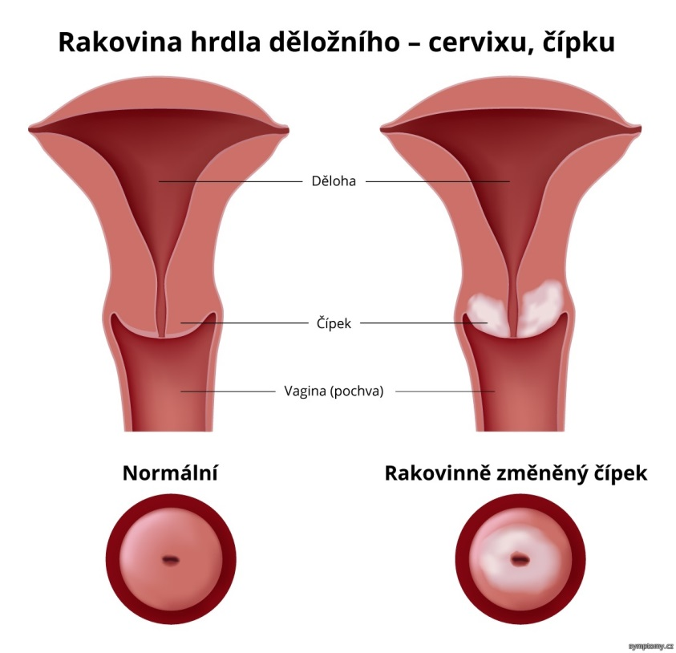
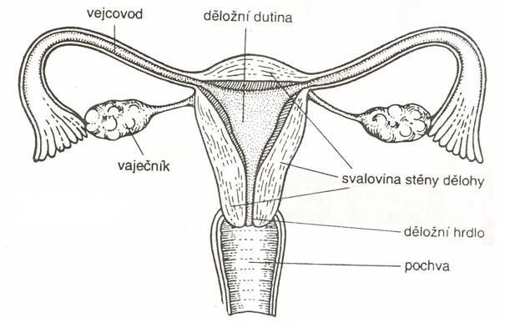
Oncological disease of the cervix
Cervix (cervix uteri in Latin)
Structure of female reproductive system
(1)
(2)

Slide 3
Occurrence of cervical cancer
(3)

Slide 4
(4)

Slide 5
Risk factors and symptoms
These signs need not necessarily mean a neoplastic disease, but certainly should be given attention!
Risk factors
Symptoms
HPV infection
Promiscuity
Selection of a partner with risky sexual behaviour
Sexual intercourse at a young age
Unprotected sexual intercourse
Smoking
Immunity disorders
There are usually no symptoms in the pre-cancer stage and initial stage.
Symptoms of late cancer stage
Pain in the lower abdomen
Bleeding other than menstruation
Pain during sexual intercourse
Discharge from the vagina
Pain during urination

Slide 6
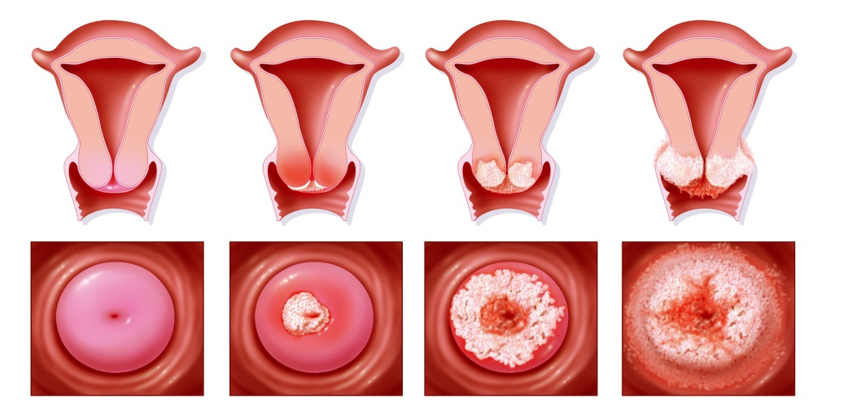
HPV
Human papillomavirus
The main factor of the onset of cervical cancer
Transmitted by sexual intercourse
Can also be transmitted by touching
(hand – genital, genital – genital)
Men can also be infected by the virus
Men are mostly carriers
Development of cervical cancer
(5)
healthy uterus – 1st neoplastic stage causing an inflammatory response – 2nd neoplastic stage covering the whole cervix – 3rd neoplastic stage reaching the vagina and surrounding parts

Slide 7
Prevention of cervical cancer
General primary prevention rules
Preventive gynaecological examination once a year
Delaying the first sexual intercourse (preferably until 18 years of age)
Partner stability
Protected sexual intercourse using a condom
HPV vaccination

Slide 8
Screening of cervical cancer HPV vaccination
Screening
HPV vaccination
Detection of pre-cancer stage or initial cancer stage.
Cervical smear is taken during regular gynaecological examination.
For the purposes of cancer prevention, girls should be first examined after the beginning of sexual life, but for the first time should see the gynaecologist at the age of 15.
Vaccination is not the only protection against HPV!
Girls between 13 and 14 year and boys at the age of 13 years have this vaccination paid by the health insurance company.
Vaccination and screening – video

Slide 9
References
Lidský papilomavirus. Cervix [online]. 2018, 6. 3. 2014 [cit. 2018-05-05]. Retrieved from: https://www.cervix.cz/index.php?pg=pro-verejnost--lidsky-papilomavirus-hpv
Rakovina děložního čípku. Cervix [online]. 2018, 18. 12. 2017 [cit. 2018-05-05]. Retrieved from: https://www.cervix.cz/index.php?pg=pro-verejnost--rakovina-delozniho-cipku--prevence
Rakovina děložního čípku. Vitalion [online]. c2018 [cit. 2018-05-05]. Retrieved from: https://nemoci.vitalion.cz/rakovina-delozniho-cipku/
Figures:
(1): Ženské pohlaví "pod lupou". Kalíšek.cz [online]. 2017 [cit. 2018-05-05]. Retrieved from: http://kalisek.cz/zenske-pohlavi-pod-lupou
(2): Rakovina děložního čípku. Symptomy [online]. 2017 [cit. 2019-03-20]. Retrieved from: https://www.symptomy.cz/nemoc/rakovina-delozniho-cipku
(3), (4): Novotvary 2015 ČR [online]. Praha: Ústav zdravotnických informací a statistik ČR, 2015. [cit. 30/04/2018]. Retrieved from: http://www.uzis.cz/publikace/novotvary-2015
(5): Nenech to náhodě! Rakovina děložního čípku už si nemusí vyžádat život žádné ženy. Marianne [online]. 2019 [cit. 2019-03-20]. Retrieved from: https://www.marianne.cz/clanek/nenech-nahode-rakovina-delozniho-cipku-uz-si-nemusi-vyzadat-zivot-zadne-zeny

