Slide 1
Oncological disease of the lungs
Teaching lesson 8
Written by: Zdeňka Smejkalová, Jitka Slaná Reissmannová

Slide 2
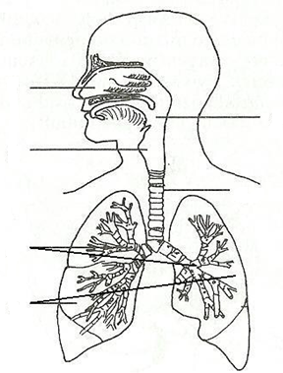
Oncological disease of the lungs
Structure of the breathing system
Paired respiratory organ
Main functions
Exchange of respiratory gases between air and blood
Air passages frequently have
metastases of other tumours, but these
tumours are not classified as lung cancer.
Nasal cavity
Pharynx
Larynx
Trachea
Bronchi
Lungs
(1)

Slide 3
Occurrence of lung cancer
Lung cancer is the fourth most frequent neoplastic disease!

Slide 4
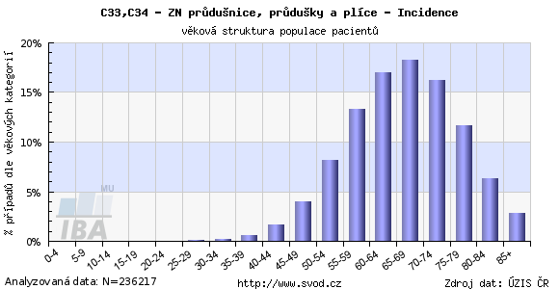

Slide 5
Risk factors and symptoms
Risk factors
Symptoms
Smoking
Active smoking = smoke is inhaled by the person who IS SMOKING.
Passive smoking = smoke is inhaled by a person who IS NOT SMOKING.
Low-quality environment
Genetic factors
There are usually no symptoms in the initial stage.
Symptoms of late cancer stage
Cough – the most frequent sign of lung cancer
Blood coughing
Pain in the chest
Hoarseness, difficult swallowing
Loss of appetite, weight loss, temperature, fatigue

Slide 6
Prevention of lung cancer
Non-smoking – the most important preventive measure
Avoiding passive smoking
Preventive programmes in school

Slide 7
References
MACHOVÁ, Jitka. Biologie člověka pro učitele. Second edition. Praha: Univerzita Karlova v Praze, nakladatelství Karolinum, 2016. ISBN 978-80-246-3357-2.
Rakovina plic. Vitalion [online]. c2018 [cit. 2018-05-09]. Retrieved from z: https://nemoci.vitalion.cz/rakovina-plic/
Faktory zevního prostředí, vliv na zdraví, prevence. Manuál prevence v lékařské praxi [online]. 2008 [cit. 2018-09-14]. Retrieved from: http://www.szu.cz/manual-prevence-v-lekarske-praxi
DIENSTBIER, Zdeněk a Evžen SKALA. Co bychom měli vědět o rakovině. Praha: Liga proti rakovině Praha, 2014. ISBN 978-80-260-7710-7.
Figures:
(1): Respiratory system. Volny-cas-uceni-cz [online]. c2015 [cit. 2018-06-12]. Retrieved from: https://volny-cas-uceni-cz.webnode.cz/prirodoveda/a5-rocnik/clovek/soustavy/dychaci-soustava/
(2), (3): Novotvary 2015 ČR [online]. Praha: Ústav zdravotnických informací a statistik ČR, 2015. [cit. 30/04/2018]. Retrieved from: http://www.uzis.cz/publikace/novotvary-2015

