Slide 1
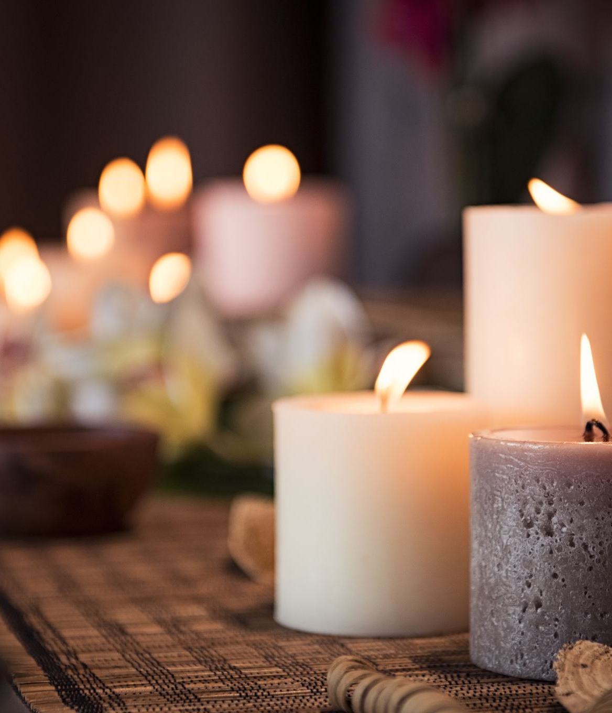
Yoga
Burn-out Syndrome – Prevention Methods in Practice
Lucie Stroupková

Slide 2
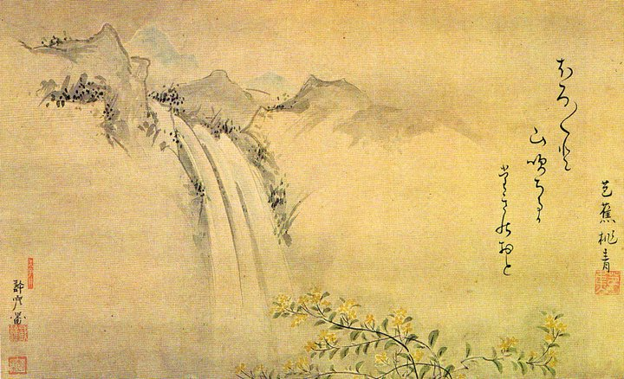
A little bit of literature..
Haiku
- a type of Japanese poem
- 3 verses
- 5 – 7 – 5 syllables

Slide 3
Haiku examples
A peaceful evening.
Sparrows singing together
with pretty feathers.

Slide 4
Haiku examples
a single poppy
blowing in a field of wheat
your face in the crowd

Slide 5
Haiku examples
I am a Spaceman
I spin, glide, soar and move through
the silence of time.

Slide 6
Haiku examples
I wake, reluctant;
Too cold to get out of bed
But I need to pee.

Slide 7
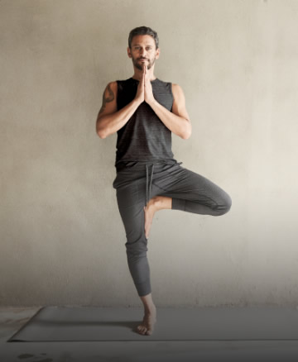
Yoga
combination of physical, mental and spiritual practice
Yuj = to attach
Being interpreted as a way to unite our mind and body; ego-self and divine self; body God and soul
Spiritual purposes x relaxation, strength improvement, flexibility improvement, breath control improvement
Ciezar-Andersen a spol. (2021): regular yoga excersice recuces stress, anxiety and depression symptomes and musculoskeletal pain

Slide 8
Types of Yoga
for example…

Slide 9
Hatha yoga

Slide 10
Kripalu yoga

Slide 11
Power yoga

Slide 12
Bikram yoga

Slide 13
Jivamukti yoga

Slide 14
Kundalini yoga

Slide 15
History and philosophy
Origins in India
Described in hindi texts
Veday
Bagavad Gita
Upanishads
Pataňjali Yoga Sutras (5th century)
The Hatha Yoga Pradipika (15th century)

Slide 16
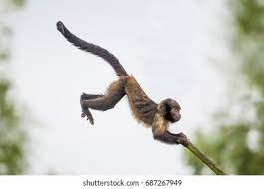
Patanjali Yoga Sutras
„yoga is stilling of the modifications of the mind“
8 aspects of yoga: Yama, Niyama, Asana, Pranayama, Pratyahara, Dharma, Dhyna, Samaghi

Slide 17
1. Yama
Ethical principles:
Asima – non-violence, not to hurt any living being -> vegetarianism, self-kindness
Satya – truth -> always telling the truth, in a pleasant way, honesty towards ourselves
Asteya – non-stealing, not-being envious, not manipulate
Brahmacharya – chastity, marital fidelity, sexual restraint
Aparigraha – non-possessiveness, non attachment -> not trying to change ourselves for every cost, accept ourselves

Slide 18
2. Niyama
Internal commitments or guidelines – commitments to yourself
Sauca – purity and clarity in our speach, mind, body, not speaking offencsively, positive thinking, keep body pure by eating organic products
Santhosa – acceptance of others and the circumstances
Tapas – self-discipline, persistence, keeping internal motivation
Swadgyaya – studying yoga deeper
Ishvara Pranidhana – Observe Supreme being, love, values or anything big

Slide 19
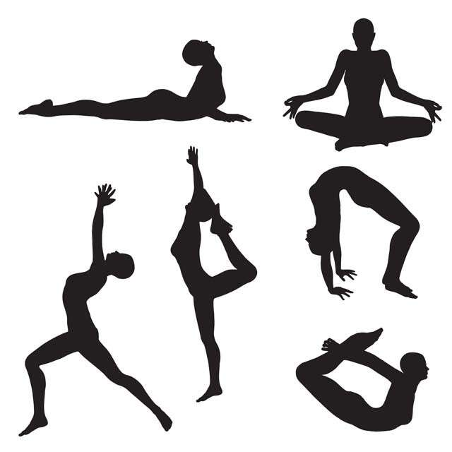
3. Asana
Basic component of yoga
Specific postures of body we are trying to gain
Aim: to try to reach the position, don´t go over the pain
the body gets stretched and strengthened, our Ming gets present and relaxed

Slide 20
4. Pranayama
Breath control excercises
Benefits: focusing on our body, staying mindful, strengthening the abdominal muscles, activating parasympatikus trough exhaling -> anxiety decreasement

Slide 21
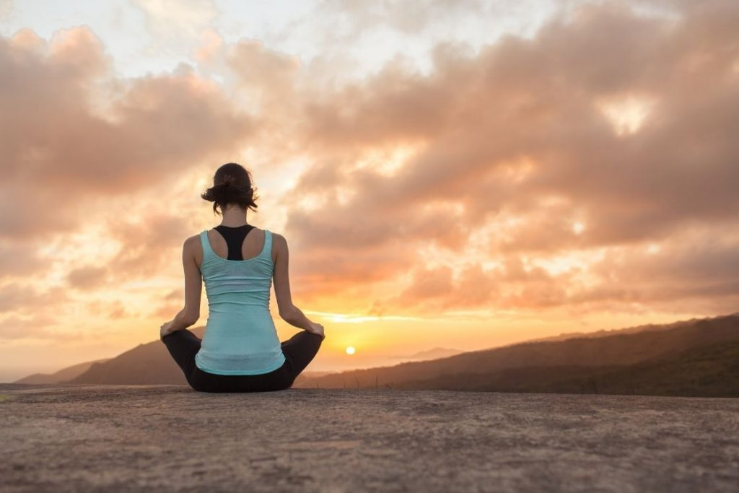
5. Pratyahara
Turning the attention inwards

Slide 22
6. Dharma
Concentration, focus

Slide 23
7. Dhyana
Mediatation and contemplation

Slide 24
8. Samaghi
Union or oneness with divine

Slide 25
References
Ciezar-Andersen, S. D., Hayden, K. A., King-Shier, K. M. (2021) A systematic review of yoga interventions for helping health professionals and students. Complementary Therapies in Medicine, 58, https://www.sciencedirect.com/science/article/pii/S0965229921000455.
Holcombe, K. (2017, April 12). Breathe easy: Relax with pranayama. Yoga Journal.
https://www.yogajournal.com/
Hurley, T. (2018, October 16). Activating the parasympathetic nervous system to decrease stress and anxiety. CanyonVista recovery center. https://canyonvista.com/
Moss, H. (2018). Practice of mindful yoga. Leaping Hare Press.
Yoga Point. (n.d). Velký průvodce mezi druhy a styly jógy. https://www.yogapoint.cz/joga/druhy-jogy/velky-pruvodce-druhy-styly-jogy/

