Slide 1
Dealing With Diversity: Practical Approach
SZ6020: Pupils with Different Mother tongues

Slide 2
Culture: Language, Traditions, different world views and values.
Gender
Ethnicity
Race
Religion

Slide 3
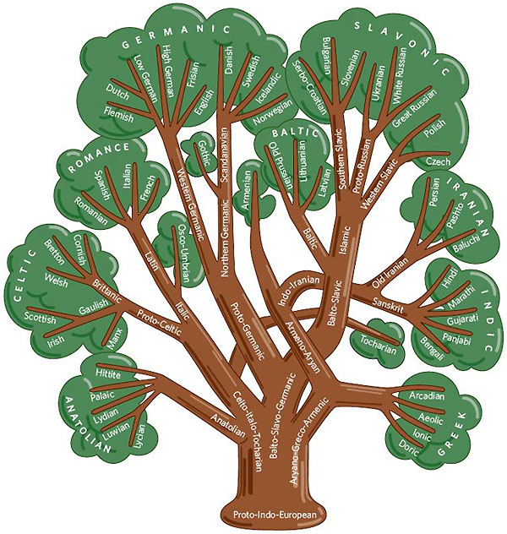
Language Diversity
Similarities and differences in languages and other aspects of culture can be traced to their origins.
Example: Čeština, Slovak and Polish traced to Western Slavic language.

Slide 4
Language ideologies: nature, structure, the use of language, gestures and social behavior towards the use of said language in a social world, attaching more value to some words over others. These are morally or politically influenced.

Slide 5
Cultural Competence
Cultural Consciousness (Yours)
Cultural Awareness (Others)
Sensitivity to dynamics of cultural interactions
Inclusion of cultural knowledge

Slide 6
Why Cultural Competence?
Our classrooms are more diverse
People are a product of their culture
Bridging the gap
Achieving learning that is effective and efficient
Effectively addressing stereotype and related classroom conflicts

Slide 7
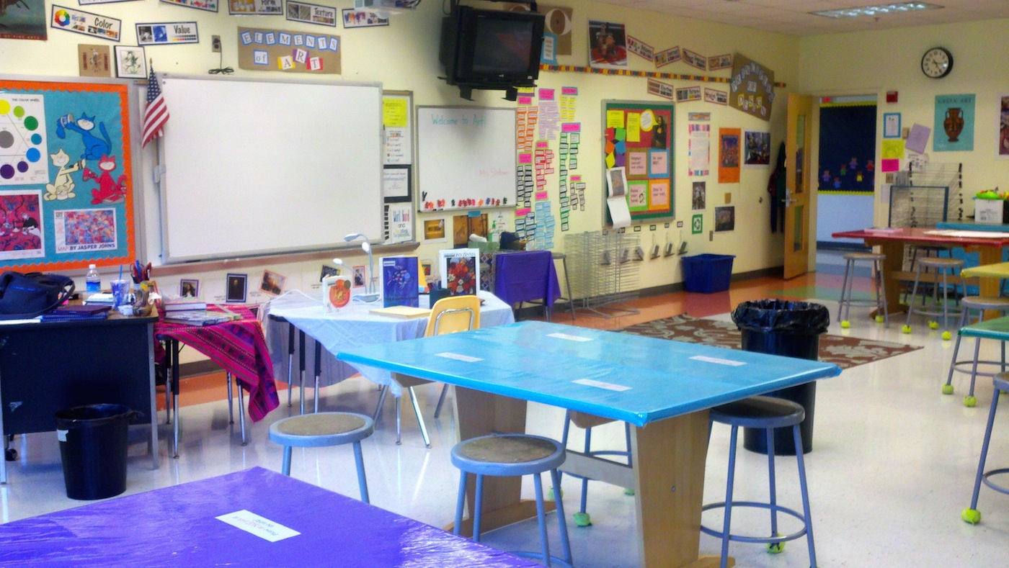
https://www.youtube.com/watch?v=NJn5neFlCq8

Slide 8
Achieving a culturally responsive learning environment
Become familiar with students cultural identity
Directional teaching methods
Diverse and inclusive curriculum.
Re-educate to address inequality
Establish ground rules for polite conversations among students
Diversity centred learning objectives and outcome. “In this course, students will consider multicultural and diversity aspects as they relate to the major concepts of this course ... .” Fuentes, et. al. (2021)

Slide 9
References:
Fuentes, M. A., Zelaya, D. G. & Madsen, J. W. (2021). Rethinking the Course Syllabus: Considerations for Promoting Equity, Diversity, and Inclusion. Teaching of Psychology, 48(1), 69-79.
Kerkhof, S. N. & Cloud, M. E. (2020). Equipping teachers with globally competent practices: A mixed methods study on integrating global competence and teacher education. International Journal of Educational Research, 103, 1-14. https://doi.org/10.1016/j.ijer.2020.101629
Rosetta Eun Ryong Lee (http://tiny.cc/rosettalee)
https://www.britannica.com/topic/Czech-language

