Slide 1
Šarka Dohnalova: Knowing the map – teaching and learning something you are not good at

Slide 2
Language and beyond
TUNE IN
Close your eyes and listen
What comes into head?

Slide 3
Australia

Slide 4
Want
What do you want to learn?

Slide 5
Create the map of Australia
TPR activity
Creating the map of Australia with the bodies of the students
Guessing
Checking

Slide 6
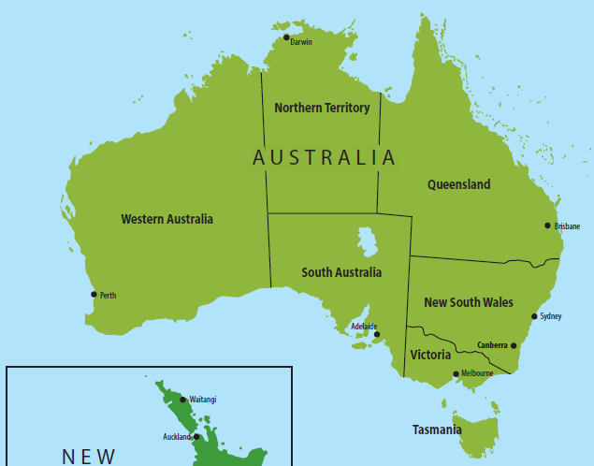

Slide 8
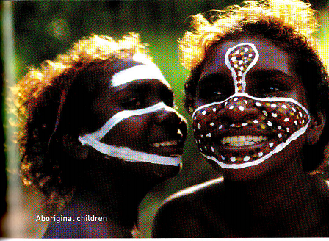
The Aborigines

Slide 9
The ABORIGINES
T reading; Ss listening:
The 300,000 Aborigines who lived in Australia until 1788 belonged to more than 300 different groups and each group had its own land and language. They travelled to different parts of their land during the year to find food and water; they ate plants and and fruits and caught animals and fish. They did not own many things, and their only buildings were houses made from branches and leaves. This way of life did not damage or destroy the land where they lived.
At special times Aborigines came together in big groups. They painted their bodies and sang, danced, and made music. They believed that a long ago the world was made by animals, plants, and humans together. This time was called “Dreamtime“, and there were many songs. Stories, and pictures about it.

Slide 10
THE BLOODY BRITISH
1788
The 1st 11 ships with the British arrived
The Aborigines call a meeting at Uluru
TIR (T= the chief of all the tribes)
Ss (chief of the 300 tribes – giving suggestions what to do with the bloody British

Slide 11
1804 (6000)
1831 (190)
1876 (0)

Slide 12
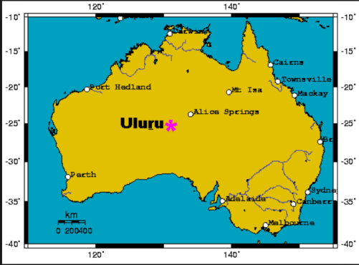
Uluru

Slide 13
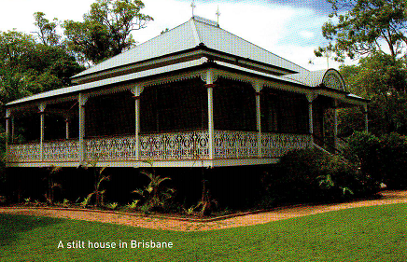
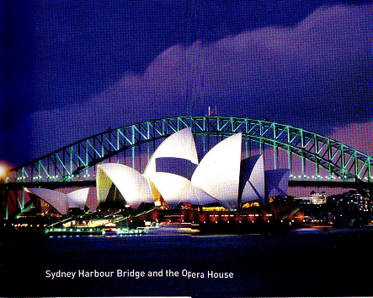
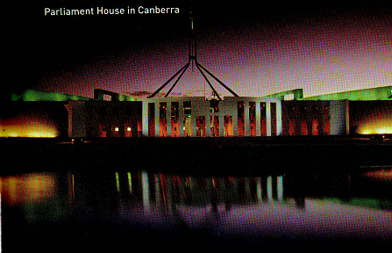

Slide 14
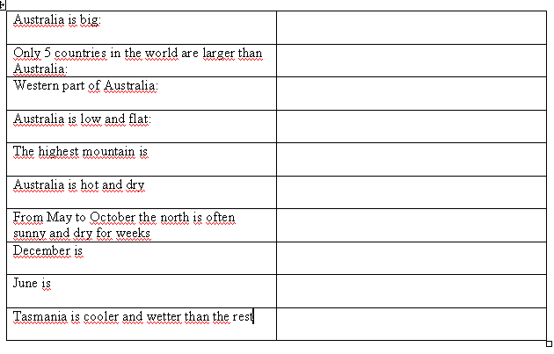

Slide 15
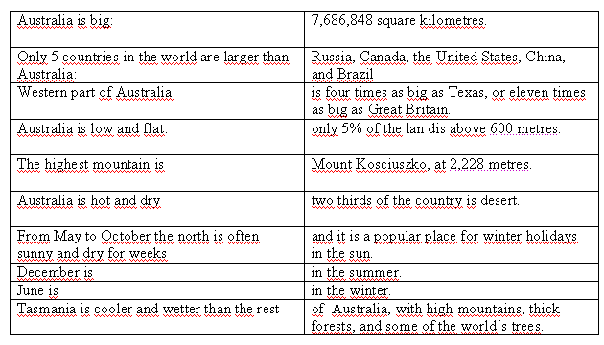

Slide 16
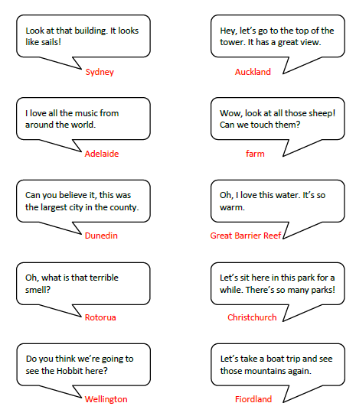

Slide 17
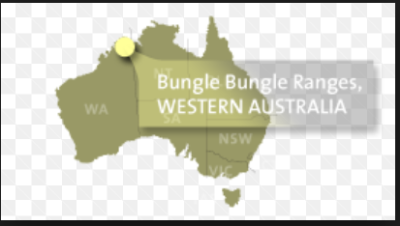

Slide 18
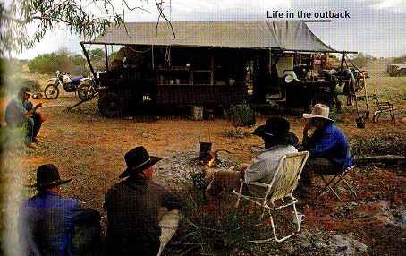

Slide 21
The Aborigines today
CANNOT
Own land
Get jobs easily
Go to school
Thought there is no hope for them
Most live in the cities
Many feel that they belong neither to Aboriginal Australia nor to white Australia
Have more health problems and shorter lives (by 17 years)
Many of them find their way to prison-about 20% of the people in the Australian prisons are Aborigines
Often have serious problems with alcohol
Many children were taken from their families (usually children with an Aboriginal mother and a white father.

Slide 22
The National sorry day
Since 1998
The film Rabbit-Proof Fence (2002)
(Oxford Bookworms Stage 3)

Slide 23
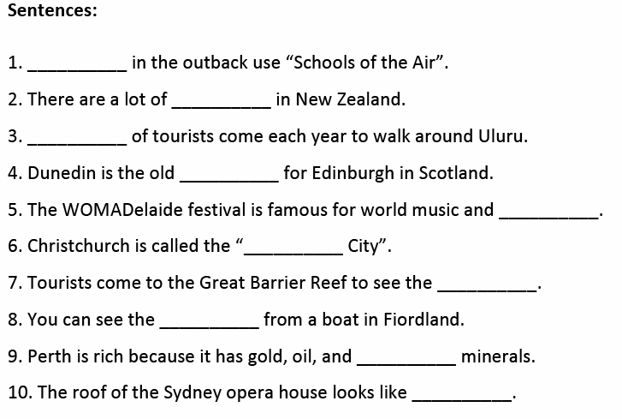

Slide 24
