Slide 1

AJ5415 Storytelling for Young Learners
Kateřina Tomková, 2060@mail.muni.cz
Block 1
Saturday, March 5, 2022

Slide 2
Our schedule today
0800-1000 Intro to Storytelling
1000-1030 Coffee break & 1st research task
1030-1200 Interactive block
1200-1230 Lunch break & 2nd research task
1230-1330 Summary, conclusion
1330-1350 Individual / group consultations

Slide 3

Current wartime narrative

Slide 4
Resources
All in the course‘s site in the IS:
- this presentation
- Rowling speech with gaps
- Tomková Segmental pronunciation of English
- Tomková Suprasegmental pronunciation of English
- Tomková The best videos for teaching English pronunciation

Slide 5
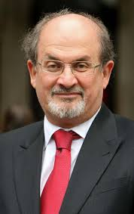
Storytelling as a basic human need
Salman Rushdie Teaches Storytelling and Writing | Official Trailer | MasterClass – YouTube

Slide 6
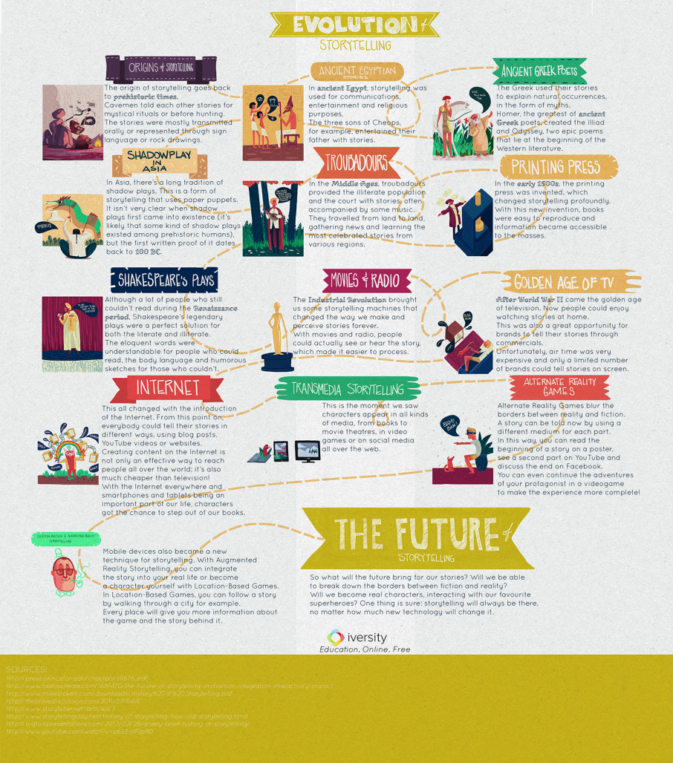
History of Storytelling

Slide 7
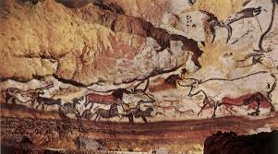
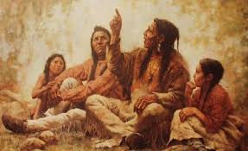
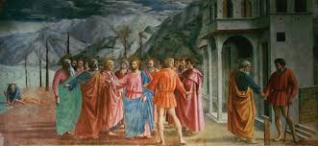
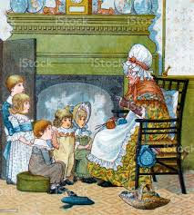
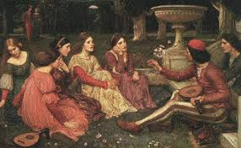
Storytelling since times immemorial

Slide 8
The world‘s greatest storytellers
Homer, Virgil, Aesop
Bocaccio, Dante
Chaucer
Shakespeare
Němcová
Čapek
Tolkien, Lewis, Pratchett
Sheherazad
Orson Welles
William Golding, Ernest Hemingway, the Grimms, Andersen, Hrubín…

Slide 9
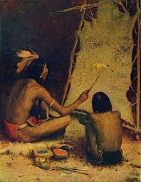
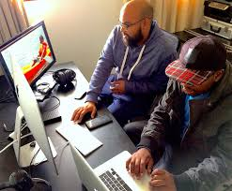
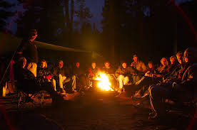

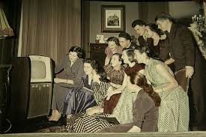
The same or different?

Slide 10
Storytelling today
In business: brands sharing their messages in ways that engage audiences and drive them to take a desired action (like making a purchase, calling a sales person, downloading or subscribing to content, etc.).
In politics: Political narrative as a term used in the humanities and political sciences the way in which storytelling can shape fact and impact on understandings of reality.
In teaching: Storytelling is the oldest form of teaching. It bonded the early human communities, giving children the answers to the biggest questions of creation, life, and the afterlife. Stories define us, shape us, control us, and make us. Not every human culture in the world is literate, but every single culture tells stories. =Failure stories are the best=
In law: ‘Liar Liar‘

Slide 11
Storytelling for children
Vital for developing their imagination
Important for their spatial and time awareness
Crucial for developing their passive language sensitivity and active speaking skills
Integral for family/community bonding and solidarity among generations
Instrumental in shaping their view of the world (Sapir-Whorf hypothesis)

Slide 12
Storytelling for children in foreign language teaching
… at their state of cognition
The use of people, narratives and realities they know in their mother tongue
The use of the great sense of formal structure, repetition, rhythm
Experientiality, well-being
Narrator‘s pronunciation and diction
Narrator‘s attention
Listener‘s personal involvement

Slide 13
Kinds of narratives
Rhymes and songs=memorised formats
(Budulinek, Father Abraham)
Fairy-tales
Simple real-life stories (Meurig)
Family/community legends (Roots)
Urban legends (Mammoth‘s trap)

Slide 14
Coffee break 10-10:30
Individual research task:
How to speak to children about war?

Slide 15
Interactive block 10:30-12
Results of research discussed in groups and breakout rooms
Back in the main session: secondary presentations of research results

Slide 16
Discussion outcomes 1
Michal: no opportunity; honesty; asked
Jone: thoughtfulness; no downplaying
Eva Č.: assist. Judge; tact to Russ.
Carmen: kids=canvas; prevent xenophobia
Lucie F.: avoidance, insightful, Putin=%x%x
Jason: feelings; talk+explain; influence
Eva H.: be sensitive; Q+A; correct
Marta: graphical representation (geography
etc.)

Slide 17
Discussion outcomes 2
Martin: ignorance=fear=suffering; taboo+
Jonande: tolerance of different opinions

Slide 18
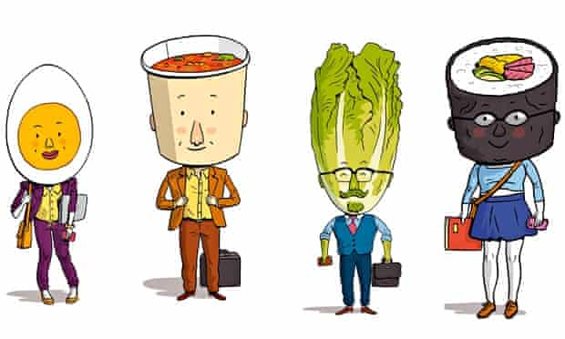
Lunch break 12:05-12:35
From the Guardian 3 Jul 2015:
It’s a wrap: the working lunch – plus recipes from Britain's favourite quick lunch chains
Sandwich, sushi or macaroni cheese? Lunch can be the biggest decision of your working day. Plus how to recreate the nation’s favourite takeaway lunches at home, from an M&S wrap to a Boots sandwich

Slide 19
Discussion outcomes 3
Lucie L.: exp. as au-pair - moderation
Petra: weigh info+previous knowledge
Jan: the 3-armed teacher; dilute but not
trivialise
Josh: listening; no forcing; civil behaviour
Eva D.: attention diversion; harvesting
https://docs.google.com/document/d/1WZkflTtgAjGgtNTisT60UQoU1NDecxY_OSCrv7aDPRY/edit#
https://www.centrumlocika.cz/novinky/jak-mluvit-s-detmi-o-valce
Lucie H.: knowledge, thought, consideration

Slide 20
Discussion outcomes 4
Jitka: shielding
Marie: Montessori – full age-appr. truth
Nina: ways to help
Míla: caring, helping actively; diff. ages

Slide 21
Homework
Make a 2-5+minute recording about how storytelling can be implemented in your daily personal/professional life. Upload it in the File Vault (Poskytovna) by April 25.
Before the next block on April 30, listen to your peers‘ recordings and be ready to discuss them in class. For inspiration, go to Spring 2021 File Vault.

Slide 22

I am now free for individual /group consultations
Peace with you!

