Slide 1
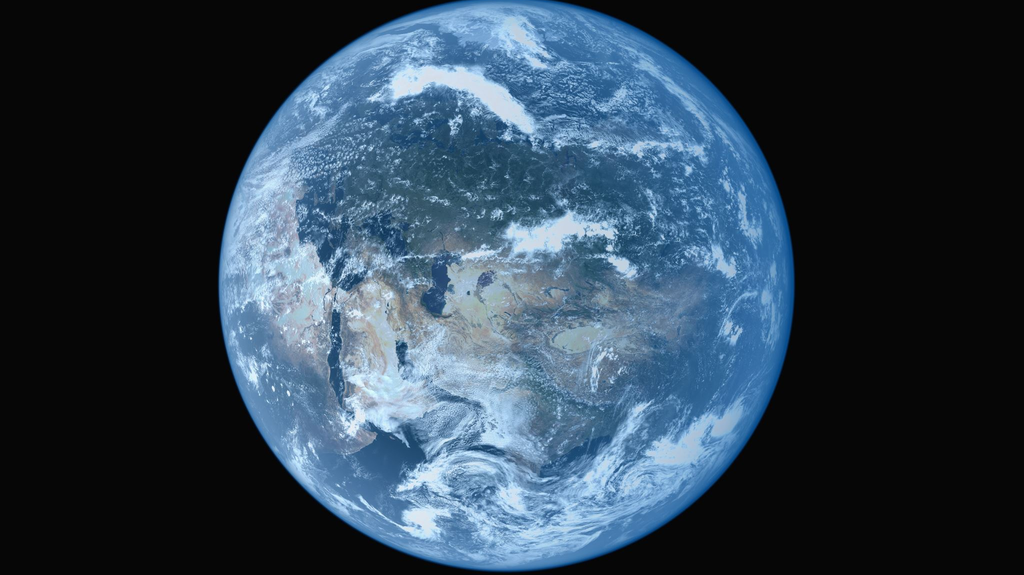
GLOBAL EDUCATION
sz6014

Slide 2
“Those young adults will face a new world order. Their daily contacts will include individuals from diverse ethnic, gender, linguistic, racial, and socioeconomic backgrounds. They will experience some of history's most serious health problems, inequities among less-developed and more-developed nations, environmental deterioration, overpopulation, transnational migrations, ethnic nationalism, and the decline of the nation-state. . . . Will they have acquired the sensitivities, tolerance, and respect for all human beings to live harmoniously in an interdependent world? That is the fundamental question facing educators in the new millennium, when the global age requires a global education.”
Kirkwood (2001) in Heilman, E. E. (2006). chapter 13: Critical, Liberal, and Post-structural Challenges for Global Education, in Social Studies—THE NEXT GENERATION: Researching in the Postmodern. Counterpoints, 272, 189-208.

Slide 3
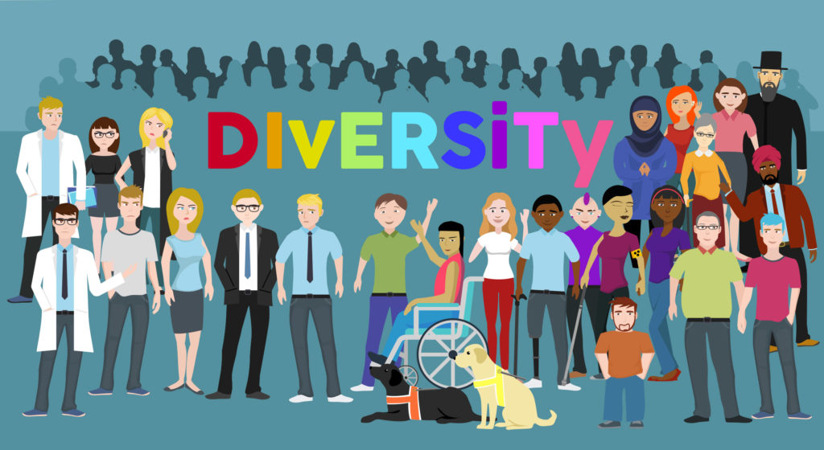

Slide 4
The Concept of Global Education
Global Education is concerned with:
Awareness and understanding of our interconnectedness (The Cognitive- Knowing)
Developing concern for every human being, human kind and humanity (The Socio Emotional)
Taking a stand for an inclusive, just and peaceful world (The Behavioural-Acting)
Developing a sense of communality to promote world Peace (The Outcome)

Slide 5
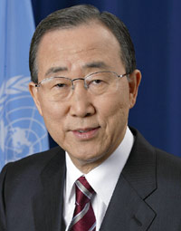
Giving Importance to Global Education
Global Education was included in the United Nations Sustainable Developmental Goals under education in 2015, with the aim of developing global citizens who would challenge current day inequities and take action to solve global issues.
Ban Ki-moon
Former Secretary-General of the United Nations

Slide 6
Being a Global Citizen
Being a global citizen entails that
One becomes aware of one’s own complicities
Build global consciousness
Develop cultural flexibility
We understand our shared responsibilities as global citizens
We understand global structure of oppression and domination on the basis of categories such as gender, race and class
Develop empathy and solidarity
We are able to critical think and reflect upon social policies that promote marginalization
Taking social action to achieve an equitable society.

Slide 7
Challenges of Global Education
Fear that they undermine patriotism towards the nation states
Lack of a disciplined heritage. The family and other agents of socialization inform the structures within the society and group members perception about these structures, like with stereotypes.
Mistrust
Formation of the wrong values

Slide 8
Intersectionality
This focuses on structures of oppression and injustices which people could face as a result of:
Gender
Race
Social Class
Religion
Ethnicity

Slide 9
Intersectional Global Education
Aims at exposing structural oppression so they can be challenged.
Aims at encouraging critical thinking about the power structures responsible for oppression and injustice, leading to action.
Aims to empower by negotiating differences to build alliances out of consensus.
Aims to help students work through their differences for the common good.

Slide 10
Diversity is important because everyone is unique, think differently and has varying and interesting ideas and views. Diversity as a result of globalization has provided the following benefits:
A culturally rich and colourful society
More creative and innovative ideas
A rich work force
New experiences (such as trying out new food)
Gives a wider world view leading to understanding and respect for others

Slide 11
Thank you

