Slide 1
Waldorf School
Education for Freedom and Responsibility

Slide 2
https://www.youtube.com/watch?v=BkrgkslnD9g&t=

Slide 3
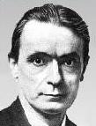
Rudolf Steiner (1861 – 1925)
„ At school, it's not about to get any education, but to prepare so that we get out of life“

Slide 4
Rudolf Steiner (1861 – 1925)
- founder of Waldorf alternative school
- austrian philosopher, educator, literary critic, artist, playwright, social thinker, esoteric
- significantly influenced by the philosophy of W. Goethe
- * 1861 Kraljevec (the border between Austria and Hungary) in a family of Austrian railway official
- † 1925 Dornach (Switzerland)
- final exam in Vienna, mathematics and natural sciences at university + lectures on philosophy, literature, psychology and medicine

Slide 5
student and teacher at the same time
1891 PhD in philosophy at the University of Rostock
1899 - 1904 teacher in Berlin - considers it his life's task to find new methods of investigating the soul on a scientific basis; he presents the results of his research to a small circle of interested people
personal correspondence with famous personalities of the cultural life (Ernst Haeckl), for a long time was not accepted by the official representatives of culture in Germany
1904 publishes the work Theosophia
author anthroposophy

Slide 6
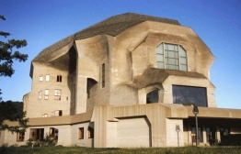
1913 Anthroposophic the company's base Goetheanum (Dornach)
-

Slide 7
anthroposophy
- from Greek. anthropos = man, sophia = wisdom
science of the spiritual nature of man
- a system of philosophical and pedagogical views on the education of man - based on Christianity, Eastern philosophy, Egyptian and Greek mysteries, natural mysticism, Goethe's works

Slide 8
Waldorf School
it is one of the most significant current alternative pedagogical thinking 20th century (the first school was founded in 1919)
they differ in a number of substances, the teaching of foreign languages, nature is not divided into isolated parts
special subject called eurythmia (rhythmic aesthetic teaching)
they pay close attention to the teacher's personality and creates a two-year teacher training

Slide 9
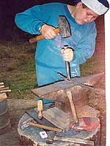
Waldorf Schools about themselves
round development of the child in practical and artistic fields
it is based on anthroposophy anthropology (distinctive view of human, development cultivates respect for free human individuality)
discover the pupil's ability
not to prioritize any subject above another in the curriculum
achieve harmony between science, art and spiritual values
illuminating basic principles through clear examples, not trying to cover students with encyclopedic overviews

Slide 10
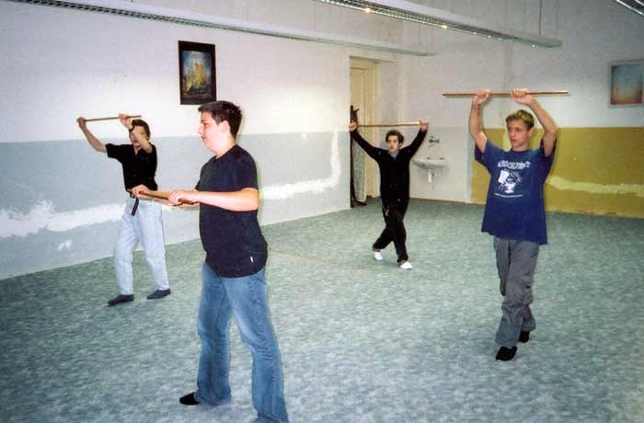
Waldorf Schools about themselves
teaching of the main subjects conducted in two-hour blocks - called epochs, which have further divided into the rhythm, teaching and narrative part
the lack of books (books can be complementary but the most important are pupil workbooks that they make up yourself)
certificate in the form of verbal assessment, not repeated school year
one class teacher for the entire school session
an important part of the training image, rhythm
and movement, activity

Slide 11
The first Waldorf School
7 September 1919 on the request of Emil Molt in the village of Waldorf, Stuttgart
by establishing a school according to Steiner's ideals, Molt wanted to provide a new and adequate education, especially for the children of his employees
first Waldorf school started with eight teachers and 175 pupils
management of first Waldorf School was very liberal
- a voluntary tasks formulated to arouse interest
rejected strict, externally enforced discipline
all school activities = direct contact between teachers and students

Slide 12
Anthroposophy as the basis of Waldorf education
educational system of philosophical views, about the nature of human science
Rudolf Steiner founded the first anthroposophical society at the beginning of the 20th century
human, according to Steiner, is complex of three worlds (body, soul, spirit) – these are represented by three body types: physical, etheric, astral (and fourth type - "I„)
this is related to the division of childhood into three stages and seven-year developmental periods, according to which the educational content is adapted

Slide 13
Human development in terms of Anthroposophy and Waldorf Education
to 7 years - the development of the physical body
an important example and imitation, the greatest possible of freedom; explanation is not practical, it is not effective to act on the rational side
14 years - the development of the etheric body
importance of the natural authority of a teacher as a model, acting through parable and moral examples; constitutes the clearance, development of memory; importance is accorded to music and art
14 years - the development of the astral body
aesthetic, moral and religious components are preferred; authentic judgments and judgments about things and phenomena are generated from memory and emotional content
around 21 years - the birth of a free, creative and independent man

Slide 14
Three of the objectives pursued in Waldorf schools (Trostli)
Develop the ability to clearly, logically and creatively think, to lead children to self-knowledge
Discover and develop the skills of deep feeling, sensitivity to the beautiful, the joys and the sorrows of this world, to others
Cultivate the strength and willingness to do what has to be done, to work not only for ourselves but for the benefit of all humanity and the Earth

Slide 15
Structuring, organization and management of the Waldorf School
Kindergarten - preschool degree
Twelve years of school - team classes remains unchanged
1st - 8th year – lower level (elementary school)
class teacher teaches almost all subjects
9th - 12th year - is higher (upper) level (high school)
teaching of subjects by specialist teachers
13th year with maturity (final) exam
Director is not responsible for the management of the school. The entire staff in cooperation with the association of parents, teachers and friends of the Waldorf School manage the school.

Slide 16
Internal organization of teaching
the division of subjects on the main and training (vocational)
main teaching - didactic form EPOCH (combined two or three lessons, discusses the same subject for three to six weeks, epochs are repeated about every six months)
mother language, mathematics, geography, history, science education, physics, chemistry and others.
training (vocational) classes - takes place in normal lessons (45 min), focuses on subjects that require constant exercise
foreign languages, practical work, religion, eurythmy
daily class schedule includes theoretical, artistic and practical subjects
during the school year - monthly festivals, holidays, class games, excursions, trips

Slide 17
School Day at the Waldorf School
rhythmic changing of the main teaching (epochal) and training - in accordance with the basic life-rhythms and hygiene requirements
initiation of day - 15 to 30 minutes simple art activities
the main object - two-hour block called epoch
training subjects for 45 min. (possibly another two-hour block)
5th, 6th class - afternoon classes (practical, artistic and physical activity courses)

Slide 18
The Curriculum
They do not have a precise and uniform curriculum framework plans but the curriculum is adapted to the needs of the school
anthropocentric
trying to reconcile science, art and religion

Slide 19
Epochs
monothematic two-hour (sometime three-hour) block of instruction
at the beginning of day
one teacher develops a given topic (eg. math, house building, the history of Greece)
the emphasis on the aesthetic and work items and foreign languages
one main subjects, usually for 3-6 weeks continuously, then joins the main subject of the next epoch
epochs usually taught by one classroom teacher
divides the rhythm, teaching and narrative section
the advantage of epochs – undistributed pupil attention for many subjects
subject occurring only on Waldorf School eurythmy - art to express the idea of movement, music or your own experience

Slide 20
Evaluation
students are not graded
valued by characteristics that always relate to the abilities of the child
not compared with other pupils
receive recommendations for further development
pupils do not drop out, pupils usually stay together as a group throughout their schooling

Slide 21
Methods
They use an image, rhythm and movement
Three phases of each individual procedure – recognizing, understanding and skills to create:
1. observation, experience, experimentation
2. remembering, describing, drawing, verbalized
3. processing, analysis, abstraction, generalization, formation theories
Includes a range of physical activities
The pupils catch himself, record, describe and document all learning material in an epoch workbook

Slide 22
Aids at the Waldorf School I.
materials, that the teacher creates itself or in cooperation with other colleagues
books they can be complementary (eg. exercise books and atlases), rather than the main means of teaching
pupil work and epoch notebooks

Slide 23
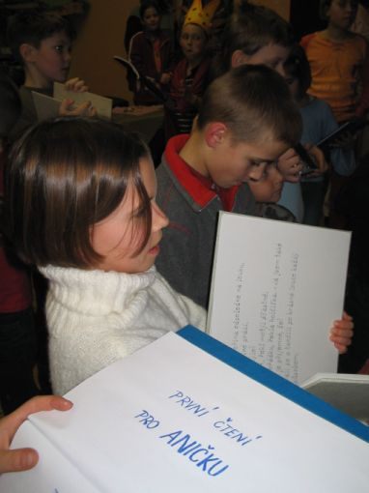
Aids at the Waldorf School II.
traditional type of textbooks are considered like a secondary sources and "passive" learning resources - use limited
the basis aids are "active" learning resources (collections of texts, original documents, statistics, manuals, which creates a teacher)
pupils recording all the development of teaching material in the epoch notebooks (teacher checks, requires corrections and additions)
media are not used in teaching

Slide 24
Negative Pages of Waldorf School
small continuity eg. primary schools in regular secondary schools
some students can develop feelings of frustration eg. the fact that the school learned nothing systematic, that they will not be able to cope graduates from other schools
too much freedom for pupils in these alternative schools leads to lower levels of educational achievement
education often provide young teachers, who usually have little experience
does not put enough emphasis on the standard pedagogical higher education (class teacher from first to eighth year teaches almost all subjects, as a prerequisite for it high school leaving graduation and completion of education workshops for teachers of Waldorf education)
not open to scientific criticism, confrontation with other alternative schools

Slide 25
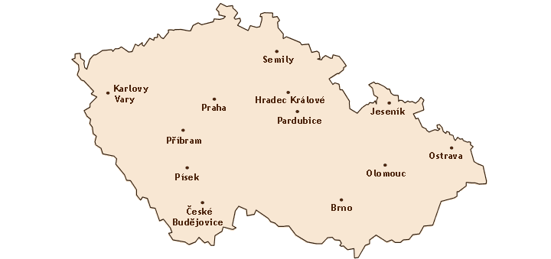
Waldorf Schools in Czech republic
Brno, České Budějovice, Hradec Králové, Jeseník, Karlovy Vary, Olomouc, Ostrava, Pardubice, Písek, Praha, Příbram, Semily
Currently, the most common type of alternative schools (over 1 182 Waldorf Schools worldwide, 802 in Europe, 48 in Czech republic

Slide 26
Overview Waldorf Schools
Kindergarden
Beroun, Boseň, Brno, České Budějovice, Karlovy Vary, Klatovy, Olomouc, Písek, Praha 3, Praha 6, Příbram, Rovensko pod Troskami, Sedlčany, Staré Ždánice, Semily, Strakonice, Turnov, Žďár n. Sázavou
Primary and Secondary School
Brno, Olomouc, Ostrava, Pardubice, Písek, Praha 5, Praha 6, Příbram, Semily
High School
Ostrava, Praha, Příbram, Semily
Special School
Praha

Slide 27
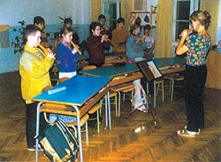
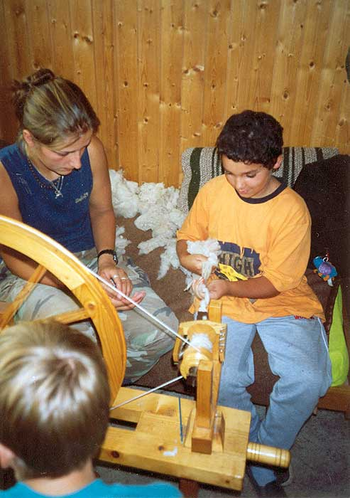
Samples of some types of Waldorf Schools

Slide 28
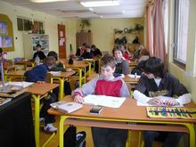
Waldorf class - special color tones (different in each class, corresponding to the psyche of age), flowers, artwork and amount of student paintings and products
Notes:
28

Slide 29
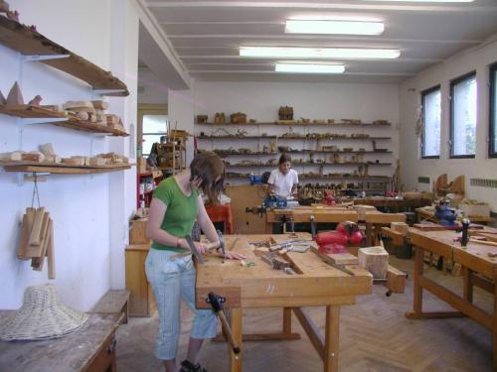
learning experience
emphasis on artistic and creative aspect of teaching
handicrafts
foreign language teaching

Slide 30
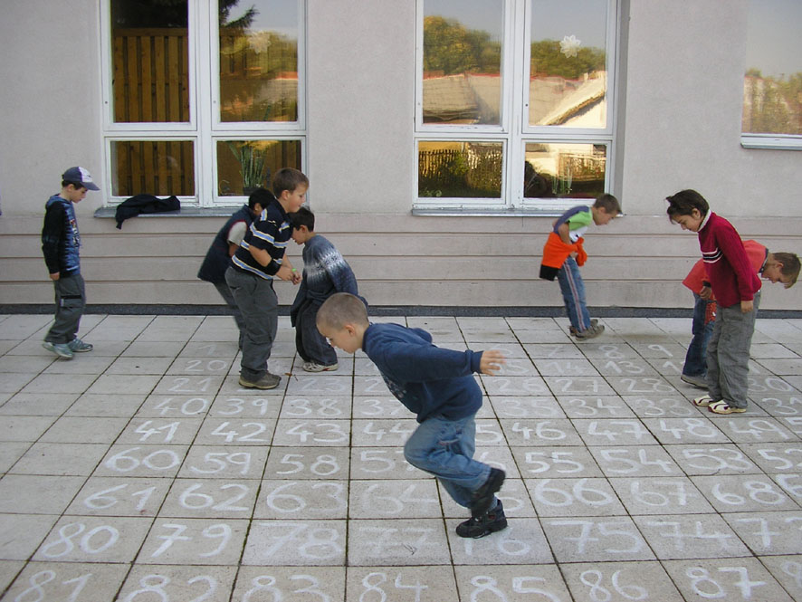
Demonstration of physical activity during math lessons - 4th grade

Slide 31
Sample the English language teaching
drawing letters:
every letter has a story, characterization and color
example, the letter „W“
teacher tells a story, which plays an important role in the water, the sea (eg. The Little Mermaid), will focus on colorful description of waves
children along with teachers demonstrate the movement of hands and whole body and say, „Wave after wave of swirling wind, high water sprayed upward."
the next day everything is repeated and they paint pictures of the stormy sea
with the teacher's help, they discover the letter „w" in the middle of the waves, which is blue in coloured

Slide 32
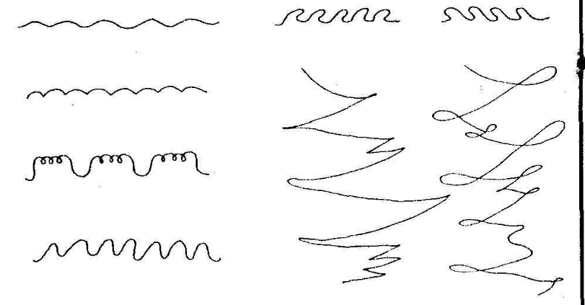
Samples drawing forms
It is a specific subject area, it is a dynamic drawing that expresses feelings, rhythm and movement
through drawing, children discover the laws of the world around them, they will explore geometric shapes (sun, conch, spiral etc.).
The picture shows a rendering of the rhythm of walking, jumping, dancing, blowing wind, a stream of water, waves, flight
the drawing of forms is also connected with the teaching of writing, fine motor skills training

Slide 33
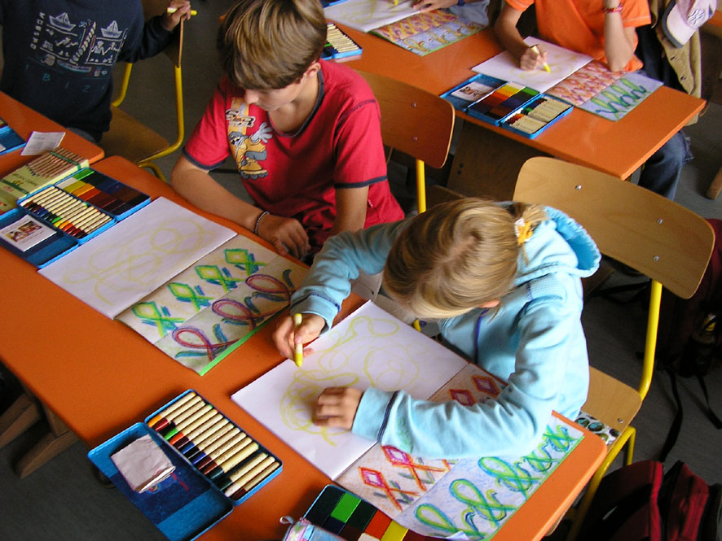
Samples drawing forms – 4th grade

Slide 34
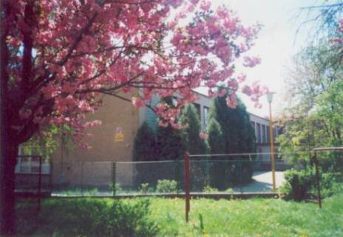
The first school in the Czech Republic, which began work on the principles of Waldorf education – ZŠ Svobodná v Písku (od 1990/91)

