Slide 1
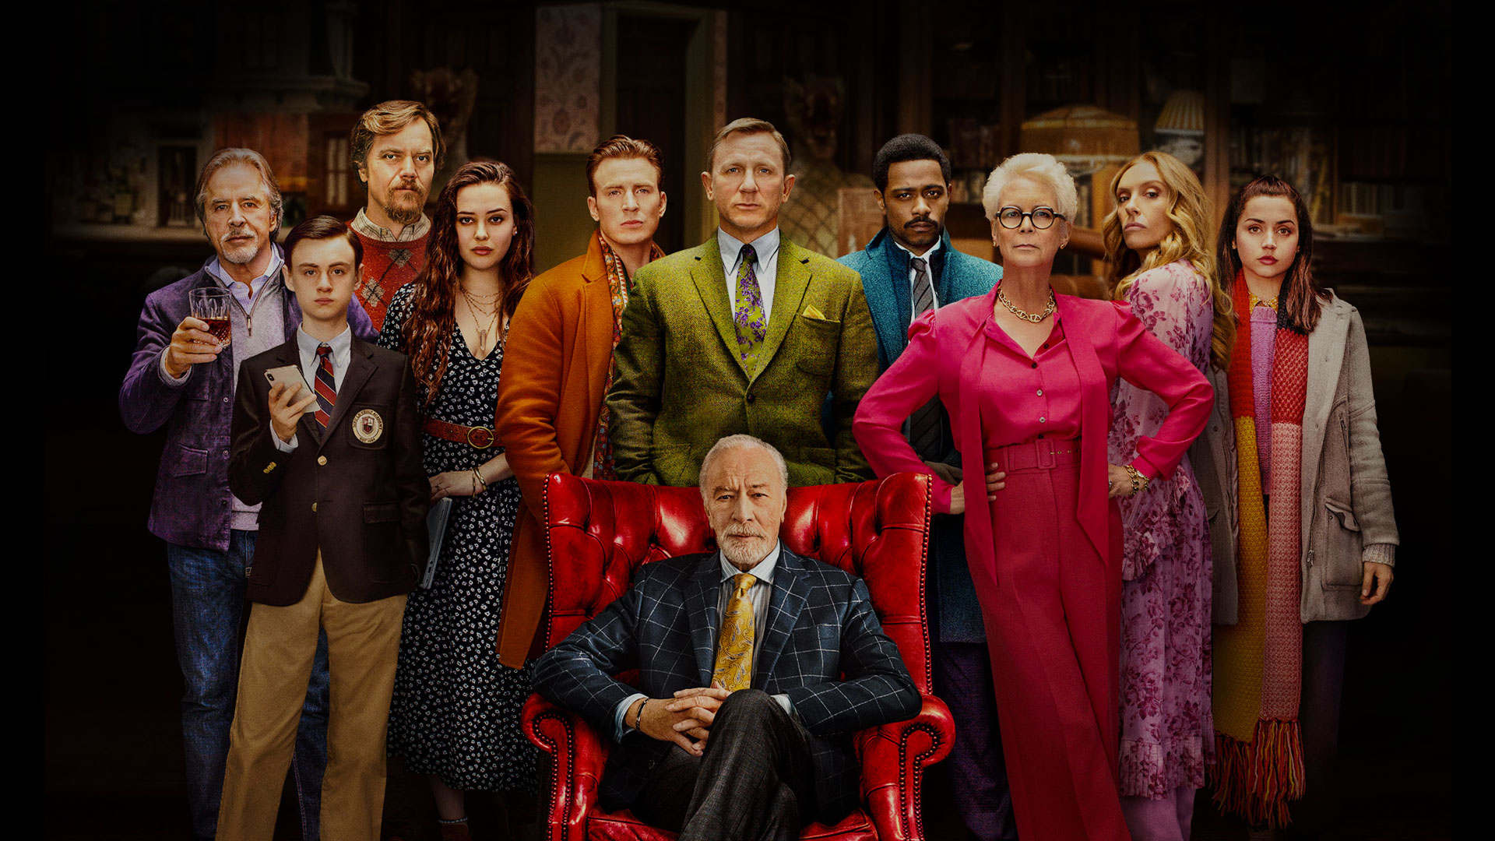

A PICTURE IS WORTH A THOUSAND WORDS
THE STRANGE VARIETY OF ACCENTS IN KNIVES OUT
Marketing
Plan

Slide 2
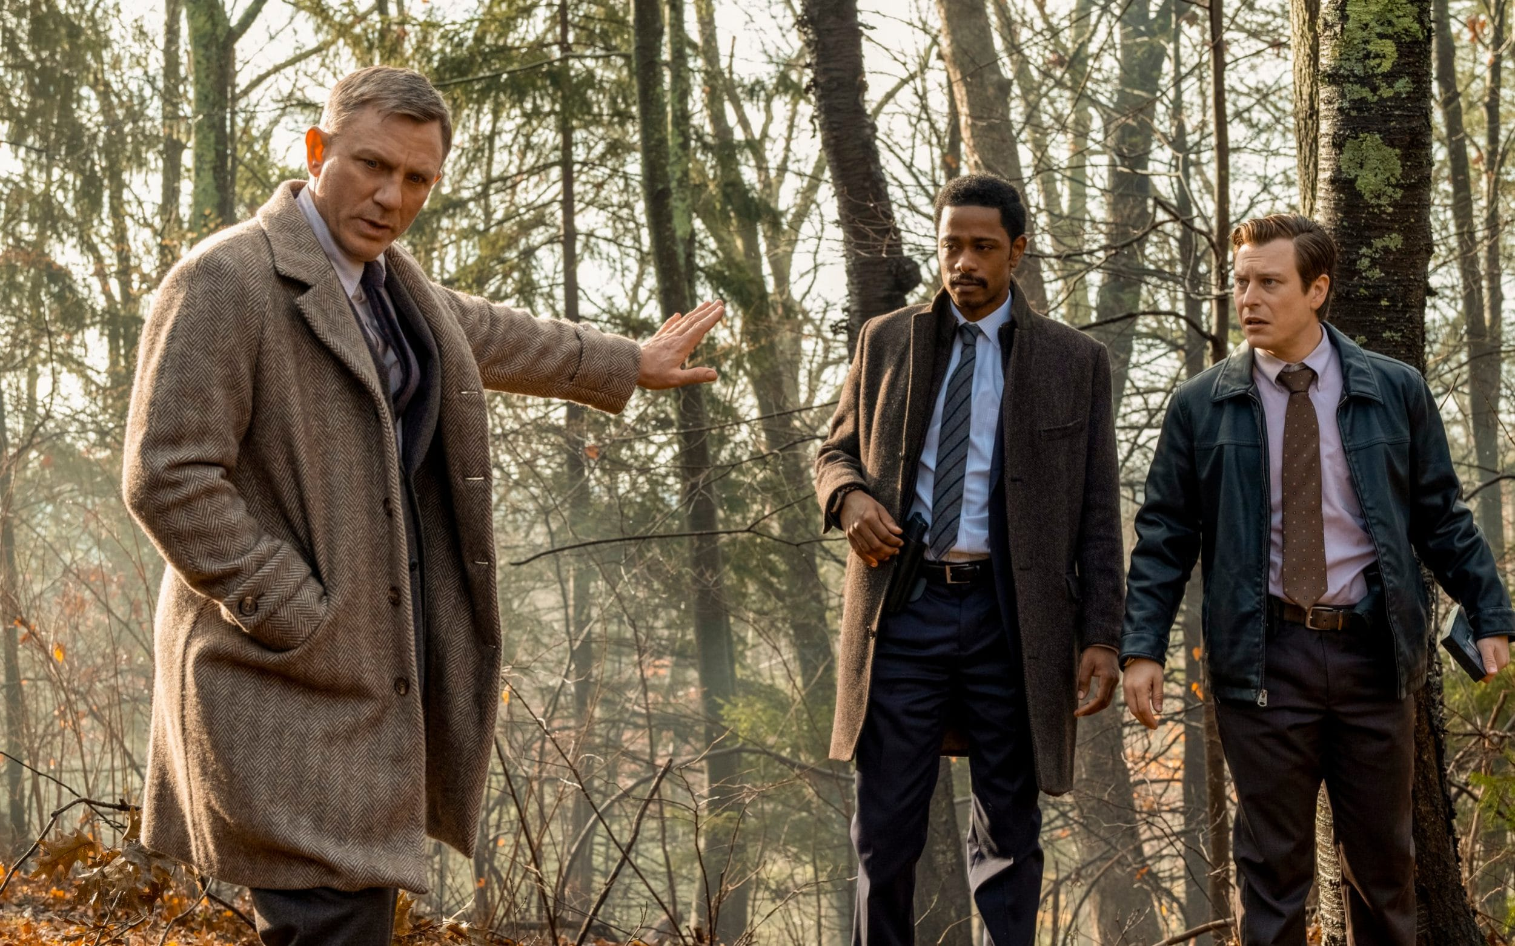
THE BEST WHODUNNIT EVER MADE!
2019
Director: Rian Johnson
Academy Award nominated for Best Original Screenplay
52 awards

Slide 3
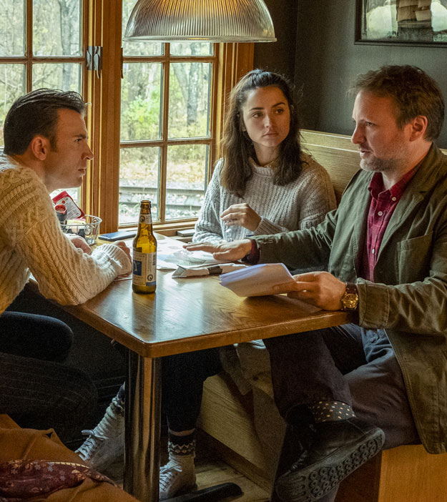
THE PLOT
When renowned crime novelist Harlan Thrombey is found dead at his estate after his 85th birthday, Detective Benoit Blanc is mysteriously enlisted to investigate.
From Harlan’s disfunctional family to his devoted staff, Blanc sifts through a web of red herrings and self-serving lies to uncover the truth behind Harlan’s untimely death.
(Boston)

Slide 4
VARIOUS ACCENTS IN KNIVES OUT

Slide 5
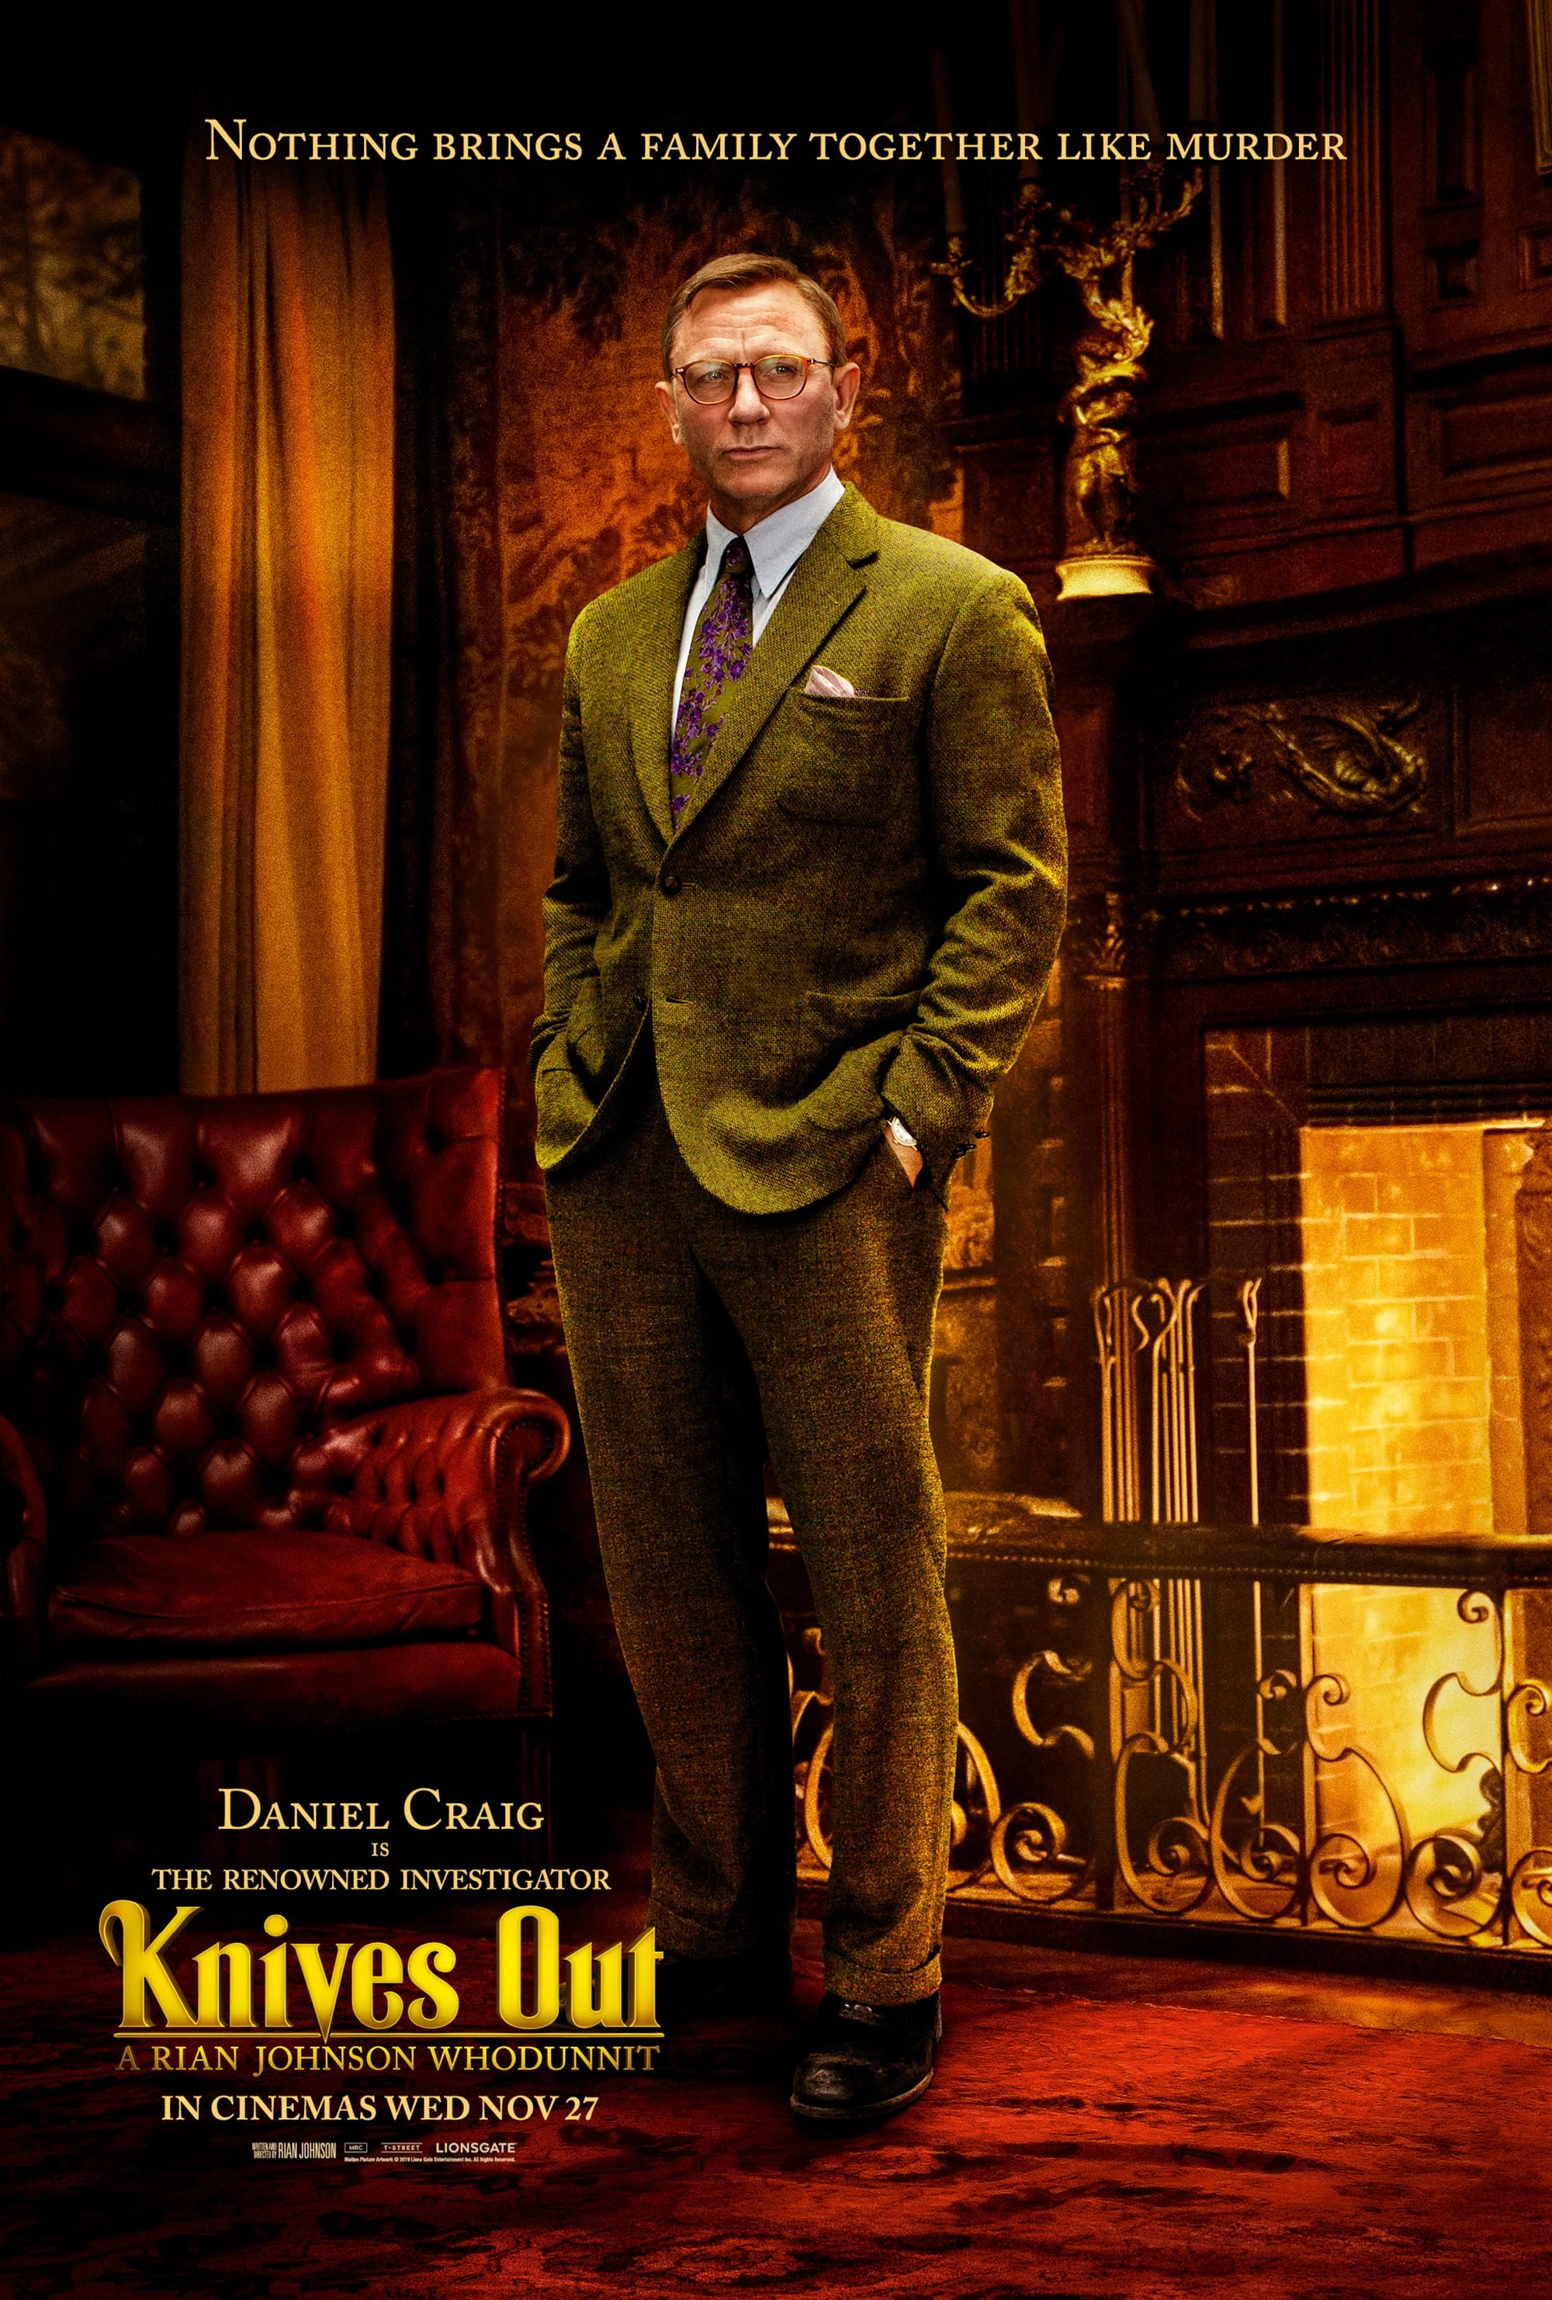
THE BACKGROUND
01
BENOIT BLANC
the detective
deep southern accent
02
MARTA
personal caretaker
background: latin america
03
THE FAMILY
grew up together, but have
different accents

Slide 6
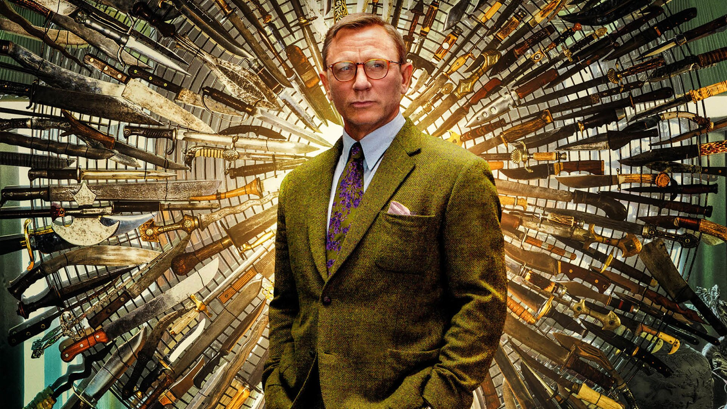
BENOIT BLANC (DANIEL CRAIG)

Slide 7
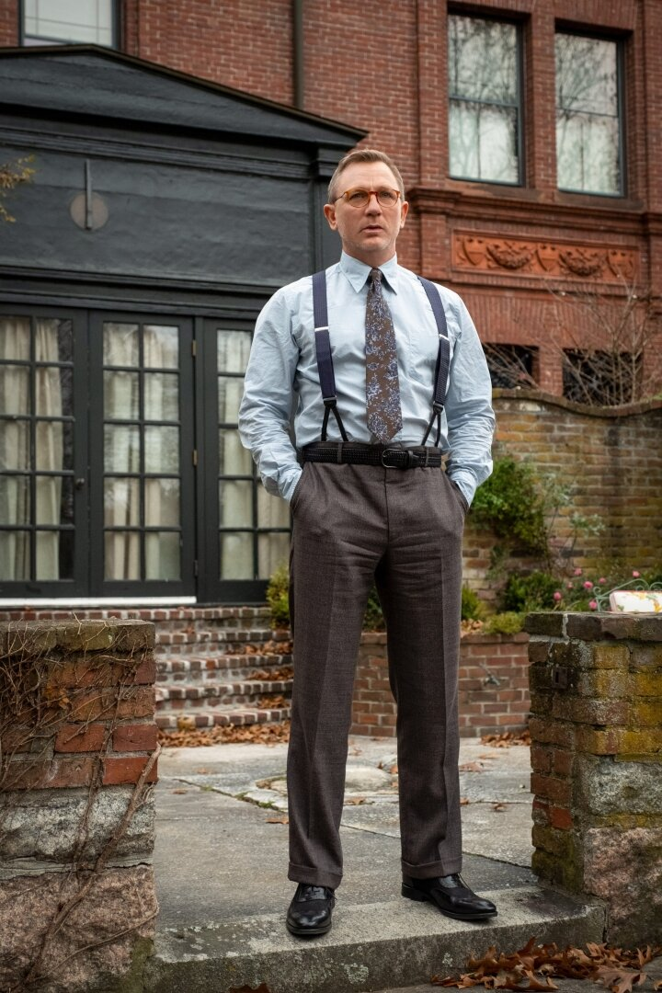
BLANC’S ACCENT
Blanc talks like a member of the Southern aristocracy with an accent that has been described by Ransom as a "Kentucky Fried Foghorn Leghorn Drawl".
Many people online stated the accent to be distracting, difficult and even just terrible.
Designed to be over the top.
Trying to capture that slow-spoken drawn out deep south accent
“a very subtle southern accent”

Slide 8
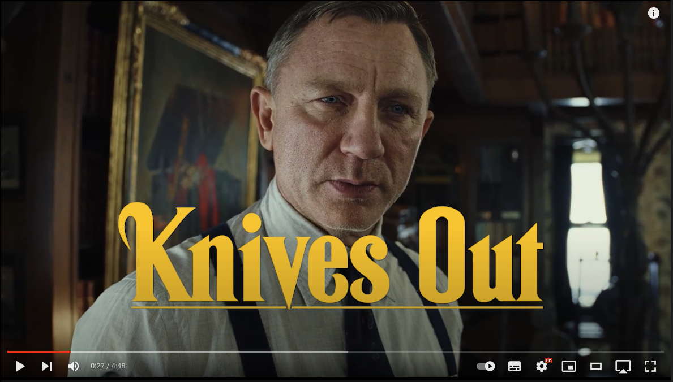
A VIDEO
https://youtu.be/_O3eKij7jkA

Slide 9
THE ACCENT:
01
STRONG & OVERDONE
02
03
PEOPLE WITH STRONG ACCENTS ARE GENERALLY DUMBER.
04
FIRST SYLLABLE STRESS
05
OLD MONEY LOUISIANA
06
DROPPING G’s
[ɛ] MERGING [ɪ]
Falling back onto RP
Goin‘

Slide 10
TALKING ABOUT THE ACCENT
THE CAST
https://www.youtube.com/watch?v=5-jA-vXNX-M

Slide 11
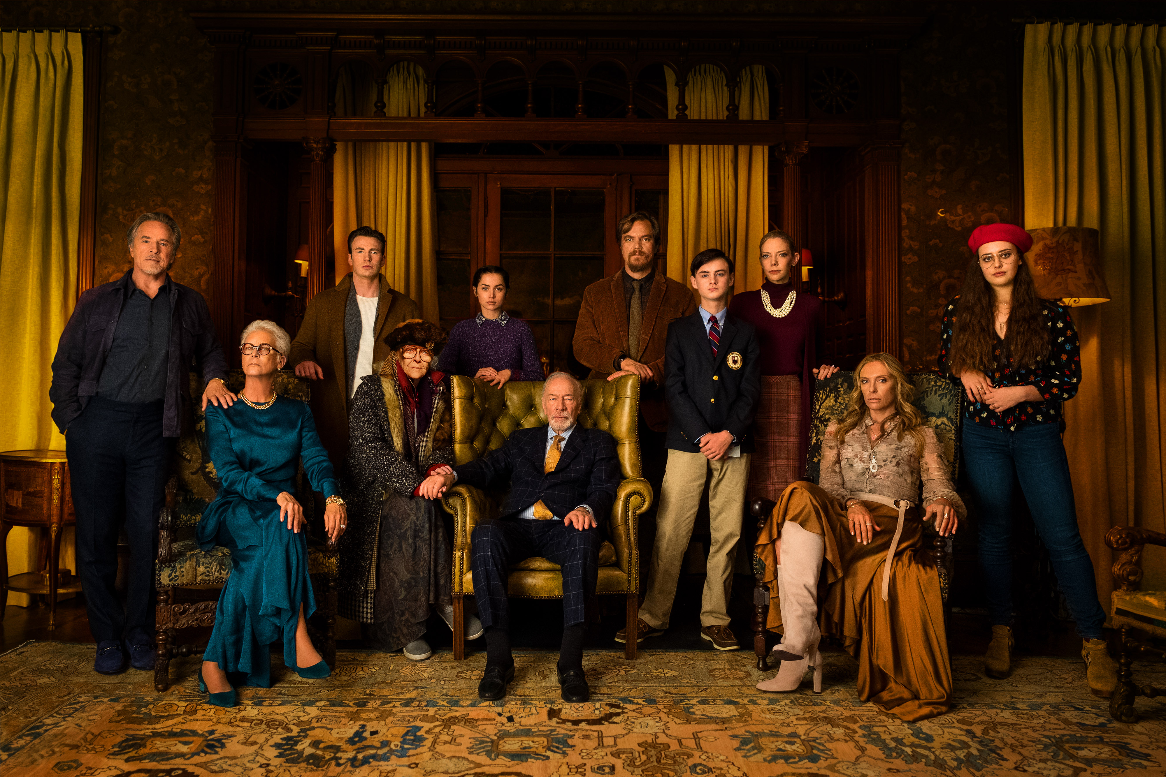
THE FAMILY

Slide 12
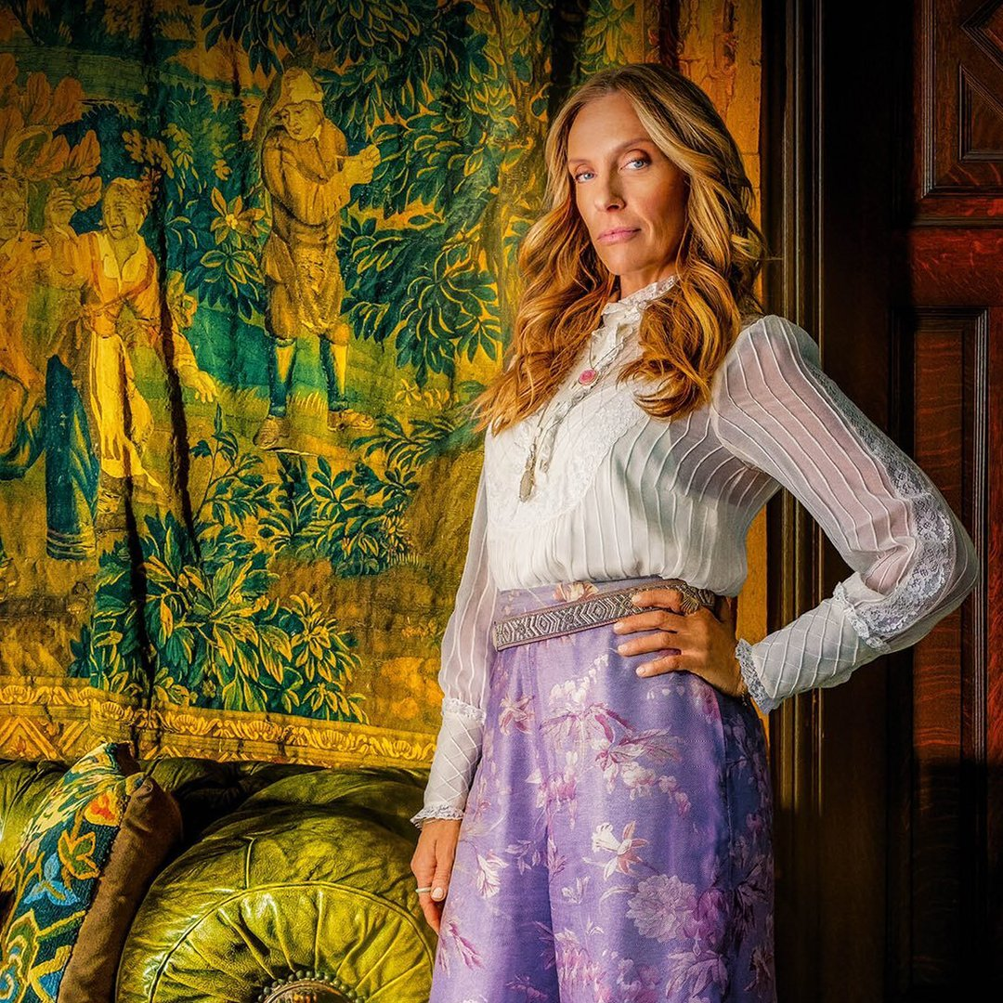
JONI THROMBEY
(TONI COLLETTE)
VALLEY GIRL
Open mouth
Uptalking
End-emphasis
“Who is that guy?” “You’re famous.”

Slide 13
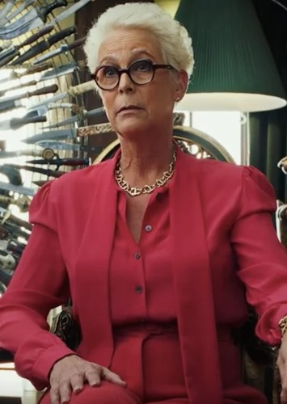
LINDA
DRYSDALE
(JAMIE LEE CURTIS)
GIRL BOSS
Rhotic (father, here)
T-flapping
Intrusion
https://www.youtube.com/watch?v=JZWtuAIM1Ak
(Listen to the difference of here with Linda and Mr. Blanc)

Slide 14
WATCH THE TRAILER HERE
https://www.youtube.com/watch?v=sL-9Khv7wa4

