Slide 1
“A true story that might not have happened” (Peter Stormare)

Slide 2
Cinematography & Reality What is the film? What was x is its purpose?

Slide 3
Film as an illusion of reality

Slide 4
What reality?
“PROJECTIVE ILLUSION” (Richard Allen)
we experience the film as a “fully realized world”, the active spectator voluntarily enters this illusion and participates on the experience
SUSPENSION OF DISBELIEF – a typical feature of media based on vision and sound, but especially film (we do not think about the film as a lie, we approach it with an intention to believe what is being shown
potential danger – propaganda, misrepresentation of history
Real emotional and physical consequences – our immersion into the “illusion” of film reality (how far can the filmmakers go & how far are we willing to follow = suspension of disbelief in practice on both sides)

Slide 5
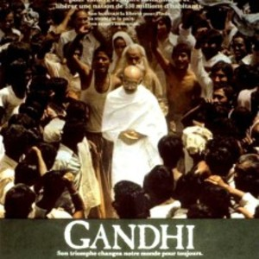
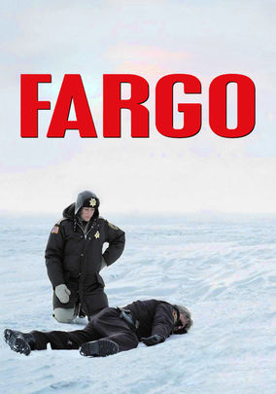
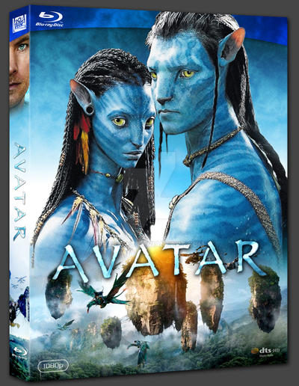
What is the relationship between the film and reality?
Documentary “objective reality” ???
Biography
Fiction (real-world setting)
Fiction (fictional-world setting)
?

Slide 6
Fargo – documentary or fiction?
Trailer
Disclaimer
Setting
Plot
Characters
Minimalist filmmaking
Camera work
“A reality-based crime drama set in Minnesota in 1987. […]”
Official MGM Trailer – https://www.youtube.com/watch?v=ju75Sd4yAZw

Slide 7
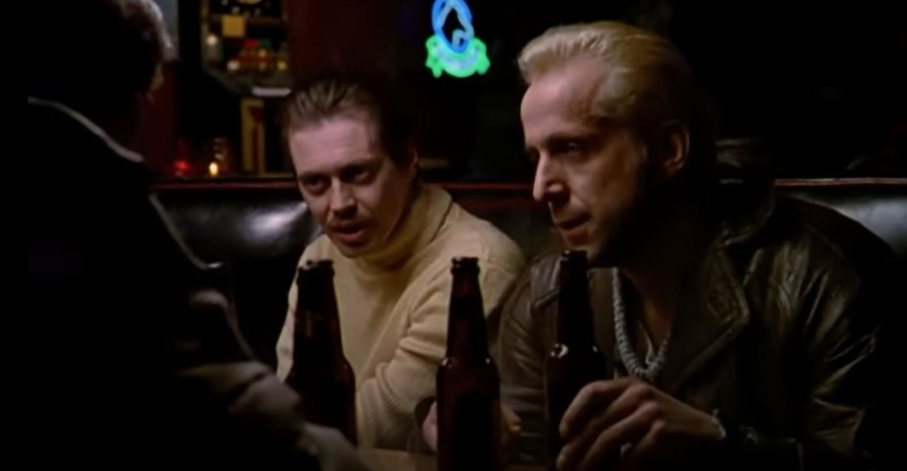
Camera work - invisible filmmaking in Fargo
position of the camera
Observational / objective
personalized / amidst the action

Slide 8
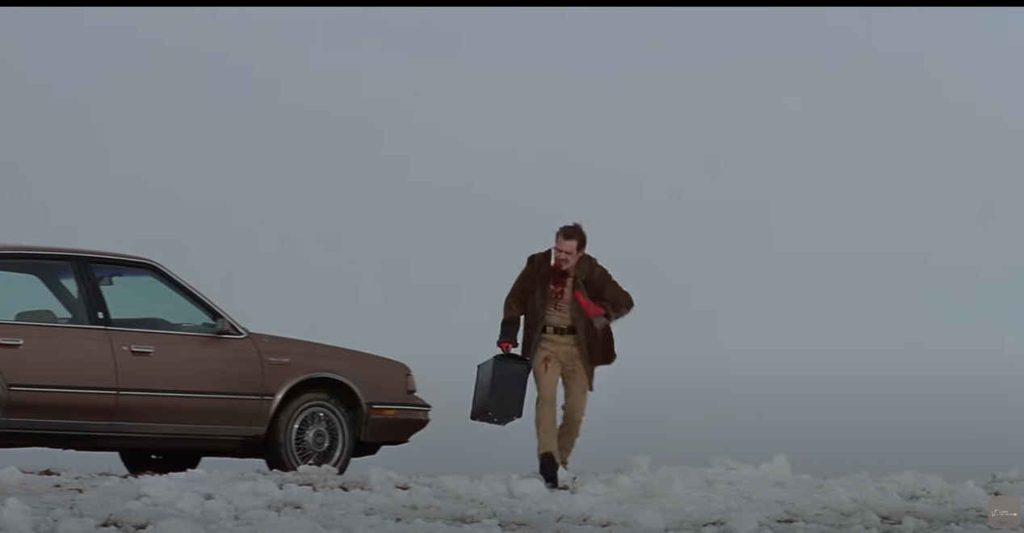
FRAMING as a central technique in Fargo WHAT/WHO is in the frame and WHERE

Slide 9
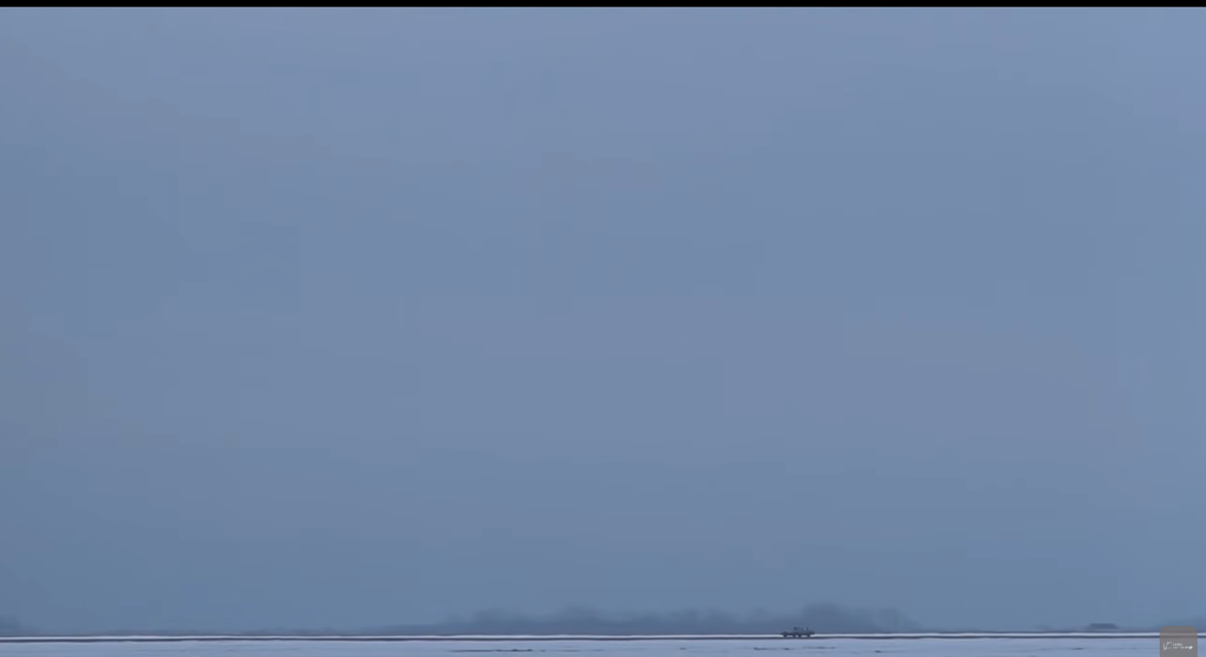
Creating the desolation of place

Slide 10
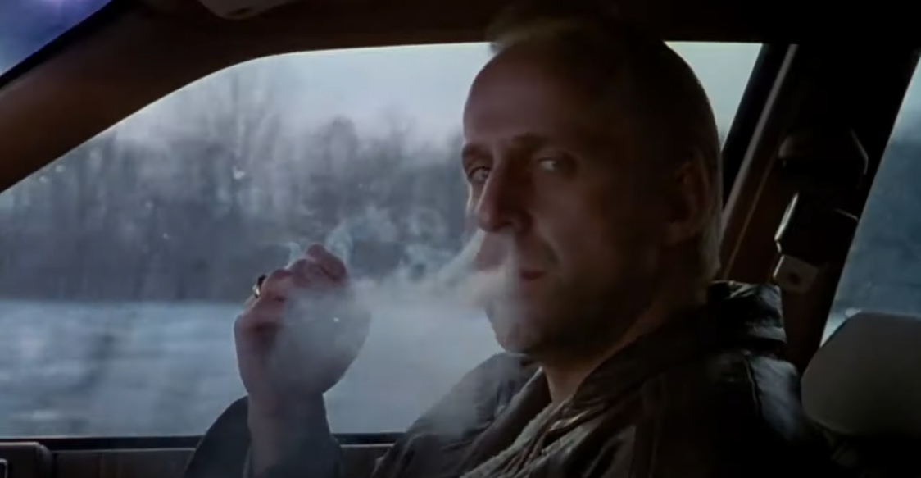
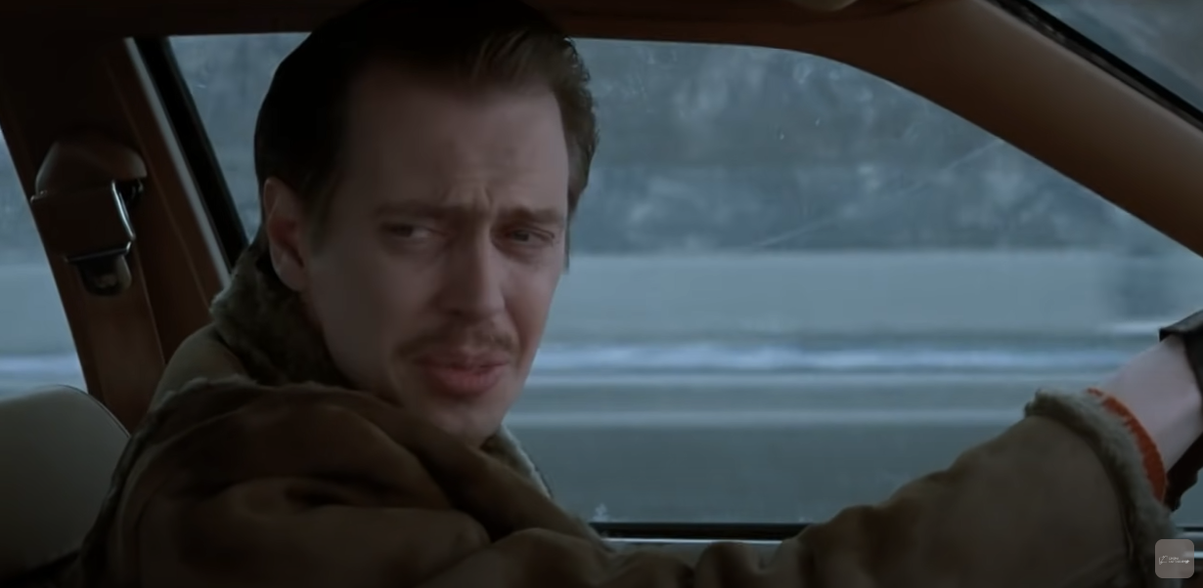
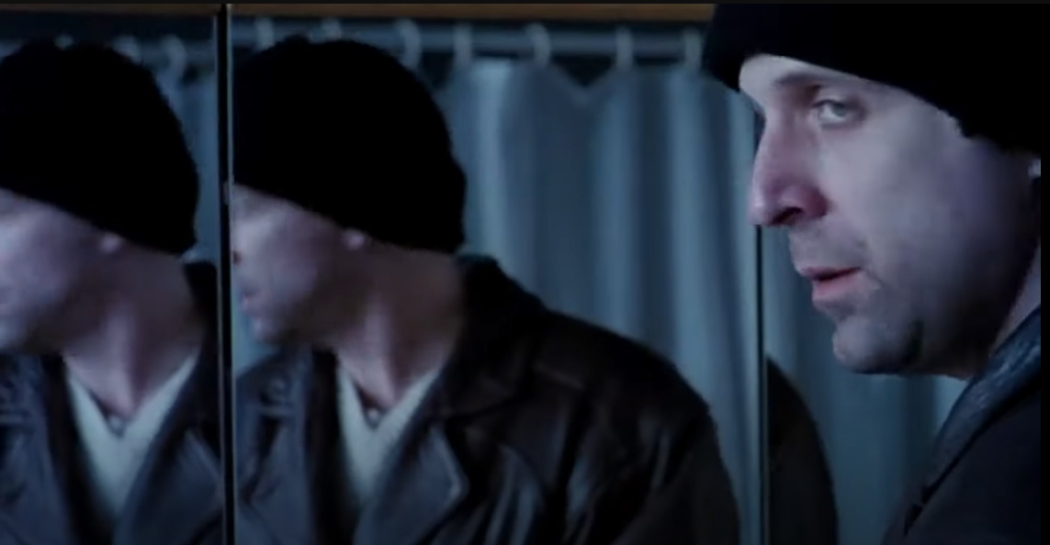
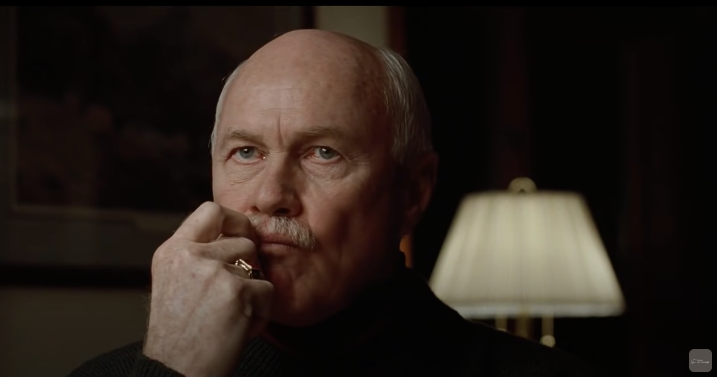
Characterization of the actors

Slide 11
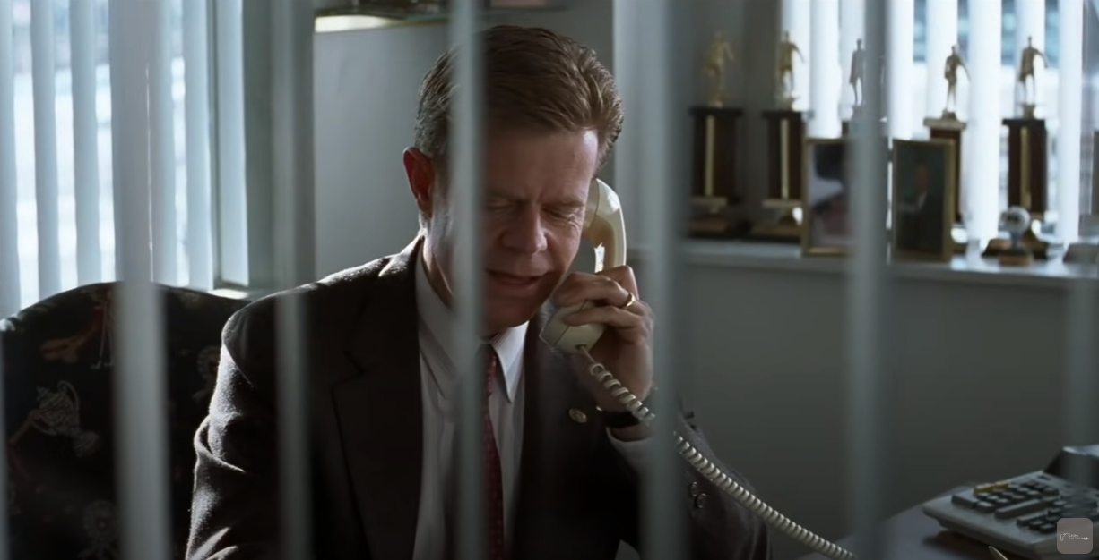
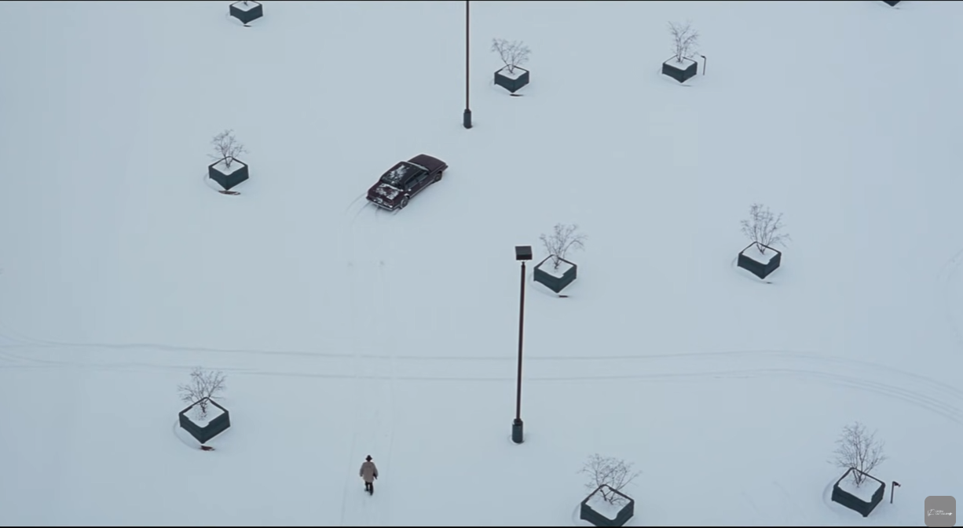
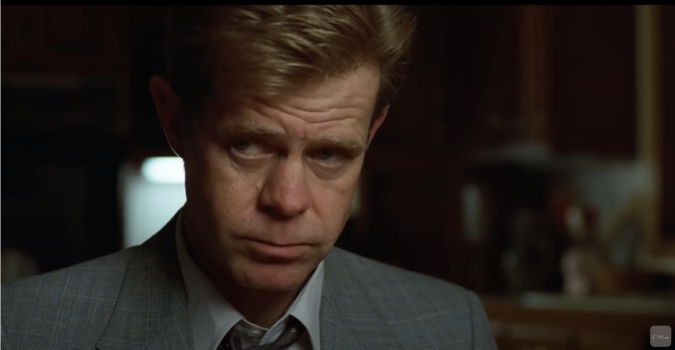
Isolation and desperation of a character (Jerry)

Slide 12
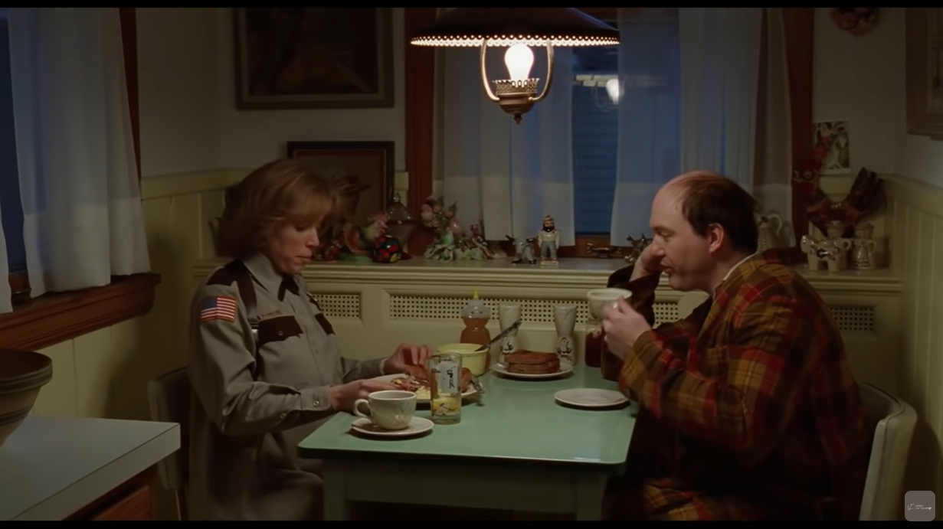
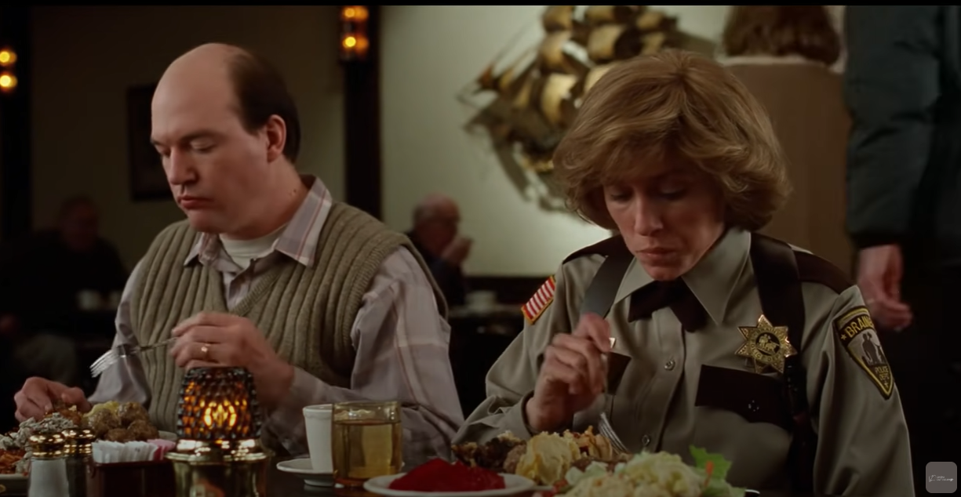
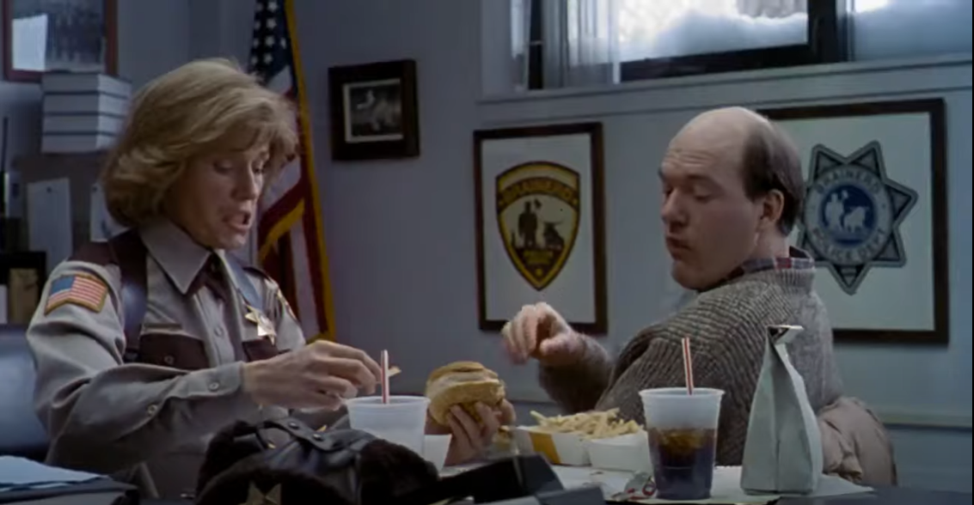
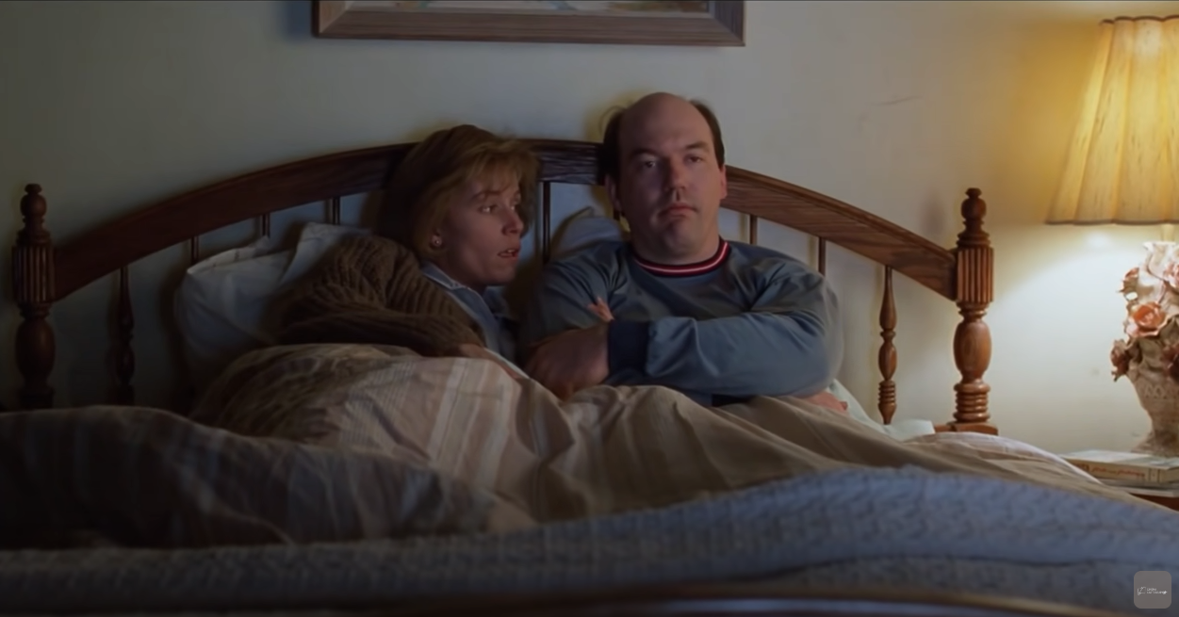
Support and involvement (Marge)

Slide 13
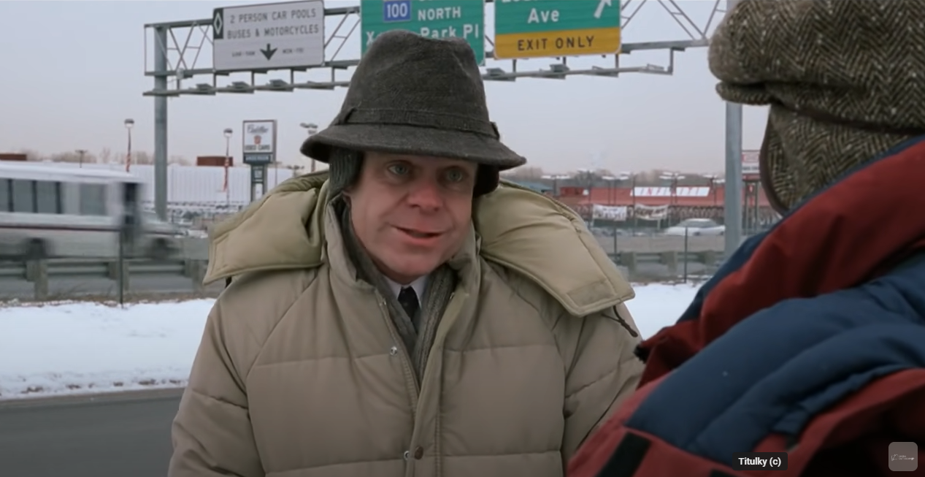
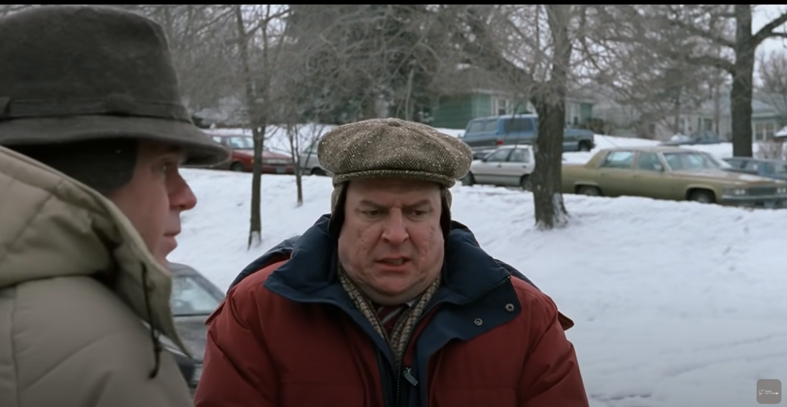
Shot – reverse shot “over the shoulder” typical for conversations

Slide 14
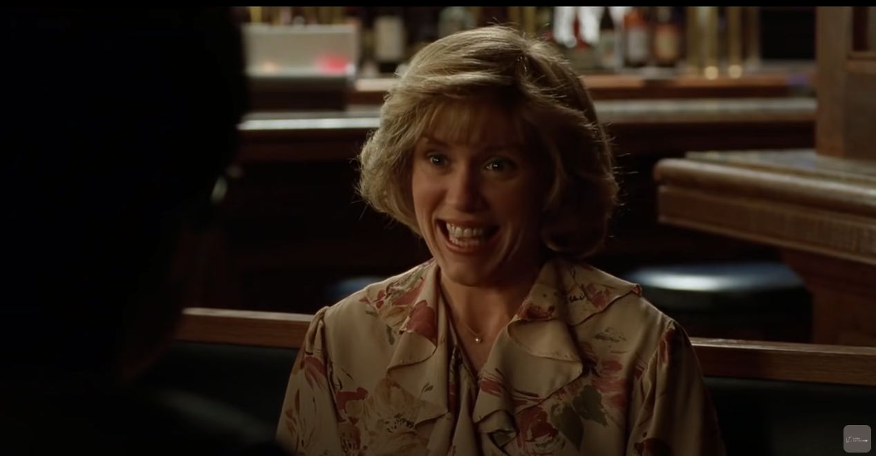
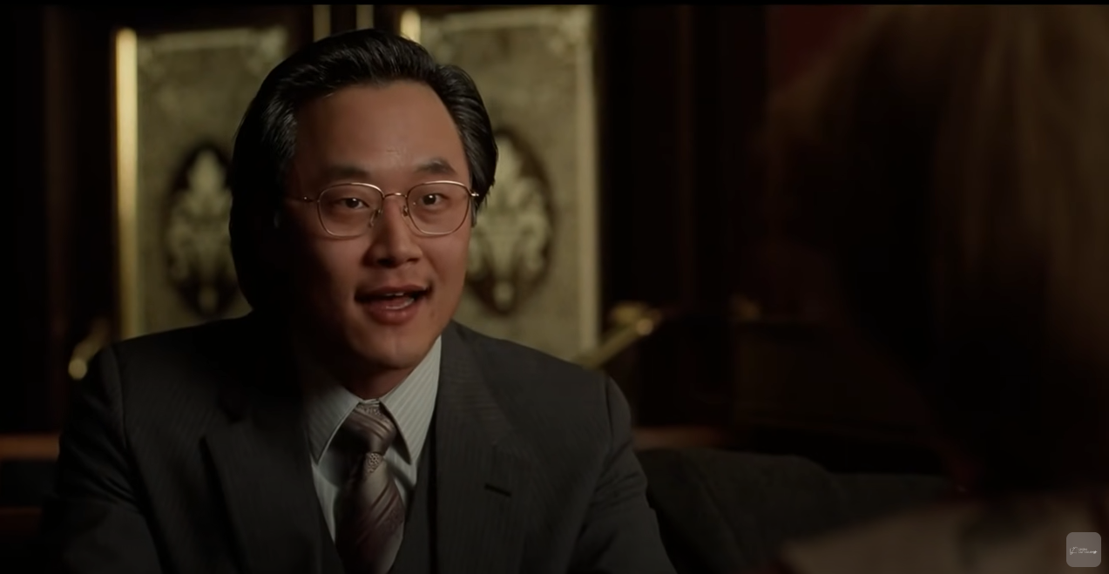
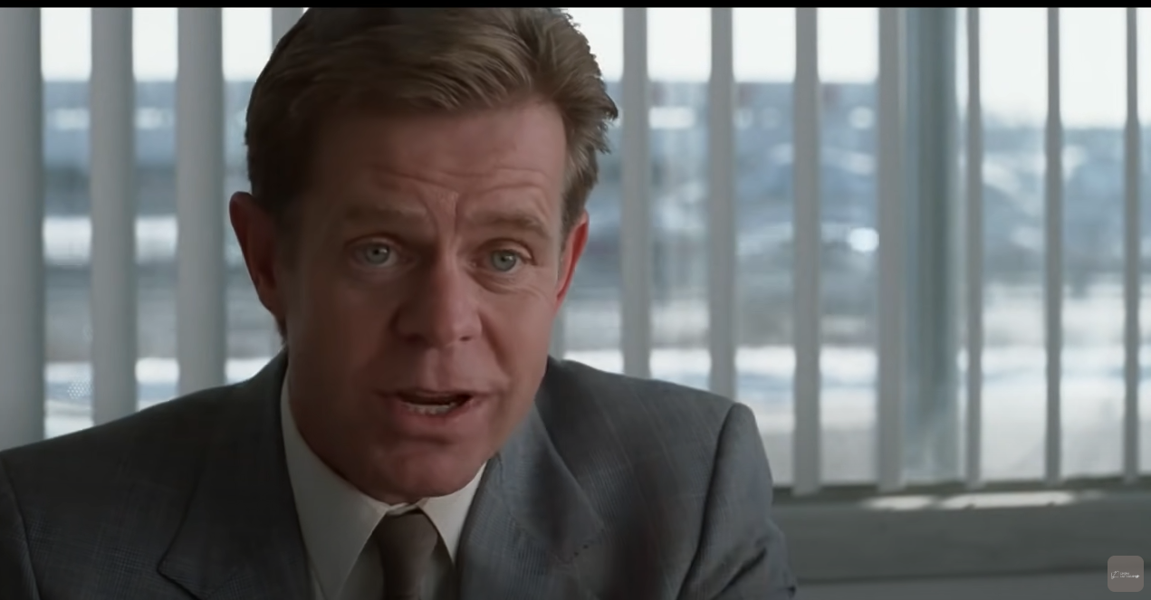
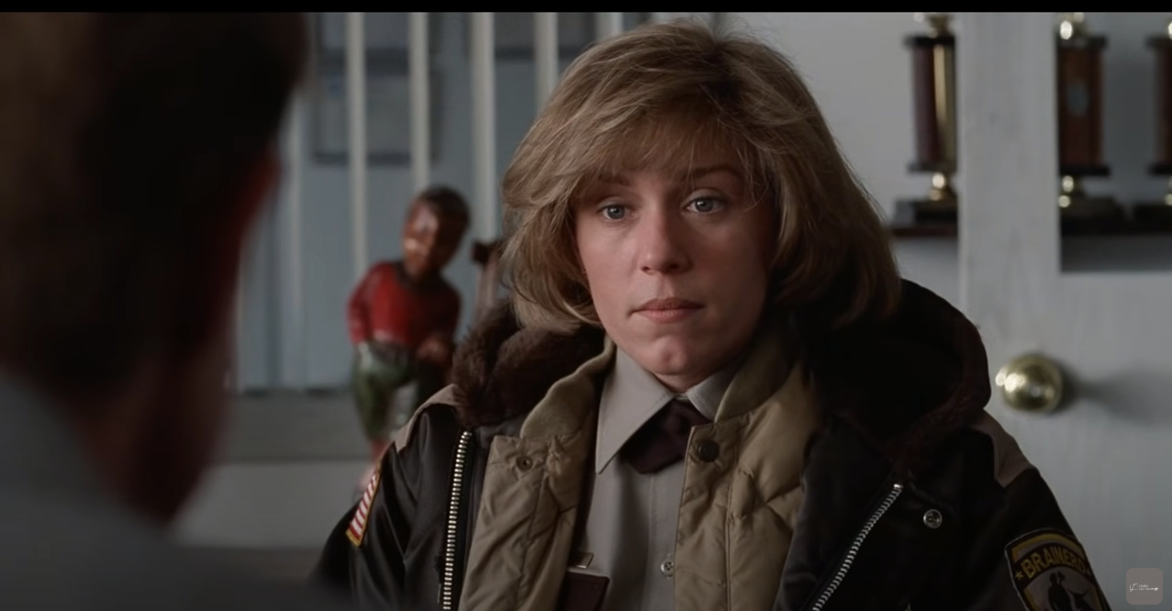
showing relationships through conversations

Slide 15
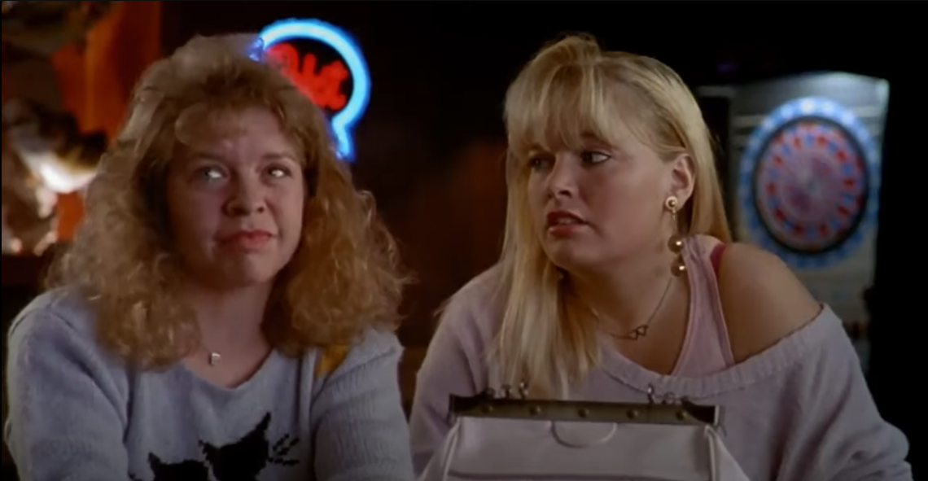
That’s it… Really? … Yeah!

Slide 16
Sources and other interesting materials:
https://www.youtube.com/watch?v=FW0NG-CGGRM - Fargo: The Coen Brothers and Frances McDormand interview (1997)
https://www.youtube.com/watch?v=2EFV_xyXH9I - reality in Christopher Nolan’s films
https://books.google.cz/books?hl=cs&lr=&id=6CtsiAEqemIC&oi=fnd&pg=PP15&dq=films+perception+reality&ots=JTAivAPZpn&sig=oKKavj8H643QyyhHkUn8YAL8pdc&redir_esc=y#v=onepage&q=films%20perception%20reality&f=false
Projecting Illusion: Film Spectatorship and the Impression of Reality: Richard Allen
https://www.youtube.com/watch?v=xjUtWpsbggo - 4 screenwriting secrets in Fargo
https://www.youtube.com/watch?v=rasAbD3Y60c - 7 Things You (Probably) Didn’t Know About Fargo!
https://www.youtube.com/watch?v=ju75Sd4yAZw - MGM official trailer
https://youtu.be/WxD0zbJV-VM- the interview where the actors and the directors discuss the reality of the film
https://www.youtube.com/watch?v=h-vVdxt_xtQ - Lewis Bond for The Cinema Cartography
https://www.youtube.com/watch?v=MO7DuX56lXg - Fargo – Discussing Minimalist Cinematography with Roger Deakins

