Slide 1


AJ5415 Storytelling for Young Learners
Kateřina Tomková, tomkat@phil.muni.cz
Block 1
Saturday, March 4, 2023

Slide 2
Course Information
This block option is held in room 62 on the 5th floor of building A on March 4 (Block 1) and May 6 (Block 2) from 2 to 7:50pm (twelve 50-minute sessions altogether).
By attending each block on-site you score 30+30pts.
Attendance online, in case of serious unability to attend on-site, yields 5pts. Link to join online:
Join Zoom Meeting
https://cesnet.zoom.us/j/7289230078
Meeting ID: 728 923 0078
By creating an audio/video-essay due in the File Vault (Poskytovna) by May 1 you score up to 40pts.
You need to score min. 70pts to pass the course worth 3 credits which represent 75 hours of work during the semester.

Slide 3
Our schedule today
1400-1600 Intro to Storytelling
1600-1630 Coffee break I & individual introspective task
1630-1800 Interactivity 1
1800-1820 Coffee break II & group discussion
1820-1930 Interactivity 2

Slide 4

Oral and Aural aspects of narrative:
* situational context and preparation
* diction
* relevance for listeners
* same context, different renditions

Slide 5
Resources
All is on the course‘s site in the IS:
- Block 1 and Block 2 presentations
- Rowling speech with gaps
- Limericks and AI
- Sting Russians Songfacts Lyrics
- Nursery Rhymes
- Fairy Tales
- Easter class in stress, rhythm and intonation
- Tomková Segmental pronunciation of English
- Tomková Suprasegmental pronunciation of English
- Tomková The best videos for teaching English pronunciation

Slide 6
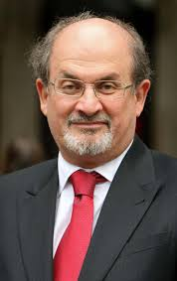
Storytelling as a basic human need
Salman Rushdie Teaches Storytelling and Writing | Official Trailer | MasterClass – YouTube

Slide 7
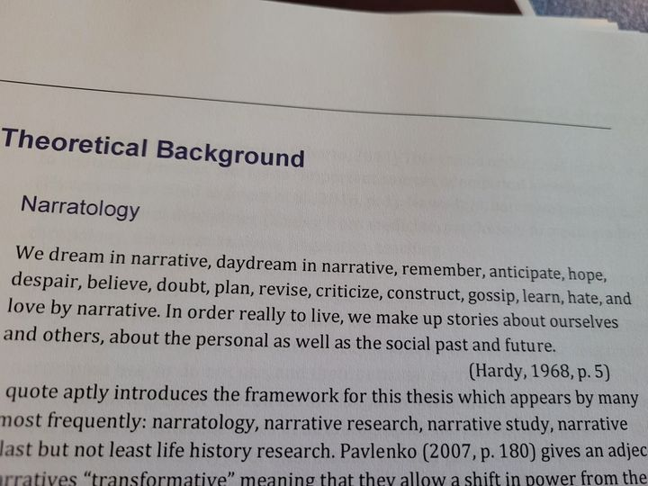
Hardy 1968
Daňková, G. (2023) Exploration of visual language learning histories. Unpublished master‘s thesis, MUNI.

Slide 8
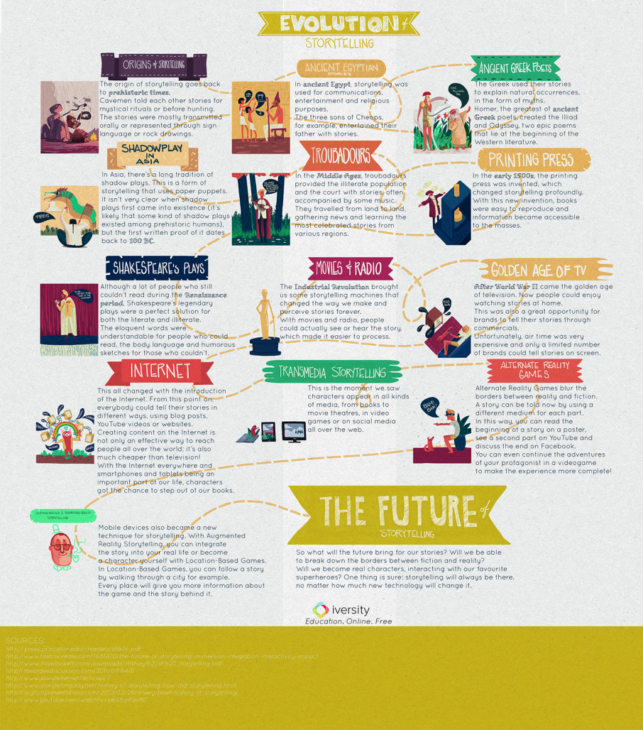
History of Storytelling

Slide 9
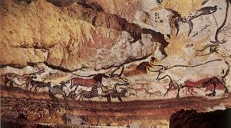
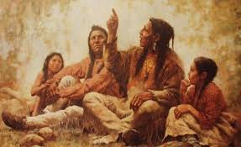
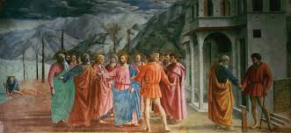
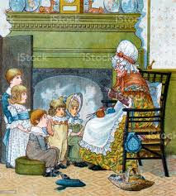
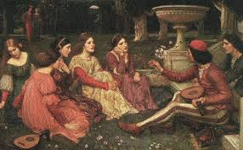
Storytelling since times immemorial

Slide 10
The world‘s greatest storytellers
Homer, Virgil, Aesop
Bocaccio, Dante
Chaucer
Shakespeare
Němcová
Čapek
Tolkien, Lewis, Pratchett
Sheherazad
Orson Welles
William Golding, Ernest Hemingway, the Grimms, Andersen, Hrubín…

Slide 11
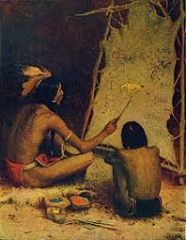
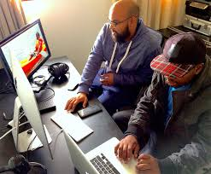
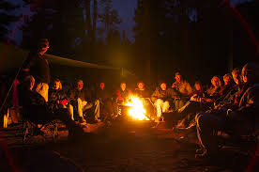

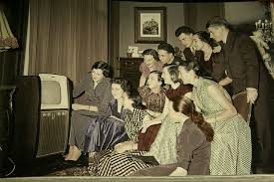
The same or different?

Slide 12
Storytelling today
In business: brands sharing their messages in ways that engage audiences and drive them to take a desired action (like making a purchase, calling a sales person, downloading or subscribing to content, etc.).
In politics: Political narrative as a term used in the humanities and political sciences the way in which storytelling can shape fact and impact on understandings of reality.
In teaching: Storytelling is the oldest form of teaching. It bonded the early human communities, giving children the answers to the biggest questions of creation, life, and the afterlife. Stories define us, shape us, control us, and make us. Not every human culture in the world is literate, but every single culture tells stories. =Failure stories are the best=
In law: ‘Liar Liar‘
The AI revolution

Slide 13
Storytelling for children
Vital for developing their imagination
Important for their spatial and time awareness
Crucial for developing their passive language sensitivity and active speaking skills
Integral for family/community bonding and solidarity among generations
Instrumental in shaping their view of the world (Sapir-Whorf hypothesis)

Slide 14
Storytelling for children in foreign language teaching
… at their state of cognition
The use of people, narratives and realities they know in their mother tongues
The use of their sense of formal structure, repetition, rhythm
Experientiality, well-being
Narrator‘s pronunciation and diction
Narrator‘s attention
Listener‘s personal involvement

Slide 15
Kinds of narratives
Rhymes and songs=memorised formats
(Budulinek, Father Abraham)
Fairy-tales
Simple real-life stories (Francesca, John, Meurig)
Family/community legends (Roots)
Urban legends (Mammoth‘s trap)

Slide 16
Coffee break 16-16:30
Individual research task:
Remember your earliest memory of being told a story, or a story told by a teacher at elementary school which may not have been related to the subject matter but remains a story you remember to this day.

Slide 17
Interactive block 16:30-18
Stories and contexts told across the room and screen.

Slide 18
Your Stories 1
Zahra A.: DON‘T LOOK IN THE MIRROR
Michaela A.: PROTECT YOURSELF
Oihane B.: APPRECIATE WHAT YOU HAVE
Andrea B.:
Petra B.: HORRORS OF THE PAST
Petra D.: ELEMENTARY ADVENTURE
Barbora F.: MYSTERIOUS STORY OF BLACKMAIL AND THREAT
Christiana G.: TYRANY & GUILT

Slide 19
Your Stories 2
Kateřina G.: A LESSON IN HAND WASHING
Lenka H.: DRINKING TO HEALTH
Andrea J.: NO NAIL BITING
Anastasiya L.: PORRIDGE FRIEND
Rocío M.B.: CRYBABY‘S TEARS
David M.S.: CREATE YOUR OWN GOD
Michal P.: HOW TO FIGHT A BEAR
Pavel P.: CRIME AND PUNISHMENT

Slide 20
Your stories 3
Saioa S.T.: STORY TRIPS
Ondřej S.:
Elias T.: FIT FOR SCHOOL
Táňa T.: EVEN BASIC QUESTIONS WELCOME!
Aneta T.: TRAIN TO JOY
Daniel T.C.: CLEANING AFTER PIPPIN
Kristýna T.: ANGRY DRIVING = DRUNK DRIVING
Tomáš U.: GOD‘S POWER

Slide 21
18:20-19:30 Team Discussion
Form teams containing 4-6 ppl. Give your team a name. Discuss whether you‘ll be sharing opinions on HOW TO SPEAK TO CHILDREN ABOUT WAR, or THE CURRENT POSSIBILITIES OF AI.
Team 1: THE INCREDIBLES
Team 2:LIZARDS
Team 3: THE EXOTIC
Team 4: PANDAS

Slide 22
Homework: spoken essay
Make a 5+minute recording about how storytelling can be implemented in your daily personal/professional life, or create a more theoretical audio/video essay about storytelling, AI, the current wartime narrative. Upload it in the File Vault (Poskytovna) by May 1.
Before the next block on May 6, listen to your peers‘ recordings and be ready to discuss them in class. For inspiration, go to Spring 2021 and 2022 File Vaults.

Slide 23

I am now free for individual /group consultations
Peace with you!

