Slide 1
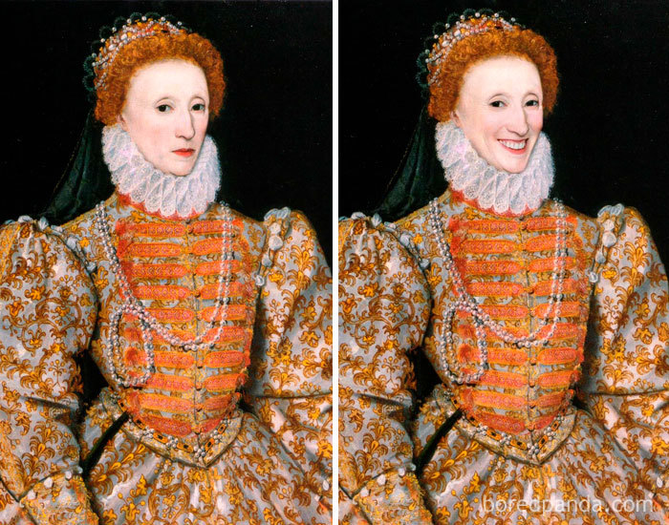
Reine Elizabeth 1

Slide 2
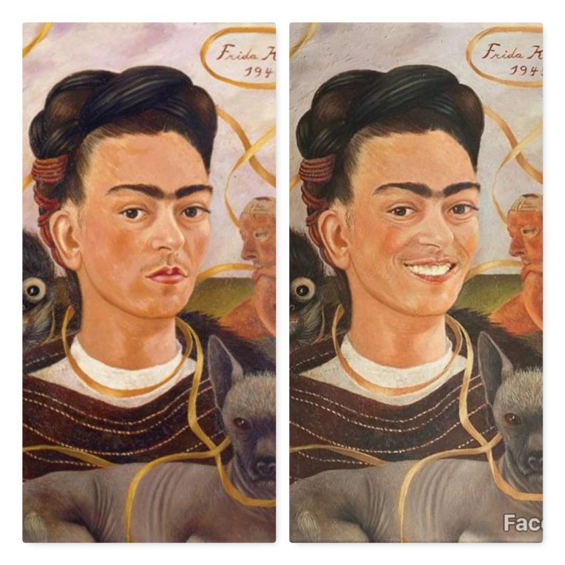

Slide 3
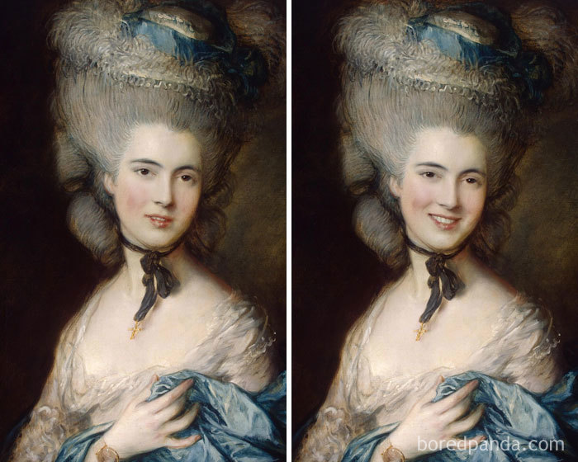
Lady In Blue By Thomas Gainsborough

Slide 4
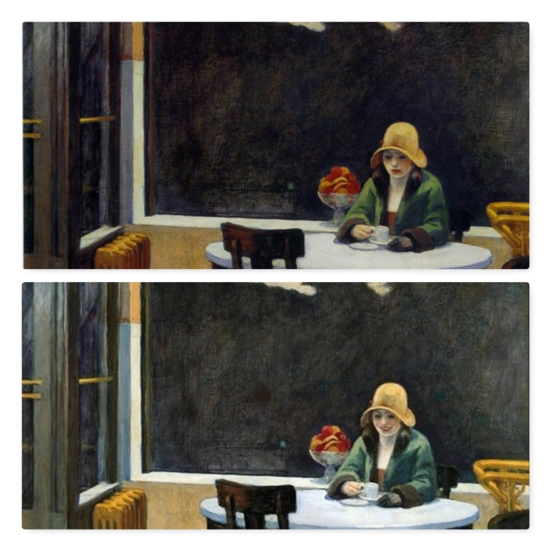

Slide 5
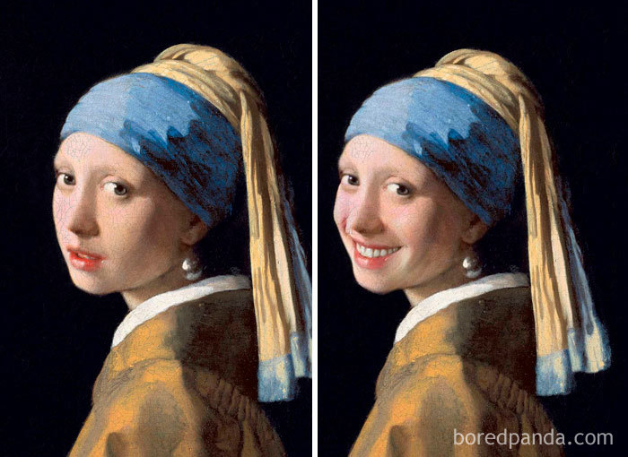
Girl With A Pearl Earring By Johannes Vermeer

Slide 6
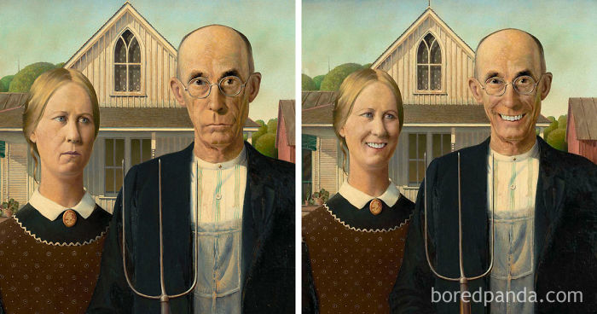

Slide 7
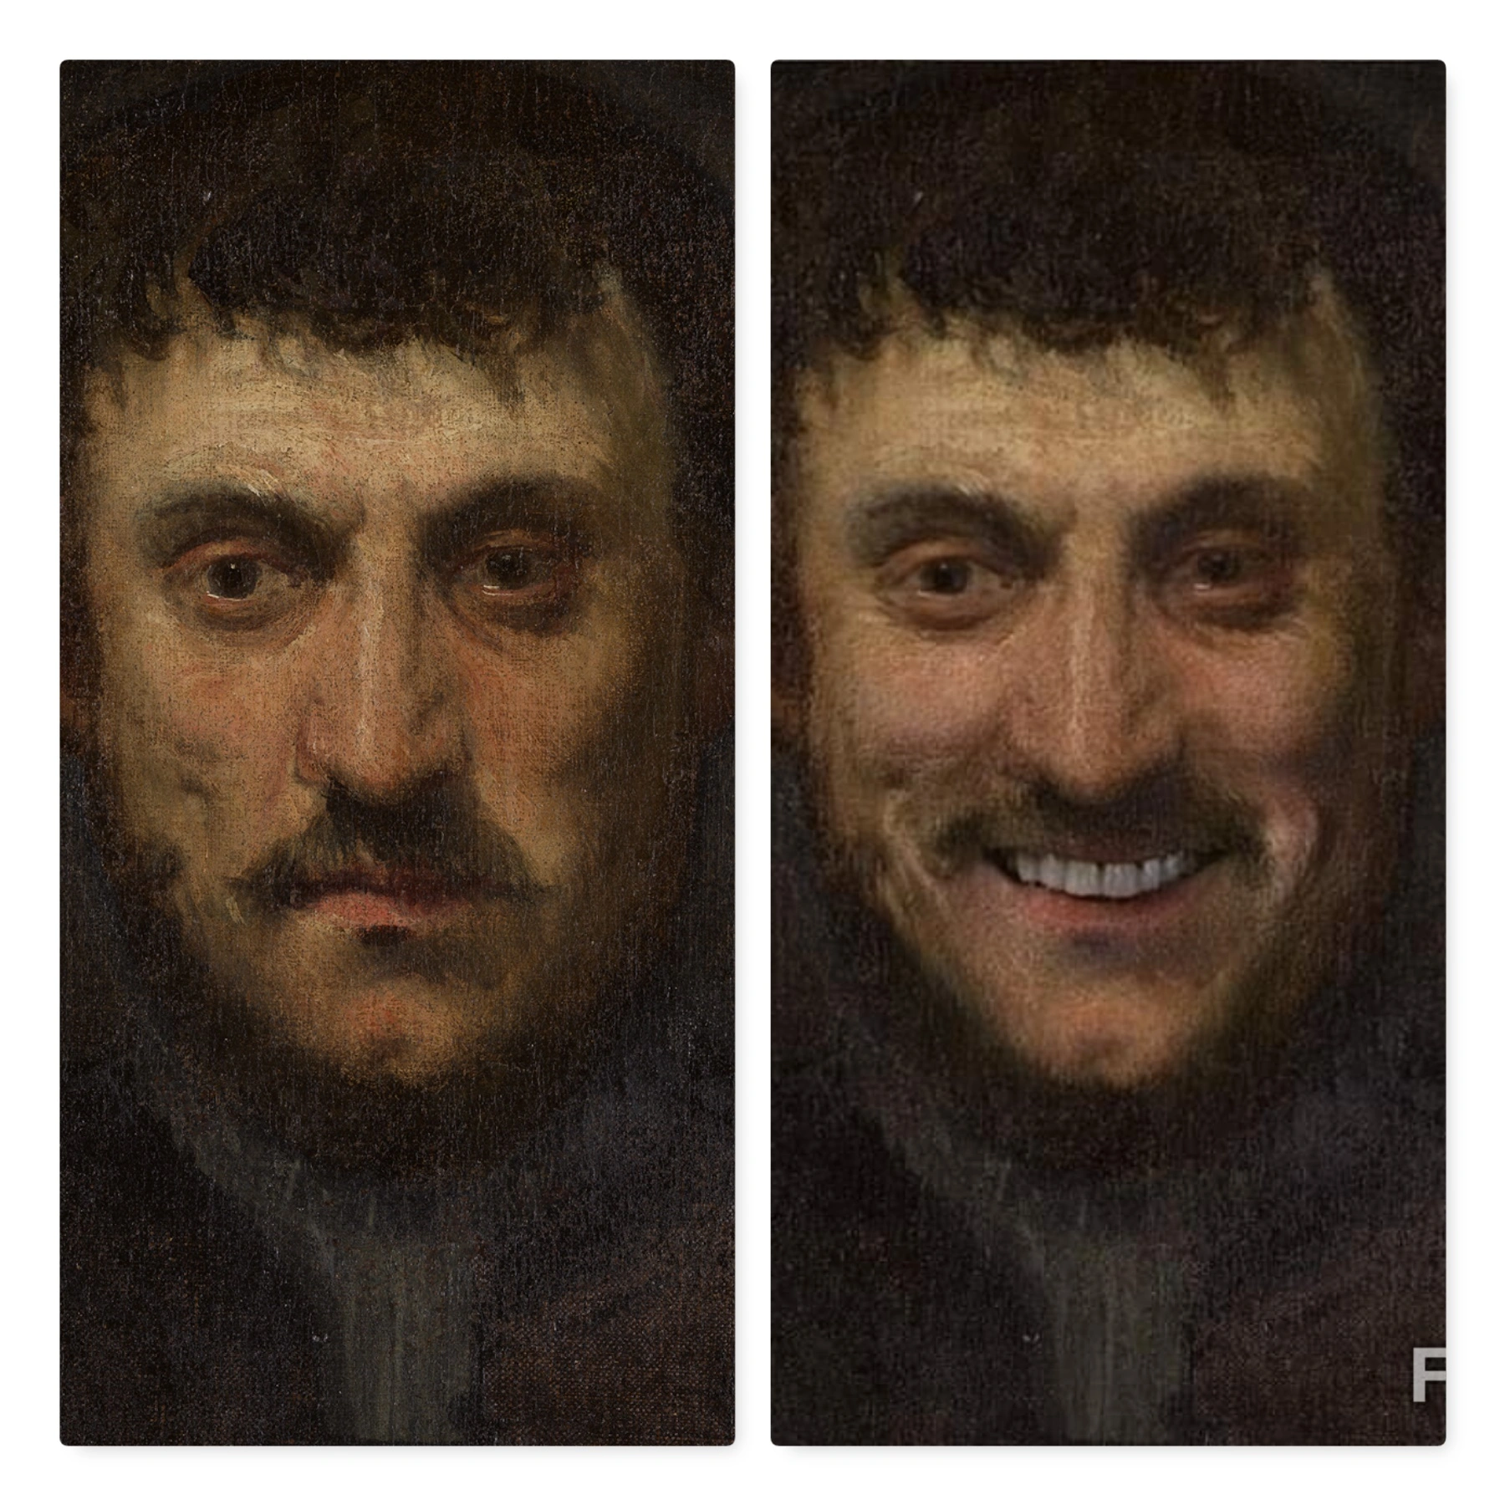

Slide 8
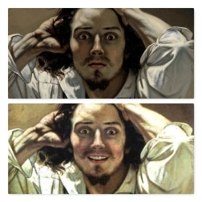
The Desperate Man By Gustave Courbet

Slide 9
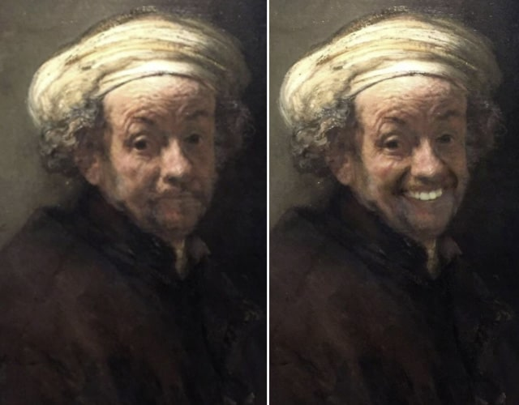

Slide 10
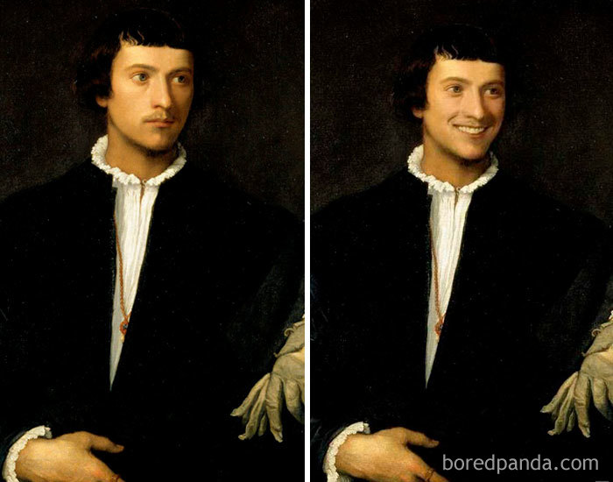
Man With A Glove By Titian

Slide 11
D’autres portraits à qui on a redonné le sourire :
https://www.boredpanda.com/famous-classical-paintings-with-smile-koty2/?utm_source=google&utm_medium=organic&utm_campaign=organic
https://www.demilked.com/famous-portraits-smiling-faceapp/

