Slide 1
Phonetics 2
Week 3

Slide 4
Can you produce all the sounds?
Which of the signs do you find difficult?
Which sounds do you find difficult?

Slide 5
Cheese – cheers
Knee – near
We – we‘re
D – dear
Leave – live
Feel – fill
Field – filled
Team - Tim
Pool – pull
Fool – full
Luke – look
Pool – pull
Match – much
Ran – run
Sang – sung
Rang – rung
Walk – work
Born – burn
Short – shirt
Board – bird
Men – man
Said – sad
Met – mat
Set – sat

Slide 6
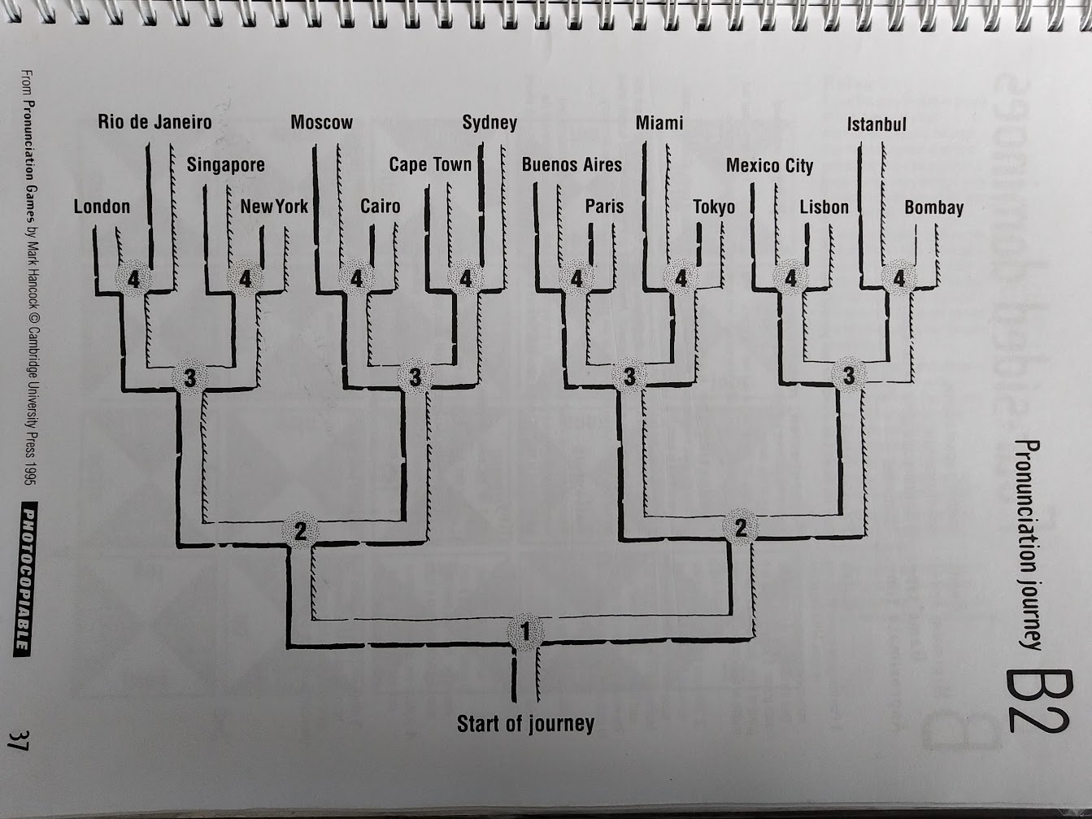
Rules:
Define which sound goes which way.
One reads out words, the other follows the route in their head.
Check together.
(If too difficult, check after each word.)
Cheese – cheers
Knee – near
We – we‘re
D – dear
Leave – live
Feel – fill
Field – filled
Team - Tim
Pool – pull
Fool – full
Luke – look
Pool – pull
Men – man
Said – sad
Met – mat
Set – sat
Match – much
Ran – run
Sang – sung
Rang – rung
Walk – work
Born – burn
Short – shirt
Board – bird

Slide 9


Slide 12
Bug in a rug
“I need my sleep tonight, “ says bug.
“Tomorrow I start work for slug.”
Bug hugs his bear he starts to nap.
Then he hears barking… Yap, Yap, Yap.
Bug plugs his ears, but all too soon…
Owl is hooting at the moon… T-wit T-woo!
A car alarm adds to the row… parb beep parb
I can´t sleep now!
Bug plods to work. His eyes feel sore.
Slug´s going out. “Bug, mind the store!”
“I feel so sleepy now,” thinks Bug.
“And all these rugs look soft and snug…”
When slug comes back at 10 o´clock…
…his store is packed, it´s quite a shock.
The shoppers want a rug from slug.
Soon we shall be as snug as Bug!

Slide 13
Week 3 – fricatives

Slide 14
Fricatives
What makes these two groups different?
What problems can we expect?
Week 3 – fricatives

Slide 17
Problems?
s
θ
Baker, Ann. Ship or Sheep? Book and Audio CD Pack: An Intermediate Pronunciation Course. Cambridge University Press, 2006.

Slide 18
Problems?
t
θ
Baker, Ann. Ship or Sheep? Book and Audio CD Pack: An Intermediate Pronunciation Course. Cambridge University Press, 2006.

Slide 19
Problems?
d
δ
Baker, Ann. Ship or Sheep? Book and Audio CD Pack: An Intermediate Pronunciation Course. Cambridge University Press, 2006.

Slide 20
Baker, Ann. Ship or Sheep? Book and Audio CD Pack: An Intermediate Pronunciation Course. Cambridge University Press, 2006.

Slide 21
Baker, Ann. Ship or Sheep? Book and Audio CD Pack: An Intermediate Pronunciation Course. Cambridge University Press, 2006.

Slide 22
Problems?
f
θ
Baker, Ann. Ship or Sheep? Book and Audio CD Pack: An Intermediate Pronunciation Course. Cambridge University Press, 2006.

Slide 23
Problems?
f
v
Baker, Ann. Ship or Sheep? Book and Audio CD Pack: An Intermediate Pronunciation Course. Cambridge University Press, 2006.

Slide 24
Problems?
w
v
Baker, Ann. Ship or Sheep? Book and Audio CD Pack: An Intermediate Pronunciation Course. Cambridge University Press, 2006.

Slide 25
Problems?
z
δ
Baker, Ann. Ship or Sheep? Book and Audio CD Pack: An Intermediate Pronunciation Course. Cambridge University Press, 2006.

Slide 26
Problems?
s
z
Baker, Ann. Ship or Sheep? Book and Audio CD Pack: An Intermediate Pronunciation Course. Cambridge University Press, 2006.

Slide 27
Problems?
https://supersimple.com/song/farmer-in-the-dell-finny-the-shark/
s
z

Slide 28
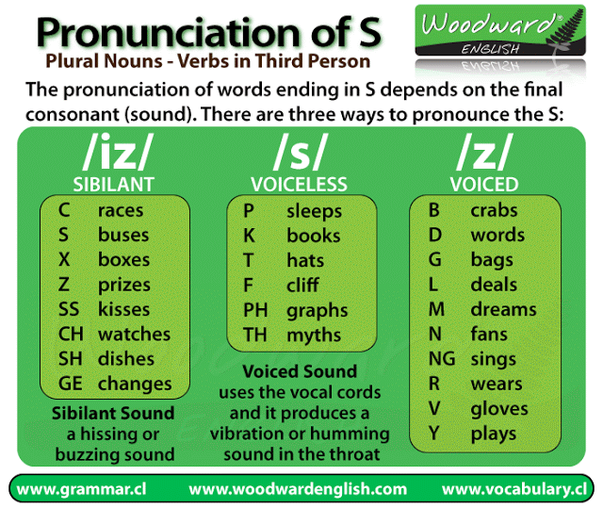
https://www.google.com/url?sa=i&url=https%3A%2F%2Fwww.pinterest.com%2Fpin%2F430516045623053861%2F&psig=AOvVaw0KDh485XELwtpDI7GrkiJQ&ust=1664566586926000&source=images&cd=vfe&ved=0CAwQjRxqFwoTCPj83vbfuvoCFQAAAAAdAAAAABAD

Slide 29
Bug in a rug
“I need my sleep tonight, “ says bug.
“Tomorrow I start work for slug.”
Bug hugs his bear he starts to nap.
Then he hears barking… Yap, Yap, Yap.
Bug plugs his ears, but all too soon…
Owl is hooting at the moon… T-wit T-woo!
A car alarm adds to the row… parb beep parb
I can´t sleep now!
Bug plods to work. His eyes feel sore.
Slug´s going out. “Bug, mind the store!”
“I feel so sleepy now,” thinks Bug.
“And all these rugs look soft and snug…”
When slug comes back at 10 o´clock…
…his store is packed, it´s quite a shock.
The shoppers want a rug from slug.
Soon we shall be as snug as Bug!

