Slide 1
Phonetics 2
Week 5 – the rest of the consonants

Slide 2
Past tense snap!

Slide 3
Chants
What are they? What are they good for?
Can they help you to learn?
Can they help you to teach?
Notes:
Talk about chants – think, pair, share
Do the chant Who‘s this as described in the book
Show them the information in the book. You have done this – what would you do next to provide more personalised dril to your students? Design an activity in your group and then we will show them to each other/discuss/try them out (depending on time)

Slide 4
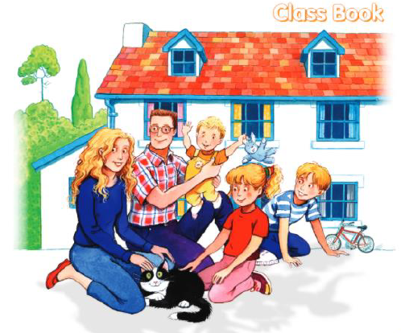

What would you do with this?

Slide 5
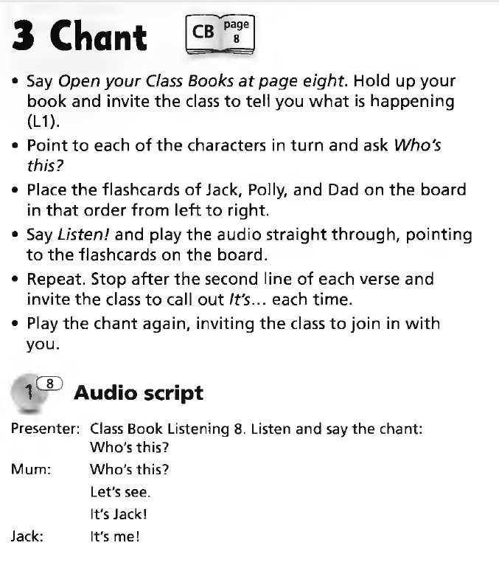
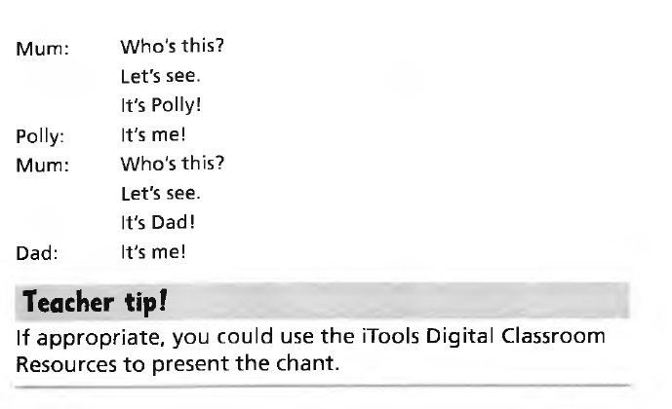

Slide 6
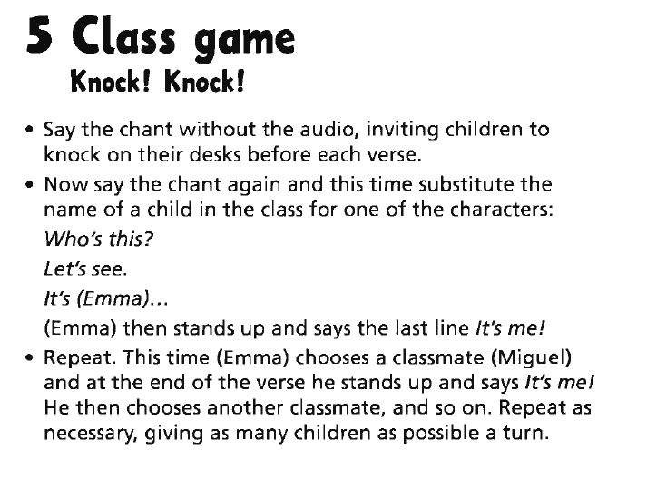

Slide 7
How to creat a jazz chant
Have you thought about your jazz chant?
https://www.youtube.com/watch?v=U5bIXaKxcvs
https://www.youtube.com/watch?v=ZXItVqHL_VY
Examples:
https://www.youtube.com/watch?v=Jb9jq0oTxZg&list=PLauwxQ-VGyUvLfP5Ckk_ajLSmH0fIuibj&index=13
https://www.youtube.com/watch?v=ijxRuVE4gWo&list=PLauwxQ-VGyUvLfP5Ckk_ajLSmH0fIuibj&index=39
https://www.youtube.com/watch?v=nO_55r1PEKQ&list=PLauwxQ-VGyUvLfP5Ckk_ajLSmH0fIuibj&index=4

Slide 8
H, W, J
What problems can we expect?

Slide 9
Baker, Ann. Ship or Sheep? Book and Audio CD Pack: An Intermediate Pronunciation Course. Cambridge University Press, 2006.

Slide 10
https://www.youtube.com/watch?v=uKxd30lQ1f0&t=223s
Listen and find which sounds they focus on
What did you learn about the English pronunciation of H

Slide 11
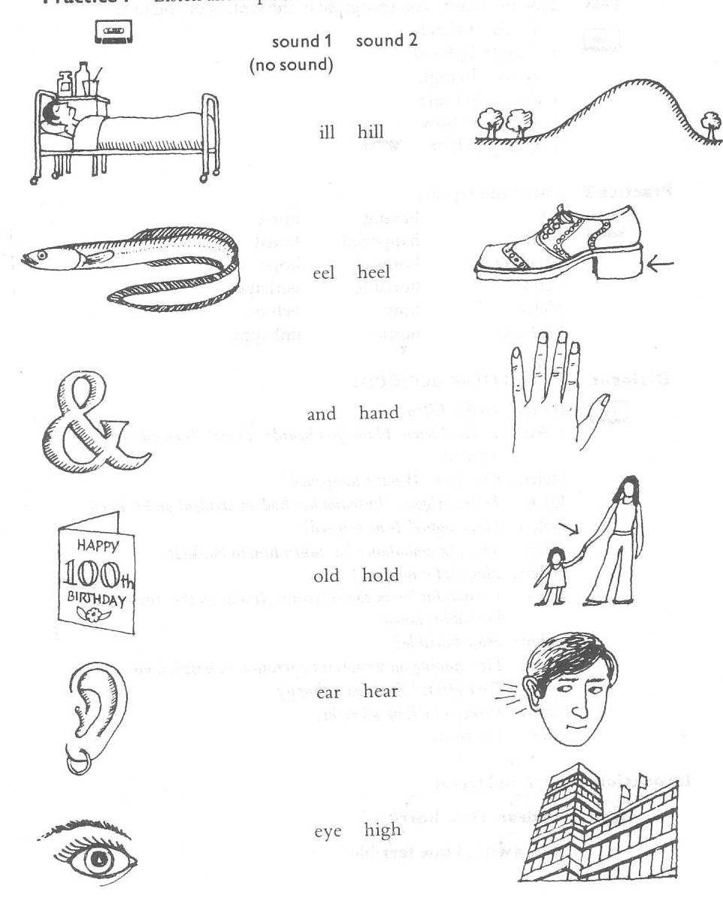

Slide 14
L, R
What problems do we expect?

Slide 16
What problems can we expect?

Slide 18
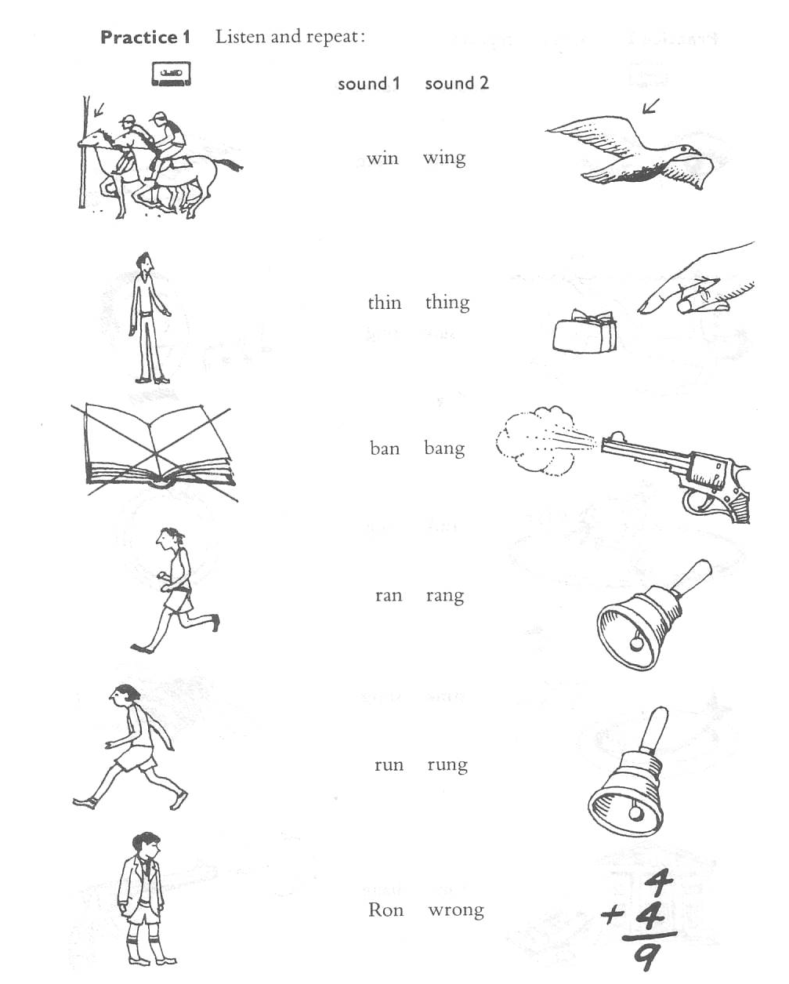
Baker, Ann. Ship or Sheep? Book and Audio CD Pack: An Intermediate Pronunciation Course. Cambridge University Press, 2006.

Slide 19
Baker, Ann. Ship or Sheep? Book and Audio CD Pack: An Intermediate Pronunciation Course. Cambridge University Press, 2006.

Slide 20
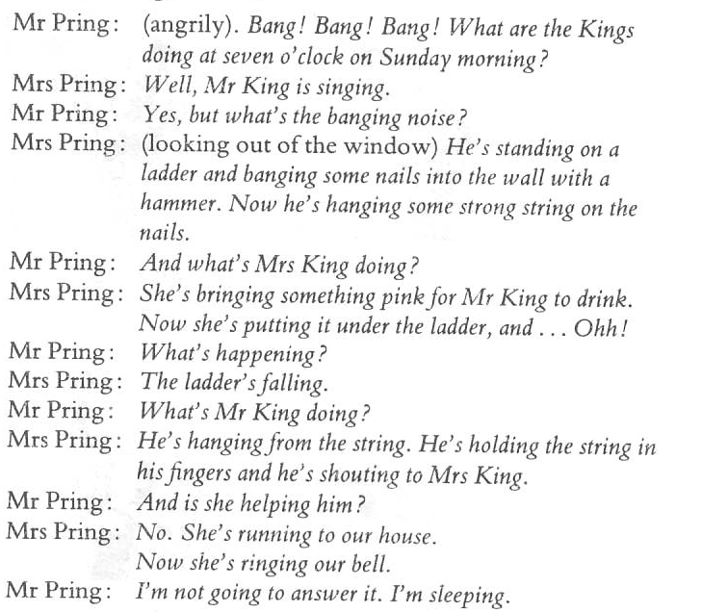
Baker, Ann. Ship or Sheep? Book and Audio CD Pack: An Intermediate Pronunciation Course. Cambridge University Press, 2006.

Slide 21
More ways to practice
https://www.youtube.com/watch?v=jmtOKfTEBh8
https://www.youtube.com/watch?v=amQDqMdDERg

Slide 22
Books
Find examples of difficult words in your book

