Slide 1
Phonetics 2
Week 10
Sentence stress
Linking

Slide 2
Revision – read the words and mark the stress
rɪdɪkjʊləs
ɪlæstɪk
fəʊtəɡræfɪk
tiːtʃɪŋ
lɜː(r)nɪŋ
kjʊəriəs
ʌnjuːʒʊəl
rɪˈdɪkjʊləs
ɪˈlæstɪk
ˌfəʊtəˈɡræfɪk
ˈtiːtʃɪŋ
ˈlɜː(r)nɪŋ
ˈkjʊəriəs
ʌnˈjuːʒʊəl

Slide 7
Weak forms
Match the strong and the weak forms

Slide 8
ə
ə
ɪ
ə
ə
ə

Slide 9
Underline all the stressed syllables.
Circle all weak forms
ə
ə
ɪ
ə
ə
ə

Slide 10


Slide 12
Linking

Slide 13
Linking
A word starting with a VOWEL links to the word BEFORE
The word before ends with a consonant:
PETS ENTER

Slide 15


Slide 21
Linking
A word starting with a VOWEL links to the word BEFORE
The word before ends with a consonant:
PETS ENTER
The word before ends with an ɪ or i: sound
HE_{J} EARNS
The word before ends with an ʊ or u: sound
YOU_{W} ACHE

Slide 23
Linking
A word starting with a VOWEL links to the word BEFORE
The word before ends with a consonant:
PETS ENTER
The word before ends with an ɪ or i: sound
HE_{J} EARNS
The word before ends with an ʊ or u: sound
YOU_{W} ACHE
The word before ends with a r sound
HER ACE

Slide 25
Linking - consonant sounds

Slide 27
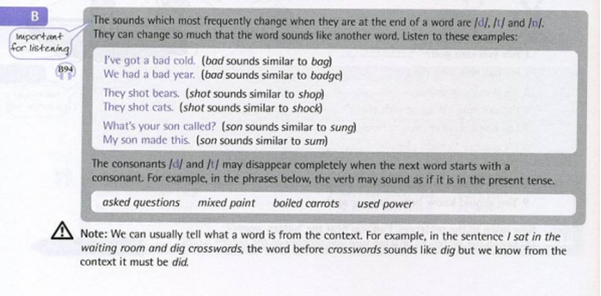

Slide 29
Underline all the stressed words.
Circle all weak forms
Mark all the linking
ə
ə
ɪ
ə
ə

Slide 30


