Slide 1
AJ5415 Storytelling for Young Learners
Kateřina Tomková, tomkat@phil.muni.cz
Block 1
Saturday, March 2, 2024

Slide 2
Course Information
This block option is held in room 50 on the ground floor of building A on March 4 (Block 1) and May 11 (Block 2) from 2 to 7:50pm (twelve 50-minute sessions altogether).
By attending each block on-site you score 30+30pts.
Attendance online, in case of serious unability to attend on-site, yields 5pts. Link to join online:
Join Zoom Meeting
https://cesnet.zoom.us/j/7289230078
Meeting ID: 728 923 0078
By creating an audio/video-essay due in the File Vault (Poskytovna) by May 5 you score up to 40pts.
You need to score min. 75pts to pass the course worth 3 credits which represent 75 hours of work during the semester.

Slide 3
Our schedule today
1400-1600 Intro to Storytelling (120 mins)
1600-1630 Coffee break I & individual introspective task (30 mins)
1630-1800 Interactivity 1 (90 mins)
1800-1835 Coffee break II & group discussion (35 mins)
1835-1940 Interactivity 2 (90 mins)

Slide 4
Oral and Aural aspects of narrative: * situational context and preparation * diction * relevance for listeners * same context, different renditions

Slide 5
Resources
All is on the course‘s site in the IS:
- Block 1 and Block 2 presentations
- Rowling speech with gaps
- Limericks and AI
- Sting Russians Songfacts Lyrics
- Nursery Rhymes
- Fairy Tales
- Easter class in stress, rhythm and intonation
- Tomková Segmental pronunciation of English
- Tomková Suprasegmental pronunciation of English
- Tomková The best videos for teaching English pronunciation

Slide 6
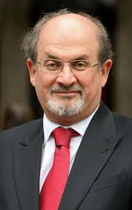
Storytelling as a basic human need
Salman Rushdie Teaches Storytelling and Writing | Official Trailer | MasterClass – YouTube
2:32

Slide 7
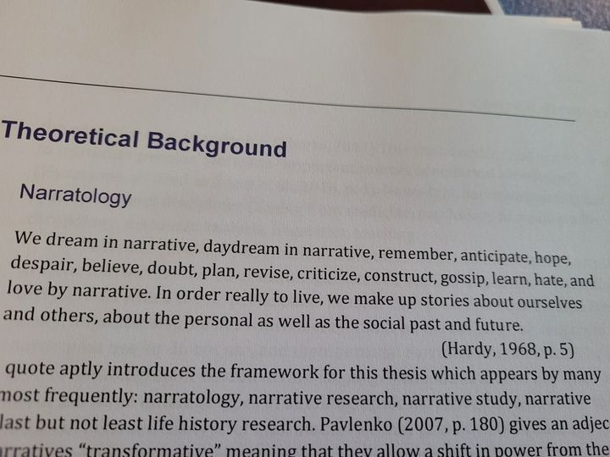
Hardy 1968
Daňková, G. (2023) Exploration of visual language learning histories. Unpublished master‘s thesis, MUNI.

Slide 8
History of Storytelling

Slide 9
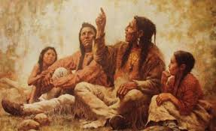
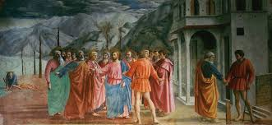
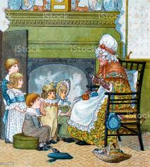
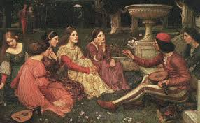
Storytelling since times immemorial

Slide 10
The world‘s greatest storytellers
Homer, Virgil, Aesop
Bocaccio, Dante
Chaucer
Shakespeare
Němcová
Čapek
Tolkien, Lewis, Pratchett
Sheherazad
Orson Welles
William Golding, Ernest Hemingway, the Grimms, Andersen, Hrubín…

Slide 11
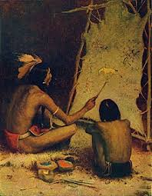
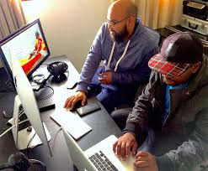
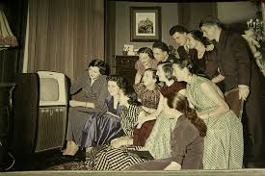
The same or different?

Slide 12
Storytelling today
In business: brands sharing their messages in ways that engage audiences and drive them to take a desired action (like making a purchase, calling a sales person, downloading or subscribing to content, etc.).
In politics: Political narrative as a term used in the humanities and political sciences the way in which storytelling can shape fact and impact on understandings of reality.
In teaching: Storytelling is the oldest form of teaching. It bonded the early human communities, giving children the answers to the biggest questions of creation, life, and the afterlife. Stories define us, shape us, control us, and make us. Not every human culture in the world is literate, but every single culture tells stories. =Failure stories are the best=
In law: ‘Liar Liar‘
The AI revolution

Slide 13
Storytelling for children
Vital for developing their imagination
Important for their spatial and time awareness
Crucial for developing their passive language sensitivity and active speaking skills
Integral for family/community bonding and solidarity among generations
Instrumental in shaping their view of the world (Sapir-Whorf hypothesis)

Slide 14
Storytelling for children in foreign language teaching
… at their state of cognition
The use of people, narratives and realities they know in their mother tongues
The use of their sense of formal structure, repetition, rhythm
Experientiality, well-being
Narrator‘s pronunciation and diction
Narrator‘s attention
Listener‘s personal involvement

Slide 15
Kinds of narratives
Rhymes and songs=memorised formats
(Budulinek, Father Abraham)
Fairy-tales
Simple real-life stories (Francesca, John, Meurig)
Family/community legends (Roots)
Urban legends (Mammoth‘s trap)

Slide 16
Coffee break 16-16:30
Individual research task:
Remember your earliest memory of being told a story, or a story told by a teacher at elementary school which may not have been related to the subject matter but remains a story you remember to this day.

Slide 17
Interactive block 16:30-18
Stories and contexts told across the room and screen.

Slide 18
Your Stories 1
Momoka: the P/ʰ/each Boy
Amaya: Math teacher‘s orphan story
Henry: Twisted Robin Hood Story
Zuzana: My Dad‘s thinner arm
Kateřina: My Dad‘s mysterious scar
Carmen: Mind the gap!
Vláďa: the Put-Put car

Slide 19
Your Stories 2
Helena: a Super easy Graduation exam
Aneta: Chemistry teacher‘s environmental
initiatives
Jitka I.: Kitten‘s big homecoming
Jitka J.: a Rhyme for future vegetarians
Jitka J.-S.: Toys come alive
Petr: on May 11

Slide 20
Your stories 3: on May 11
Barbora:
Leona:
Montserrat:
Sai Sai:
Natálie:
María:
Lenka:

Slide 21
Your stories 4: postponed to May 11!
Tereza:
Jiřina:
Jana:

Slide 22
18:00-18:35 Team Discussion in prep. of Class discussion
Form 5 teams containing 4 ppl. Give your team a name. Discuss whether you‘ll be sharing opinions on HOW TO SPEAK TO CHILDREN ABOUT WAR, THE CURRENT POSSIBILITIES OF AI or ANY OTHER PRESSING ISSUE. Make sure your topic is different from other teams‘.
Bilingual Kids (Petr)
Tug-of-War
Artificial Blondies
Flexi
Methodologists

Slide 23
1835-1930: Exchange of opinions and experience accross the room

Slide 24
Homework: spoken essay
Make a 5+minute recording about how storytelling can be implemented in your daily personal/professional life, or create a more theoretical audio/video essay about storytelling, AI, the current wartime narrative. Upload it in the File Vault (Poskytovna) by May 5.
Before the next block on May 11, listen to your peers‘ recordings and be ready to discuss them in class. Unsure of your topic? For inspiration, go to Spring 2021, 2022 and 2023 File Vaults.

Slide 25
I am now free for more individual /group consultations
Peace with you!

