Slide 1
Phonetics 2
Week 6
Revision

Slide 2
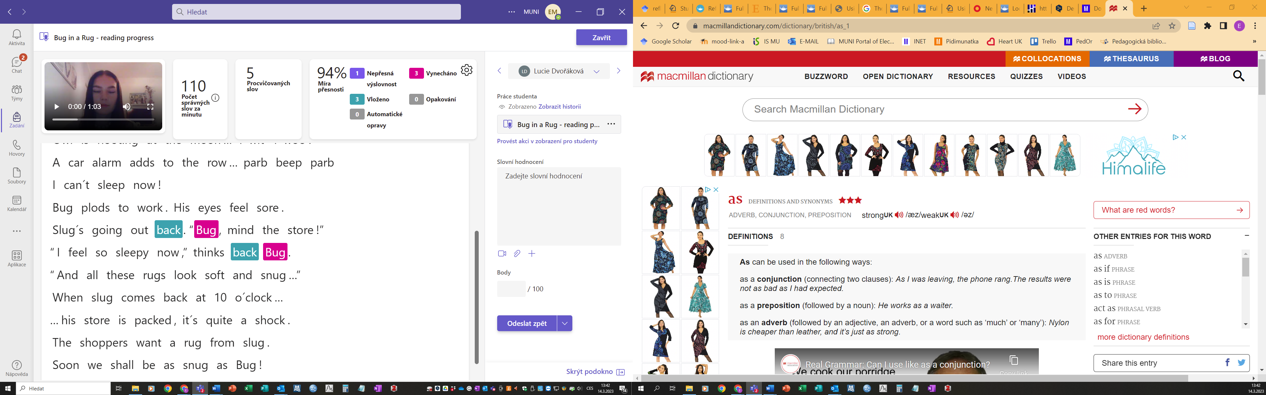

Slide 3
Task 1 Vowel sounds | Task 9 Reading progresss 3
Task 2 S x Z | Task 10 Vowel sounds
Task 3 S x Z | Task 11 ð θ
Task 4 ŋ | Task 12 -s endings
Task 5 NEW! Unstressed words in sentences | Task 13 Phonetic transcription - reading
Task 6 NEW! Unstressed words in sentences | Task 14 Reading
Task 7 NEW! Unstressed words – auxiliaries | Task 15 NEW! Unstressed words (bonus)
Task 8 NEW! Unstressed words – short words | Task 16 m n ŋ
Bonus task Chant | Task 17 Past tense -ed

Slide 5
Task 1
Vowel sounds
In each line, find the words with a different vowel sound.

Slide 6
Task 1
Answer key
In each line, find the words with a different vowel/diphtong sound.

Slide 7
Task 2
S x Z

Slide 8
Task 2
Answer key

Slide 9

Task 3
S x Z

Slide 10
Task 3
Answer key

Slide 11
Task 4

Slide 12
Task 4
Answer key

Slide 13

Task 5
NEW! Unstressed words in sentences
Listen and repeat the sentences.
List all the types of words that are typically unstressed in a sentence

Slide 14

Task 5
Answer key

Slide 15

Task 6
NEW! Unstressed words in sentences

Slide 16
Task 6
Answer key

Slide 17

Task 7
NEW! Unstressed words – auxiliaries

Slide 18
Task 7
Answer key

Slide 19

Task 8
NEW! Unstressed words – short words

Slide 20
Task 8
Answer key

Slide 21
Task 9
Reading progresss 3
Identify difficult words in the next Reading progress:
Words with th
Wods with –s ending
Voiced consonant endings
Regular past tenses
Anything else?
In the light of the moon a little egg lay on a leaf.
On Sunday morning the warm sun came up and – pop!
– out of the egg came a tiny and very hungry caterpillar.
He started to look for some food:
On Monday he ate through one apple, but he was still hungry.
On Tuesday he ate through two pears, but he was still hungry.
On Wednesday he ate through three plums, but he was still hungry.
On Thursday he ate through four strawberries, but he was still hungry.
On Friday he ate through five oranges, but he was still hungry.
On Saturday he ate through:
One piece of chocolate cake, one ice-cream cone, one pickle, one slice of Swiss cheese,
One slice of salami, one lollipop, one piece of cherry pie, one sausage, one cupcake,
And one slice of watermelon.
That night he had a stomach-ache.
The next day was Sunday again. The caterpillar ate through one nice green leaf,
And after that he felt much better.
Now he wasn´t hungry anymore – and he wasn´t a little caterpillar anymore.
He was a big, fat caterpillar.
He built a small house, called the cocoon, around himself.
He stayed inside for more than two weeks.
Then he nibbled a hole in the cocoon, pushed his way out and…
He was a beautiful butterfly!

Slide 22

Task 9
Answer key
You can listen to the story read and see if you find any other difficulties.

Slide 23
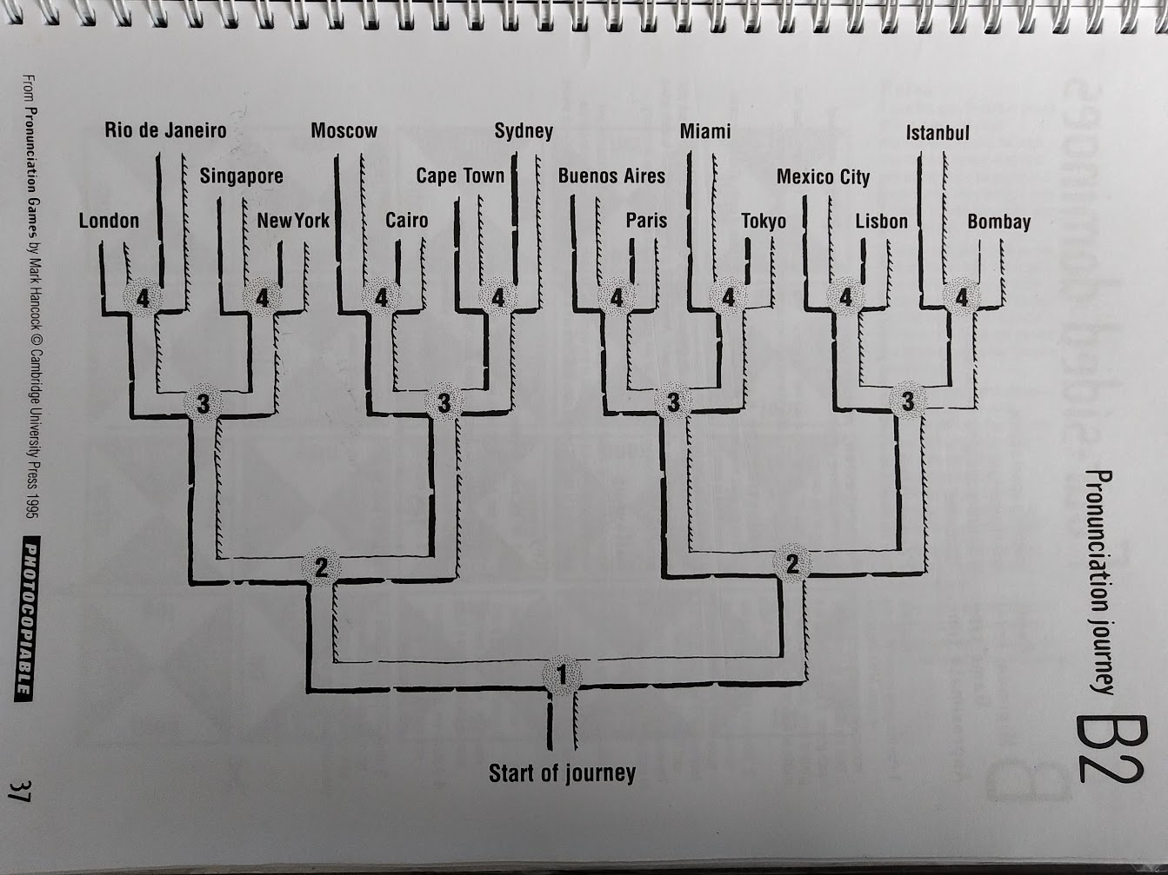
Task 10
Vowel sounds
Rules:
Define which sound goes which way.
One reads out words, the other follows the route in their head.
Check together.
(If too difficult, check after each word.)

Slide 25
Task 11
δ
θ
Read out all the words. Pay attention to the difference between the sound pairs.
Student A chooses five words from the list and dictates them to student B. Student B writes them down in normal writing and in phonetic transcription. Check (with a dictionary).
Swap roles.

Slide 26
Task 11
Baker, Ann. Ship or Sheep? Book and Audio CD Pack: An Intermediate Pronunciation Course. Cambridge University Press, 2006.

Slide 27
Task 12
-s endings
Choose all the 3rd person singular present simple verbs and all plural nouns from this book.
Divide them into three groups according to their pronunciation (/s/, /z/, /iz/

Slide 28
Task 12
Answer key
/s/ | /z/ | /iz/
shouts | chews | Squashes
Shakes | Wiggles | daisies
Gallops | jiggles | perches
Quacks | Turns | splashes
leaps | Paddles | hatches
 | Smells | Dances
 | wears
 | wellies

Slide 29
Task 13
Phonetic transcription - reading
Turn the book to the marked page.
Place the cards on the correct objects.
When you are done, put away the cards and try to write down as many of the words as you can – in phonetic transcription ☺

Slide 31
Task 14
Reading
Choose one book each.
Read this book to your partner as well as you can. You can try to interact, ask questions etc.
Take time to prepare. When you are both ready, start.
Write down three of the most difficult words in phonetic transcription and then check in the dictionary.

Slide 33
Task 15
NEW! Unstressed words
Open the book on the marked page.
Which words are unstressed? How would you pronounce them?
If unsure, ask the teacher.

Slide 34
Task 15
Answer key
ˈdædi pɪɡ ˈmʌmi pɪɡ peppa ən/ən ʤɔːʤ ɔːl klaɪm ˈɒntʊ ə pedalo
jʊ/jə həv tə ˈpɛdl mɪs ˈræbɪt tɛlz ðəm
ɪnˈʤɔɪ jə bəʊt trɪp!
ɒf wi ɡəʊ ʃaʊts ˈdædi pɪɡ
Peppa ən/ənd ʤɔːʤ ˈɡɪɡl
ɪts laɪk ə ˈbaɪsɪkl ɒn ðə ˈwɔːtə

Slide 35
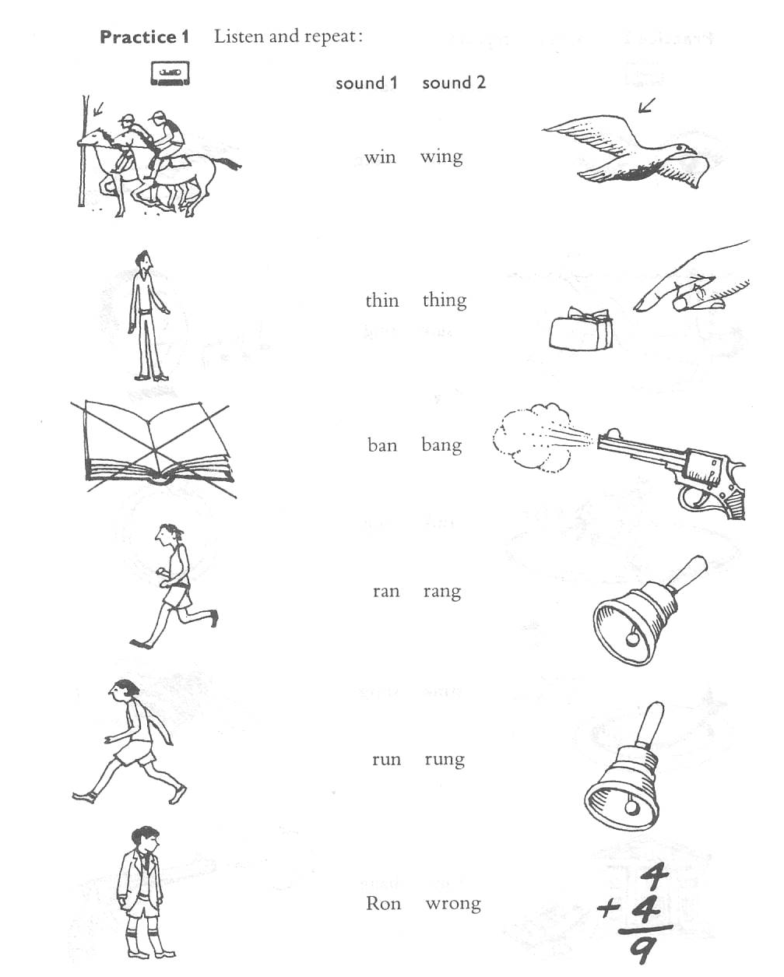

Task 16
Practice saying these words.
Play left hand/right hand.
Bonus: more on the ng sound

Slide 37
Task 17
Past tense -ed
Put the cards into three groups (/t/, /d/, /id/). Then turn the cards and check.

Slide 39
Bonus task
Come up with a vocabulary chant on the topic of clothes.

Slide 41
Task 13 - cards
/pleɪn/ | /ˈblækˌbɔːd/ | /kəmˈpjuːtə/
/kɑː/ | /ˈzebrə/ | /bəˈluːn/
/ˈmʌŋki/ | /læmp/ | /ˈkærət/
/ˈtʃɒklət keɪk/ | /klɒk/ | /ˈpɪktʃə(r)/
/ˈbɒtl/ | /tʃeə/ | /ˈbɑːskɪt/

Slide 42
Feedback
What was your favourite activity in the station learning and why?
How did you feel about station learning? Was it useful for you? Why (not)?
Now to the course:
  What do you enjoy about the course?
  What do you not enjoy? What changes would you suggest?
  What do you need to learn as best as you can in this course?

Slide 43
Cheese – cheers
Knee – near
We – we‘re
D – dear
Leave – live
Feel – fill
Field – filled
Team - Tim
Match – much
Ran – run
Sang – sung
Rang – rung
Pool – pull
Fool – full
Luke – look
Pool – pull
Task 10 – Student A
Task 10 – Student B
Walk – work
Born – burn
Short – shirt
Board – bird
Men – man
Said – sad
Met – mat
Set – sat

