Slide 1

Dalton Plan

Slide 2
https://is.muni.cz/auth/de/radek.pospisil/Dalton_Husova_Brno.mp4

Slide 3
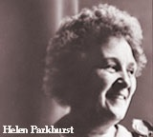
Dalton Plan
The founder of the Dalton plan was Helen Parkhurst
(*1886 ,+1973)

Slide 4
What is the Dalton Plan?
Dalton is not a method or system. Dalton is the influence.
Helen Parkhurst
Dalton plan proposed Helen Parkhurst in Dalton around 1920.

Slide 5
What is the Dalton Plan?
An alternative approach to teaching that focuses on development of the pupil as an individuality through the "controlled self-education"

Slide 6
History, development
Helen Parkhurst was originally teacher at an one-class school in Wisconsin, USA - in 1905 as a beginning teacher for the first time choses the type of education adapted to individual needs of the pupil instead of a "frontal" method of teaching.
Since 1911 she organized classes for 8 and 12 year old pupils to deal with their individual problems.
During the years 1913-1915 she stayed in Europe. Here she cooperated with Maria Montessori from whom she gained major impetus for her own school and deepened her teacher training. This meeting influenced her a lot.

Slide 7
History, development
Then she returned to the USA and in 1919 she founded in Dalton (State of New York) the Child university school.
The school was later renamed the Dalton School.
It was a secondary experimental school for boys and girls (High School for Boys and Girls).
Helen Parkhurst put her perspective on youth education into practice there. This school still works together with other institutions around the world.

Slide 8
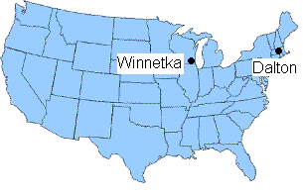
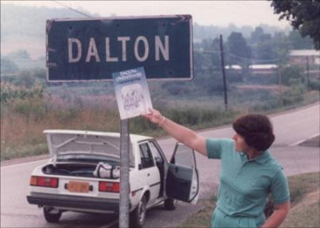
Soon the teaching according to the Dalton plan spread in England and in the 20s further into China, Japan, the Soviet Union and through Canada, Australia, India and South Africa to other countries. In Europe it was tested with great success in the Netherlands, Poland.
Dalton plan got no more interest in its home country (USA).

Slide 9
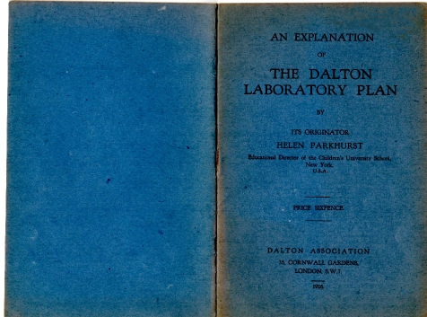
Theoretical basics and practice of her reform school the author interpreted in the book Education on the Dalton Plan - the book was published in 1923 in London and was translated into many foreign languages.

Slide 10
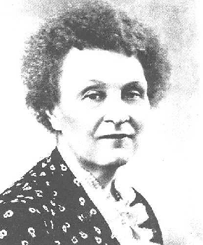
Basic Principles

Slide 11
Basic Principles
Freedom and Responsibility - it is not an absolute freedom. The pupil learns to dispose his time by himself, has the freedom to choose the method, time and place when and where he will devote to the curriculum.
Independence - student learns to act on hos own, he shares the responsibility for his education. He is forced to independence also by a element of freedom.
Cooperation - student may choose cooperation with others when solving the tasks. The school community is strengthened by cooperation between older and younger students and of course between students and teachers.

Slide 12
Freedom and Responsibility
Freedom allows the student to choose which task to do sooner and which later.
Children after a sufficient explanation organize the entire block of tasks themselves.
Children perform several pre-assigned tasks but they can choose the order and tempo that suits them.
They decide what to accomplish as soon as possible and what in the end and how much time they devote to each task.
They choose the place for their work and aids, they think about with whom to collaborate.
The teacher passes part of the responsibility to the pupil. This means that the pupil is also responsible for the final result, but also for the way how it will be achieved.

Slide 13
Independence
Through this principle, children learn to rely on themselves.
The possibility to work independently affects the motivation of students. (Students like to be active themselves)
Independence is also an important didactic and organizational factor. (If students can work independently, they do so at their own level and the teacher has more time to help those who need his help.)
Pupils must decide themselves, not to require teacher´s assistance to teachers whenever they are unsure, not to rely always on classmates around.
Initially, all of this is difficult for children because they have to manage their tasks without outside help, but gradually they begin to be led to independence as well as to self-control.

Slide 14
Cooperation
Cooperation is the possibility to consult, if children do not know where to find the information they need.
By learning to cooperate pupils create their social and democratic consciousness.
There are two forms of teams cooperation :
1) Cooperative Teams – the pupils fulfill the task together in pairs or in groups of three or four.
2) Support Teams – the pupils complete the task individually, but if they do not understand something, they can ask a classmate.

Slide 15
Five key points of cooperation (Ebbens)
1) Positive Interdependence – to achieve a good result at a task students need each other.
2) Individual Responsibility – each group member is responsible for their own benefit and for the overall result.
3) The Ability of two-way Communication – content assignment calls for collaboration and supports mutual communication.
4) Social Emergency – mutual cooperation is urgently needed and will be evaluated.
5) Attention to Team Work – after completion of the task, which is designed for collective processing, carry out the final interviews given to both content and process of cooperation.

Slide 16
Methods of Working
Long-term Tasks
House
Laboratory
Extended Attention
Many other partial methods...

Slide 17
Long-term Tasks
One of the most important parts. Pupil gets a long-term task.
The goal is to set and to get to it, pupil must develop a careful scheduling.
The task is not just a set of activities, but an educational project, in which teacher is also involved. One of the meanings of the basic (principle of cooperation).
There is one basic material and a set of possible methods for each task that pupil can choose (principle of freedom).
Another part of the task are extra activities for other pupils (handier).
The task is closed up by a test or an exam. Only after the completion of one task may pupils make a contract for next task.

Slide 18
House
This feature strengthens the community of pupils and helps them obtain better social skills.
Pupils are grouped into a "tribal" class. Every day at the beginning of classes pupils discuss together the school issues and their own problems.
In Dalton, this element is supported a lot. At the lower degree of children of the same age put together. On a higher degree the pupils of different ages are associated according to the same orientation. At the secondary school (high school) they live together.
The class teacher is a trainer as well. A teacher changes into a coach and transfers responsibility for education to the pupil.

Slide 19
Laboratory
Do not imagine a chemical laboratory.
It is a special predetermined time at which pupils pay attention only to their projects. They work at their own pace and by their own method.
These lessons need to be well planned ahead, because it serves as a tutorial.
The teacher enters the process only on request.

Slide 20
Extended Attention
Czech version of Laboratory.
It is by a teacher appointed during the normal lesson when the teacher is "not available"
Students must work independently. At the lower degree, there is something on his table (a stuffed toy, a ball, ...) and that symbol means that „its not allowed“ to work with the teacher

Slide 21
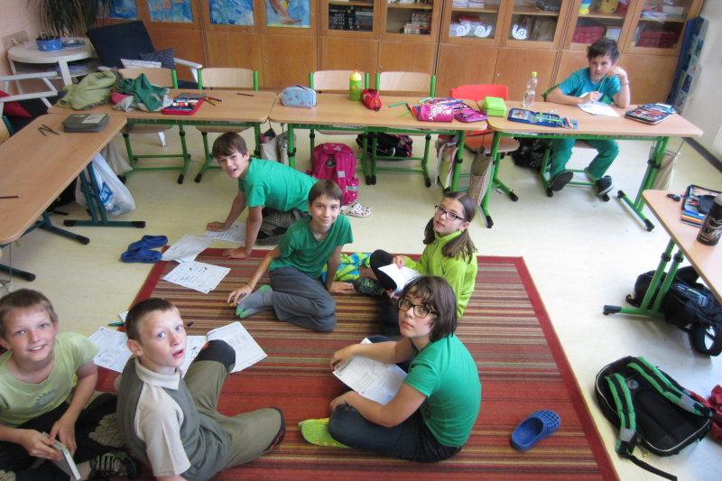
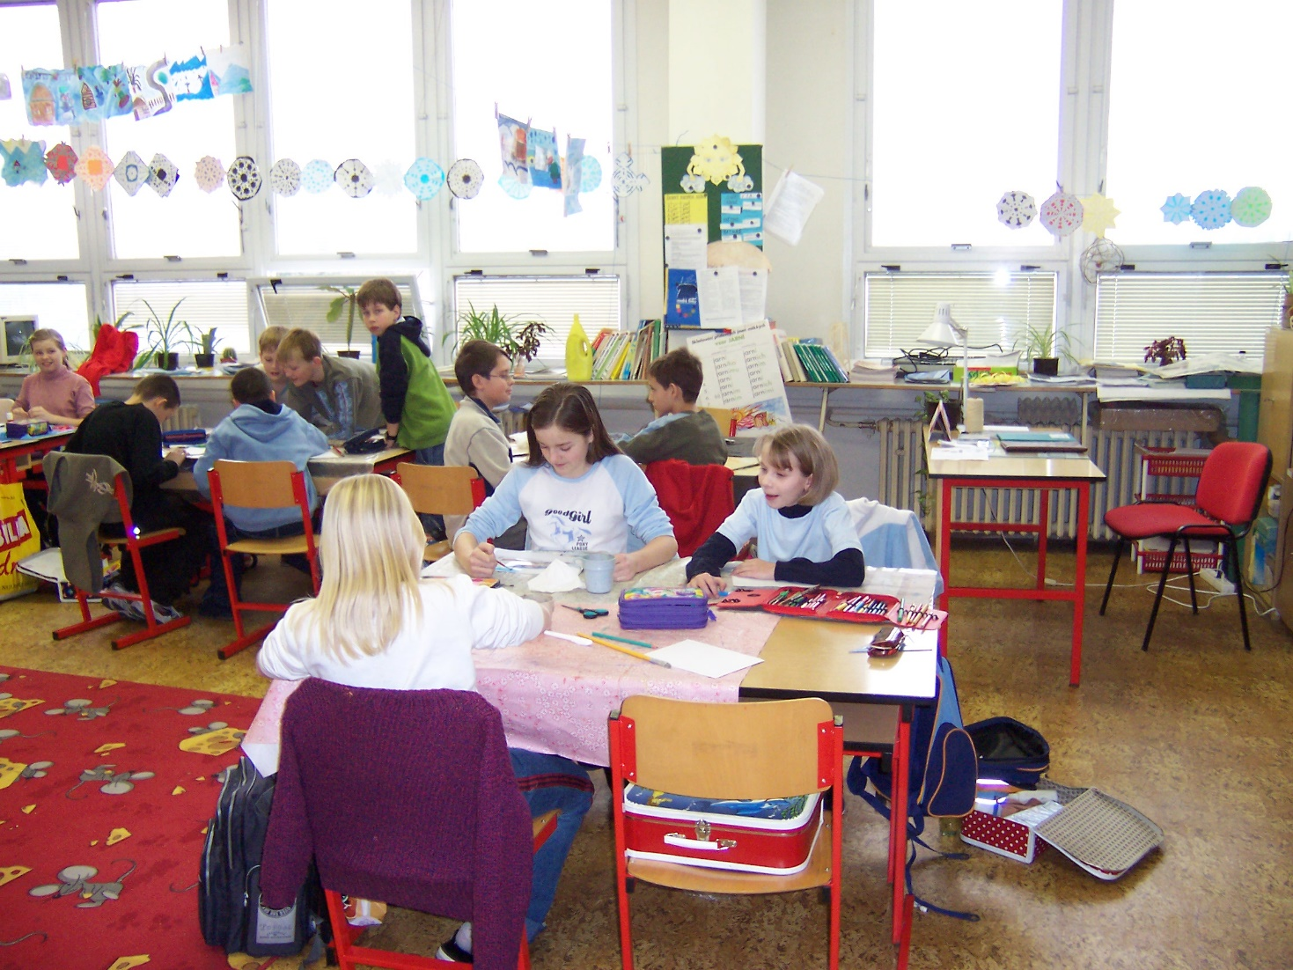

Slide 22
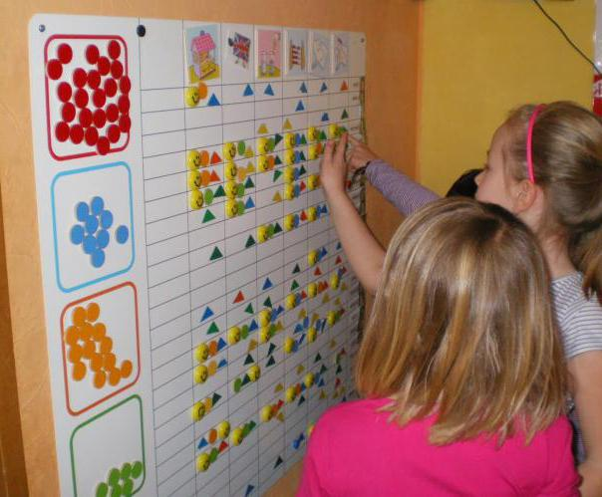

Slide 23
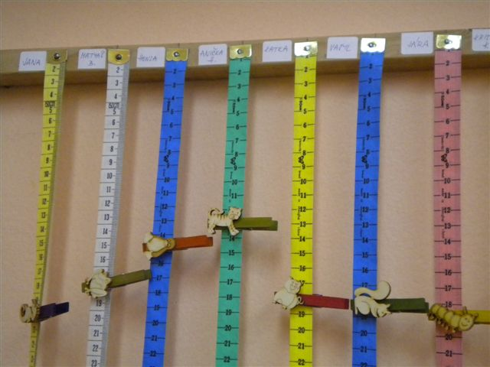
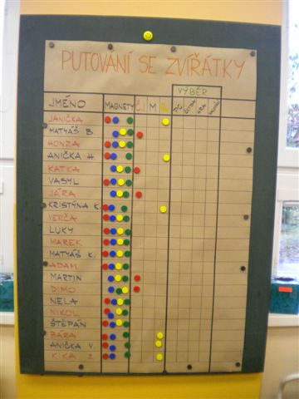

Slide 24
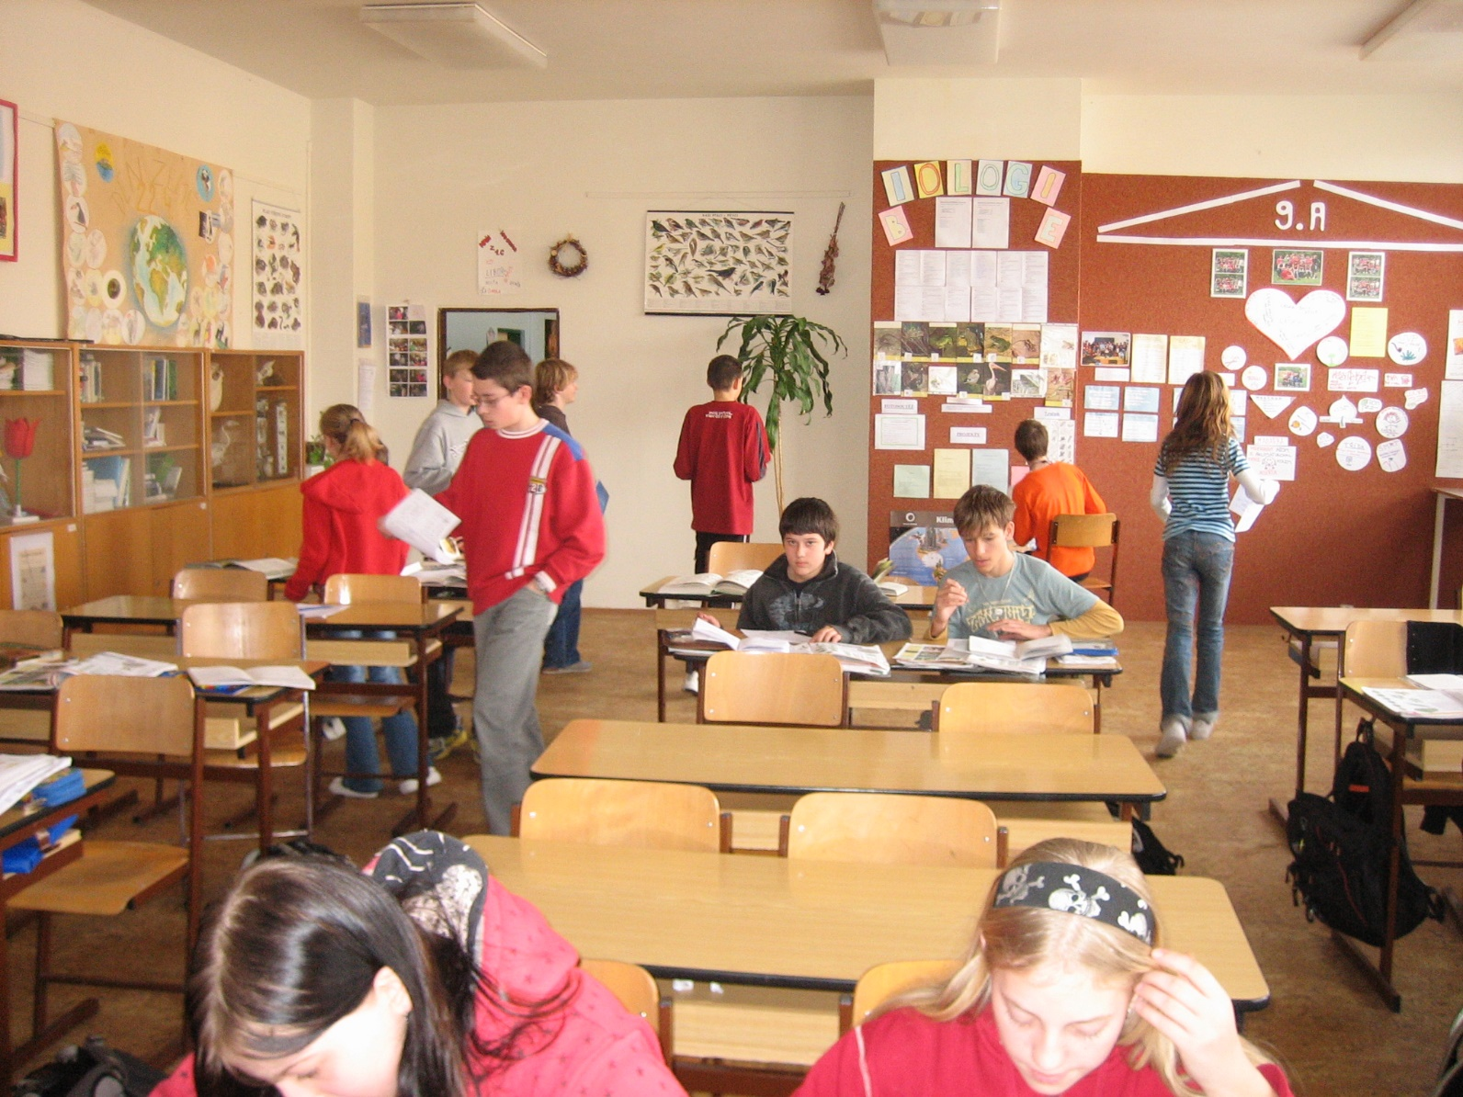

Slide 25
Teacher
Dalton plan is not for everyone.
The teacher is crucial for the Dalton plan.
Suits to creative teachers.
Dalton is essential for communication between teachers and between the teacher and the pupil.
The teacher must give up his dominant position in the classroom.

Slide 26
The teacher performs the following tasks
Together with pupils preparing a work plan, tests and exams
Works closely with other teachers and parents
Communicates with pupils about the curriculum both in classes and outside
Helps pupils with further choices of study

Slide 27
The teacher's role
teacher deals with only one subject
plays the role of a consultant, a technician and the evaluator
prepares tasks for pupils
enters monthly plans
acquaint the pupil with the task and highlights specific problems
directs the work of students
maintains essential social contact
ensures the collective work of pupils
controls the working conference
leads a personal chart for each pupil and classes graph
keeps detailed records of individual pupils progress
checks mastering the curriculum

Slide 28
Distinctive Features I.
classroom is divided into subject corners according to year and equipped them with necessary tools
the traditional system of lessons is abolished as well as the organization of pupils in the age-homogeneous classes, which enables the pupils to advance at a rate above or below
teaching is based on individual work of pupils using appropriate tools and libraries
pupilss work in laboratories on their individual plans with the advisory assistance of the teacher

Slide 29
Distinctive Features II.
the curriculum is not cancelled, its given by the sylabus and its divided into 10 lots to be mastered during the school year (10 months)
each pupil closes a deal (contract) with the teacher and confirms it with his signature → gets work program for one month (for each item separately)
at the beginning of the year the program for individual pupils is establishedon the base of talen and knowledge of each child as it is found out thanks to the test

Slide 30
This work program includes tasks that the student has to complete and instructions how to work
introduction (getting to know the task)
object (determining curriculum, which refers to the task)
problems (issues and challenges for the pupil)
written work (tasks, which must be passed in writing process)
memory tasks
conference (topics and dates of collective meetings of pupils and teachers)
references (specific references to books, journals and other academic sources
equivalents (how many points a student receives while working for solving certain tasks)
study bulletin boards (notifies pupil what to have to notice on bulletin boards - maps, pictures, etc.).

Slide 31
the program contains the minimum, maximum and standard procedures, which is required to achieve in a certain time
pupil starts any suobject in its sole discretion and proceed at his own pace
some subjects continue to be taught in a bulk form (eg. physical education, music, religion)
no homework
on a daily collective meetings (30-40 minutes conferences) the pupils talk about the results of their work

Slide 32
For the pupils are available:
structured working instructions
bibliographic data
instructions
professional working office (pupils can move from one office to another)

Slide 33
Pensum I
the most visible sign
learning contents which should be processed in a certain period or in which they should be able to orientate themselves.
pupil meaning has a complete overview of all the teaching content for clearer ultimate goal of teaching.
has to clearly establish requirements and defines the possible difficulties.
can have different forms - practical exercises, teaching, drawing, separate treatment of the topic

Slide 34
Pensum II
It is posted on a special board, which may have many graphic designs
color system symbolizing the days of the week
the color shows the day when the child has successfully dealt with a certain subject
Dalton teaching does not interfere with school bell

Slide 35
Sense of Dalton plan
permanent modernity and actuality, very good and functional preparation for the civic life in a community of other people
way of life or an offer for a conception of life
advantages in the sphere of
moral (sense of responsibility for their own progress)
social (rejection of envy, learning cooperation, refusing uniformity)
educational (activation of pupils, change of relationships at school )
didactic (development of pupils´ self-learning, not blocking good or weak pupils, increased motivation to learn)

Slide 36
Criticism of Dalton Plan
lack of repetition
non systematic acquisition of knowledge
preponderance of book knowledge acquisition
lack of activities that teach students to listen and communicate
curriculum is little discussed with the pupil
lack of teacher educational activity
students have few opportunities for team activities
pupil's volitional qualities, activity and interest are overestimated

Slide 37
Pros and cons
Variability of Teaching
Education to Freedom
Education to Accountability
Education to Cooperation
Insufficient repetition
Unsystematic
Over-reliance on students' independence .

Slide 38
How does Dalton class looklike?
The benches arrangement should allow movement around the classroom, team and individual work.
Somewhere benches are relocated for the necessary period of time.

Slide 39
How does Dalton education work?
In Czech schools it is taught only in Dalton blocks eg. three times a week for one lesson.
The section is devoted to practicing and repeating the subject. Children choose which course to deal with and they fulfill the tasks required, optional and so called extra tasks.
They rely on literature or classmate for help.
The task solutions are posted in the classroom for easy self-control and the task accomplishing children record on boards (thanks to which the teacher can see how much and what work remains to whom).

Slide 40
Dalton resources in higher classes (3rd class and above)
weekly tasks assignment
for the entire week there must be offered many variations of the curriculum, so that every child can fulfill in at an agreed time, at their own pace and according to their own choice the task order
number of tasks to accomplish is three tasks a day
everyday children fulfills language and mathematical tasks, another subject or task is up to their choice

Slide 41
CDA – Czech Dalton Association,
List of Dalton schools in Brno
ZŠ Brno, Husova 17
ZŠ Brno, Chalabalova
ZŠ Brno, Křídlovická
ZŠ Brno, Mutěnická 3
ZŠ Brno, Staňkova 14 – first grade
ZŠ Praha 5, Mohylová 1963 - only 1 to 3 classroom
Hig School Slovanské Náměstí, Brno
A total of about 25 other schools applying elements of the Dalton Plan.
Due to our FEP (Framework Education Programme) not fully Dalton schools!

Slide 42
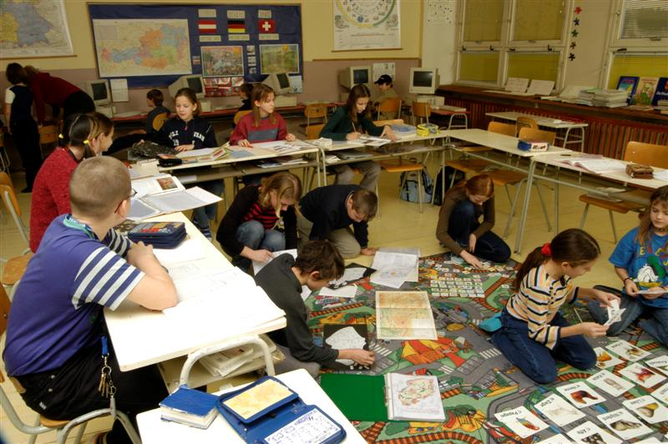
ZŠ Chalabalova, Brno
Collaborates with Dutch colleagues in Utrecht
Implements a three-week cycles, one lesson a week - maths homework, Czech Language and Nature Science
Children pre-select the tasks order from singular subjects and suscribes themselves into the prepared forms
There are specialized classrooms for mathematics, nature science and Czech language, literature, they use alternative coursebooks

Slide 43
Tasks are divided into daily tasks and extra tasks. The emphasis is on independence and self-control. Extra task can be registered into a separate workbook that is permanently stored in the classroom.
Teachers explain beforehand what tasks is compulsory. Pupils ask teacher and then rely only on their strengths. At the end of work a test can be used.
Dalton way of work allows the teacher to focus on weaker pupils. Above all, it creates more space for more doted children.

Slide 44
https://www.youtube.com/watch?v=W57vvOvNMJU

