Slide 2
Learning strategies

Slide 3
= specific behaviors or
thought processes
methods
that students use to learn

Slide 5
Strategies
Cognitive
Metacognitive
Memory-related
Compensatory strategies
Affective
Social

Slide 7
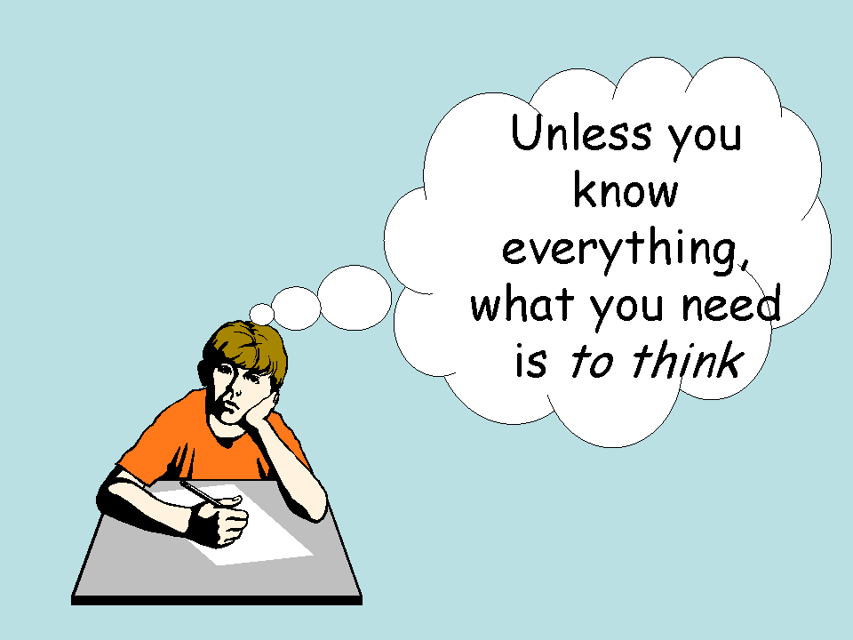
Cognitive strategy
to manipulate the language material in direct ways
reasoning,
analysis,
note-taking,
summarizing,
synthesizing,
outlining,
reorganizing information,
practicing in naturalistic settings,
practicing structures and sounds formally

Slide 8
Metacognitive strategies
To manage the learning process
identifying one’s own learning style preferences and needs,
planning the task,
gathering and organizing materials,
arranging a study space and a schedule,
monitoring mistakes,
evaluating task success,
evaluating the learning strategy

Slide 9
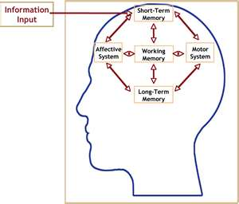
Memory-related strategies
to learn and retrieve information
Helping techniques:
Acronyms
Rhyming
Mental picture of the word
TPR
mechanical means (flashcards, pictures, page …)

Slide 10
Compensatory strategies
To make up for missing knowledge
guessing from the context,
using synonyms,
“talking around” the missing word,
using gestures or pause words

Slide 11
Affective strategies
related to L2 proficiency
identifying one’s mood and anxiety level,
talking about feelings,
rewarding oneself for good performance,
using deep breathing or positive self-talk

Slide 12
Social strategies
To work with others and understand the target culture as well as the language
asking questions to get verification,
asking for clarification of a confusing point,
asking for help in doing a language task,
talking with a native-speaking conversation partner,
exploring cultural and social norms

Slide 13
L2 learning strategy use is related to
learning motivation,
gender,
age,
culture,
brain hemisphere dominance,
career orientation,
academic major,
Beliefs,
the nature of the L2 task.

Slide 14
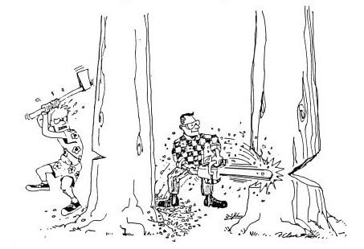
Effective and uneffective strategy

