Slide 1
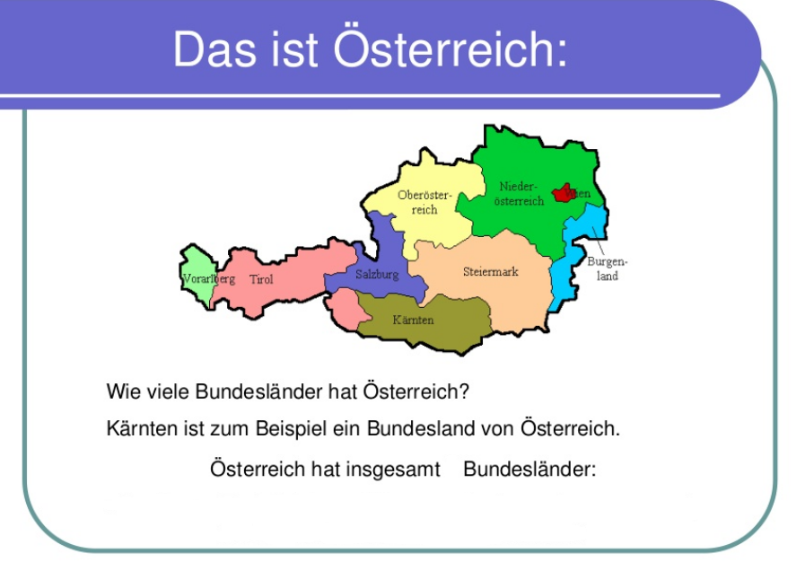
Station 1

Slide 2
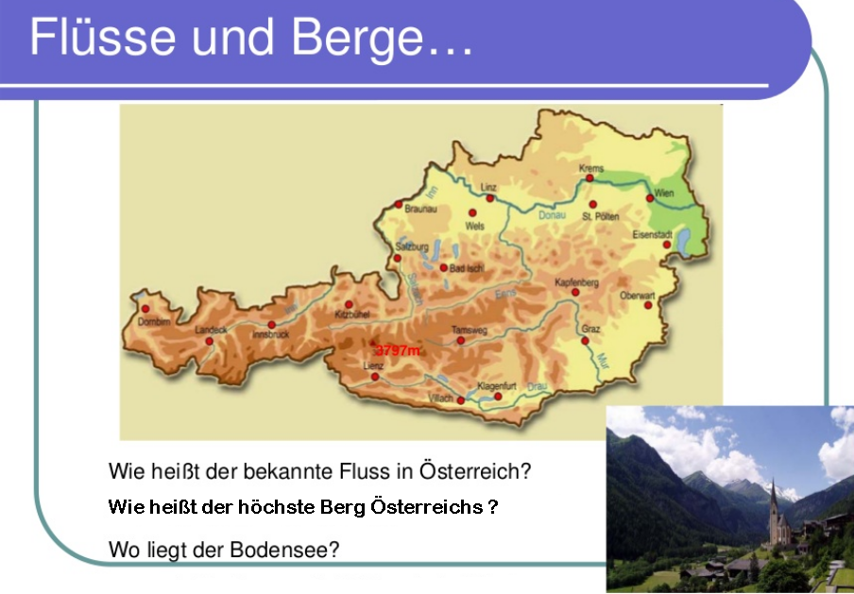
Station 2

Slide 3
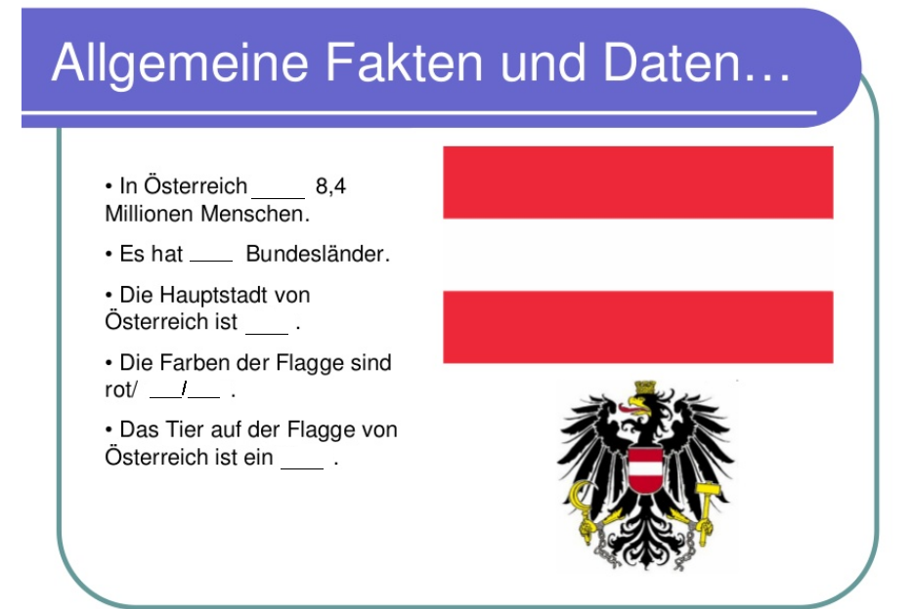
Station 3

Slide 4
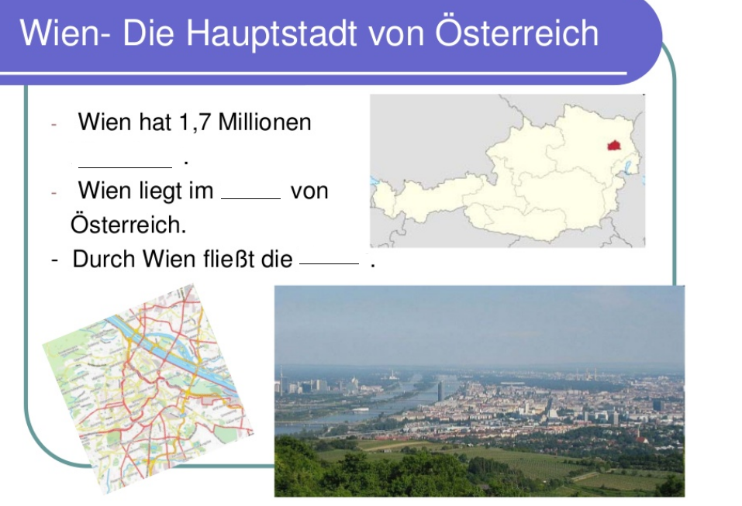
Station 4

Slide 5
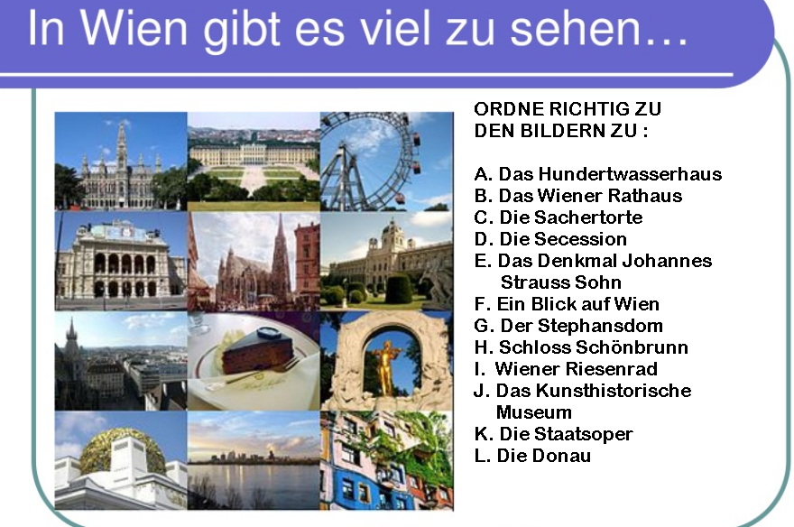
Station 5

Slide 6
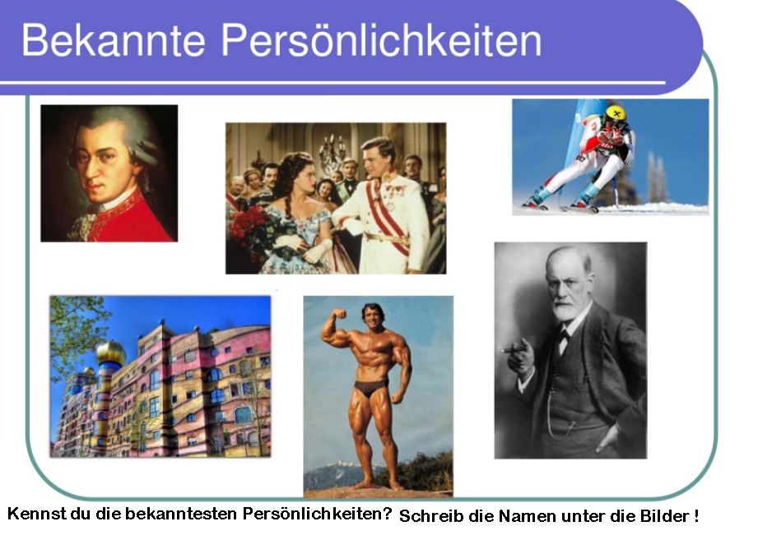
Station 6

Slide 7
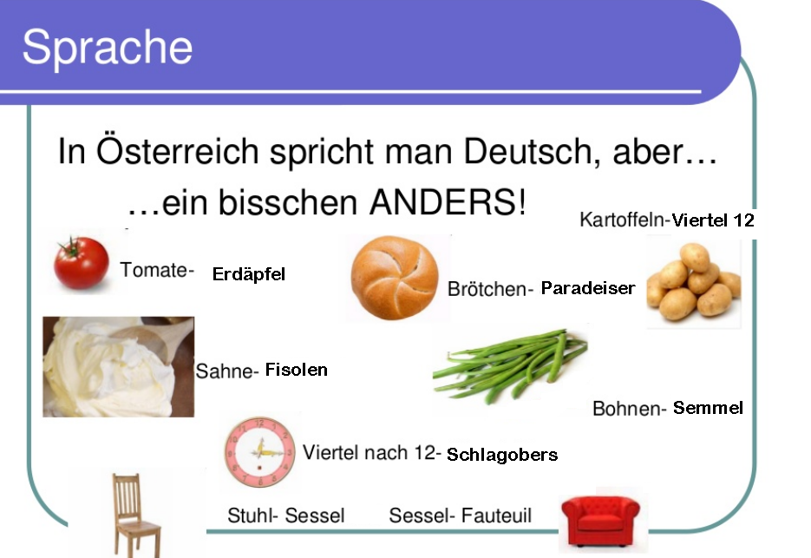
Station 7

Slide 8
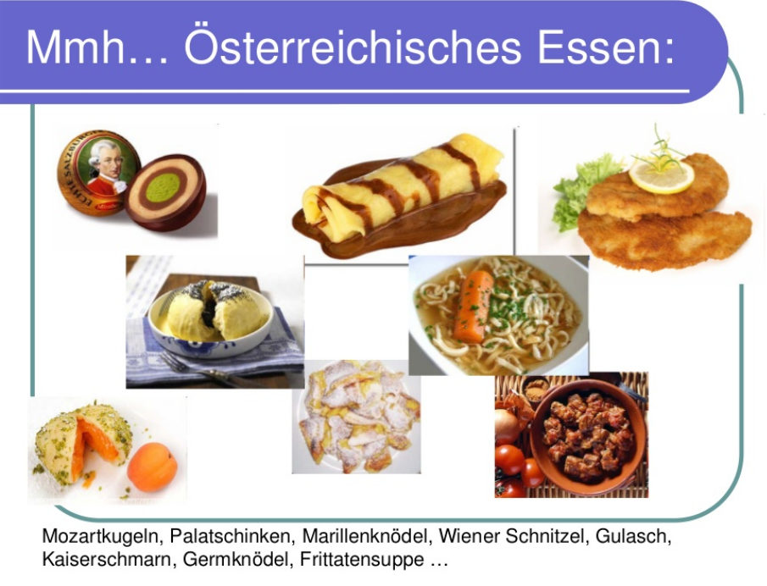
Station 8

Slide 9
Danke für die Aufmerksamkeit
Kateřina Schmolzová
UČO: 327583

