Slide 1
Czech Educational System
Katerina Lojdova
lojdova@ped.muni.cz

Slide 2
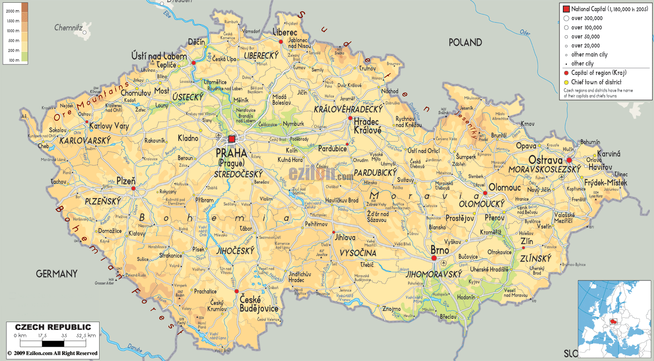
Introduction
Czech republic

Slide 3
Basic facts
Compulsory school attendance
Literacy rate
Velvet revolution
Educational reform

Slide 4
ISCED

Slide 5
Basic education
Educational reform

Slide 6
Objectives of basic education
Create preconditions for pupils to acquire basic learning strategies and motivate them to life-long learning
Stimulate and encourage pupils to creative thinking, logical reasoning and problem solving
Guide pupils to engage in efficient, effective, open communication on all aspects of their life
Develop pupils’ abilities to cooperate and to value their own work and achievements as well as the work and achievements of others
Guide pupils so that they should become free and responsible individuals who exercise their rights and meet their obligations
Induce in pupils the urge to express positive feelings and emotions in their behaviour, ways of acting and when experiencing important situations in their lives; develop in them sensitivity and responsiveness towards other people, the environment and nature

Slide 7
Objectives of basic education
Teach pupils to actively develop and protect their physical, mental and social health and to be responsible for it
Guide pupils to tolerance and consideration for other people, to a respect for their culture and spiritual values; teach pupils to live together with others
Help pupils to discover and develop their own abilities and skills in the context of actual opportunities and to use their abilities and skills in combination with their acquired knowledge when making decisions regarding the aims of their own life and profession

Slide 8
The National Education Programme = The Framework Educational Programmes
defines initial education as a whole.
The Framework Educational Programmes devone binding educational norms across various stages: pre-school education, basic education and secondary education (for pupils and students from 3 to 19 years of age)are based on a new education strategy, stressing key competencies, their interlinking with
educational contents and the application of acquired knowledge and skills in practical life;
build on the concept of life-long learning
promote the educational autonomy of schools as well as teachers’ professional responsibility for the outcomes of the educational process.

Slide 9
Educational fields
Language and Language Communication (Czech Language and Literature, Foreign Language)
Mathematics and Its Applications (Mathematics and Its Applications)
Information and Communication Technologies (Information and Communication Technologies)
Humans and Their World (Humans and their World)
Humans and Society (History, Civic education)
Humans and Nature (Physics, Chemistry, Natural Sciences, Geography)
Arts and Culture (Music, Fine Art)
Humans and Health (Health Education, Physical Education)
Humans and the World of Work (Humans and The World of Work)

Slide 10
Cross-Curricular Subjects
Cross-curricular subjects in the FEP BE are subjects related to contemporary present-day issues and represent an important and inseparable part of basic education. They represent an important formative element of basic education.
This contributes to the pupils’ comprehensive education and positively influences the formation and development of their key competencies.
Cross-curricular subjects represent a mandatory part of basic education. Schools must include all cross-curricular subjects contained in the FEP BE10 into Stages 1 and 2 of education. Not all crosscurricular subjects, however, must be represented at each grade level. It is the school’s responsibility to, over the course of basic education, gradually offer pupils all thematic areas contained in the individual cross-curricular subjects.

Slide 11
Cross-curricular subjects
Personal and Social Education
Democratic Citizenship
Education towards Thinking in European and Global Contexts
Multicultural Edu cation
Environmental Education
Media Education

Slide 12
Key competencies
learning competencies;
problem-solving competencies;
communication competencies;
social and personal competencies;
civil competencies;
working competencies

Slide 13
Seminar work
Comparsion of educational system in your country and Czech educational systém in terms of:
A) ISCED
B) Goals of basic education
C) Subjects in basic education
D) Key competencies
E) Interesting facts
Presentation date: 14.4.2014
Presentation time: 13:55 - 15:35, room10

