Slide 1
Czech Educational System
International student ASSESSMENT
Katerina Lojdova
lojdova@ped.muni.cz

Slide 2
Basic facts About contemporary czech education
Compulsory school attendance.
Literacy rate: 99%.
Classification system: 1 – 5
Preschool enrollment is guaranteed for children in their last year before entering elementary school.
Elementary education takes 9 years, usually from ages 6-15.
Elementary education is divided into two stages: primary (grade 1 – 5) and lower secondary (stage 6-9).
In addition, children have the option to apply for gymansium or concervatory.

Slide 3
Basic facts
Upper secondary education can be general or vocational.
Upper secondary education takes 3 – 4 years and is mandatory.
Tertiary education: Bologna proces (1999):
  the process has created the European Higher Education Area.

Slide 4
ISCED (International Standard Classification of Education)
The ISCED classification was adopted by the UNESCO.
Includes definitions for types of education.
Contributes to the production of even more reliable and comparable international statistics on education, reflecting the ongoing evolution of education systems worldwide.

Slide 5
Cech educational system according to isced

Slide 6
Basic education in The czech republic
Educational reform (Act 561/2004)

Slide 7
Framework Educational Programme for Basic Education
www.msmt.cz/file/9481_1_1/

Slide 8
The Framework Educational Programmes
defines initial education as a whole.
The Framework Educational Programmes devone binding educational norms across various stages: pre-school education, basic education and secondary education (for pupils and students from 3 to 19 years of age)are based on a new education strategy, stressing key competencies, their interlinking with
educational contents and the application of acquired knowledge and skills in practical life;
build on the concept of life-long learning
promote the educational autonomy of schools as well as teachers’ professional responsibility for the outcomes of the educational process.

Slide 9
Objectives of basic education
Create preconditions for pupils to acquire basic learning strategies and motivate them to life-long learning
Stimulate and encourage pupils to creative thinking, logical reasoning and problem solving
Guide pupils to engage in efficient, effective, open communication on all aspects of their life
Develop pupils’ abilities to cooperate and to value their own work and achievements as well as the work and achievements of others
Guide pupils so that they should become free and responsible individuals who exercise their rights and meet their obligations
Induce in pupils the urge to express positive feelings and emotions in their behaviour, ways of acting and when experiencing important situations in their lives; develop in them sensitivity and responsiveness towards other people, the environment and nature

Slide 10
Objectives of basic education
Teach pupils to actively develop and protect their physical, mental and social health and to be responsible for it
Guide pupils to tolerance and consideration for other people, to a respect for their culture and spiritual values; teach pupils to live together with others
Help pupils to discover and develop their own abilities and skills in the context of actual opportunities and to use their abilities and skills in combination with their acquired knowledge when making decisions regarding the aims of their own life and profession

Slide 11
Educational fields
Language and Language Communication (Czech Language and Literature, Foreign Language)
Mathematics and Its Applications (Mathematics and Its Applications)
Information and Communication Technologies (Information and Communication Technologies)
Humans and Their World (Humans and their World)
Humans and Society (History, Civic education)
Humans and Nature (Physics, Chemistry, Natural Sciences, Geography)
Arts and Culture (Music, Fine Art)
Humans and Health (Health Education, Physical Education)
Humans and the World of Work (Humans and The World of Work)

Slide 12
Key competencies
learning competencies;
problem-solving competencies;
communication competencies;
social and personal competencies;
civil competencies;
working competencies

Slide 13
Cross-Curricular Subjects
Cross-curricular subjects in the FEP BE are subjects related to contemporary present-day issues and represent an important and inseparable part of basic education. They represent an important formative element of basic education.
This contributes to the pupils’ comprehensive education and positively influences the formation and development of their key competencies.
Cross-curricular subjects represent a mandatory part of basic education. Schools must include all cross-curricular subjects contained in the FEP BE10 into Stages 1 and 2 of education. Not all crosscurricular subjects, however, must be represented at each grade level. It is the school’s responsibility to, over the course of basic education, gradually offer pupils all thematic areas contained in the individual cross-curricular subjects.

Slide 14
Cross-curricular subjects
Personal and Social Education
Democratic Citizenship
Education towards Thinking in European and Global Contexts
Multicultural Edu cation
Environmental Education
Media Education

Slide 15

International student ASSESSMENT

Slide 16
PISA
The Programme for International Student Assessment (PISA) is a triennial international survey which aims to evaluate education systems worldwide by testing the skills and knowledge of 15-year-old students.
It assess the competencies of 15-year-olds in reading, mathematics and science in 65 countries and economies.

Slide 17
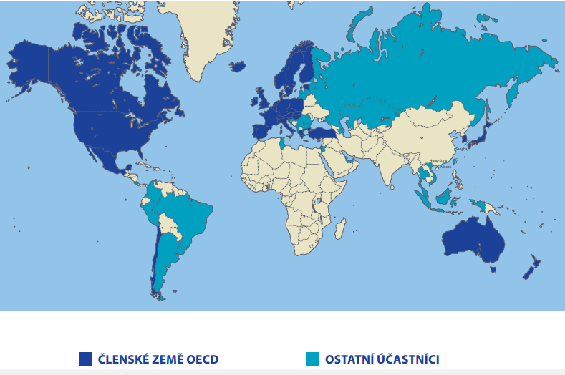
PISA 2012: focused on mathematics

Slide 18
PISA 2012: Results
http://www.oecd.org/pisa/keyfindings/pisa-2012-results-overview.pdf

Slide 19
PISA 2012:
Noncognitive results
Students whose parents have high expectations for them tend to have more perseverance, greater intrinsic motivation to learn mathematics, and more confidence in their own ability to solve mathematics problems .
Four out of five students in OECD countries agree or strongly agree that they feel happy at school .
Better teacher-student relations are strongly associated with greater student engagement with and at school.
PISA results show that even when girls perform as well as boys in mathematics, they tend to report less perseverance, less openness to problem solving, less intrinsic and instrumental motivation to learn mathematics, less self-belief in their ability to learn mathematics and more anxiety about mathematics than boys

Slide 20
PISA: CZECH REPUBLIC
http://www.compareyourcountry.org/pisa/country/cze

Slide 21

Who’s Afraid of the Big Bad Dragon
Zhao offers provocative insider’s account of the Chinese school system, revealing the secrets that make it both “the best and worst” in the world. Born and raised in China’s Sichuan province and a teacher in China for many years, Zhao has a unique perspective on Chinese culture and education. He explains in vivid detail how China turns out the world’s highest-achieving students in reading, math, and science
Is it possible to quantify quality of education?
How can result-oriented education influence educational proces?

Slide 22
Criticism of pisa
Academics from around the world express deep concern about the impact of Pisa tests and call for a halt to the next round of testing:
Pisa results are awaited by governments, education ministers, and the editorial boards of newspapers, and are cited authoritatively in countless policy reports.
They have begun to deeply influence educational practices in many countries
Lack of progress on Pisa has led to declarations of crisis and "Pisa shock" in many countries, followed by calls for resignations, and far-reaching reforms according to Pisa precepts.

Slide 23
Criticism of pisa
While standardised testing has been used in many nations for decades, Pisa has contributed to an escalation in such testing and a dramatically increased reliance on quantitative measures.
  For example, in the US, Pisa has been invoked as a major justification for programme, which has increased the use of standardised testing
  More scripted "vendor"-made lessons, and less autonomy for teachers.
  As an organisation of economic development, OECD is naturally biased in favour of the economic role of public [state] schools.
  No reform of any consequence should ignore the important role of non-educational factors, among which a nation's socio-economic inequality is paramount.
  No reform of any consequence should be based on a single narrow measure of quality.

