Slide 1
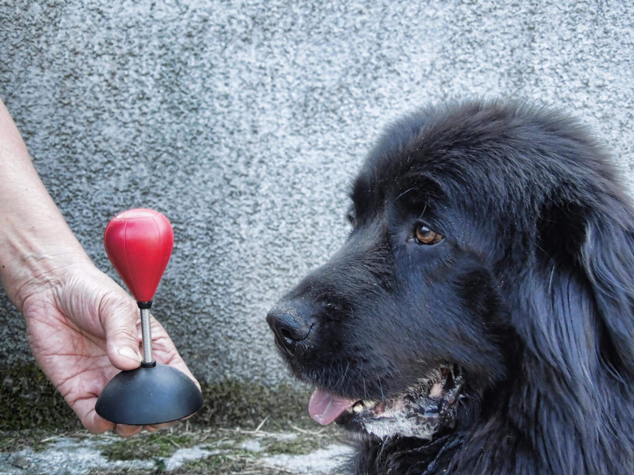
Classical Conditioning
What on earth is going here?
Well, first of all, let’s just note what is happening in this picture. What you are seeing is a dog (Lilly) salivating in the presence of toy punch bag. As to why she might be doing that, we’ll have to wait until further into the lesson.
Time

Slide 2
Pairing
RETURN

Slide 3
Pairing
With this procedure, the CS begins at the same time as the US and it ends at the same time as the US.
RETURN

Slide 4
Pairing
With this procedure, the CS begins well before the start of the US and it continues up to the US, ending at the same time as it.
RETURN

Slide 5
Pairing
With this procedure, the CS begins and ends before the start of the US.
RETURN

Slide 6
Pairing
With this procedure, the sequence of presentations is reversed. The CS is now presented after the US ends.
RETURN

Slide 7
The Process
In this tutorial you will be taken through some fundamental issues in the study of Classical Conditioning. This is a field of study first investigated by a Russian physiologist called Ivan Pavlov (1849-1936). When he was studying digestion in dogs, he discovered by accident that his dogs were salivating before food entered their mouths. In fact, what he uncovered was a simple form of learning.
Pavlov’s early attempts to investigate this phenomenon represent a milestone in the experimental analysis of behaviour. He showed the value of systematic experimentation as a method of uncovering laws of nature.
Here is a conceptual space to show you the steps that Pavlov followed when he eventually tailored his procedures to investigate the salivation reflex in dogs.
Time

Slide 8
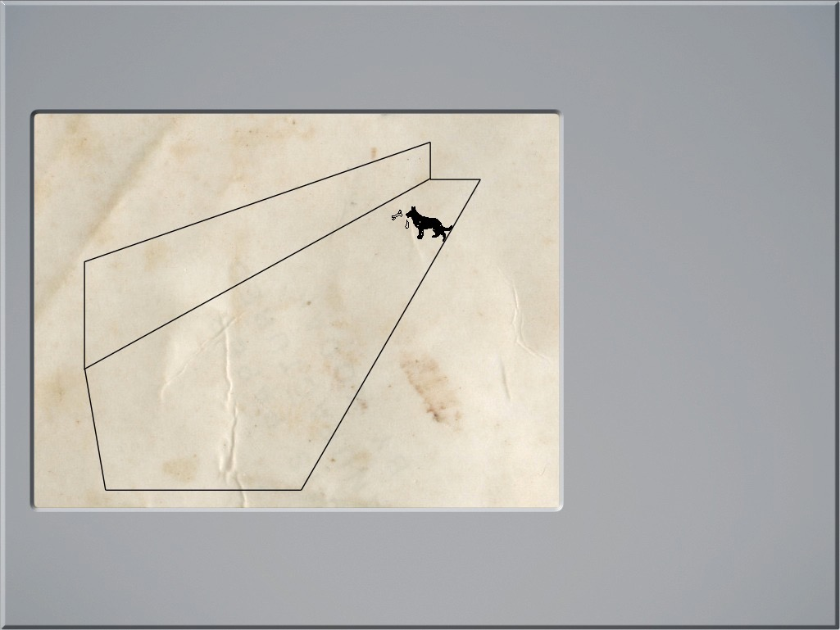
Unconditioned Stimulus
Unconditioned Stimulus
Unconditioned Response
Unconditioned Response
US
UR
Here we see a dog salivating when presented with a bone. Given that we are studying a science of behaviour it shouldn’t surprise you to see that some technical terms have been developed to label our observations. Your first two terms to learn are, the US and the UR.
The US elicts the UR because that is how the organism has been genetically programmed to respond.

Slide 9
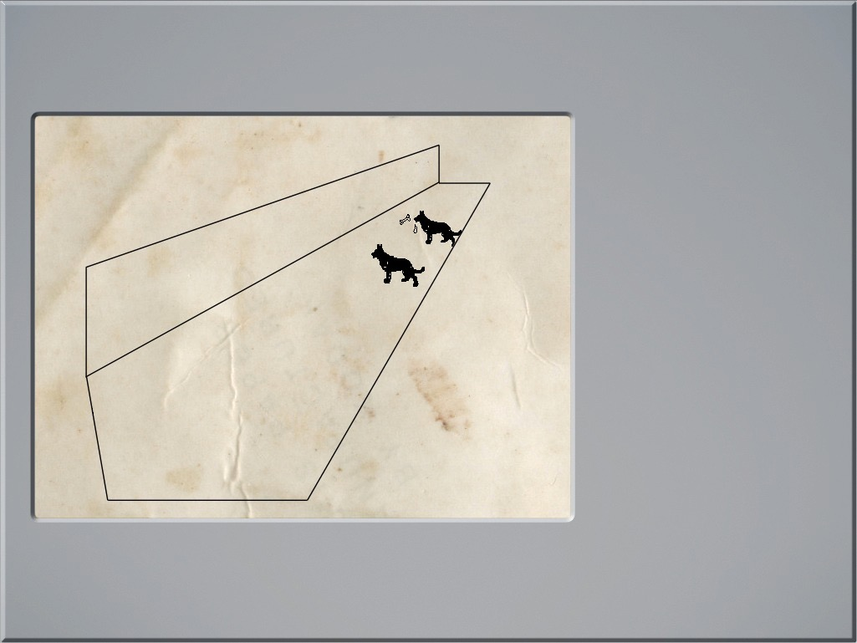
Neutral Stimulus
Conditioned Stimulus
US
UR
NS
CS
But he soon discovered that the function of such stimuli could change if he carefully arranged a relation between a neutral stimulus and the US. Because this stimulus now produced a specific change in behaviour, he called it a Conditioned Stimulus (CS).
The stimuli that Pavlov worked with were at first considered ‘Neutral Stimuli’ (NS), i.e., they were ‘behaviourally neutral’ because they had no obvious effect on the dog’s behaviour.
US
UR

Slide 10
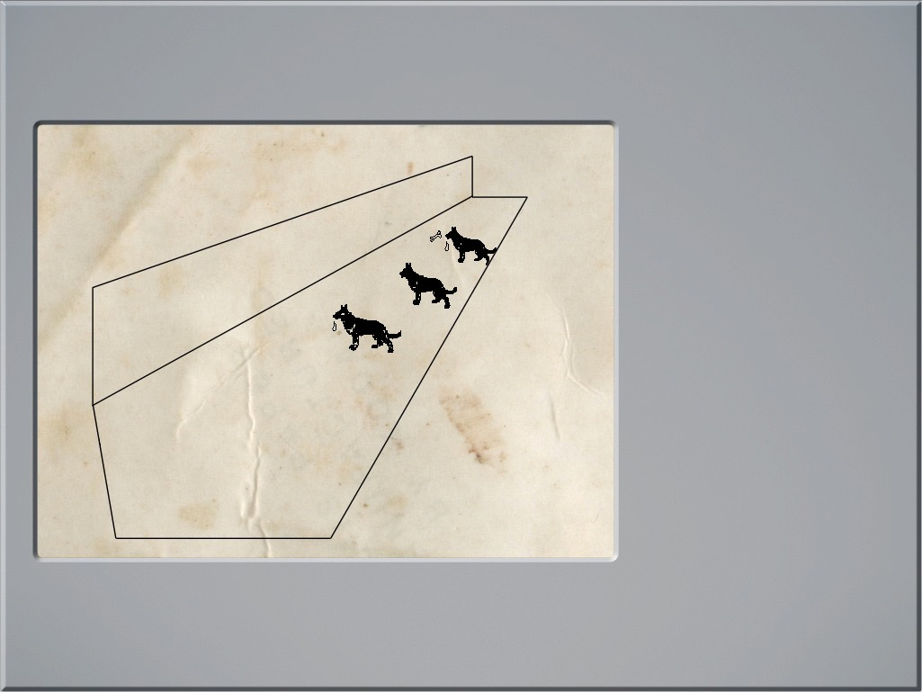
Conditioned Stimulus
US
UR
NS
CS
But he soon discovered that the function of such stimuli could change if he carefully arranged a relation between a neutral stimulus and the US. Because this stimulus now produced a specific change in behaviour, he called it a Conditioned Stimulus (CS).
Pairing Procedure
click here

Slide 11
Conditioned Stimulus
US
UR
NS
CS
But he soon discovered that the function of such stimuli could change if he carefully arranged a relation between a neutral stimulus and the US. Because this stimulus now produced a specific change in behaviour, he called it a Conditioned Stimulus (CS).
Pairing Procedure
click here

Slide 12
Conditioned Response
US
UR
NS
CS
Salivation now occurred in the presence of the CS! Because this salivation response was under the control of the CS, it was called the Conditioned Response (CR).
CR

Slide 13
Conditioned Response
US
UR
NS
CS
Salivation now occurred in the presence of the CS! Because this salivation response was under the control of the CS, it was called the Conditioned Response (CR).
CR

Slide 14
Conditioned Response
US
UR
NS
CS
Salivation now occurred in the presence of the CS! Because this salivation response was under the control of the CS, it was called the Conditioned Response (CR).
Are they the same?
CR
click here

Slide 15
Conditioned Response
US
UR
NS
CS
Salivation now occurred in the presence of the CS! Because this salivation response was under the control of the CS, it was called the Conditioned Response (CR).
CR

Slide 16
Conditioned Response
US
UR
NS
CS
Salivation now occurred in the presence of the CS! Because this salivation response was under the control of the CS, it was called the Conditioned Response (CR).
CR

Slide 17
Conditioned Response
US
UR
This turns out to be a surprisingly difficult question to answer. This is because there a number of things that influence the CR.
Imagine you were in Pavlov’s shoes and you were conducting the original experiments. Initially you discover by accident that a dog salivates before it receives food. You then decide to explore this phenomenon.
How do you do this? Well, this is where Pavlov taught us the value of systematic experimentation. You focus on a particular CS and a particular US. You make the necessary arrangements to measure both the UR and the CR. This allows you to judge the extent to which the CR and UR are similar.
NS
CS
Are they the same?
CR
RETURN

Slide 18
Conditioned Response
Measurement
1. Quality
In the case of salivation, quality is determined by looking at the chemical constitution of the saliva. Initially it was thought the saliva produced by a CS differed from that produced by a US only in terms of quantity. However, it has been found that quality is determined by the exact nature of the stimuli used.........
2. Strength
It has been reliably shown with many reflexes that increasing the number of CS-US pairings results in an increase in the strength of the CR. Also, the maximum strength of the CR depends on both the reflex studied and on the intensities of the CS and US. Strength is measured by a combination of factors.
US
UR
NS
CS
Are they the same?
CR
RETURN

Slide 19
Conditioned Response
Measurement
1. Quality
In the case of salivation, quality is determined by looking at the chemical constitution of the saliva. Initially it was thought the saliva produced by a CS differed from that produced by a US only in terms of quantity. However, it has been found that quality is determined by the exact nature of the stimuli used.........
2. Strength
Probability - You measure this by counting the number of times the CR occurs after all of the CS presentations.
Latency - You measure this by recording the time taken for response to occur after the CS has occurred. Short durations indicate a strong response.
US
UR
NS
CS
Are they the same?
CR
RETURN

Slide 20
Conditioned Response
US
UR
NS
CS
CS1
CS2
Pavlov also discovered that the CS could now be paired with other stimuli so that they too could control salivation. In the example here, the label for the CS is changed to CS1 prior to pairing it with the new stimulus, CS2.
CS1
CR
CR

Slide 21
Conditioned Response
CS2
Now we see why Lilly responds to the punch bag by salivating!! She was first trained using a clicker that was paired with food. Once she responded reliably to the clicker, the punch bag was presented before the clicker was pressed.
CR

