Slide 1
Pavlovian Conditioning

Slide 2
People are born with certain stimulus-response relationships that are built-in to our bodies
These relationships are called unconditional reflexes
These unconditional reflexes are familiar to everyone
Called unconditional because they have not been learned

Slide 3
Examples of unconditional reflexes
Unconditional Stimulus | Unconditional Response
Puff of air to the eye | Eye blink
Food in the mouth | Salivation
Cold Temperature | Shivering
High Temperature | Perspiration
Foreign matter in nose | Sneezing
Foreign matter in throat | Coughing
Spoiled food | Sickness, vomiting

Slide 4
The stimulus that causes the response is an unconditional stimulus (US)
The response caused by the unconditional stimulus is the unconditional response (UR)
The unconditional stimulus elicits the unconditional response

Slide 5
If you say a string of random words but always squirt a person in the face immediately after saying the word "pear," you can condition the person to flinch at the word "pear" without squirting them in the face with water
By pairing the squirting of the water with the word "pear," the person learns associates being squirted with hearing that particular word
Therefore, the reflex of flinching becomes transferred or "conditioned" to occur with the neutral stimulus

Slide 6
Pavlovian/Classical/Respondent Conditioning
Learning that builds on unconditional responses
Ivan Pavlov and his dogs
Most basic demonstration:
  Food as a US and salivation as a UR
  Before putting food in the dogs mouth he sounded a metronome
  Predictive relationship between sound of metronome and the US (the food)

Slide 7
The metronome sound predicted the food because:
  A: whenever the metronome sounded, food came soon afterward
  B: whenever the metronome was silent, no food was delivered
Once there was experience of the predictive relationship the dog began to salivate to the metronome alone

Slide 8
Before conditioning took place it is said that the metronome sound was a neutral stimulus (NS)
  It had no effect on salivation
After conditioning the metronome sound became a conditional stimulus (CS) for salivation
The response that a CS elicits is a conditional response (CR)
  Salivation to the metronome was the CR

Slide 9
Basic Procedure
  US UR
Food Salivation
Unconditional reflex

Slide 10
Basic Procedure
NS US UR
Metronome Food Salivation
NS-US prediction Unconditional reflex

Slide 11
Basic Procedure
  CS CR
Metronome Salivation
Conditional reflex

Slide 12
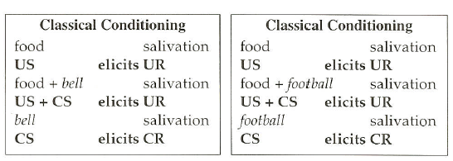
Further Examples

Slide 13
Each pairing of CS and US is one trial and this is the procedure we know as Classical Conditioning
Important to note:
  The presentation of the two stimuli is independent of the behaviour of the organism
    (presented regardless of what the organism does)
  The behaviour is a reflex response

Slide 14
Practical
15 mins
In the following examples identify the:
  US (Unconditional Stimulus)
  UR (Unconditional Response)
  CS (Conditional Stimulus)
  CR (Conditional Response)

Slide 15
Clearly then the ability to develop conditional reflexes would give an organism a chance of surviving in a changing world
Reacting to certain sights, smells and sounds instead of waiting for an attack will ensure our survival
A variation of the basic procedure that is more beneficial to humans is higher-order conditioning

Slide 16
Higher-Order Conditioning
Conditioning can also occur without a US
Pairing a neutral stimulus with a well established CS can produce effects much the same as if the stimulus had been paired with a US
The procedure of pairing a neutral stimulus with a well-established CS is higher-order conditioning

Slide 17
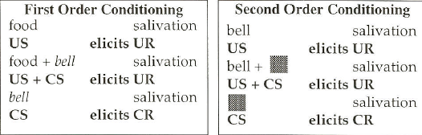
Higher-Order Conditioning

Slide 18
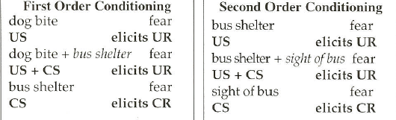
Higher-Order Conditioning

Slide 19
Higher-order conditioning increases the importance of Pavlovian Conditioning
It means that many more stimuli can come to elicit conditional responses
Higher-order conditioning is effective in establishing verbal stimuli as CSs (Staats & Staats, 1957; Moran, 1981)

Slide 20
Many words we use are CSs for our emotional and evaluative responding
We respond with positive emotions to words such as happy, baby and love
Negative emotions to words such as murder, rape and wicked
These emotional reactions these words stir in us are through previous learning
Very young children do not respond emotionally to words in the way that adults do

Slide 21
Staats and Staats experiment
Showed that words with positive and negative references could be used to change people’s evaluations of neutral stimuli
Uni students were showed nonsense syllables: xeh, yof
Paired with either positive (e.g. beauty) or negative (e.g. thief) words

Slide 22
1:CS UR
Thief Bad Feelings
2: NS CS CR
Xeh Thief Bad feelings
NS-CS prediction Old Conditional reflex
3:CS CR
Xeh Bad feelings
New conditional reflex

Slide 23
Results indicate that when a nonsense syllable was regularly associate with pleasant words, it became pleasant, when it was paired with unpleasant words it became unpleasant
YOF came to elicit good feelings in some students and bad feelings in others, depending on the words with which it was paired
Higher-order conditioning would appear to play an important role in the emotional meaning of words

Slide 24
Higher-order conditioning using word CSs has been successful in solving behaviour problems:
  Phobias
  Discourage smoking, alcohol consumption and drug use in children
  Reduction of racist behaviour

Slide 25
So how do we measure learning?
How do we know when learning has occurred if the US, is by definition capable of evoking the UR?
Learning can be measured by the latency of a response
  The interval between the onset of the CS and the first appearance of saliva
More pairings, a response latency diminishes

Slide 26
What if the interval between CS onset and the appearance of the US is so short that measuring latency is very difficult?
Test Trials
Involves presenting the CS alone every now and then
If salivation occurs when there is no food then salivation is clearly a conditional response to the tone
Test trial data is plotted on a curve therefore learning is represented as an increase in the frequency of the conditional response

Slide 27
You could also measure the intensity or amplitude of the CR
Initial CRs are quite weak (a drop or two)
Repeated trials result in an increase in saliva flow
Learning is represented by the increase in the number of drops of saliva

Slide 28
Variables affecting Pavlovian Conditioning
The manner of which the conditional and unconditional stimuli are paired is an important variable to remember
Four basic ways to pairing stimuli:
  Trace
  Delayed
  Simultaneous
  Backward

Slide 29
Trace Conditioning
The CS begins and ends before the US is presented
However, to maximise the conditioning process, research has demonstrated that short NS-US intervals should be used
E.g. thunder and lightening storm

Slide 30
Delayed Conditioning
The CS and US overlap
The US appears before the CS has disappeared
E.g thunder and lightening storm
*Most studies of Pavlovian conditioning involve one of these two procedures*

Slide 31
Simultaneous Conditioning
The CS and US coincide exactly
Weak procedure for establishing a conditional response

Slide 32
Backward Conditioning
The CS follows the US
E.g. a puff of air into a person’s eye then followed by the sound of a buzzer
Very difficult (near impossible) to produce a CR with this procedure
*Simultaneous and Backward procedures rarely used in studies *

Slide 33
CS-US contingency
A behaviour is contingent on a certain event
Been suggested that the effectiveness of Pavlovian procedures varies with the degree of contingency between CS and US
To ensure rapid learning create a high degree of contingency between the CS and the US

Slide 34
Prior experience with CS and US
Exposure to a potential CS before training reduces its effectiveness during the conditioning procedure
Shrimp, Stuart and Engle (1991) conditioned positive emotional responses to different colas
Well known brands, moderately known brands and obscure brands

Slide 35
Used attractive pictures as the Uss
Conditioning was more effective with the unknown and moderately known brands
WHY?
Ceiling effects: people have been extensively conditioned to coke and pepsi through advertising
Difficult then to improve these conditioning effects further

Slide 36
Another explanation was the CS pre exposure effect
More difficult to condition positive responses to well-known brands because people have more extensive pre exposure to them

Slide 37
Extinction of Conditional Responses
A response can be maintained as long as the conditional stimulus is sometimes followed by the unconditional stimulus
Repeated presentations without the CS the conditional response will become weaker and weaker
Extinction is the term for repeatedly presenting the CS without the US
When the CR no longer occurs it is said to be extinguished

Slide 38
However, just because the response has been extinguished does not mean that it will never come back
Spontaneous recovery can occur
This is the reappearance of the response when the CS is presented once again
Can occur even if training discontinues for weeks or months

Slide 39
Pavlovian conditioning does not begin and end with dogs in a lab
Proven to be immensely useful in understanding a wide range of human and animal behaviours
Next week we will look at the application of these procedures…

